Slide 1
PEAK TIME ANALYSIS
EE4211 QUESTION 3 GROUP 16
Feng Xijia, A0232695X, e0724494@u.nus.edu
Liang Zihan, A0232558B, e0724357@u.nus.edu
Tan Tian, A0229561B, e0679994@u.nus.edu
Yao Yuan, A0232893X, e0724692@u.nus.edu

Slide 2
Motivations
01
Analyze the user’s gas consumption habits through their daily peak gas usage times.
People’s gas consumption habits may also relate to the day of the week.
The month of the year may also have an impact on the maximum usage of gas.
With proper analysis on users consumption habits, gas company as well as power company etc. will be able to adapt and prepare ahead of time to provide steady run or make more profits.

Slide 3
PEAK TIME IN MONTH SCALE
02
The month of the year may have an impact on the usage of gas. Peak time has two meanings here: 1. the peak hour in each month; 2. the peak month among the 6 months. Plot the peak time of all users versus months to find out if two groups have different patterns.

Slide 4
Pipeline
Collect the peak time everyday in each group.
In each group:
For each user, get the mode peak time from all the readings in each month.
For all users, get the mode peak time of their monthly peak time and get the peak time of all users in each month.
Compare the peak time in both groups

Slide 5
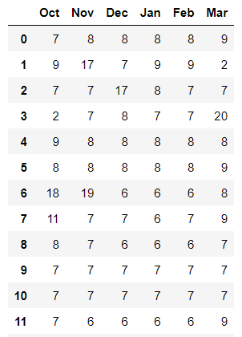
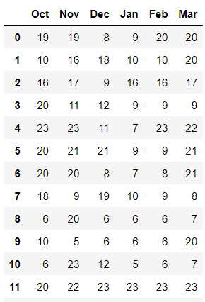
Peak time in months in both groups
The image on the left shows the statistics of part of the users’ peak time every month in group1.
The right one shows the statistics of parts of the users in group2.

Slide 6
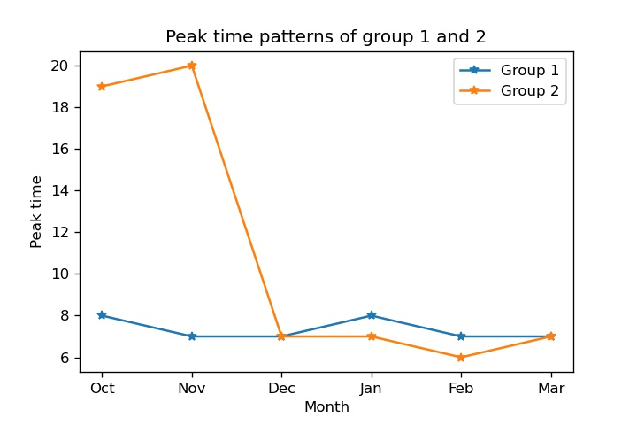
Results and Analysis
Peak time of the day
People from group 1 prefer to consume more gas in the mornings during each month.
Group 2 uses more gas in the evenings in October and November. In the rest months, group 2 use more gas in the mornings as well.

Slide 7
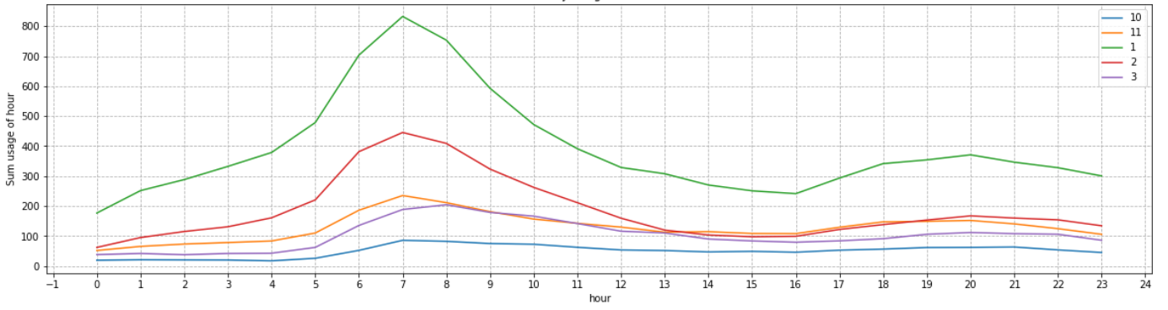
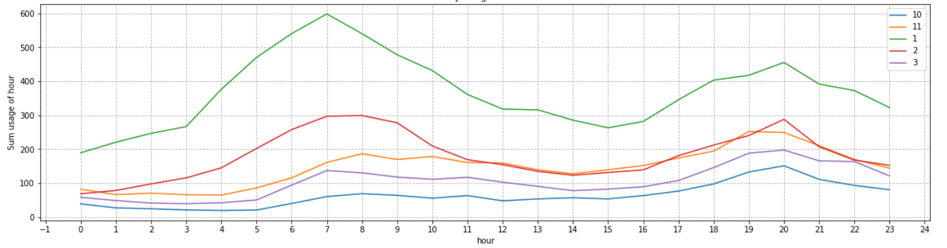
Results and Analysis
Peak month of the year
From both graphs, the peak month of both groups is January. The second peak month is February.
Group 1 consume more gas than group 2.
Group 2 have a more obvious second peak compared to group 1.
Group 1
Group 2

Slide 8
THANK YOU

