Slide 1
Scale GNN to giant graph in DGL
Da Zheng

Slide 2
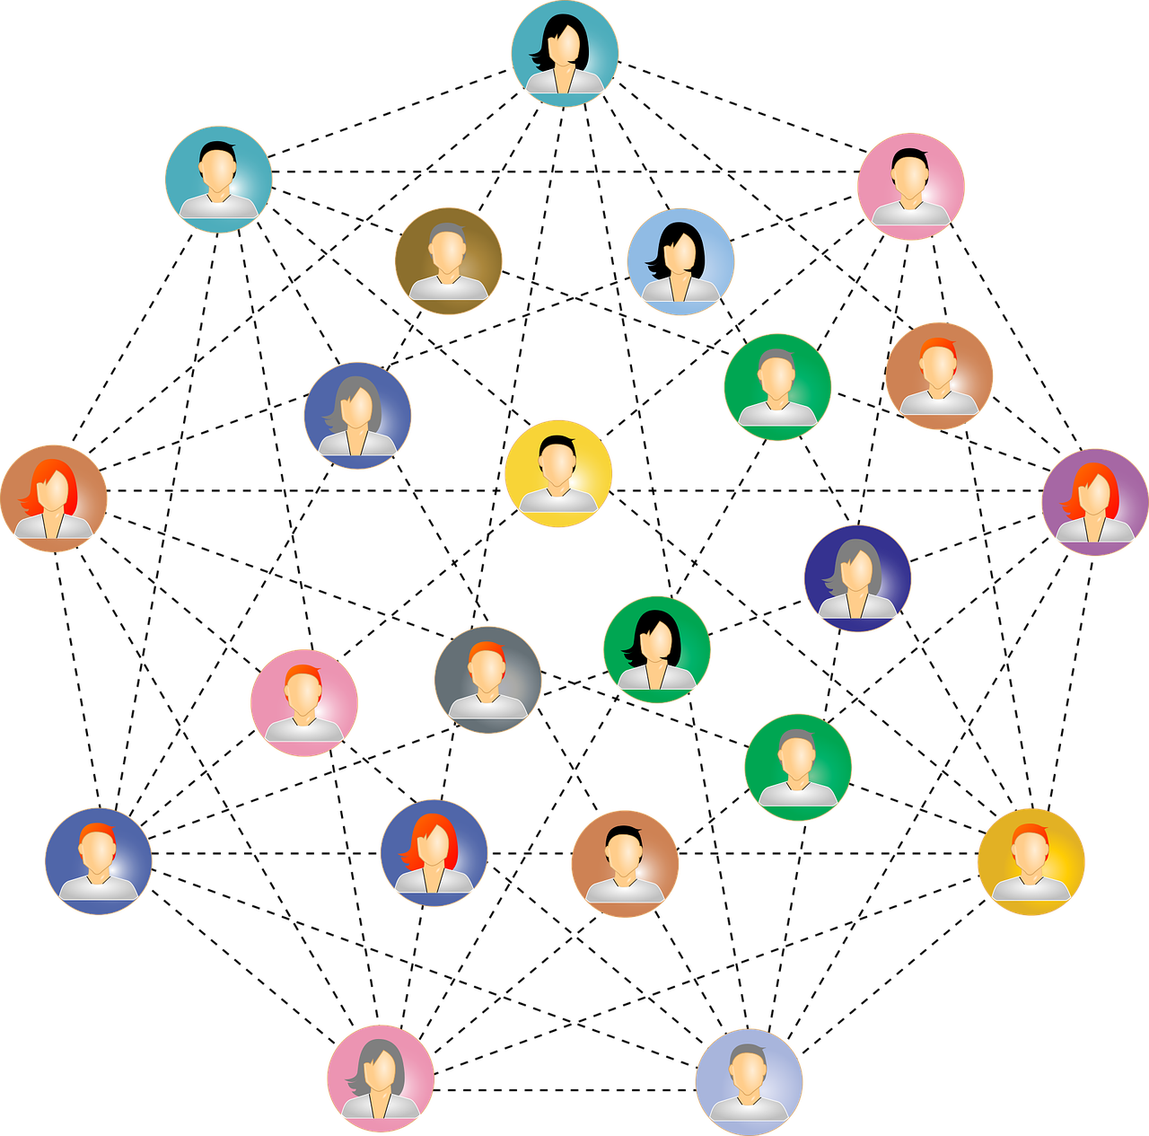
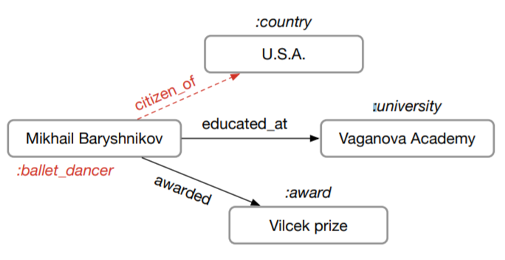
Train GNN on giant graphs
users
products
Social network
Knowledge graph
Recommendation
|V|: 100M – 1B
|V|: 1M – 100M
|V|: 1M – 1000M

Slide 3
Full graph training
Run forward and backward computation on the full graph.
Memory consumption of a GNN model is proportional to |V| and |E|.
A graph with 1B edges may require terabytes of memory to store data.

Slide 4
Recap: mini-batch training in deep learning

Slide 5
Recap: mini-batch training in deep learning
DL models
Batch 1
Data points are independent and identically distributed (IID).
The full dataset

Slide 6
How to apply mini-batch training to graphs?
Nodes (data points) in graphs have edges (dependencies).
2
3
1
2
3
10
5
9
4
1
6
8
7
4
11

Slide 7
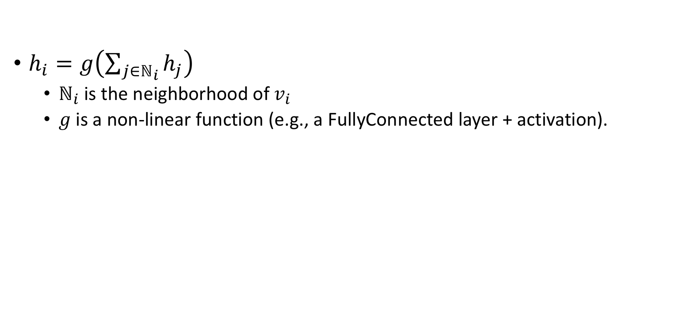
Recap: Graph convolution network (GCN)
$h_{i}=g\left(\sum_{j∈ℕ_{i}}{h_{j}}\right)$
$ℕ_{i}$ is the neighborhood of $v_{i}$
$g$ is a non-linear function (e.g., a FullyConnected layer + activation).
Notes:
We need to describe the concept of layers.

Slide 8
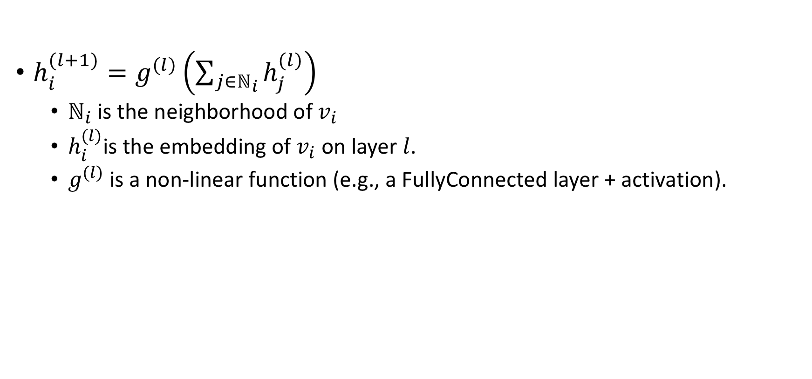
Multi-layer GCN
$h_{i}^{(l+1)}=g^{(l)}\left(\sum_{j∈ℕ_{i}}{h_{j}^{(l)}}\right)$
$ℕ_{i}$ is the neighborhood of $v_{i}$
$h_{i}^{(l)}$is the embedding of $v_{i}$ on layer $l$.
$g^{(l)}$ is a non-linear function (e.g., a FullyConnected layer + activation).

Slide 9
Two-layer GNN from the perspective of a vertex
Compute the embedding of node 1 of layer 2
2
3
1
10
5
9
4
6
8
7
11

Slide 10

Two-layer GNN from the perspective of a vertex
Compute the embedding of node 1 of layer 2:
$h_{1}^{(2)}=g^{(2)}\left(h_{2}^{\left(1\right)}+h_{3}^{\left(1\right)}+h_{4}^{\left(1\right)}+h_{5}^{\left(1\right)}+h_{6}^{\left(1\right)}\right)$
2
3
1
10
5
9
4
6
8
7
11

Slide 11

Two-layer GNN from the perspective of a vertex
Compute the embedding of node 1 of layer 2:
$h_{1}^{(2)}=g^{(2)}\left(h_{2}^{\left(1\right)}+h_{3}^{\left(1\right)}+h_{4}^{\left(1\right)}+h_{5}^{\left(1\right)}+h_{6}^{\left(1\right)}\right)$
Compute the embedding of nodes $i$ of layer 1:
$h_{2}^{(1)}=g^{(1)}\left(h_{1}^{\left(0\right)}\right)$
2
3
1
10
5
9
4
6
8
7
11
Notes:
Say $h_{6}^{(0)}$ is the input data.

Slide 12

Two-layer GNN from the perspective of a vertex
Compute the embedding of node 1 of layer 2:
$h_{1}^{(2)}=g^{(2)}\left(h_{2}^{\left(1\right)}+h_{3}^{\left(1\right)}+h_{4}^{\left(1\right)}+h_{5}^{\left(1\right)}+h_{6}^{\left(1\right)}\right)$
Compute the embedding of nodes $i$ of layer 1:
$h_{3}^{(1)}=g^{(1)}\left(h_{1}^{\left(0\right)}+h_{4}^{\left(0\right)}\right)$
2
3
1
10
5
9
4
6
8
7
11
Notes:
Say $h_{6}^{(0)}$ is the input data.

Slide 13
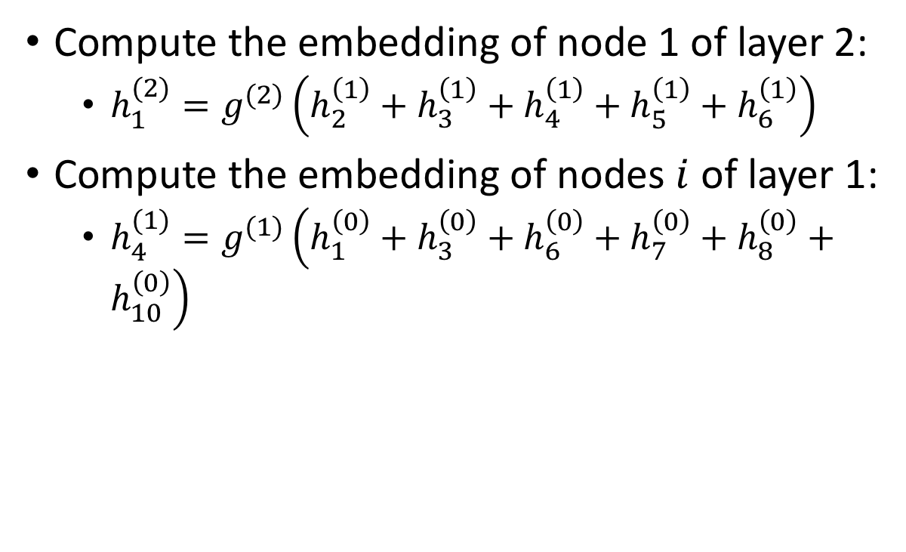
Two-layer GNN from the perspective of a vertex
Compute the embedding of node 1 of layer 2:
$h_{1}^{(2)}=g^{(2)}\left(h_{2}^{\left(1\right)}+h_{3}^{\left(1\right)}+h_{4}^{\left(1\right)}+h_{5}^{\left(1\right)}+h_{6}^{\left(1\right)}\right)$
Compute the embedding of nodes $i$ of layer 1:
$h_{4}^{(1)}=g^{(1)}\left(h_{1}^{\left(0\right)}+h_{3}^{\left(0\right)}+h_{6}^{\left(0\right)}+h_{7}^{\left(0\right)}+h_{8}^{\left(0\right)}+h_{10}^{\left(0\right)}\right)$
2
3
1
10
5
9
4
6
8
7
11
Notes:
Say $h_{6}^{(0)}$ is the input data.

Slide 14
Two-layer GNN from the perspective of a vertex
Compute the embedding of node 1 of layer 2:
$h_{1}^{(2)}=g^{(2)}\left(h_{2}^{\left(1\right)}+h_{3}^{\left(1\right)}+h_{4}^{\left(1\right)}+h_{5}^{\left(1\right)}+h_{6}^{\left(1\right)}\right)$
Compute the embedding of nodes $i$ of layer 1:
$h_{3}^{(1)}=g^{(1)}\left(h_{1}^{\left(0\right)}+h_{4}^{\left(0\right)}\right)$
2
3
1
10
5
9
4
6
8
7
11
Notes:
Say $h_{6}^{(0)}$ is the input data.

Slide 15

Two-layer GNN from the perspective of a vertex
Compute the embedding of node 1 of layer 2:
$h_{1}^{(2)}=g^{(2)}\left(h_{2}^{\left(1\right)}+h_{3}^{\left(1\right)}+h_{4}^{\left(1\right)}+h_{5}^{\left(1\right)}+h_{6}^{\left(1\right)}\right)$
Compute the embedding of nodes $i$ of layer 1:
$h_{6}^{(1)}=g^{(1)}\left(h_{1}^{\left(0\right)}+h_{4}^{\left(0\right)}+h_{7}^{\left(0\right)}+h_{11}^{\left(0\right)}\right)$
2
3
1
10
5
9
4
6
8
7
11
Notes:
Say $h_{6}^{(0)}$ is the input data.

Slide 16



A view of data dependency
Neighborhood size increases exponentially when L increases.
$$h_{1}^{(2)}$$
1
$$h_{i}^{(1)}$$
2
3
4
5
6
$$h_{j}^{(0)}$$
1
3
4
6
7
8
9
10
11

Slide 17
mini-batch training on graphs
Step 1: randomly sample target nodes.
Sample nodes for computing node embeddings.
Step 2: randomly sample neighbors
Equivalent to prune the computation for node embeddings.

Slide 18
Sampling strategies
Neighbor sampling
Control-variate based sampling
Layer-wise sampling
Random walk sampling

Slide 19
Sampling strategies
Neighbor sampling
Control-variate based sampling
Layer-wise sampling
Random walk sampling

Slide 20
Neighbor sampling
Always sample neighbors from a neighbor list of a vertex.

Slide 21
Neighbor sampling
Always sample neighbors from a neighbor list of a vertex.
1
1
2
3
4
5
6
2
4
1
7
8
1
3
4
6
7
8
9
10
11

Slide 22
Mini-batch training in GNN models
2
3
1
1
GNN models
10
5
2
4
9
4
6
8
7
1
7
8
11
A batch
The full graph

