Slide 1
Scale GNN to giant graphs in DGL
Da Zheng

Slide 2
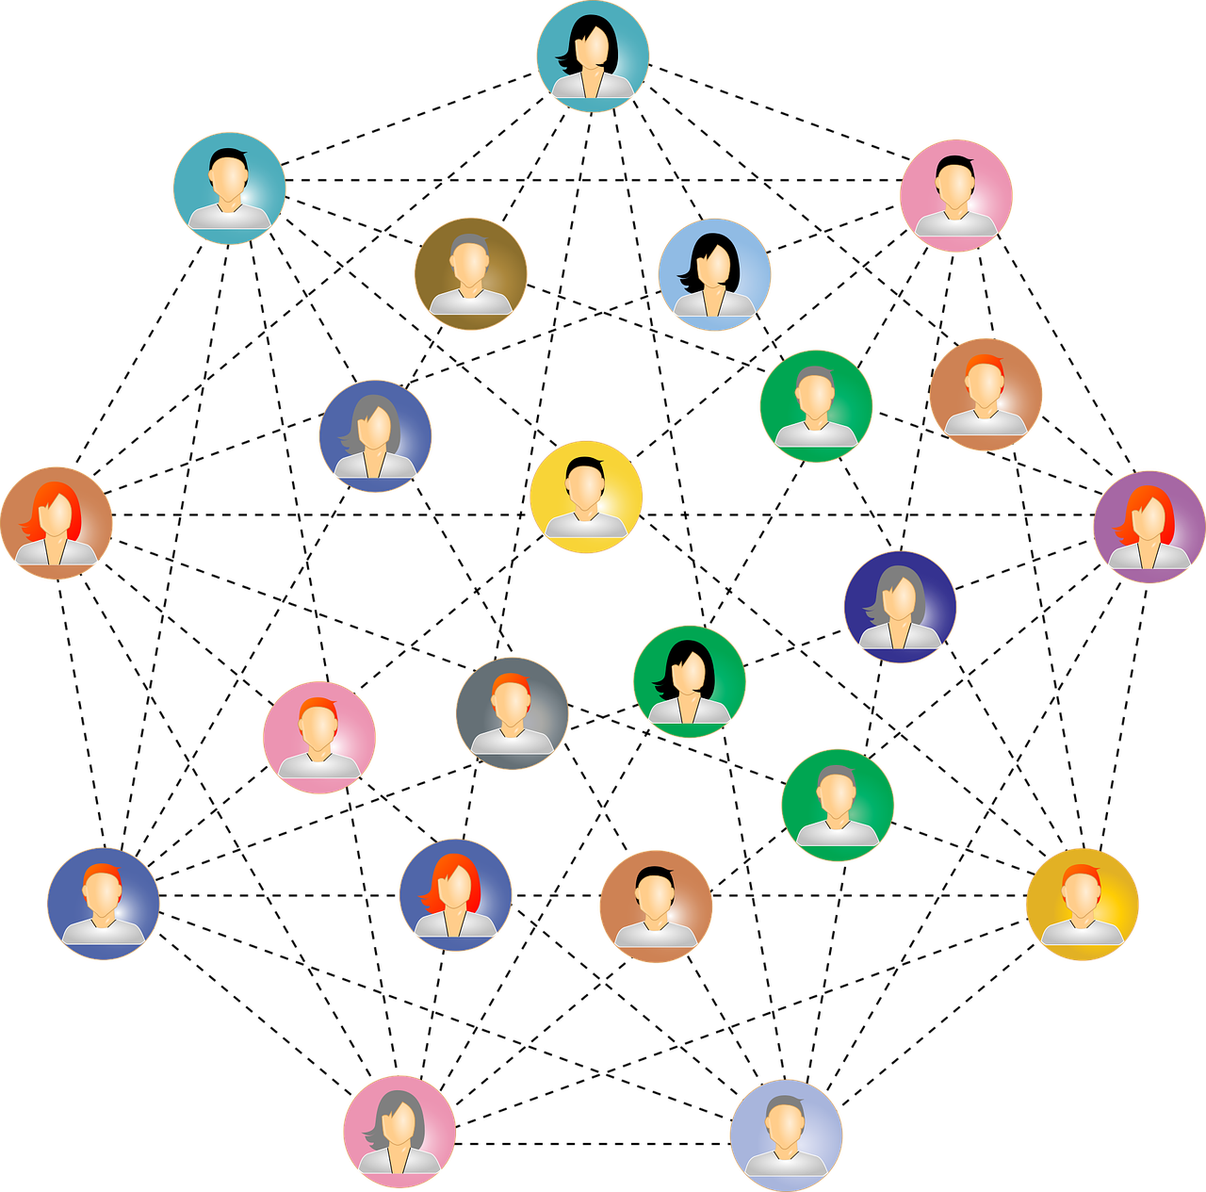
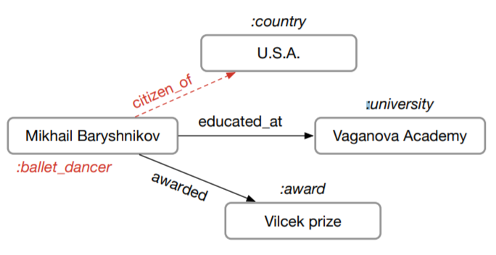
Train GNN on giant graphs
users
products
Social network
Knowledge graph
Recommendation
|V|: 100M – 1B
|V|: 1M – 100M
|V|: 1M – 1000M

Slide 3
Full graph training
Run forward and backward computation on the full graph.
Memory consumption of a GNN model is proportional to |V| and |E|.
A graph with 1B edges may require terabytes of memory to store data.

Slide 4
Recap: mini-batch training in deep learning

Slide 5
Recap: mini-batch training in deep learning
DL models
Batch 1
Data points are independent and identically distributed (IID).
The full dataset

Slide 6
How to apply mini-batch training to graphs?
Nodes (data points) in graphs have edges (dependencies).
2
3
1
2
3
10
5
9
4
1
6
8
7
4
11

Slide 7

Recap: GraphSage
$h_{N(v)}^{k}={AGGREGATE}_{k}\left({\{h}_{u}^{k−1}, ∀u∈N(v)\}\right)$
$h_{v}^{k}=σ(W^{k} CONCAT(h_{v}^{k−1},h_{N(v)}^{k}))$

Slide 8
Two-layer GNN from the perspective of a vertex
Compute the embedding of node 1 of layer 2
2
3
1
10
5
9
4
6
8
7
11

Slide 9

Two-layer GNN from the perspective of a vertex
Compute the embedding of node 1 of layer 2:
$h_{N(1)}^{2}={AGGREGATE}_{2}\left(\{h_{2}^{1},h_{3}^{1},h_{4}^{1},h_{5}^{1},h_{6}^{1}\}\right)$
$h_{1}^{2}=σ(W^{2} CONCAT(h_{1}^{1},h_{N(1)}^{2}))$
2
3
1
10
5
9
4
6
8
7
11

Slide 10

Two-layer GNN from the perspective of a vertex
Compute the embedding of node $2$ of layer 1:
$h_{N(2)}^{1}={AGGREGATE}_{1}\left(\{h_{1}^{0}\}\right)$
$h_{2}^{1}=σ(W^{1} CONCAT(h_{2}^{0},h_{N(2)}^{1}))$
2
3
1
10
5
9
4
6
8
7
11
Notes:
Say $h_{6}^{(0)}$ is the input data.

Slide 11

Two-layer GNN from the perspective of a vertex
Compute the embedding of node $3$ of layer 1:
$h_{N(3)}^{1}={AGGREGATE}_{1}\left(\{h_{1}^{0},h_{4}^{0}\}\right)$
$h_{3}^{1}=σ(W^{1} CONCAT(h_{3}^{0},h_{N(3)}^{1}))$
2
3
1
10
5
9
4
6
8
7
11
Notes:
Say $h_{6}^{(0)}$ is the input data.

Slide 12

Two-layer GNN from the perspective of a vertex
Compute the embedding of node $4$ of layer 1:
$h_{N(4)}^{1}={AGGREGATE}_{1}\left(\{h_{1}^{0},h_{3}^{0},h_{6}^{0},h_{7}^{0},h_{8}^{0},h_{10}^{0}\}\right)$
$h_{4}^{1}=σ(W^{1} CONCAT(h_{4}^{0},h_{N(4)}^{1}))$
2
3
1
10
5
9
4
6
8
7
11
Notes:
Say $h_{6}^{(0)}$ is the input data.

Slide 13

Two-layer GNN from the perspective of a vertex
Compute the embedding of node $5$ of layer 1:
$h_{N(5)}^{1}={AGGREGATE}_{1}\left(\{h_{1}^{0}, h_{9}^{0}\}\right)$
$h_{5}^{1}=σ(W^{1} CONCAT(h_{5}^{0},h_{N(5)}^{1}))$
2
3
1
10
5
9
4
6
8
7
11
Notes:
Say $h_{6}^{(0)}$ is the input data.

Slide 14

Two-layer GNN from the perspective of a vertex
Compute the embedding of node $6$ of layer 1:
$h_{N(6)}^{1}={AGGREGATE}_{1}\left(\{h_{1}^{0},h_{4}^{0},h_{7}^{0},h_{11}^{0}\}\right)$
$h_{6}^{1}=σ(W^{1} CONCAT(h_{6}^{0},h_{N(6)}^{1}))$
2
3
1
10
5
9
4
6
8
7
11
Notes:
Say $h_{6}^{(0)}$ is the input data.

Slide 15



A view of computation/data dependency
Neighborhood size increases exponentially with the number of layers.
$$h_{1}^{(2)}$$
1
$$h_{i}^{(1)}$$
2
3
4
5
6
$$h_{j}^{(0)}$$
1
3
4
6
7
8
9
10
11

Slide 16
mini-batch generation on graphs
Step 1: randomly sample target nodes.
Sample nodes for computing node embeddings.
Step 2: randomly sample neighbors
Equivalent to prune the computation/data dependency.

Slide 17
Strategies of sampling neighbors
Neighborhood sampling
Control-variate based sampling
Layer-wise sampling
Random walk sampling
…

Slide 18
Sampling strategies
Neighborhood sampling
Control-variate based sampling
Layer-wise sampling
Random walk sampling

Slide 19
Neighborhood sampling
Always sample neighbors from a neighbor list of a vertex.
1
1
2
3
4
5
6
2
4
1
7
8
1
3
4
6
7
8
9
10
11

Slide 20
Mini-batch training in GNN models
2
3
1
1
GNN models
10
5
2
4
9
4
6
8
7
1
7
8
11
A mini-batch
The full graph

Slide 21


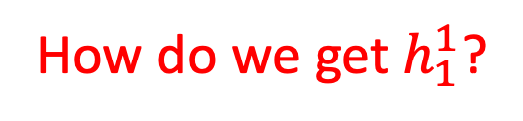


Review of computation/data dependency
Compute the embedding of node 1 of layer 2:
$h_{N(1)}^{2}={AGGREGATE}_{2}\left(\{h_{2}^{1},h_{4}^{1}\}\right)$
$h_{1}^{2}=σ(W^{2} CONCAT(h_{1}^{1},h_{N(1)}^{2}))$
$$h_{1}^{2}$$
1
$$h_{i}^{1}$$
2
4
How do we get $h_{1}^{1}$?
$$h_{j}^{0}$$
1
7
8

Slide 22
Mini-batch construction in DGL
Sample target nodes
Sample neighbors of target nodes
Construct a mini-batch

Slide 23
Sample target nodes
This is done outside DGL.
Use numpy.random.choice
Use torch.utils.data.DataLoader
…

Slide 24
Sample neighbors of target nodes
DGL API for sampling neighbors and edges.
dgl.sampling.sample_neighbors(G, seeds, num_fanout)
Call sample_neighbors recursively for each layer.
1
2
3
1
10
sample_neighbors(G, [1], 2)
2
4
5
9
4
6
8
3
5
6
7
7
8
9
10
11
11
G
block1

Slide 25
Sample neighbors of target nodes
DGL API for sampling neighbors and edges.
dgl.sampling.sample_neighbors(G, seeds, num_fanout)
Call sample_neighbors recursively for each layer.
2
2
4
3
1
10
sample_neighbors(G, [2, 4], 2)
1
7
8
5
9
4
6
8
3
5
6
7
9
10
11
11
G
block2

Slide 26
Construct a mini-batch
DGL API for constructing a bipartite graph for message passing
dgl.to_block(block)
1
0
local id
2
4
dgl.to_block(block1,
include_dst_in_src=False)
1
3
5
6
7
2
4
8
9
10
11
1
0
local id
block1

Slide 27
Construct a mini-batch
DGL API for constructing a bipartite graph for message passing
dgl.to_block(block)
2
4
1
0
local id
2
4
1
7
8
dgl.to_block(block2,
include_dst_in_src=False)
3
5
6
1
7
8
2
1
0
local id
9
10
11
block2

Slide 28
Construct a mini-batch
DGL API for constructing a bipartite graph for message passing
dgl.to_block(block)
1
0
local id
2
4
dgl.to_block(block1,
include_dst_in_src=True)
1
3
5
6
7
2
4
1
8
9
10
11
2
1
0
local id
block1

Slide 29

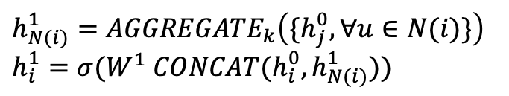
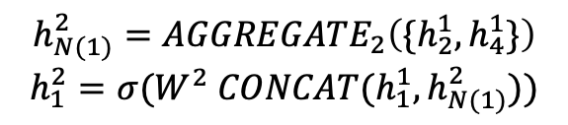



Blocks for GraphSage
1
$$h_{1}^{2}$$
$$h_{N(1)}^{2}={AGGREGATE}_{2}\left(\{h_{2}^{1},h_{4}^{1}\}\right)$$
$$h_{1}^{2}=σ(W^{2} CONCAT(h_{1}^{1},h_{N(1)}^{2}))$$
2
4
1
$$h_{i}^{1}$$
2
4
1
$$h_{i}^{1}$$
$$h_{N(i)}^{1}={AGGREGATE}_{k}\left({\{h}_{j}^{0}, ∀u∈N(i)\}\right)$$
$$h_{i}^{1}=σ(W^{1} CONCAT(h_{i}^{0},h_{N(i)}^{1}))$$
1
7
8
3
5
2
4
1
$$h_{j}^{0}$$

Slide 30
Coding session

