Slide 1

Bigdata analysis system
Tianyu Tan, Wen Gu

Slide 2
Architecture
CLI unit provides a all-in-one station to manipulate all the files the analysis pipeline requires.
HDFS&Spark unit is where the analysis happens.
Airflow unit enables the analysis to be periodically triggered, which results in an always-up-to-date result. It also provides data-orchestration ability, which will be very useful if we want to split our analysis task into several subtasks.

Slide 3
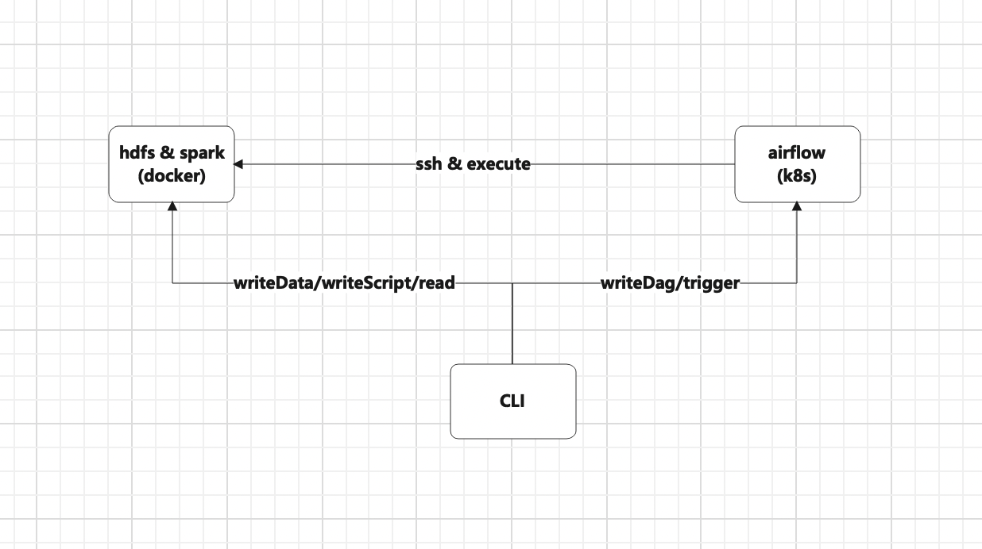
Architecture

Slide 4
Commands
writeData: Write .csv files to a fixed HDFS directory where spark tasks read from.
writeScript: Write pyspark files to a fixed HDFS directory where airflow taskRuns read from.
read: Read analysis result from a fixed HDFS directory where spark analysis stores its result to.
writeDag: Copy airflow dag to a fixed local directory and use github to synchronize it to airflow webserver pod, scheduler pod and worker pod.
trigger: Trigger a new data analysis task and update the analysis result.

Slide 5
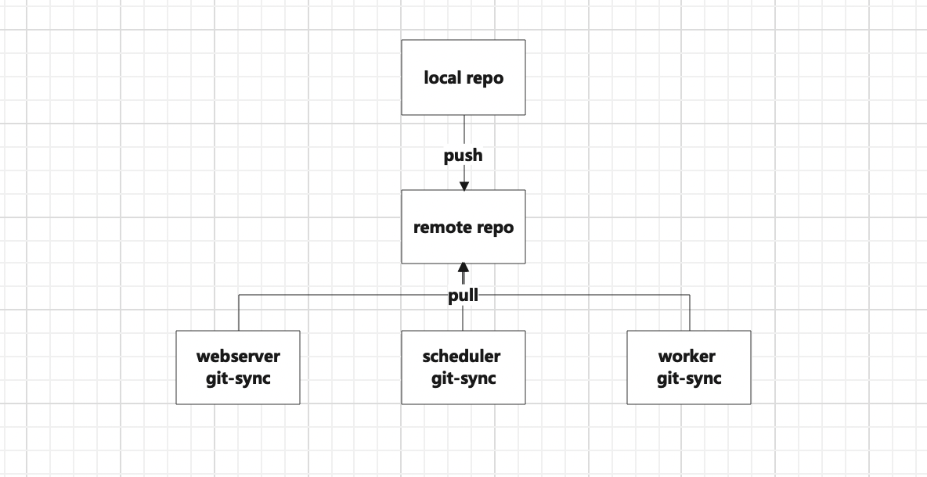
Technical points
Reflection to avoid handling user input case by case.
Local resolving to access HDFS datanode which is in an internal network on GCP
Git-sync to synchronize dags to kubernetes pods

Slide 6
Challenge
Editing airflow image doesn’t help installing JDK and defining environment variables in the pods, which restricts the usage of a SparkSubmitOperator. So I have to update the rsa public key every time I change the airflow worker
CSV files have different headers(both in categories and sequence). To make the analysis executed in a correct manner, I can’t union the files all at once, but have to format the data row by row, which slows the analysis process down 10x.

