Slide 1
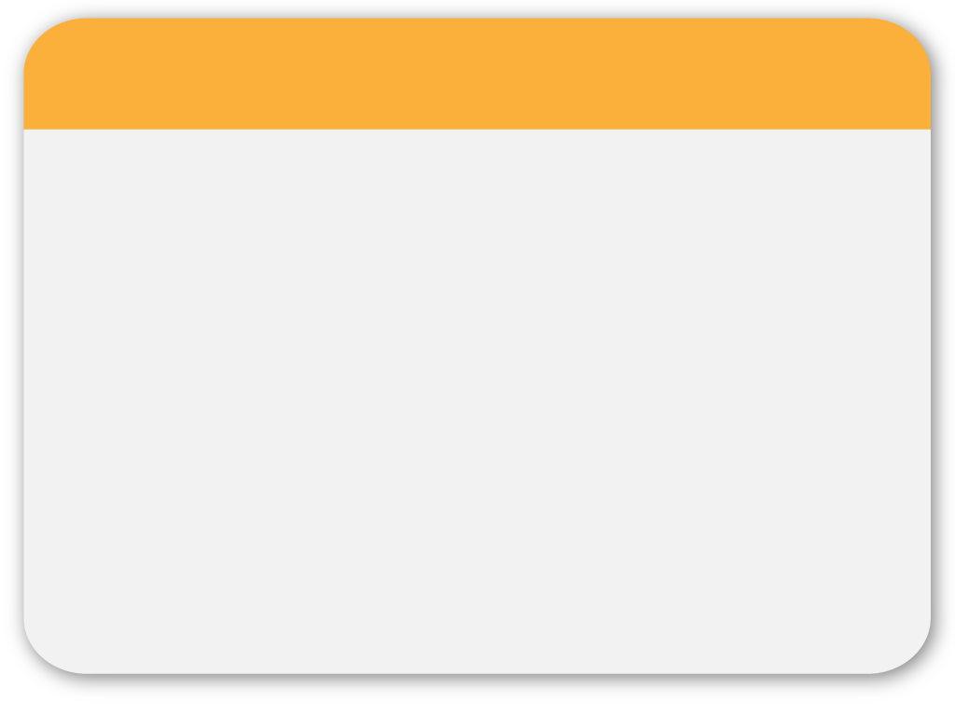
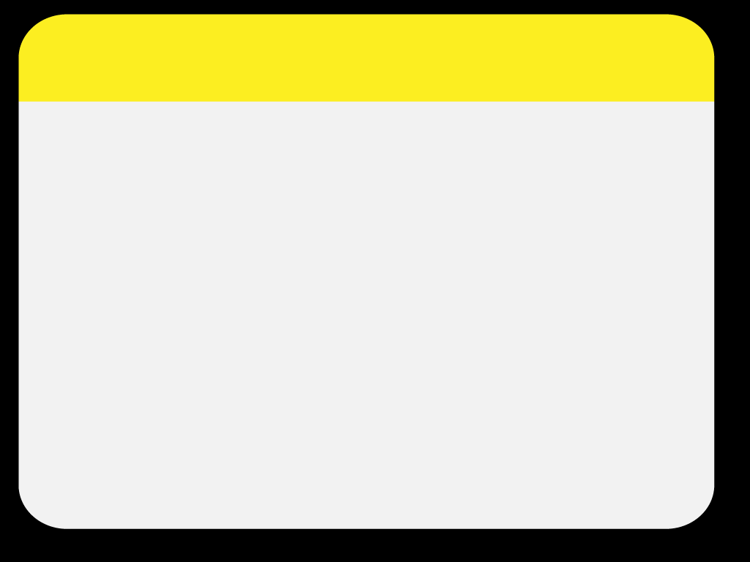

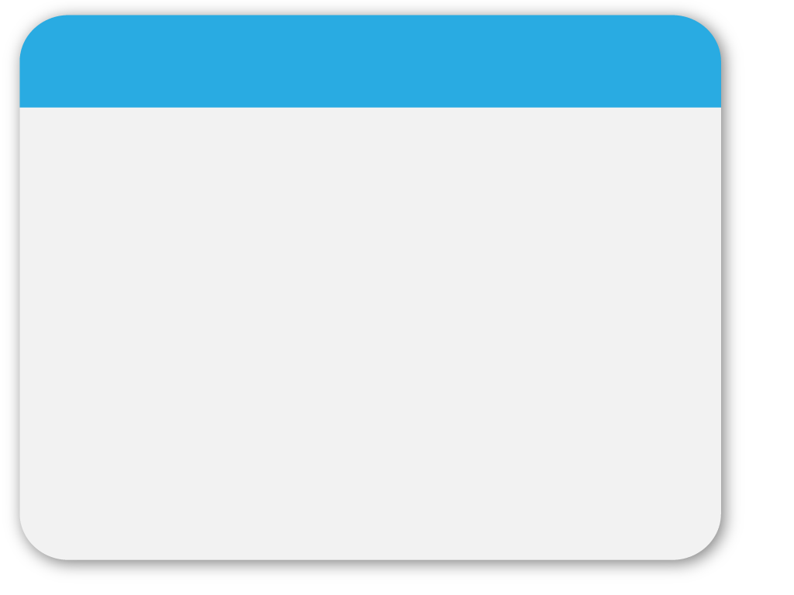

WINTER
Team 6
Third Sprint
Rui Wang, Victor Zhao
Carol Cheng, Hua Tang, Yan Zhao
Template

Slide 2
Architecture
Collection Reader
Analysis Engine
CAS Consumer
AtomicQuery
Factoid Questions
Factoid Answers
ComplexQuery
Concept
Document
Triple
Snippets

Slide 3
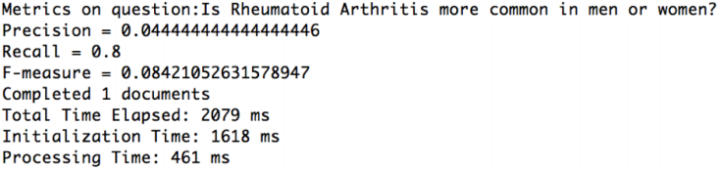
Overview
Milestone 2
Snippet retrieval
Measure snippet results
Improve the pipeline
Low performance

Slide 4
How to improve?
Question preprocessing
Remove stop words
Do stemming or lemmatization
A question → Several AtmicQuery
Several AtomicQuery → A complexQuery
Is Rheumatoid Arthritis more common in men or women
Question
AtomicQuery
Rheumatoid
Arthritis
more
common
man
woman
Rheumatoid AND Arthritis AND more AND common AND [ men OR man ] AND [ women OR woman ]
ComplexQuery

Slide 5
Architecture
Questions
Evaluation
Answers
Aggregate Analysis Engine
Collection Reader
CAS consumer
ComplexQuery
(AND)
Annotator
Concept Annotator
Question
Annotator
ComplexQuery
(OR)
Annotator
Document
Annotator
Snippets Annotator
Atomic
Query
Complex
Query
ComplexQuery
(……)
Annotator
Triple
Annotator

Slide 6
Prior Sprint Backlog
Rui Wang
Victor Zhao
Yan Zhao
Hua Tang
Carol Cheng

Slide 7

Prior Sprint Burndown
Rui Wang
Victor Zhao
Carol Cheng
Yan Zhao
Hua Tang

Slide 8
Prior Sprint Retrospective
Team Member | Set the Stage (how did you feel this sprint) | What Happened in this sprint | Why did those things happen | What To Do to keep up what worked well and prevent what didn't
Rui Wang | Great | Be familiar with the whole pipeline. Help to build complex query annotator. | Aggressive learner. Try to utilze lots of new concepts and techniques. | Learn how to cooperate with other guys via github, and gain experience on how to merge code and sync repo.
Victor Zhao | Bad | Stuck into the development for Snippet Annotator. Still Struggling with Snippet analysis with multiple types of query. | So busssssy during last week due to another huge project. | Employ time management strategies to my own life. Be more proactive.
Carol Cheng | More challenging | Learned to create complex query concepts from atomic query concepts. | In order to get snippets, we have to create robust complex query concepts | Interact and communicate with teammates more often.
Yan Zhao | A little bit confusing, but get clear after communication with teamates | Get familiar with the pipeline. Know details about the complex query, and code for the metrics in consumer to show MAP and GMAP | Got more acknowledge about the pipeline, created a package with different functions to evaluate the performance | Create metrics calculation in separate class to make the system more clear. Learn more from other team members to get further improvement
Hua Tang | Exciting | Add complex query processing in Concept Annotator, Document Annotator and Triple Annotator. And extra finishing processing in question into atomic query. | Use complex query make query more reasonable and get more accurate answer | Begin work earlier

Slide 9
Prior Sprint Refinement
Improve ComplexQuery
Try more operators
Find the best set of ComplexQuery
Measure snippet results
Transform format to compare with golden standard
Evaluation measures
MAP and GMAP

Slide 10
Next Sprint Backlog
Task | Time (est)
Discussion about improvement and work assignment | 4
Error Analysis on snippet retrieval | 2
Processing snippets for exact answer retrieval | 2
Retrieve a list of exact answer | 2
Rerank exact answers | 3
Measure performance on exact answers | 1
Error analysis on exact answers | 2
Final evaluation | 1
Presentation preparation | 4
TOTAL | 21

Slide 11
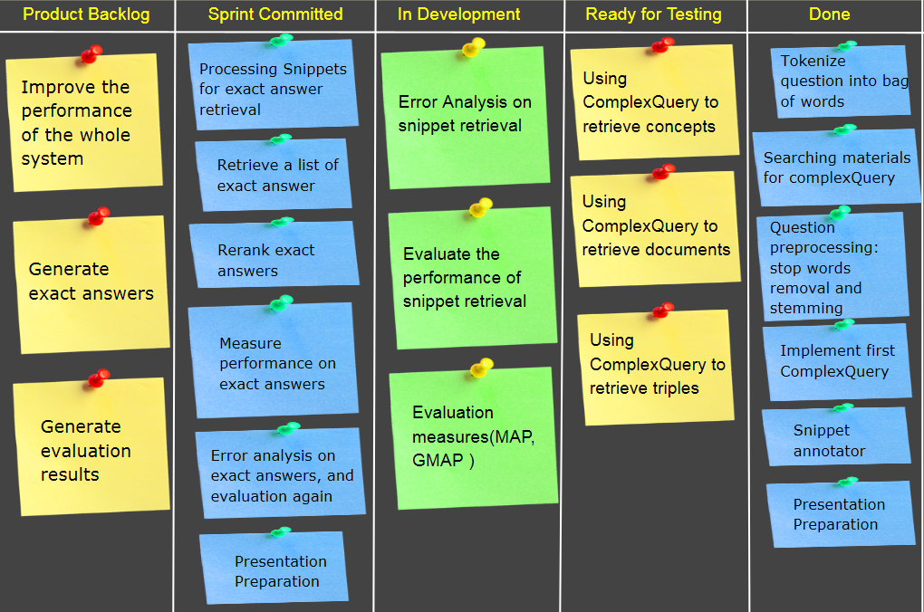
Story Wall
Complex query

Slide 12
WINTER
Team 6
Third Sprint
Have any questions?
Template

