Slide 1


Team Details
Team name: Golden Frame
Team leader name: Rahul Duggal
Theme: Manufacturing — Intelligent Operations & Industrial Efficiency
Problem Statement: After a product change, a factory line can look ready when it is not. Wrong labels, open safety covers, leftover material, or a bad first sample often slip past a rushed visual check. Golden Frame is a phone changeover gate: operators photograph today’s setup, Google AI compares it to the last good run, rules decide HOLD or CLEAR, and a human still taps the final gate. The model never starts the machine.

Slide 2
Brief about the idea
Golden Frame is a phone-first start check for factories.
Before a line starts a new job, the operator takes five photos of the setup (nest/fixture, label, safety cover, material bin, first finished sample).
Those photos are compared to the last good run (“golden” photos).
Gemini judges look-alike / flags. Document AI reads the printed product code on the label.
A risk table decides HOLD (don’t start) or CLEAR (okay to run). A person still logs the gate.
Demo lines: Line 3 Packaging (A-17) and Cell 2 Electronics (BRD-440).
One-liner: Don’t start until today’s setup looks like the last good run.

Slide 3
Opportunities
How different is it from existing ideas?
• Not a chatbot. Not mid-run defect cameras. Not another ERP/MES screen.
• Plants already use SAP/ERP, MES, PLC/HMI, Cognex/Keyence vision, label printers — those run the machine or catch defects while product moves.
• They still don’t prove, with photos, that today’s physical setup matches the last good run before start.
How will it solve the problem?
• Forces a short phone check at the dangerous moment: after setup, before first unit.
• Wrong label / open cover / leftover material → HOLD with must-fix + cost of waiting vs escape.
• Fix → recheck → CLEAR. Audit stored for the shift.
USP
• Vision + OCR + rules + human gate on Google Cloud, phone-first, works across packaging and electronics with the same five-slot pattern.

Slide 4
List of features offered by the solution
• Phone capture of five named frames per line (teach goldens + daily check)
• Live Gemini vision compare against golden album
• Document AI OCR on the label frame for product code (SKU)
• Deterministic risk table: must-fix / warn / retake → HOLD or CLEAR
• Human gate logging (operator / supervisor override with reason)
• Shift history / audit trail (Firestore)
• Cloud Storage for golden + capture evidence (private media via API)
• Multi-line support: packaging + electronics (+ custom lines)
• EN / HI language toggle for operators
• Practice engine for rehearsal without live model calls
• Deployed on Cloud Run (scale-to-zero) with health checks for each service

Slide 5
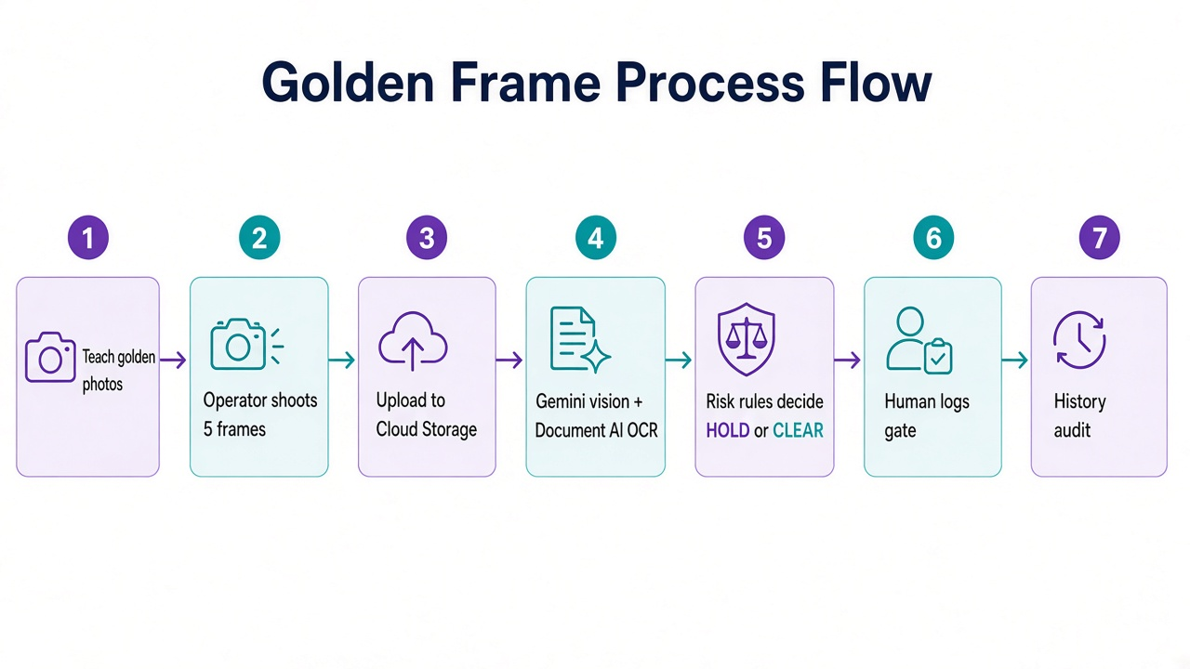
Process flow diagram or Use-case diagram
Operator path: Teach goldens → Start check → Shoot 5 frames → Inspect → HOLD/CLEAR → Human logs → History.

Slide 6
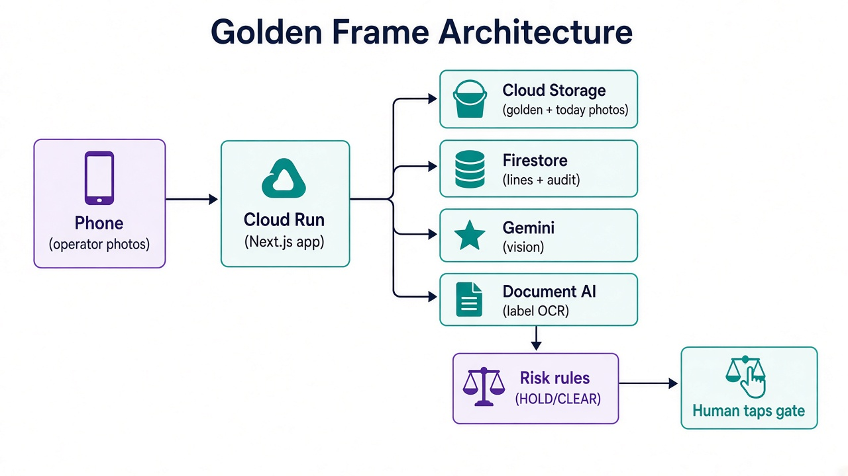
Architecture diagram of the proposed solution
Phone → Cloud Run (Next.js) → Storage + Firestore + Gemini + Document AI → Rules → Human gate.

Slide 7
Technologies to be used in the solution
Google Cloud
• Cloud Run — hosts the Next.js app + inspect APIs
• Cloud Storage — golden album + today’s capture evidence
• Firestore — lines, golden metadata, HOLD/CLEAR audit
• Gemini (gemini-3.8-flash) — multimodal vision / flags
• Document AI (OCR processor) — label product-code text
• Cloud Build / Artifact Registry — container build & deploy
App stack
• Next.js (App Router) + TypeScript + React (phone-first UI)
• Risk rules + gate engine in TypeScript (rules beat model prose)
• Vitest unit tests for SKU matching, rules, gate, inspection path

Slide 8
Estimated implementation cost (optional)
One-time implementation (this prototype)
• Build effort: ~2–3 person-weeks for a working Cloud Run MVP (UI + inspect + rules + deploy)
• Hackathon build cost: essentially $0 cash beyond team time (uses GCP free tiers / prepaid AI credits)
• No special hardware — operators use existing phones
Monthly cloud cost (pay-as-you-go estimates)
• Demo / Cup (idle most of the month, <200 inspects): ~$5–25 / month
– Cloud Run scale-to-zero + Firestore/Storage free tiers usually cover hosting
– Main variable: Gemini vision (~few cents–$1 per inspect depending on photos/tokens) + Document AI OCR (~$1.50 / 1,000 pages after 1,000 free)
• Small plant pilot (1–2 lines, ~50 checks/day ≈ 1,500/month): ~$80–250 / month
• Multi-line plant (10 lines, ~300 checks/day): ~$400–1,200 / month (mostly Gemini volume)
Why this is cheap vs the problem
• Avoided cost of one bad start / recall can be tens of thousands to millions — far above monthly AI spend
• App already shows HOLD cost vs escape cost so plants can justify the pause

Slide 9
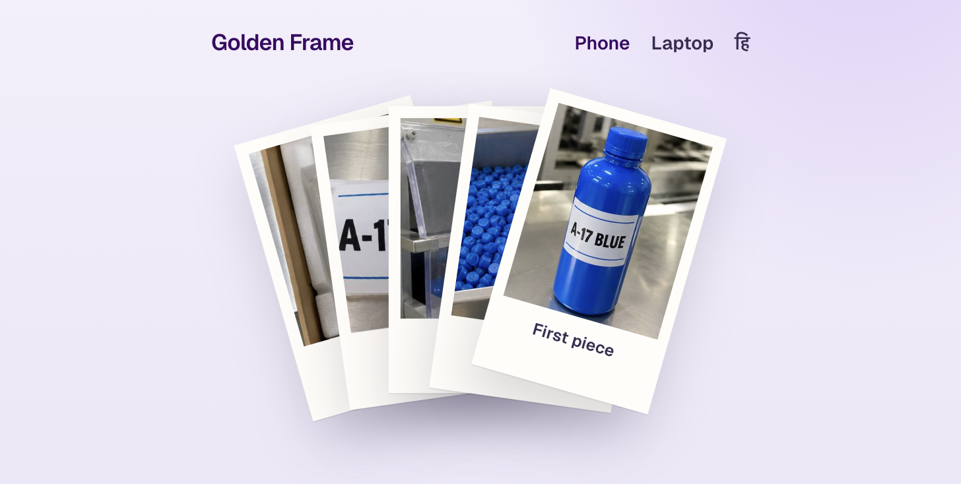
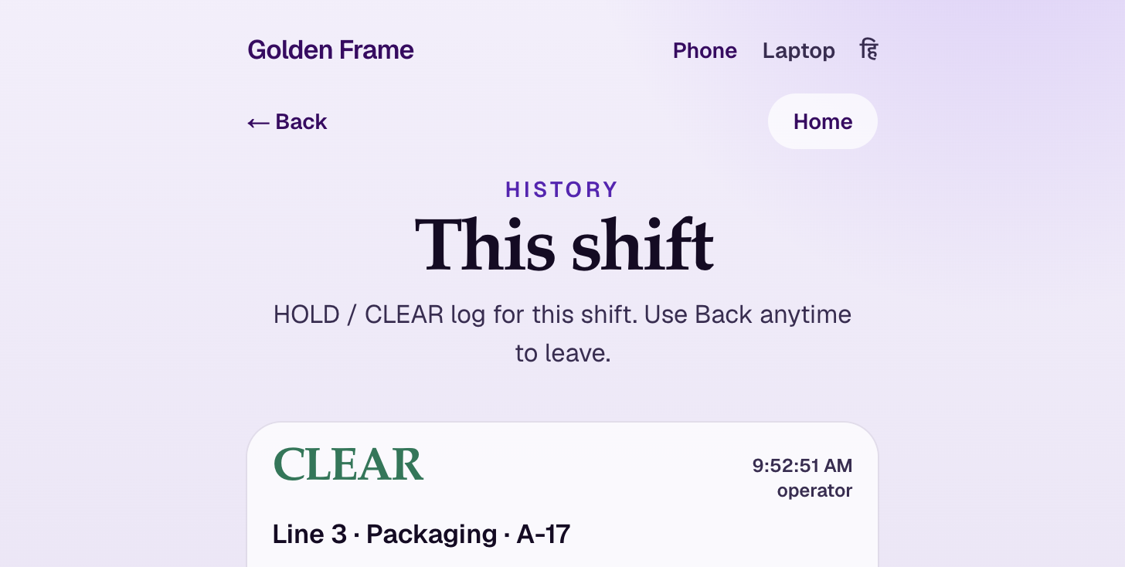
Snapshots of the prototype
Live prototype screens (phone layout). More in the 3-minute demo video.

Slide 10
Prototype Performance report/Benchmarking
• Automated tests: 46 Vitest tests covering SKU/OCR matching, risk table, HOLD/CLEAR gate, inspection path, Document AI helpers, catalog (2 industries × 5 slots), i18n
• Live Cloud Run health: gemini / firestore / storage / documentai all ok
• End-to-end demo path proven: wrong label or open cover → HOLD; fix → CLEAR; audit logged
• Document AI overrides label text when available; Gemini OCR is fallback
• Human-in-the-loop: model never starts equipment — gate tap is required
• Dual industry portability: same engine for Packaging (A-17) and Electronics (BRD-440)

Slide 11
Additional Details/Future Development (if any)
• Optional plant login / role auth (Identity Platform) for multi-shift plants
• Vertex AI Gemini path for enterprise VPC controls
• Supervisor dashboard (BigQuery exports of HOLD rates by line/SKU)
• Offline-tolerant capture queue + sync when Wi‑Fi returns
• Deeper SOP attach per frame (PDF manuals via RAG for “how to fix”)
• Integration hooks to MES/ERP work-order SKU so product code is pulled, not typed

Slide 12
Provide links to your:
GitHub Public Repository
https://github.com/11716807/hackathon
Demo Video Link (3 Minutes)
[Add your YouTube / Drive link after upload]
Final Product Link
https://golden-frame-216812516383.asia-south1.run.app

