Slide 1


Team Name: Itmam
Team Size: 1
Problem Statement: Abu Dhabi already screens at scale with IFHAS and EAS, but actionable findings still become orphan rows — patients are not reliably told, owned, booked, seen, and verified. Itmam closes that screening-to-care loop: import → enrich → prioritize → Sahhatna outreach → network-safe booking → visit → pathway verify, with a shared audit trail so no actionable result is left behind.

Slide 2
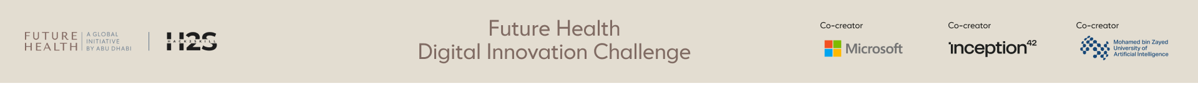
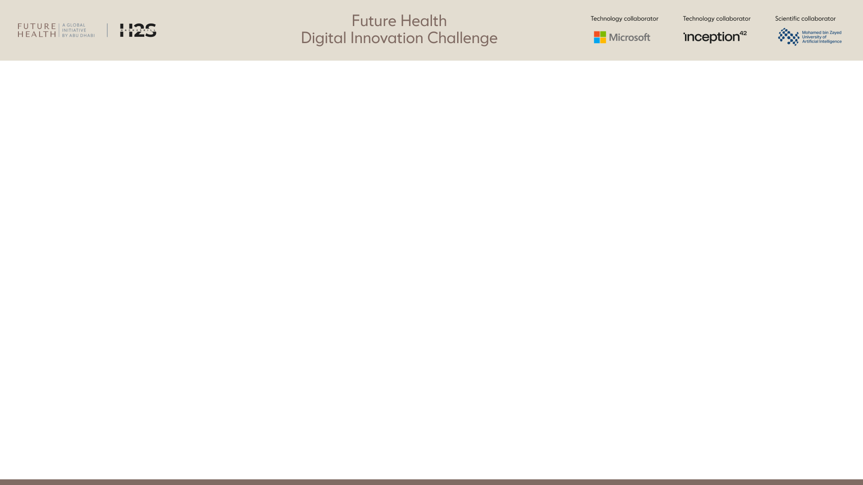
Team members*
[Name, country, role, organization, age confirmation]
S.No | Name | Country | Role | Organization | Age confirmation
1 | Rahul Duggal | India | Founder / Full-stack engineer | Independent (Itmam) | 18+ confirmed
2
3
4
5

Slide 3
Team Capability Summary*
Maximum 1,000 characters
Team capability (≤1000 characters)
Itmam is a production-ready closed-loop care coordination prototype for Abu Dhabi IFHAS/EAS follow-up. Built solo end-to-end: React/TypeScript UI, deterministic enrichment & risk ranking, Gemini-assisted outreach drafting/translation, Firestore-backed shared board + audit, and Google Cloud Run deploy. Capabilities: CSV/demo import; actionable vs borderline classification; urgency/SLA scoring; Sahhatna patient messaging (EN/AR/HI/UR); consent-first booking; clinician visit + confirmatory referral branch; no-show rebook; patient-level audit; editable risk weights; Case Ask. Safety: rules beat model prose; no diagnosis/prescribe; human verifies loop close. Live on Cloud Run with Gemini + Firestore health checks.

Slide 4
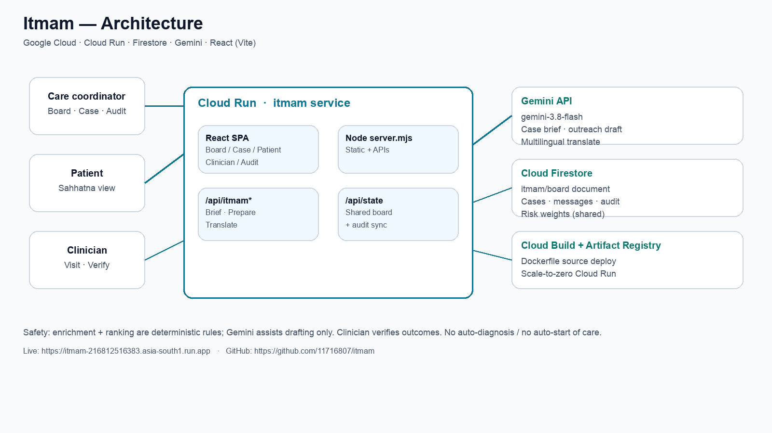
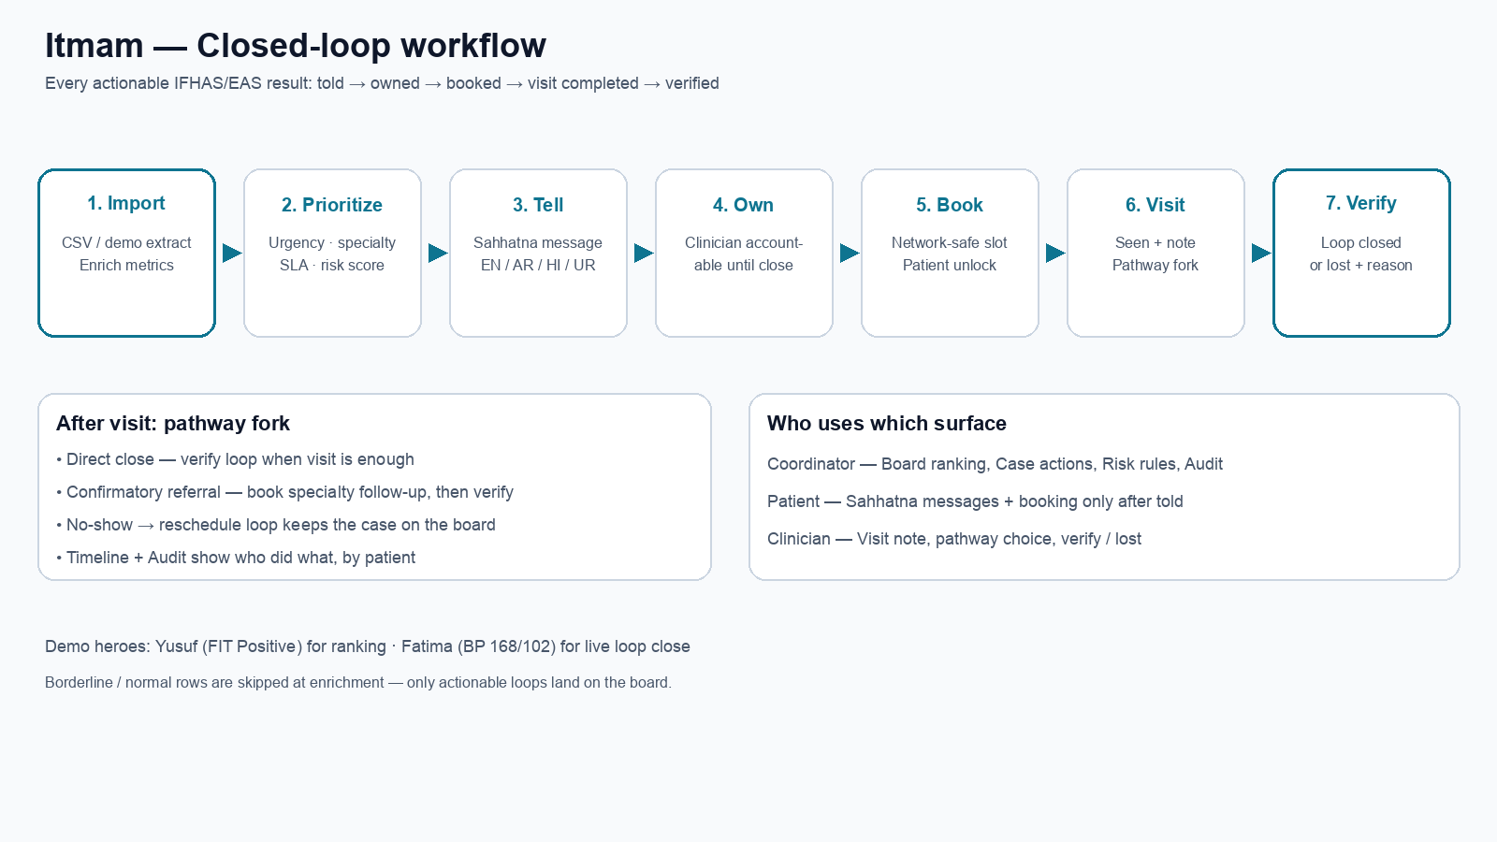
Architecture or workflow diagram*
Left: Cloud architecture (Cloud Run · Firestore · Gemini). Right: closed-loop workflow told→owned→booked→seen→verified.

Slide 5
Target users and intended outcome*
Primary users
• Care coordinators / population-health ops — triage IFHAS/EAS extracts, assign owners, chase SLAs.
• Patients — Sahhatna-style informed outreach; booking unlocks only after they are told.
• Clinicians — complete visit notes, choose direct close vs confirmatory referral, verify outcomes.
Intended outcome
• Zero orphan actionable screening results: every finding is told → owned → booked → seen → verified (or lost with reason).
• Faster time-to-informed & time-to-booked for urgent FIT/BP/MoCA paths.
• Transparent audit for facility / quality review.
• Safer AI use: Gemini drafts; rules rank; humans decide.

Slide 6
How will success be measured?*
Product KPIs
• % actionable results with patient_told within SLA
• % with clinical owner assigned before booking
• % booked on insurance-network-safe slots
• Loop completion rate (verified) vs lost-to-follow-up with documented reason
• Median hours: result_in → told → booked → verified
Operational KPIs
• SLA breach count / aging open loops on the board
• No-show → reschedule recovery rate
• Audit completeness (every stage has actor + timestamp)
Demo proof today
• Live Cloud Run app with Firestore sync; board seed + case timeline + audit trail visible without re-import.

Slide 7
Evidence supporting the approach*
Citations, studies, benchmarks, or prior testing.
Clinical / program context
• Abu Dhabi IFHAS / EAS population screening generates high volumes of findings that need timed follow-up (FIT, BP, MoCA).
• Closed-loop care is a standard quality goal: detection without completion leaves residual risk.
Product evidence (this prototype)
• Deterministic enrichment classifies actionable vs borderline from extract metrics (waiting days, no-shows, wearable flags).
• Editable risk weights apply immediately to board ranking with explicit priority reasons.
• End-to-end path proven: import → prioritize → tell → own → book → visit → confirmatory branch → verify; audit in Firestore.
• Live health: Gemini + Firestore on https://itmam-216812516383.asia-south1.run.app

Slide 8
Data sources and legal right to use them*
List source, type, owner, sensitivity, permissions, and whether personal data is used.
Sources used in this prototype
• Synthetic IFHAS/EAS-shaped CSV extract (demo-ifhas-extract.csv) — fabricated patients/findings for demo only.
• Type: structured screening rows + optional metrics (days_waiting, prior_no_shows, wearable_flag, family_risk).
• Owner: Team Itmam (generated). Sensitivity: demo/synthetic — no real patient identifiers.
Permissions & legal basis
• Full right to use: team-authored synthetic data and open sample templates.
• Gemini API used under Google AI / Cloud terms for drafting/translation only.
Personal data handling
• Prototype stores demo case state in Firestore + browser localStorage. Production would require MoHAP/DoH agreements, Malaffi integration, DPIA, and UAE PDPL controls — not claimed as live clinical data today.

Slide 9
Risks and safeguards*
Privacy; security; bias; explainability; misuse; human oversight; failure modes.
Privacy & security
• Demo data only in current deploy; secrets via Cloud Run env (not committed). HTTPS Cloud Run endpoint.
Clinical safety
• No diagnosis, no prescriptions, no silent auto-booking before patient is told. Clinician verifies close.
Bias & explainability
• Ranking uses transparent editable weights + explicit priority reasons. Gemini outputs are assistive drafts.
Misuse / failure modes
• Model downtime → local enrichment still works. Wrong extract → borderline skip + audit. Lost requires reason.
Human oversight
• Coordinator confirms priority; clinician owns outcome; audit trail is the accountability layer.

Slide 10
Hardware requirements
Required if wearable, sensor, connected device, or other hardware is there. Include sourcing and safety.
Not required for this prototype
• Itmam is software-only: browser + Cloud Run. No wearable, sensor, or medical device is required to run the demo.
• Optional context signals (e.g., wearable_flag) arrive as columns in the screening extract — not as direct device integrations in v1.
• Future pilots may ingest device alerts via partner APIs; any hardware would remain vendor-sourced and clinically certified by those vendors, outside Itmam’s scope.
• Safety: Itmam never controls clinical devices; it coordinates human follow-up workflows only.

Slide 11
Path to pilot and scale*
Stakeholders, integration, regulatory needs, timeline assumptions, and sustainability.
Phase 0 — now (hackathon)
• Live Cloud Run prototype with demo extract, Gemini assist, Firestore audit.
Phase 1 — 90-day pilot
• Partner: one Abu Dhabi screening hub coordinating IFHAS follow-up.
• Integrate consent-backed extracts; SSO; role auth; DPIA; Arabic-first UX hardening.
Phase 2 — scale
• Malaffi / EMR hooks for result_in and visit verified; Sahhatna channel integration; enterprise logging.
Stakeholders
• DoH Abu Dhabi, facility care-coordination leads, clinicians, patient-experience / Sahhatna owners.
Regulatory / sustainability
• UAE PDPL + health-data agreements. Cloud costs scale-to-zero; value = avoided orphan follow-ups.

Slide 12
Pre-existing IP and third-party materials*
Identify ownership, licenses, open-source components, and restrictions.
Team IP
• Application code, enrichment rules, UI/UX, and demo dataset authored by Team Itmam for this challenge.
Open-source / third-party
• React, Vite, TypeScript, Node.js — MIT/permissive OSS licenses.
• @google-cloud/firestore and Google Gemini API — used under Google Cloud / Google AI terms.
• Deploy pattern adapted from the team’s prior Golden Frame Cloud Run template (same author).
Restrictions
• No third-party clinical datasets redistributed. IFHAS/EAS/Sahhatna referenced as program context only — not claimed affiliation.

Slide 13
Conflict of interest declaration*
Disclose relationships with organizers, partners, or judges.
Declaration
• No conflict of interest to declare with organizers, partners, or judges of the Future Health Digital Innovation Challenge.
• Team member is not an employee of Google, DoH Abu Dhabi, or Malaffi for this submission.
• Google Cloud / Gemini are used as technology providers only; no preferential judging relationship is claimed.

Slide 14
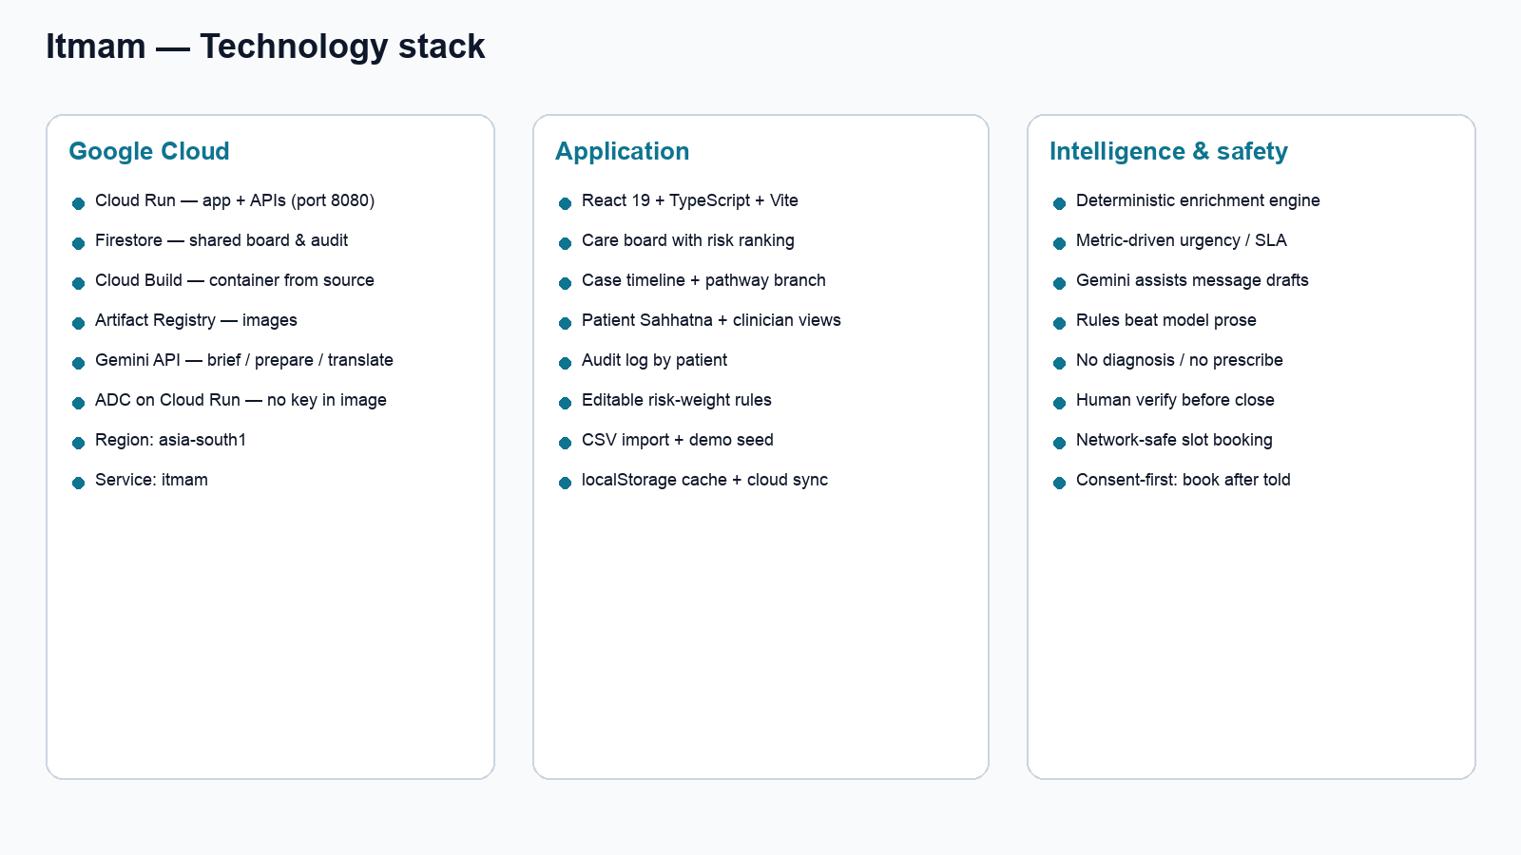
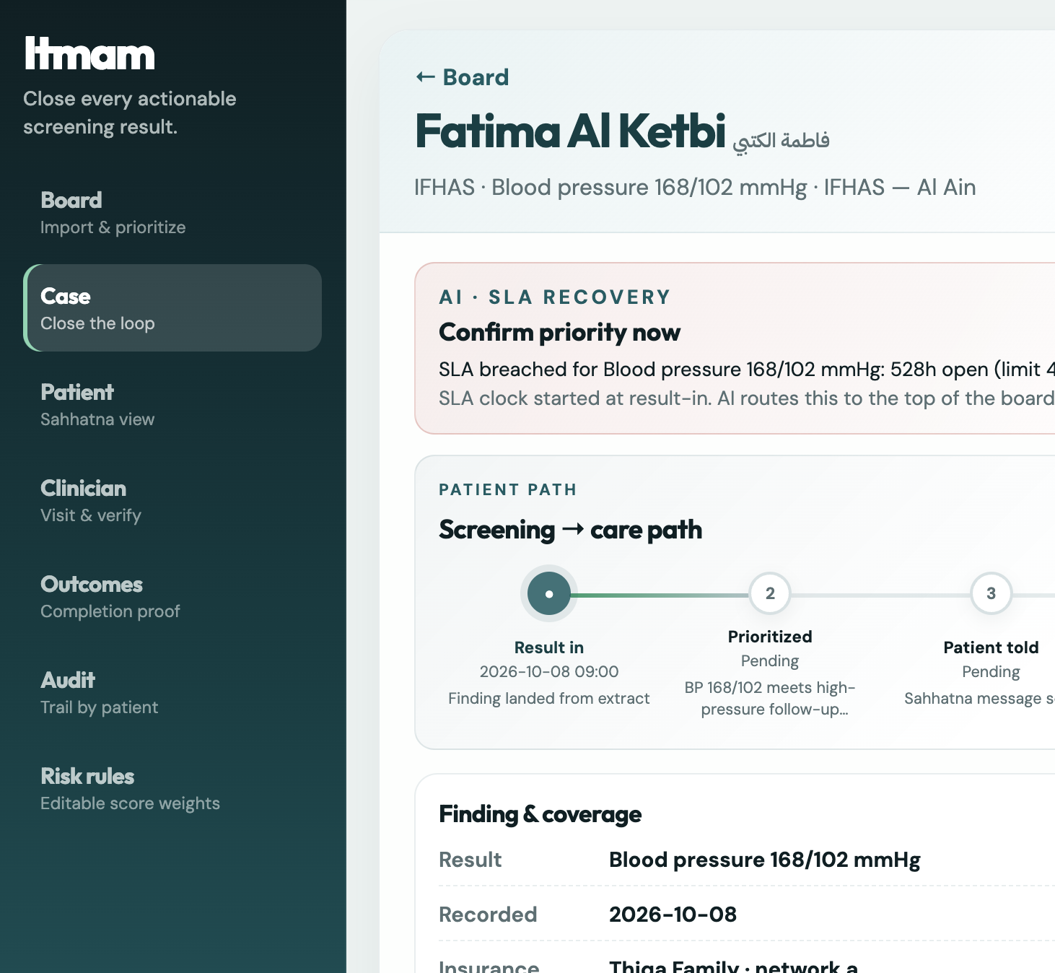
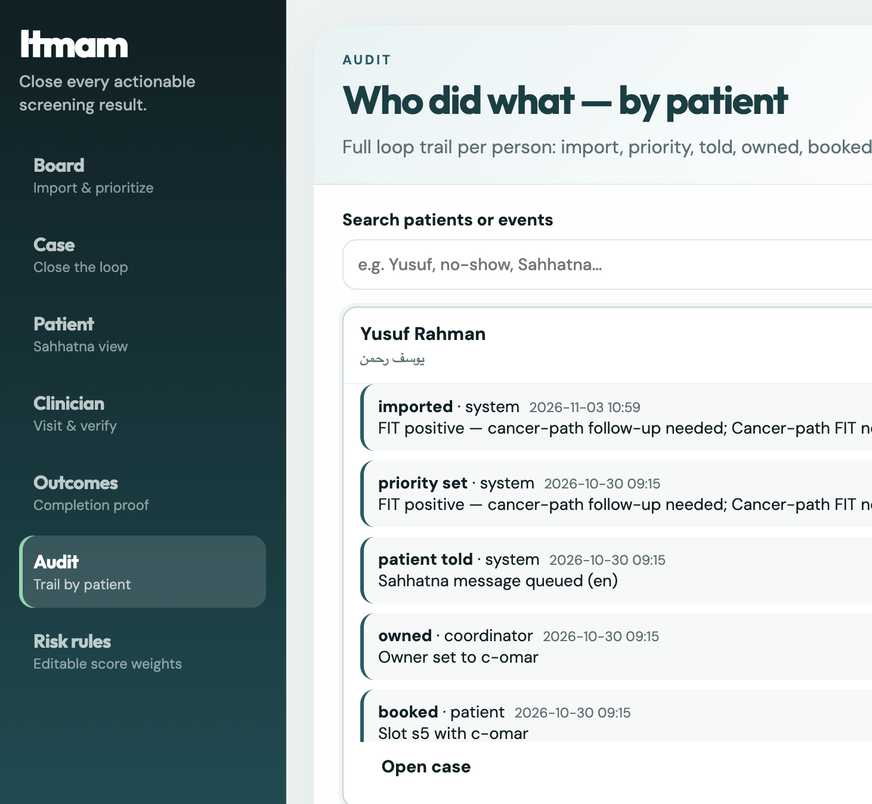
Additional — stack, live links, prototype snapshots
Live: https://itmam-216812516383.asia-south1.run.app · GitHub: https://github.com/11716807/itmam
Additional Slide

Slide 15


