Slide 1

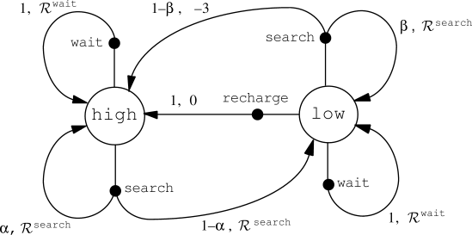

Slide 2
Initialize matrix Q as zero matrix
For each episode:
Select random initial state
Do while not reach goal state
Select one among all possible actions for the current state
Using this possible action, consider to go to the next state
Get maximum Q value of this next state based on all possible actions
Compute
Set the next state as the current state
End Do
End For

Slide 3
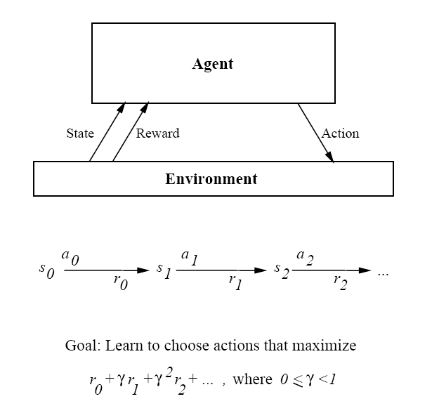

Slide 4
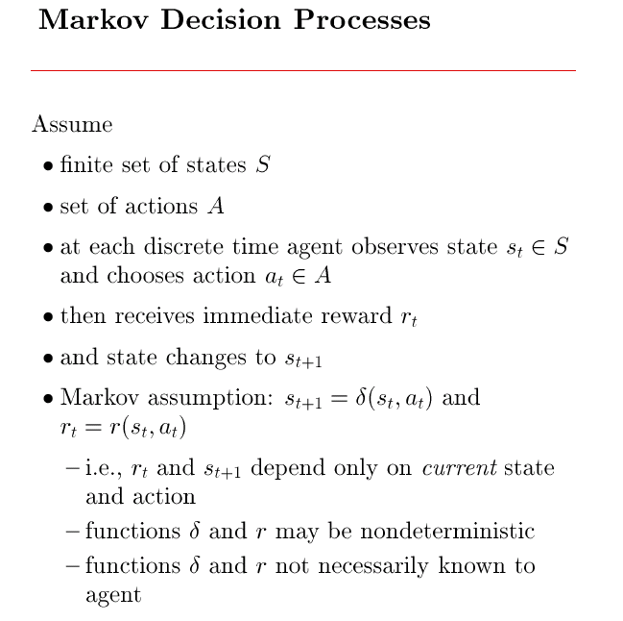

Slide 5
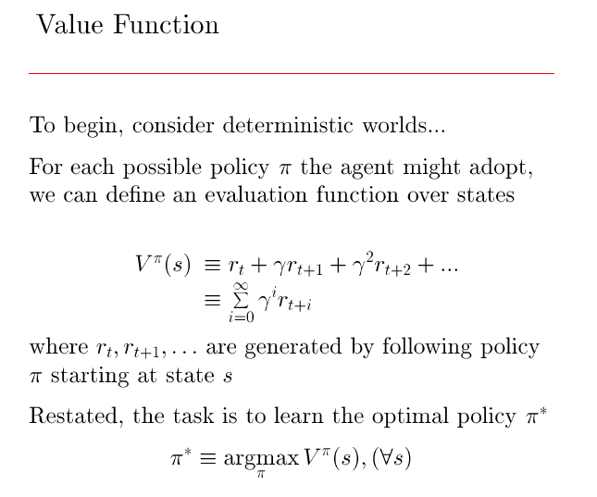

Slide 6
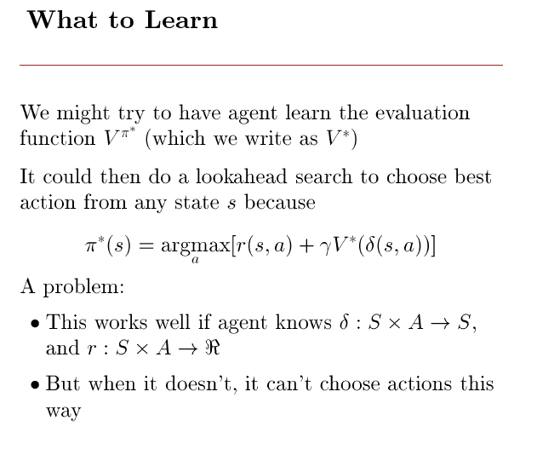

Slide 7
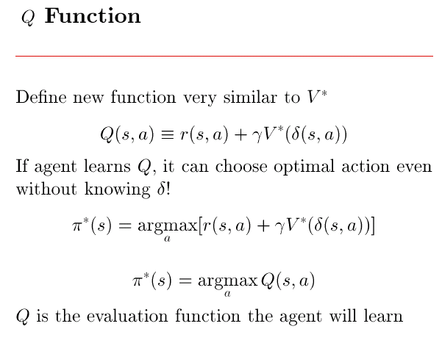

Slide 8
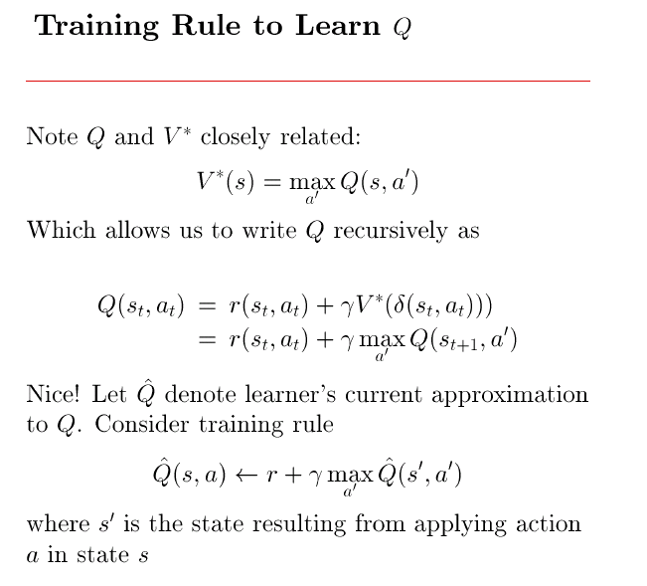

Slide 9
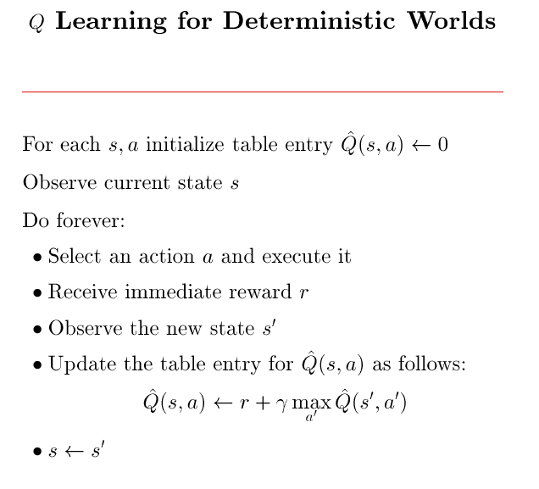

Slide 10
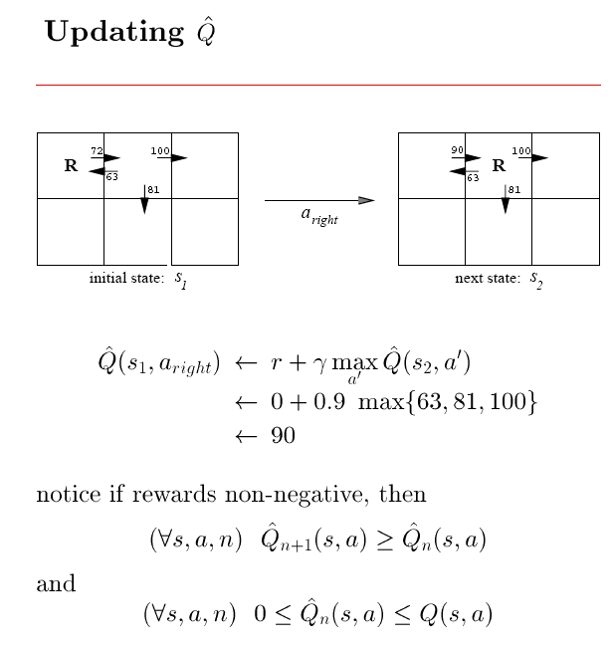

Slide 11
