Slide 1
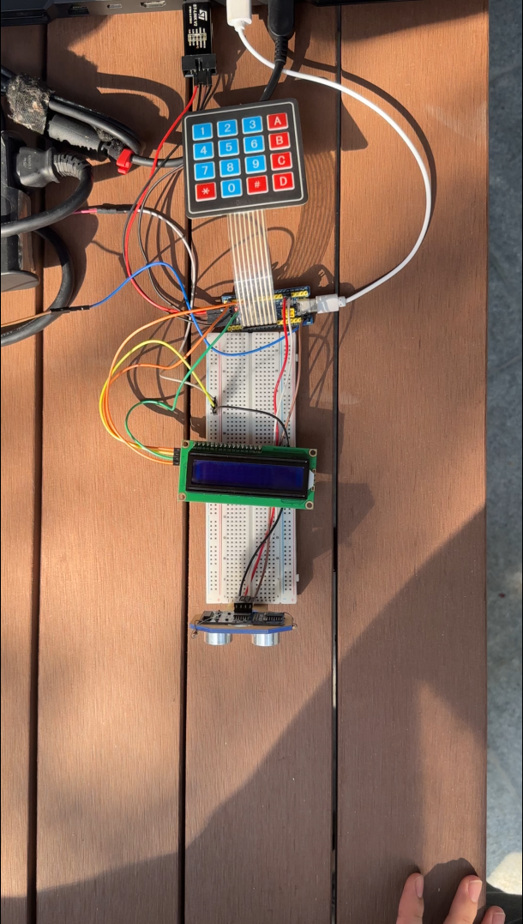
ST-Link_V2
USB
16c_keyboard
Adapter_5V
Blue_pill
LCD_1602_5V
Breadboard
HC_SR04_5V
POWER_ON by coming close to the Vending Machine

Slide 2
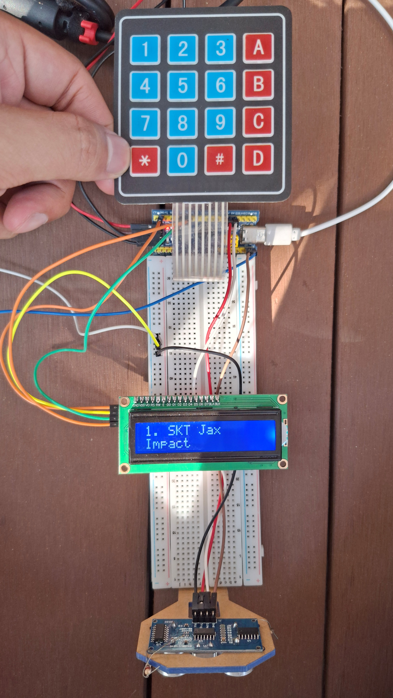
UP
DOWN
USER
LEFT
RIGHT
RETURN
DELETE
NEXT
ENTER
KEYBOARD
MONITOR

