Slide 1
11-791 Project
Team 07 - Team HOLa
Hao Zhang
Oleg Iskra
Lara Martin

Slide 2
Outline
System Description
Progress
Next Steps

Slide 3
System Description
Error Analysis
Input
Reader
AAE1
(Docs)
Consumer
Phase 1
Evaluation
Phase 2
Consumer
AAE2
Reader
Evaluation
Error Analysis

Slide 4
Progress
Basic UIMA pipeline in place
Collection Reader (from JSON), CAS Consumer (to JSON)
AAE Framework→ Documents, Concepts, Triples
Connect to databases and return links
https://github.com/11791-07/project-team07/wiki/Basic-flow-of-events

Slide 5
Next Steps
Preprocess questions to decide which web service to use
Develop ranking algorithm based on API results
Extract relevant passages from retrieved documents

Slide 6
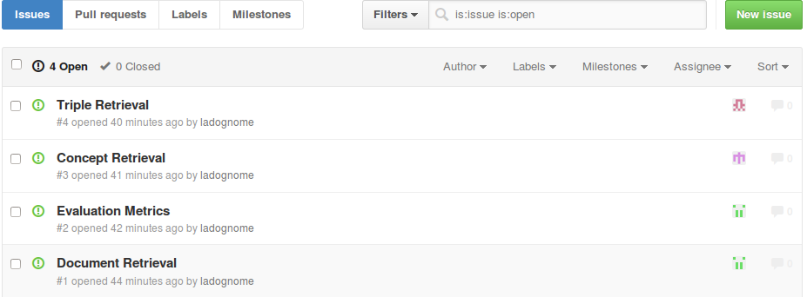
Next Steps

Slide 7
Thanks!

