Slide 1
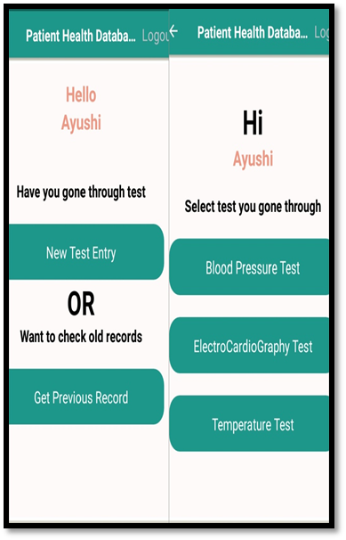
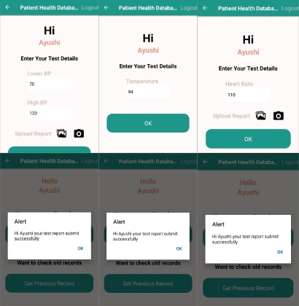
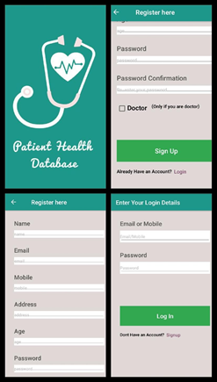
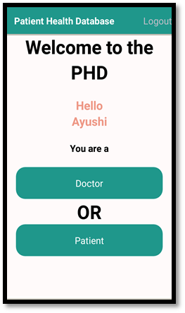
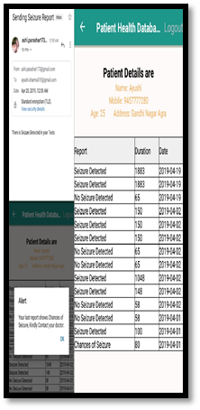

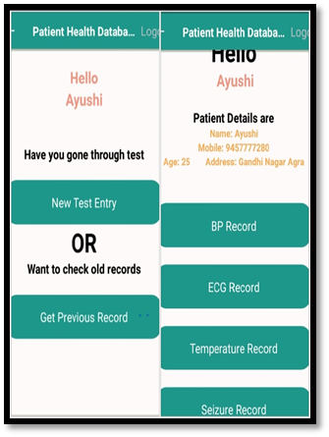
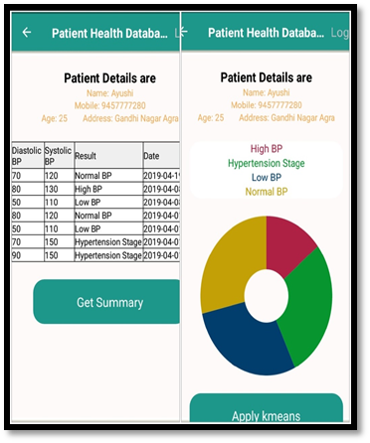
For ECG, Blood Pressure and others
Doctor and patient both can access the patient’s records
Data can be added manually
For Seizure
Continuous measurement of EEG data which is being processed and analyzed at backend. When seizures detected patient and doctor get the notification.
User
User signs-up the App
Existing records can be viewed
For others
Existing view of blood pressure records

