Slide 1

Jenkins
Continuous Integration
-written in Java

Slide 2
enable and trigger a series of incremental process improvements
Schedule the automated build through to continuous delivery into production.
help to detect and fix bugs faster
provide a useful project dashboard for both developers and non-developers.
help teams deliver more real business value to the end user.
It for all
It stand far ahead with waterfall projects and Gantt charts

Slide 3

Installation of Jenkins
Install java
Jenkins is a Java web application
How to check Java is installed or not
How to install Java
If Java is not install, you can download from Oracle - http://www.oracle.com/technetwork/java/javase/downloads/index.html
rpm -ivh jdk-8u25-linux-x64.rpm

Slide 4

Installation of Jenkins
Install Git
yum install git-core
Check the git version after installation.
With SSH keys, you can connect to GitHub without supplying your username or password at each visit
Set up SSH
Generating a new SSH key
Add it to the ssh-agent
Add the key to your GitHub account

Slide 5
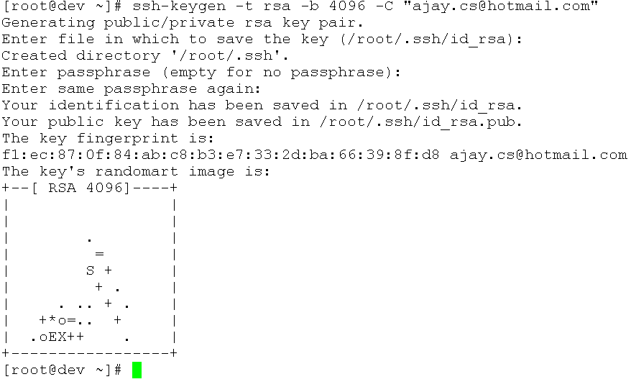
Generating a new SSH key and Add it to the ssh-agent

Slide 6
2) Adding your SSH key to the ssh-agent
Start the ssh-agent in the background.
[root@dev ~]# eval "$(ssh-agent -s)"
Agent pid 11397
b) Add your SSH private key to the ssh-agent
[root@dev ~]# ssh-add ~/.ssh/id_rsa
Enter passphrase for /root/.ssh/id_rsa:
Identity added: /root/.ssh/id_rsa (/root/.ssh/id_rsa)

Slide 7
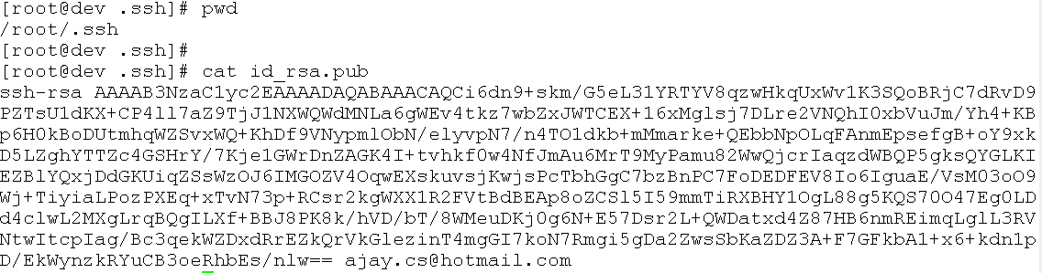
3) Adding a new SSH key to your GitHub account
Copy the SSH key to your clipboard

Slide 8
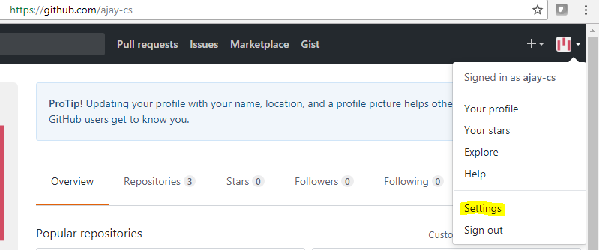
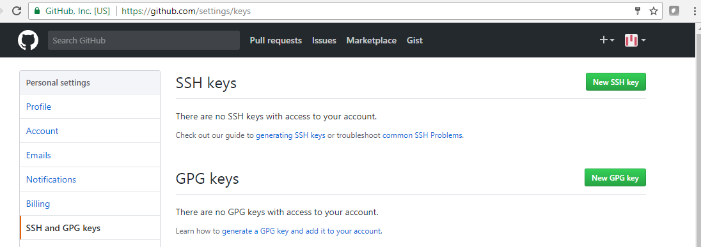
b) In the upper-right corner of any page, click your profile photo, then click Settings.

Slide 9
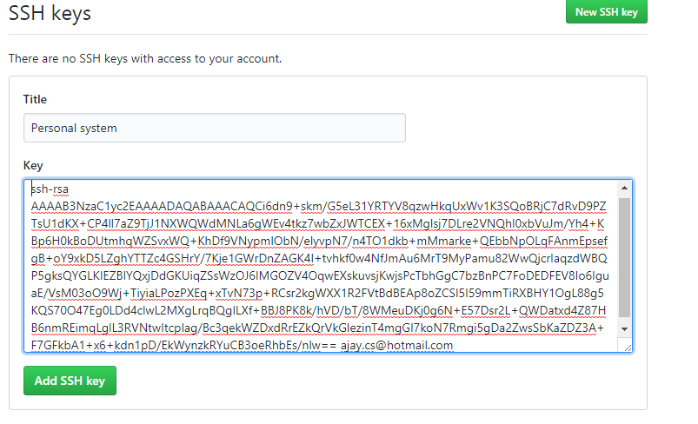
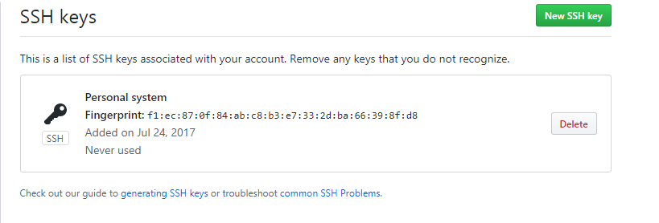

Slide 10
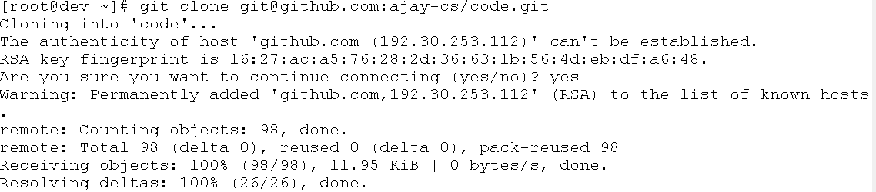
Forking the Sample Repository

Slide 11
Installation of Jenkins
https://pkg.jenkins.io/redhat/
wget -O /etc/yum.repos.d/jenkins.repo https://pkg.jenkins.io/redhat/jenkins.repo
rpm --import https://pkg.jenkins.io/redhat/jenkins.io.key
yum install jenkins
systemctl start jenkins
systemctl enable jenkins.service
systemctl status jenkins
/sbin/chkconfig jenkins –list
Make sure 8080 is listening on server - netstat -tunpl | grep java

Slide 12
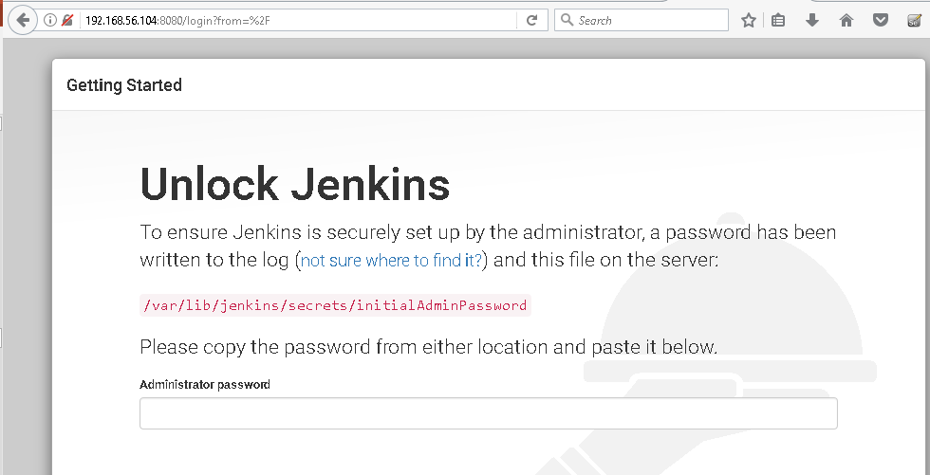
Access from web

Slide 13
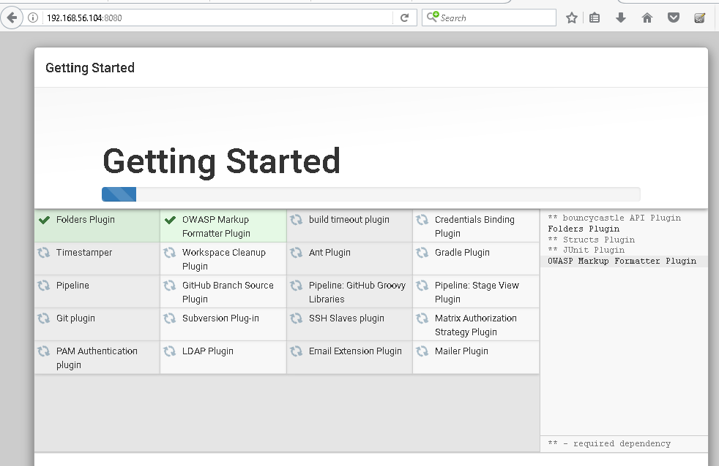

Slide 14
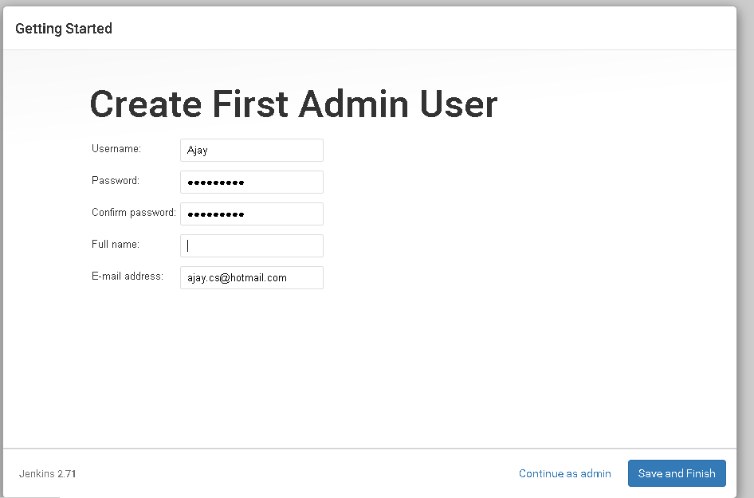

Slide 15
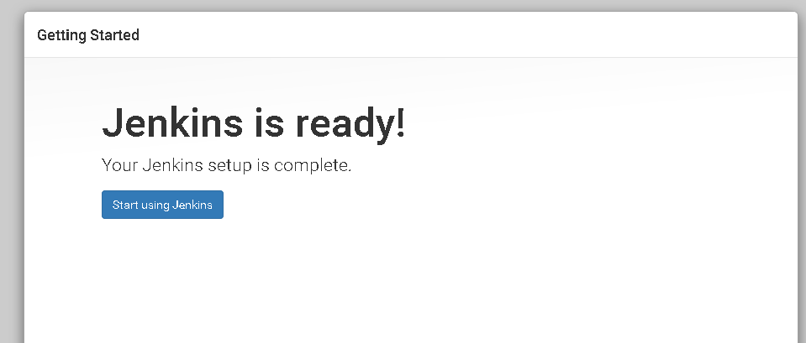

Slide 16
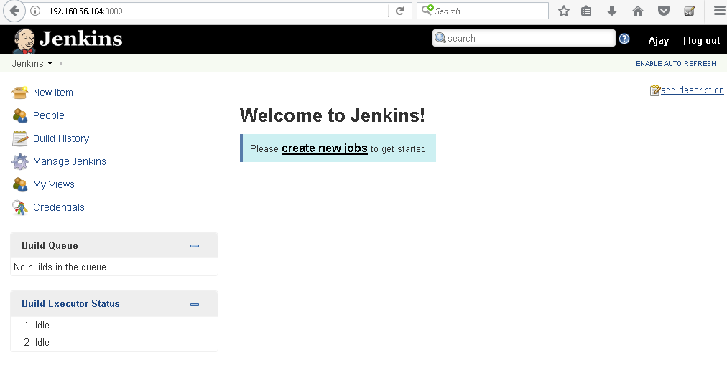

Slide 17
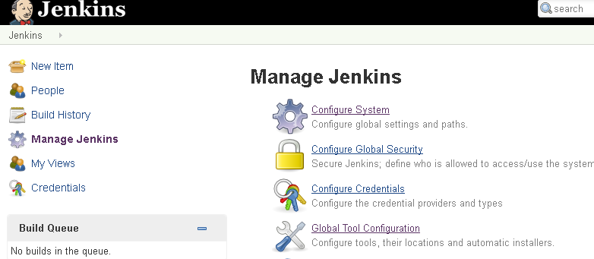
Configuring the Tools
--one-stop-shop for all
Secure Jenkins
It is recommended to secure Jenkins

Slide 18
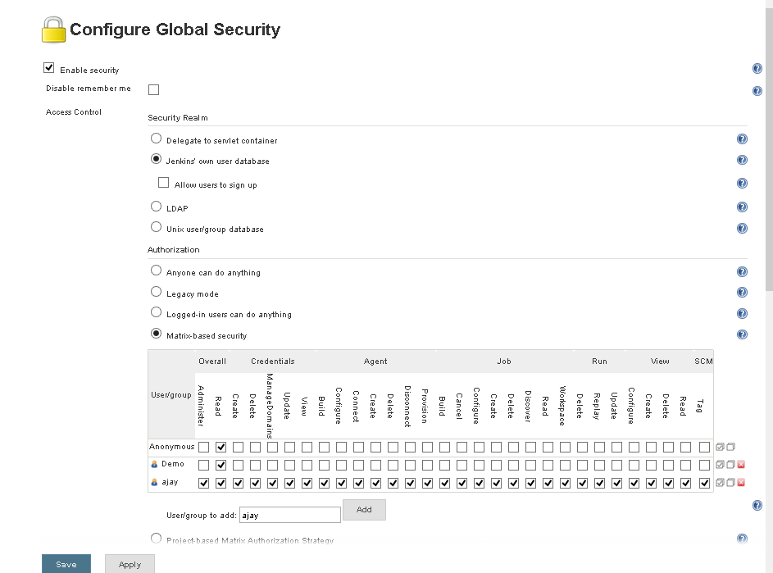

Slide 19
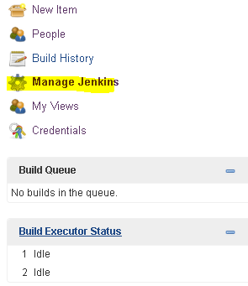
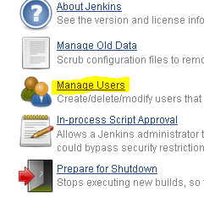
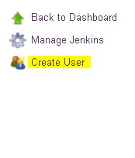
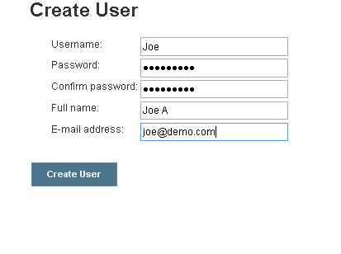
Create a new User in Jenkins

Slide 20

Manual release process
Traditional release cycle: rare releases and manual release process
Release
Server
changes
6 months
Release
Server
Manual steps
Notes:
What are the problems about this approach?
The release process is done rarely. Consequently, we are barely practiced in releasing. Mistakes can happen more easily.
Manual steps. The release process consists of a lot of steps which have to be performed manually (shutdown, set up/update infrastructure, deployment, restart and manual tests). The consequences:
Mistakes are more likely to happen when executing these steps manually.
The whole release process is more laborious, cumbersome and takes more time.
There have been a lot of changes performed since the last release 6 months ago. It’s likely that
something will go wrong when trying to put the different components together (e.g. version conflicts, side-effects, incompatible components) or
that there are bugs in the application itself.
But it is hard to see what change is causing the problem, because there have been a lot of changes. The point is that those problems are discovered too late. We are getting feedback too late, because we are trying to release the application too late in the development process and not regularly. We are only trying to release, when we really want to create a release.
All in all, we have a high risk that something will go wrong during our release process or that the application will contain bugs. Releases are dangerous and scary, aren’t they? That’s probably why releases are done so rarely. But doing them rarely makes them even more dangerous and scary. What can we do instead?

Slide 21

Continuous Delivery
Continuous Delivery: Increased release frequency and automation of the release process.
Release
Server
Release
Server
Release
Server
Release
Server
Automation
Notes:
What are the benefits of this approach?
Fewer mistakes can happen during an automated process in comparison to a manual one.
There are fewer changes done between two releases. The danger of mistakes is quite small and we can easily track them back to the causing change.
We don’t package and ship our application at the end of a development phase. We are doing it early and frequently. This way we’ll discover problems in the release process very soon.
Due to the automated release process we can bring business value faster into production and therefore reduce the time-to-market.
Deploying our application into production is low-risk, because we just execute the same automated process for the production as we did for the tests or the pre-production system.
All in all, Continuous Delivery is about
reduced risks,
increased reliability,
faster feedback,
accelerated release speed and time-to-market.

Slide 22
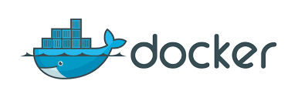

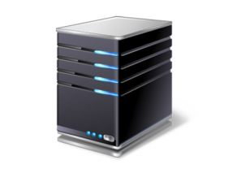

Virtualization Approach
Docker Container Approach
App1
App2
App3
Guest OS
Guest OS
Guest OS
App1
App2
App3
Bins/Libs
Bins/Libs
Bins/Libs
Hypervisor
Docker Engine
Host Operating System
Host Operating System
Infrastructure
Infrastructure
Notes:
Docker software removes some of the limitations of virtualization to help reduce CPU and memory overhead and increase application density per host.
Docker software is not a virtualization technology; rather, it is an application-delivery technology that abstracts an application and its dependencies from the operating system.
Instead of running an application within a full virtual machine, Docker software lets developers package an application with a file system, libraries, and any other dependencies that the application needs within a Docker container, which can run on a bare-metal server or in a virtual machine
The difference is that Docker containers use a shared operating-system kernel model on the host instead of relying on isolation through hardware virtualization.
Only the application and its dependencies are deployed within the container.

Slide 23
Benefits of Docker container
Simplicity: Docker containers remove a level of complexity from the development and deployment process because developers only need to package an application and its dependencies.
Speed: Docker containers share the kernel of the underlying host operating system, but the Docker architecture protects containers from each other by isolating container processes.
Interoperability: Development teams can link multiple Docker containers or services to create multi-tiered application stacks.
Portability: Docker provides a standardized method to deploy containers to any number of Docker environments, whether an environment is located on a development workstation, a private cloud infrastructure, or a public cloud service.
Density: Docker containers provide a lightweight runtime environment for applications, which can lead to increased application density per host.
Notes:
Simplicity - IT operations benefit from the simplicity of containers because Docker containers run independently in Docker environments, regardless of the underlying operating-system configurations.
Speed - Each container application views itself as running within its own environment—similar to how an application runs in a virtual machine—but the container doesn’t require a separate operating system. This lightweight environment relieves the application of operatingsystem and hypervisor overhead. Development and IT-operations teams can create and deploy new containers quickly, which can help reduce development and deployment time and increase team productivity
Interoperability - If an individual container within the stack needs to be upgraded, a developer can swap out the container without affecting the rest of the containers within the stack.
Portability: This portability simplifies development and deployment by removing host-configuration dependencies from the process.
Density:In addition, Docker containers let developers create “microservice architectures” easily, where a single service runs within a single container without interfering with other services running in other containers.

Slide 24
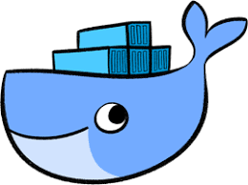
Docker Engine
Client docker CLI
REST API
Server docker daemon
Notes:
Docker Engine
It is a client server application that contains the following major components.
A server which is a type of long-running program called a daemon process.
The REST API is used to specify interfaces that programs can use to talk to the daemon and instruct it what to do.
A command line interface client.

Slide 25
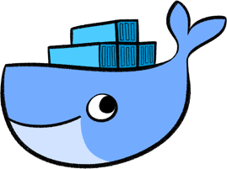




DOCKER HOST
Docker daemon
Client
Containers
Images
Registry
docker build
Docker pull
Docker run
Notes:
Docker Architecture
Docker follows client-server architecture. Its architecture consists mainly three parts.
1) Client: Docker provides Command Line Interface (CLI) tools to client to interact with Docker daemon. Client can build, run and stop application. Client can also interact to Docker_Host remotely.
2) Docker_Host: It contains Containers, Images, and Docker daemon. It provides complete environment to execute and run your application.
3) Registry: It is global repository of images. You can access and use these images to run your application in Docker environment.

Slide 26
Docker Components
Docker daemon
The Docker daemon (dockerd) listens for Docker API requests and manages Docker objects such as images, containers, networks, and volumes.
Docker client
The Docker client (docker) is the primary way that many Docker users interact with Docker. When you use commands such as docker run, the client sends these commands to dockerd, which carries them out.
Docker registries
When you use the docker pull or docker run commands, the required images are pulled from your configured registry. When you use the docker push command, your image is pushed to your configured registry.
Images
An image is a read-only template with instructions for creating a Docker container. Often, an image is based on another image, with some additional customization.
Notes:
Images - For example, you may build an image which is based on the ubuntu image, but installs the Apache web server and your application, as well as the configuration details needed to make your application run.

Slide 27

Docker Installation
Docker install on any operating system:- Mac, Windows, Linux or ant cloud.
Prerequisites:
1) Docker only work on 64-bit Linux
Command: #cat /etc/*release | grep -w NAME
2) It requires Linux kernel 3.10 or higher
Command: #uname -r

Slide 28
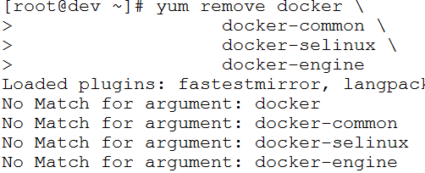
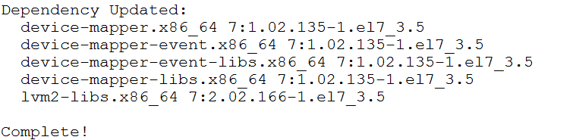
Docker Installation
Uninstall old versions:
#yum remove docker docker-common docker-selinux docker-engine
Install required packages
#yum install -y yum-utils device-mapper-persistent-data Lvm2
Notes:
Install required packages. yum-utils provides the yum-config-manager utility, and device-mapper-persistent-data and lvm2 are required by the devicemapper storage driver.

Slide 29
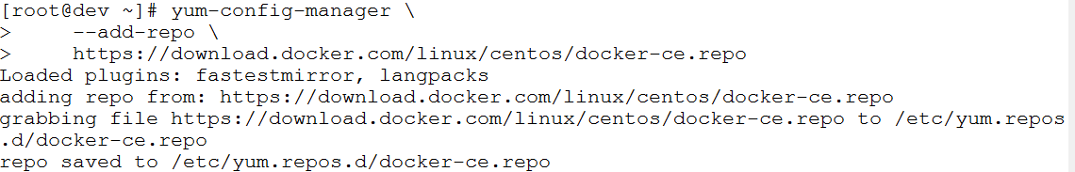
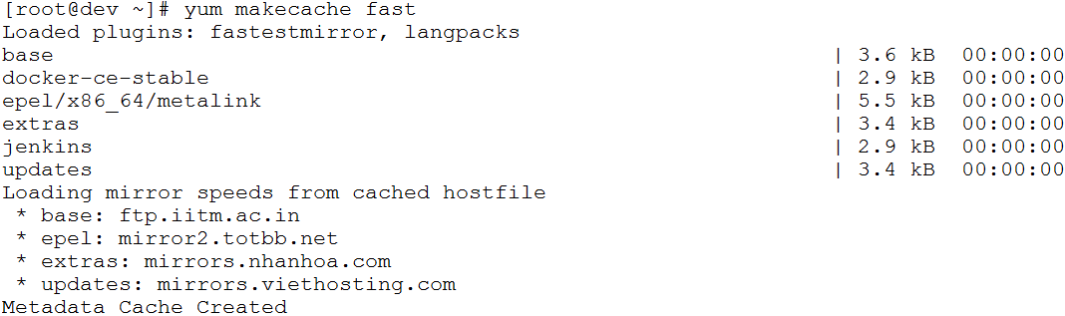
Set the repository
#yum-config-manager --add-repo https://download.docker.com/linux/centos/docker-ce.repo
#yum makecache fast

Slide 30
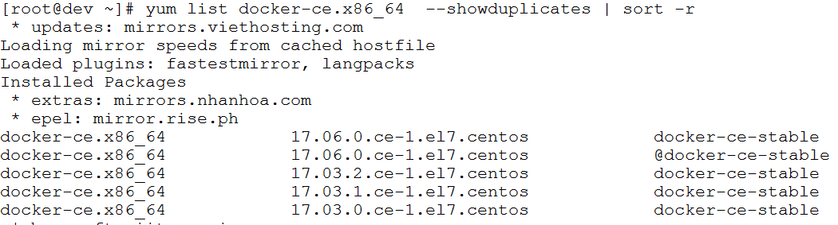
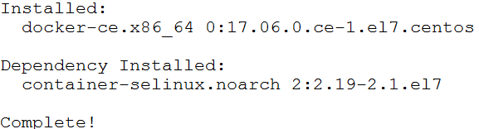
Install Docker CE
#yum list docker-ce.x86_64 --showduplicates | sort –r
#yum install docker-ce

Slide 31
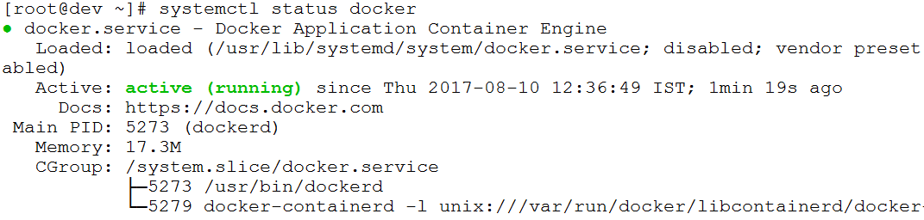
Start Docker
#systemctl start docker
.
Notes:
top - g + 4
Shift + L => docker

Slide 32
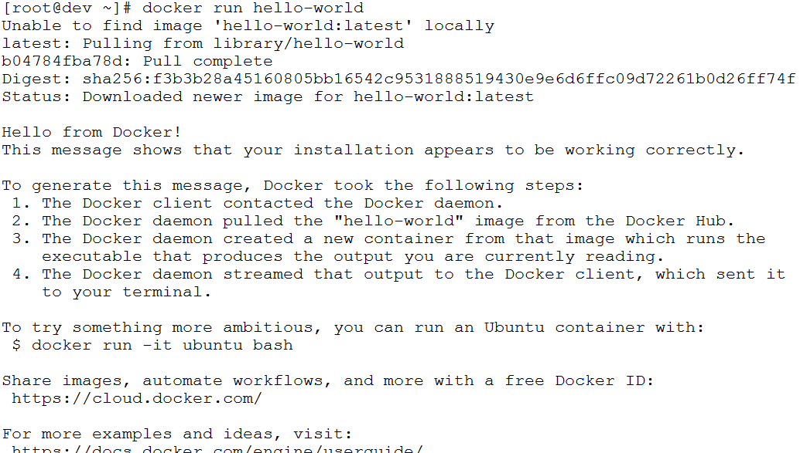
Verify that docker is installed correctly by running the hello-world image

Slide 33
Configure Docker to start on boot
#systemctl enable docker
Notes:
https://docs.docker.com/engine/installation/linux/linux-postinstall/#ip-forwarding-problems

Slide 34
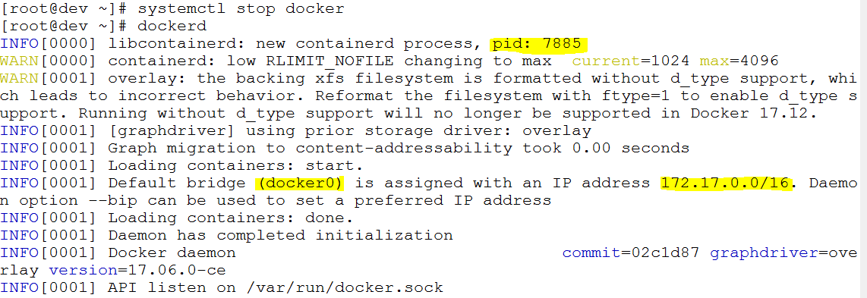
Start the daemon manually

Slide 35
Build the app
Create
Docker host
1
Dockerfile
Auto Create
Container
2
App
Inside Container install python module
Deploy python based app
3
4
Notes:
Lab - https://docs.docker.com/get-started/part2/#apppy

Slide 36
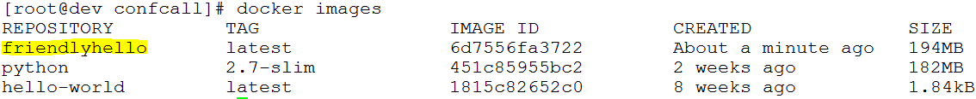
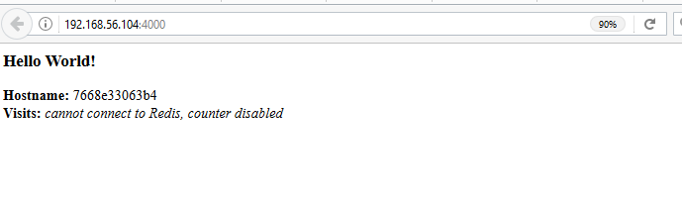
Build the app
Check all file
Create the image
Check image
Run the application
Access the application
docker run -d -p 4000:80 friendlyhello
Notes:
This port remapping of 4000:80 is to demonstrate the difference between what you EXPOSE within the Dockerfile, and what you publish using docker run -p

Slide 37
Containers
A container is a runnable instance of an image.
Create, run, stop, move or delete
Container
More than one network can be attach
Docker API or CLI
Attach storage
Image
Create a new image based on container current state

Slide 38
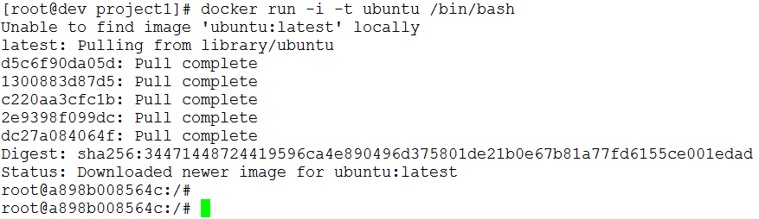
Container run command
The following command runs an ubuntu container, attaches interactively to your local command-line session, and runs /bin/bash
Notes:
If you do not have the ubuntu image locally, Docker pulls it from your configured registry, as though you had run docker pull ubuntu manually
Docker creates a new container, as though you had run a docker create command manually.
Docker allocates a read-write filesystem to the container, as its final layer. This allows a running container to create or modify files and directories in its local filesystem.
Docker creates a network interface to connect the container to the default network, since you did not specify any networking options. This includes assigning an IP address to the container. By default, containers can connect to external networks using the host machine’s network connection.
Docker starts the container and executes /bin/bash. Because the container is run interactively and attached to your terminal (due to the -i and -t) flags, you can provide input using your keyboard and output is logged to your terminal.
When you type exit to terminate the /bin/bash command, the container stops but is not removed. You can start it again or remove it.

Slide 39
Swarm clusters
A swarm is a group of machines that are running Docker and joined into a cluster.
swarm manager - Swarm managers are the only machines in a swarm that can execute your commands
Nodes - swarm as workers. Workers are just there to provide capacity and do not have the authority to tell any other machine what it can and cannot do
A swarm is made up of multiple nodes, which can be either physical or virtual machines.

Slide 40
Docker Swarm Architecture
Swarm Manager
Discovery Server
Docker Client
Swarm Node
Swarm Node
Swarm Node
Docker Daemon
Docker Daemon
Docker Daemon

Slide 41
A swarm is made up of multiple nodes, which can be either physical or virtual machines.
docker swarm init command - enable swarm mode and make your current machine a swarm manager
docker swarm join command – Other machines to have them join the swam as worker
Notes:
Docker Engine 1.12 introduces swarm mode that enables you to create a cluster of one or more Docker Engines called a swarm. A swarm consists of one or more nodes: physical or virtual machines running Docker Engine 1.12 or later in swarm mode

Slide 42
Docker Networking
Docker and iptables –
Linux hosts use a kernel module iptables to manage access to network devices , like routing, network address translation (NAT), and other concerns.
Docker modifies iptables rule when you start or stop container.

Slide 43
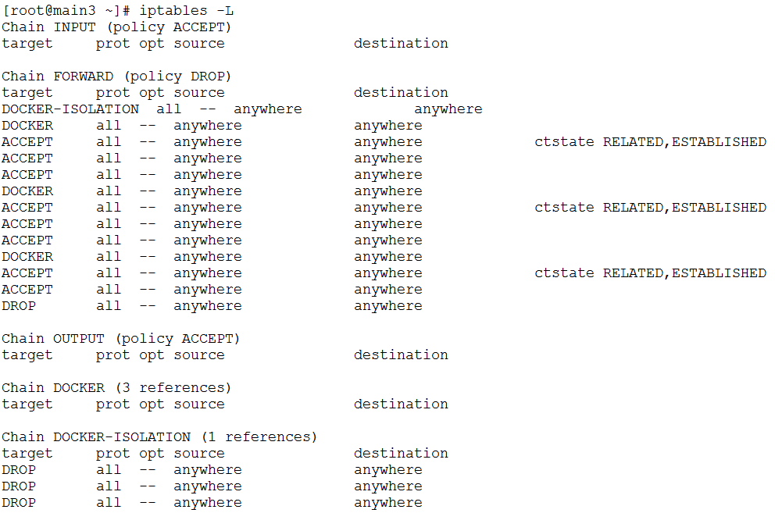
Docker Networking
Docker and iptables

Slide 44
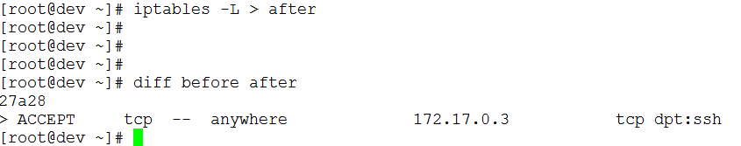
Docker Networking
Docker and iptables
Save the iptables rule in file before for later compare
Port forwarding for container node
Check the iptables rule again and see the difference

Slide 45
Docker Networking
Docker and iptables
Port 2222 is open on docker host

Slide 46
Docker Networking
On node1 make sure sshd service is running
Check the connection to container by using below command.
ssh -p 2222 192.168.56.104
Notes:
apt-get update
apt-get install net-tools
apt-get install iproute2
apt-get install iputils-ping
apt-get install openssh-server
apt-get install vim

Slide 47
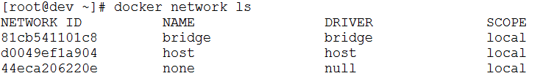
Docker Networking
Default networks – When you install Docker, it creates three network automatically.
To list the network use below command:

Slide 48
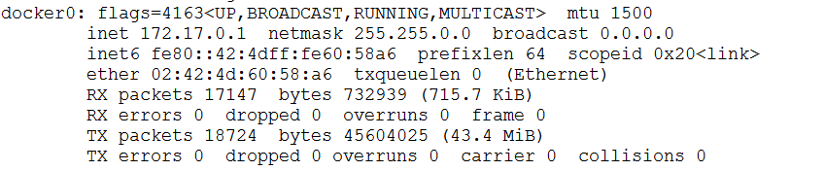
Docker Networking
Default networks - The bridge network represents the docker0 network present in all Docker installations. To change the network run below command
We can see the docker0 bridge as part of host network.
docker run --network=<NETWORK>

Slide 49
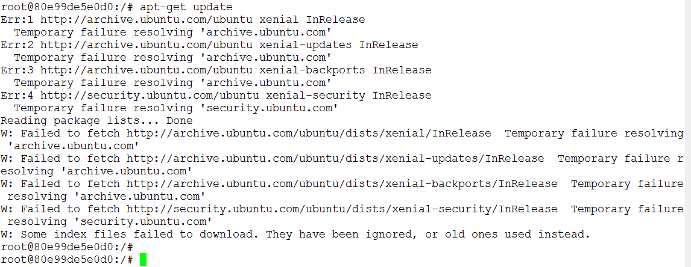
Docker Networking
Once way to not assign network to docker we can use non network.

Slide 50
Docker Networking
The default bridge network
docker network inspect [network name]

Slide 51
What is Puppet
Puppet is an open-source configuration management tool.
Enforces the define state of the infrastructure
Puppet can automate tasks on thousand of machines
Puppet enables infrastructure as code and DevOps
A framework for system automation
A declarative Domain specific Language (DSL)
An OpenSource software in written Ruby
Developed by puppet Labs

Slide 52
Why use Puppet
Infrastructure as code: Track, Test, Deploy, Reproduce, Scale
Code commits log shows the history of changes on the infrasture
Benefits
Consistency
Efficiency
Availability

Slide 53
Puppet Architecture
HOST 1 [Node 1 ]
Host1
SSL
Config
Config
Puppet Server
HOST 2 [Node 2]
SSL
Host2
Config
Config
Host3
SSL
Config
Config
HOST 3 [Node 3]

Slide 54
yum install puppet
[root@dev ~]# puppet resource user ajay
user { 'ajay':
ensure => 'present',
comment => 'ajay',
gid => '1000',
groups => ['wheel'],
home => '/home/ajay',
password => '$6$sejyEsxs3C2XKAkX$TuGDaXsRBecQjcsStWDFFDTuc0zmeq5DJyyJPKKK0WvvMA/HAIxk3ZWCbi.BwQQIOI.AztpEW.whsgGtFcVrv.',
password_max_age => '99999',
password_min_age => '0',
shell => '/bin/bash',
uid => '1000',
}

Slide 55
[root@dev ~]# puppet resource file /root/ajay
file { '/root/ajay':
ensure => 'file',
content => '{md5}d41d8cd98f00b204e9800998ecf8427e',
ctime => '2017-10-03 15:10:36 +0530',
group => '0',
mode => '644',
mtime => '2017-10-03 15:10:36 +0530',
owner => '0',
type => 'file',
}

Slide 56
[root@dev ~]# more service.pp
service { ‘httpd':
ensure => 'stopped',
enable => 'false',
}
[root@dev ~]# puppet resource service httpd
service { 'httpd':
ensure => 'running',
enable => 'true',
}
[root@dev ~]# puppet resource package httpd
Warning: The package type's allow_virtual parameter will be changing its default value from false to true in a future release. If you do not want to allow virtual packages, please explicitly set allow_virtual to false.
(at /usr/share/ruby/vendor_ruby/puppet/type.rb:816:in `set_default')
package { 'httpd':
ensure => '2.4.6-45.el7.centos.4',
}

Slide 57
[root@dev ~]# systemctl stop httpd
[root@dev ~]# cat service.pp
service { 'httpd':
ensure => 'running',
enable => 'true',
}
[root@dev ~]# puppet apply service.pp
Notice: Compiled catalog for dev in environment production in 0.09 seconds
Notice: /Stage[main]/Main/Service[httpd]/ensure: ensure changed 'stopped' to 'running'
Notice: Finished catalog run in 0.10 seconds
[root@dev ~]# systemctl status httpd
● httpd.service - The Apache HTTP Server
Loaded: loaded (/usr/lib/systemd/system/httpd.service; enabled; vendor preset: disabled)
Active: active (running) since Tue 2017-10-03 15:56:14 IST; 1min 23s ago

Slide 58
[root@dev ~]# puppet resource file /root/test
file { '/root/test':
ensure => 'file',
content => '{md5}24a82a33cf01625c6c961f451645f9ab',
ctime => '2017-03-22 11:09:01 +0530',
group => '0',
mode => '755',
mtime => '2017-03-22 11:09:01 +0530',
owner => '0',
type => 'file',
}

Slide 59
[root@dev ~]# cat file.pp
file { '/root/file1':
ensure => 'file',
type => 'file',
}
[root@dev ~]# puppet apply file.pp
Notice: Compiled catalog for dev in environment production in 0.08 seconds
Error: Parameter type failed on File[/root/file1]: type is read-only at /root/file.pp:4
Wrapped exception:
type is read-only

Slide 60
[root@dev ~]# cat file.pp
file { '/root/file1':
ensure => 'file',
type => 'file',
}
[root@dev ~]# puppet apply file.pp
Notice: Compiled catalog for dev in environment production in 0.08 seconds
Error: Parameter type failed on File[/root/file1]: type is read-only at /root/file.pp:5
Wrapped exception:
type is read-only
##############################################################################

Slide 61
[root@dev ~]# cat file.pp
file { '/root/file1':
ensure => 'file',
owner => '0',
group => '0',
mode => '0644',
}
[root@dev ~]# puppet apply file.pp
Notice: Compiled catalog for dev in environment production in 0.07 seconds
Notice: /Stage[main]/Main/File[/root/file1]/ensure: created
Notice: Finished catalog run in 0.01 seconds

Slide 62
The below command validate the puppet file -> it will check syntax error
[root@dev ~]# cat file.pp
file { '/root/file2':
ensure => 'file',
}
}
[root@dev ~]# puppet parser validate file.pp
Error: Could not parse for environment production: Syntax error at '}' at /root/file.pp:5

Slide 63
[root@dev ~]# cat file.pp
file { '/root/file2':
ensure => 'file',
content => inline_template("created by ajay at <%= Time.now%>\n"),
}
[root@dev ~]# puppet apply file.pp
Notice: Compiled catalog for dev in environment production in 0.07 seconds
Notice: /Stage[main]/Main/File[/root/file2]/content: content changed '{md5}d41d8cd98f00b204e9800998ecf8427e' to '{md5}7e9599225c8ea2dd62f35d4f02dc3189'
Notice: Finished catalog run in 0.02 seconds
[root@dev ~]#
[root@dev ~]# cat file2
created by ajay at 2017-10-04 11:09:49 +0530

Slide 64
[root@dev ~]# cat package.pp
package { 'squid':
ensure => 'installed',
}
[root@dev ~]# puppet apply package.pp
[root@dev ~]# rpm -qa | grep squid
squid-migration-script-3.5.20-10.el7.x86_64
squid-3.5.20-10.el7.x86_64

Slide 65
Installing multiple packages
[root@dev ~]# cat pkg.pp
$pkg = [ 'screen', 'strace', 'sudo' ]
package { $pkg: ensure => 'installed' }

Slide 66
[root@dev ~]# cat ntp.pp
$ntpservice = $osfamily ? {
'redhat' => 'ntpd',
'debian' => 'ntp',
default => 'ntpd',
}
service { $ntpservice:
ensure => 'running',
enable => true,
}
[root@dev ~]# systemctl status ntpd
● ntpd.service - Network Time Service
Loaded: loaded (/usr/lib/systemd/system/ntpd.service; disabled; vendor preset: disabled)
Active: inactive (dead)

Slide 67
[root@dev ~]# puppet apply ntp.pp
Notice: Compiled catalog for dev in environment production in 0.08 seconds
Notice: /Stage[main]/Main/Service[ntpd]/ensure: ensure changed 'stopped' to 'running'
Notice: Finished catalog run in 0.11 seconds
[root@dev ~]# systemctl status ntpd
● ntpd.service - Network Time Service
Loaded: loaded (/usr/lib/systemd/system/ntpd.service; enabled; vendor preset: disabled)
Active: active (running) since Wed 2017-10-04 12:40:40 IST; 2s ago

Slide 68
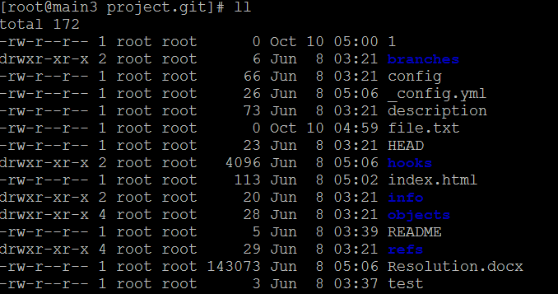
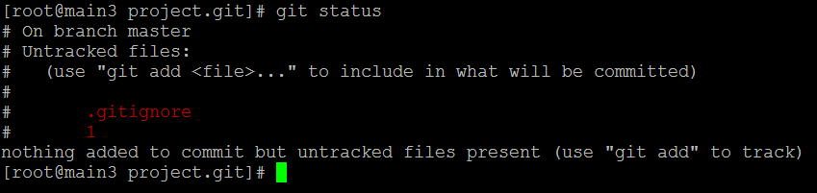
Gitignore
1
2
3

Slide 69



Creating A Branch
How to list the branch
To list the local and remote branch
2) To list only remote branch
3) To list only local branch
Notes:
you’ll want to put these changes into a separate branch to isolate them from changes in master

Slide 70
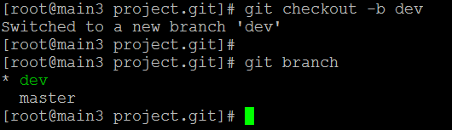
Creating A Branch
The checkout command switch the from one branch to other branch , option –b create the new branch.
Notes:
you’ll want to put these changes into a separate branch to isolate them from changes in master

Slide 71
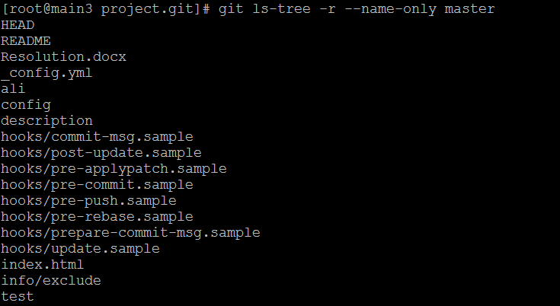

Slide 72
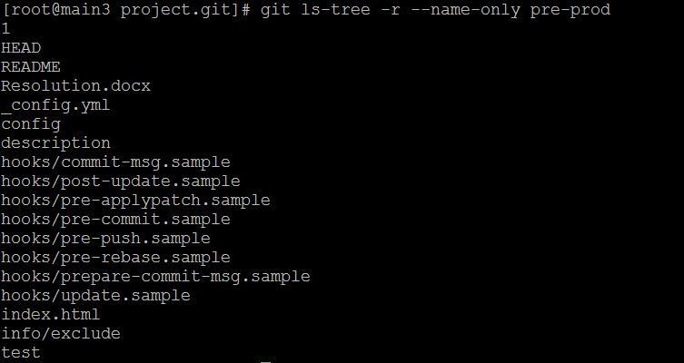

Slide 73



