Slide 1




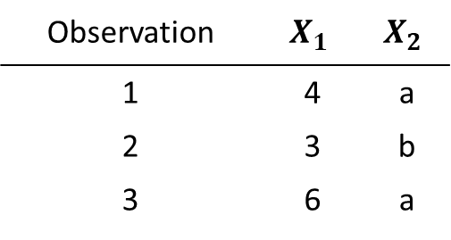


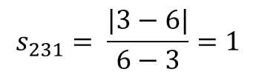

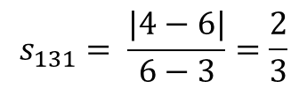

Observation | $$X_{1}$$ | $$X_{2}$$
1 | 4 | a
2 | 3 | b
3 | 6 | a
$w_{k}=1$ for $k∈\{1, 2\}$
$$S_{12}= \frac{\frac{1}{3}+1}{2}=\frac{2}{3}$$
$$s_{121}= \frac{|4−3|}{6−3}=\frac{1}{3}$$
$s_{122}=1$, since a≠b
$$s_{131}= \frac{|4−6|}{6−3}=\frac{2}{3}$$
$$S_{13}= \frac{\frac{2}{3}+0}{2}=\frac{1}{3}$$
$s_{132}=0$, since a=a
$$s_{231}= \frac{|3−6|}{6−3}=1$$
$$S_{23}= \frac{1+1}{2}=1$$
$s_{232}=1$, since b≠a

