Slide 1
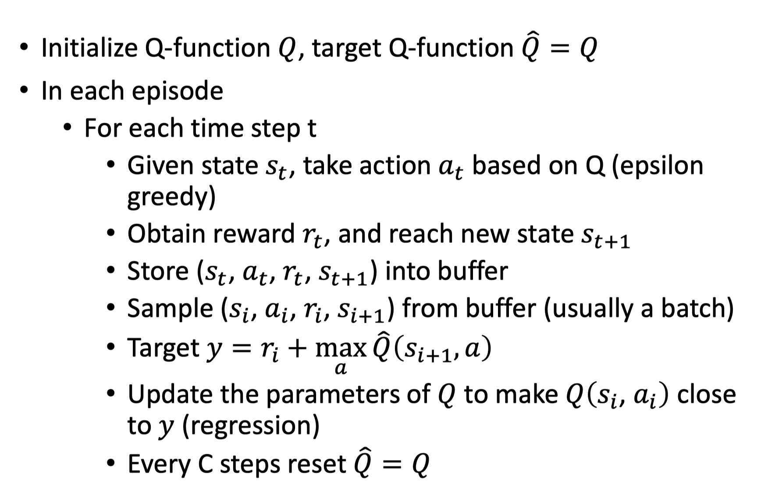
Deep Q-network(DQN) Algorithm

