Slide 1
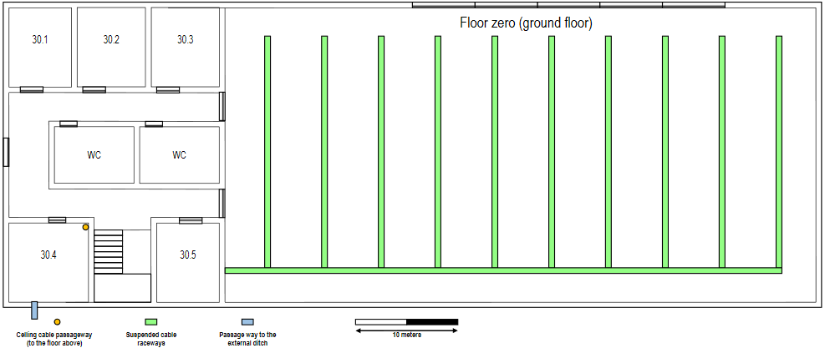
Access Point
Access Point Range
1 Outlet
3 Outlets
Horizontal Cross Conect
Intermediate Cross Conect
Fiber cable
Consolidation Point
2 Outlets
CAT7 (copper cable)

Slide 2
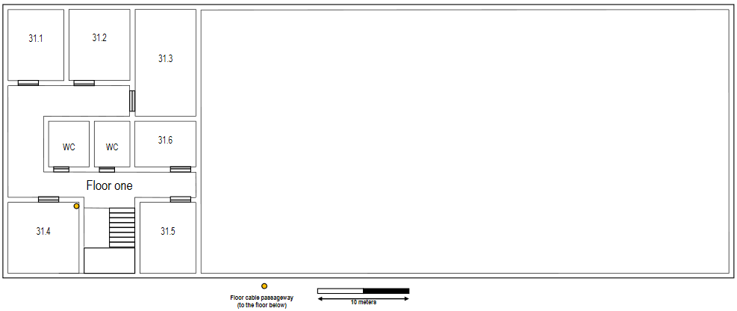
1 Outlet
Horizontal Cross Conect
Access Point
Access Point Range
2 Outlets
CAT7 (copper cable)
Fiber cable
Consolidation Point

