Slide 1
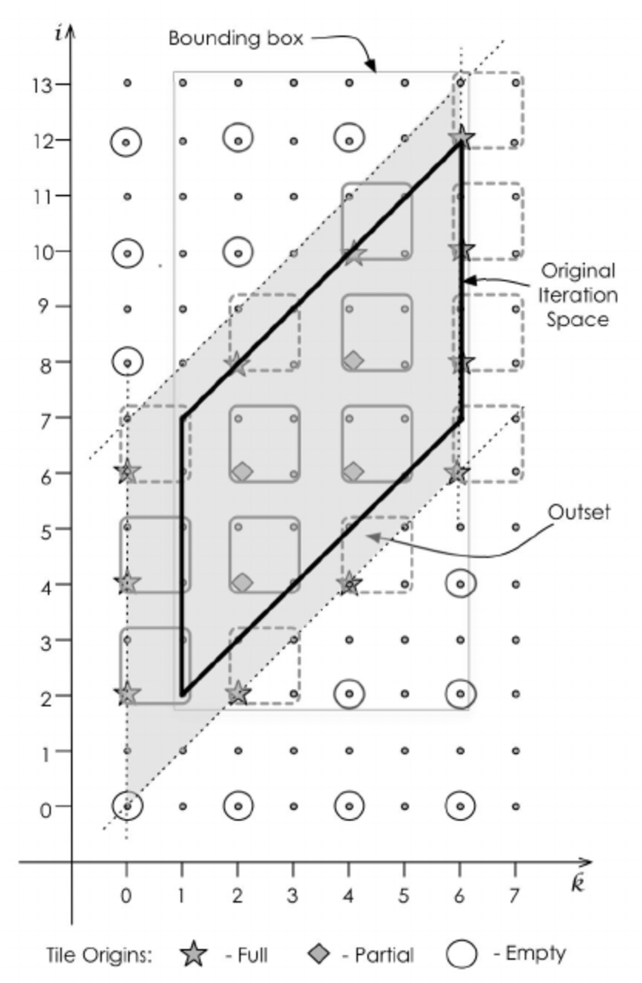
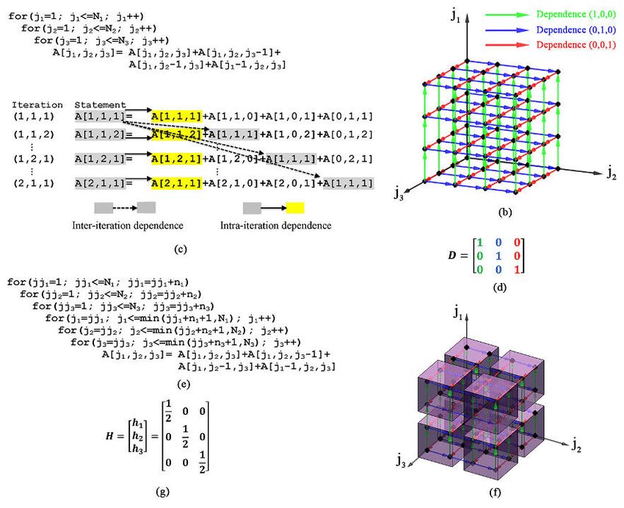
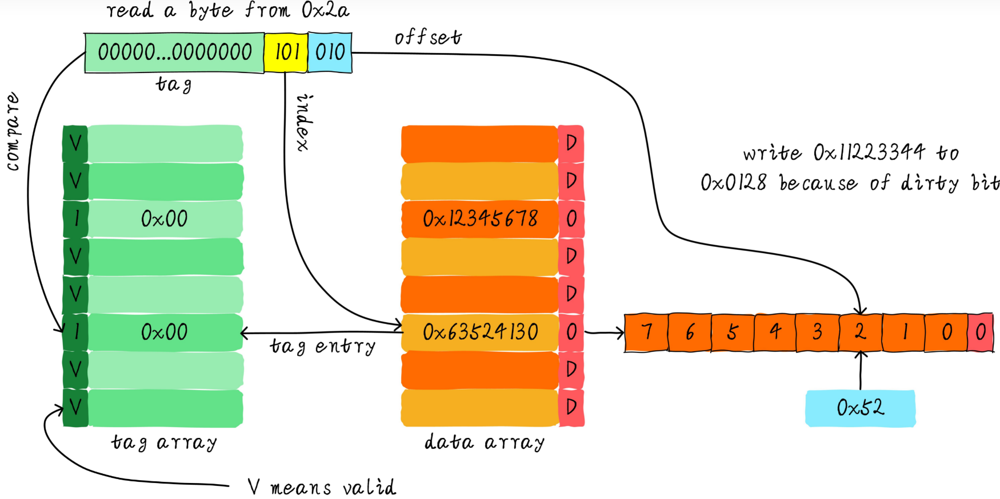
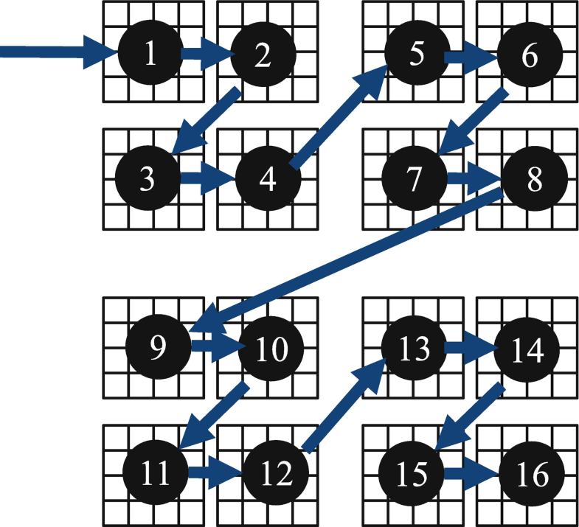
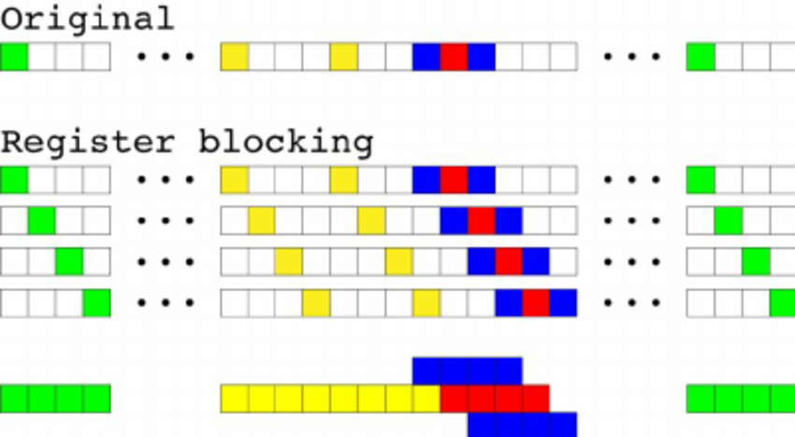
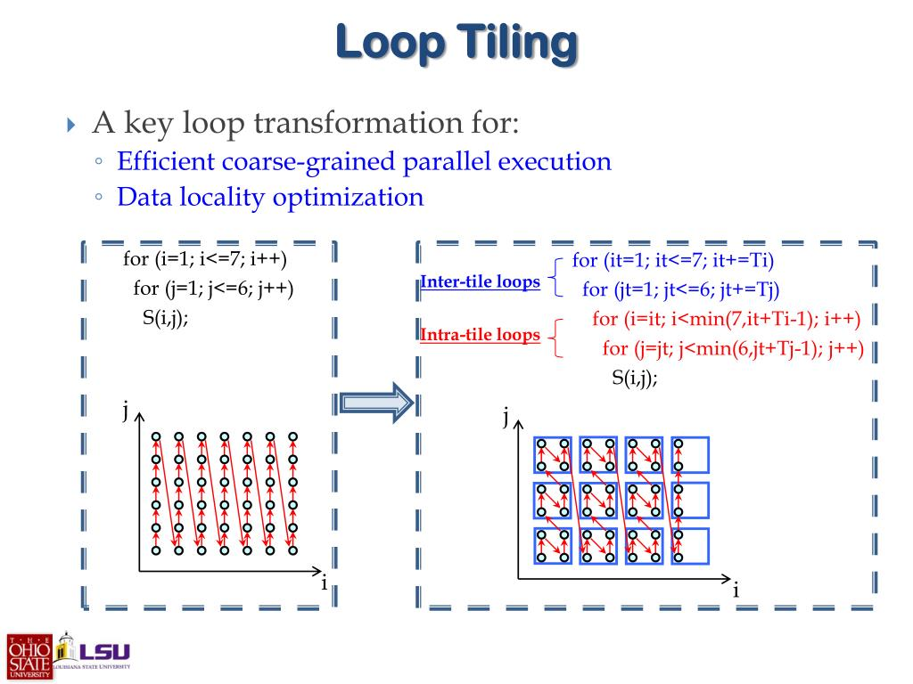
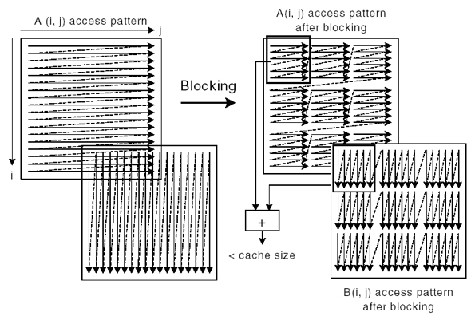
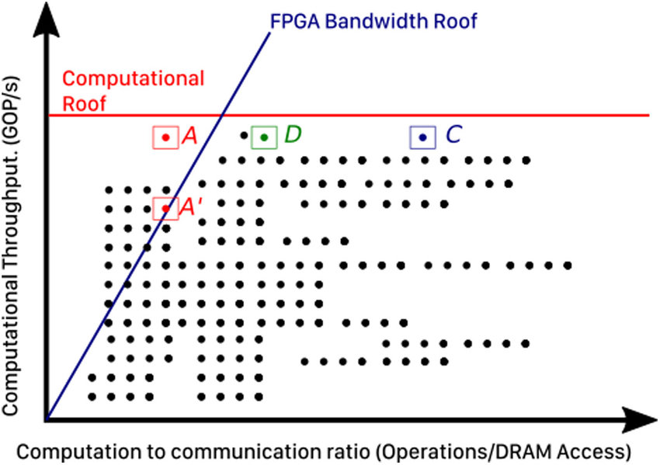
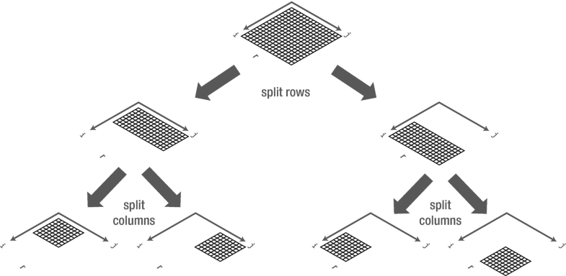
深入浅出访存优化
by 彭于斌（@archibate）
往期录播：https://www.bilibili.com/video/BV1fa411r7zp
课程PPT和代码：https://github.com/parallel101/course

Slide 2
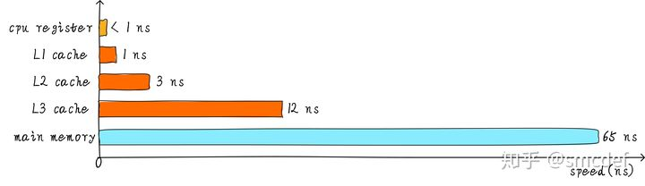
https://lwn.net/Articles/255364/
The trigger for hardware prefetching is usually a sequence of two or more cache misses in a certain pattern. These cache misses can be to succeeding or preceding cache lines. In old implementations only cache misses to adjacent cache lines are recognized. With contemporary hardware, strides are recognized as well, meaning that skipping a fixed number of cache lines is recognized as a pattern and handled appropriately.
It would be bad for performance if every single cache miss triggered a hardware prefetch. Random memory accesses, for instance to global variables, are quite common and the resulting prefetches would mostly waste FSB bandwidth. This is why, to kickstart prefetching, at least two cache misses are needed. Processors today all expect there to be more than one stream of memory accesses. The processor tries to automatically assign each cache miss to such a stream and, if the threshold is reached, start hardware prefetching. CPUs today can keep track of eight to sixteen separate streams for the higher level caches.
The units responsible for the pattern recognition are associated with the respective cache. There can be a prefetch unit for the L1d and L1i caches. There is most probably a prefetch unit for the L2 cache and higher. The L2 and higher prefetch unit is shared with all the other cores and hyper-threads using the same cache. The number of eight to sixteen separate streams therefore is quickly reduced.
Prefetching has one big weakness: it cannot cross page boundaries. The reason should be obvious when one realizes that the CPUs support demand paging. If the prefetcher were allowed to cross page boundaries, the access might trigger an OS event to make the page available. This by itself can be bad, especially for performance. What is worse is that the prefetcher does not know about the semantics of the program or the OS itself. It might therefore prefetch pages which, in real life, never would be requested. That means the prefetcher would run past the end of the memory region the processor accessed in a recognizable pattern before. This is not only possible, it is very likely. If the processor, as a side effect of a prefetch, triggered a request for such a page the OS might even be completely thrown off its tracks if such a request could never otherwise happen.

Slide 3
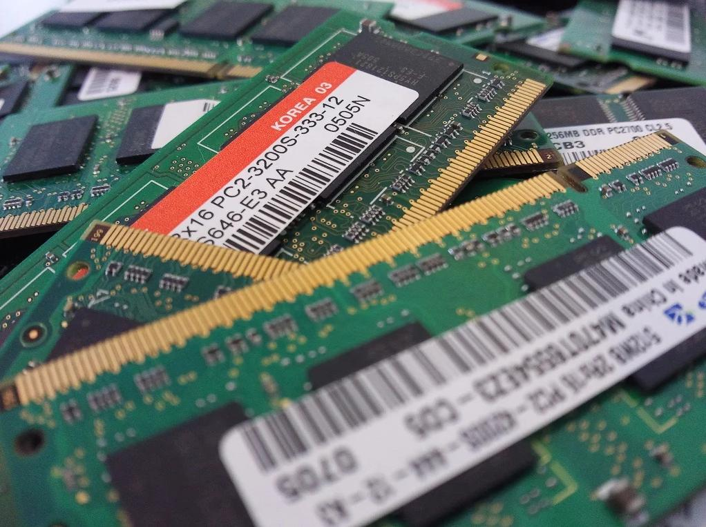
https://link.springer.com/chapter/10.1007%2F978-1-4842-4398-5_16

Slide 4
小彭老师经验公式
对于float类型而言：
1次减法 ≈ 1次加法
1次乘法 ≈ 1次加法
1次除法 ≥ 2次加法
1次读写 ≈ 32次加法（矢量化成功）≈ 4次加法（矢量化失败）
如果循环体内是 a[i] = func(a[i])，那么 func 里要包含16次加法，才能和内存的延迟相抵消。
如果是 a[i] = func(a[i], b[i])，那就是2次读1次写，总共其实是2次访存，那就要32次加法。
如果有8个核心，则需要16*8=128次加法，才能避免内存瓶颈，否则加速比会达不到16。
当然，如果你是AVX，则需要32次加法，AVX512，则需要64次加法！
为什么有人说用了 SIMD 发现没效果，可能是因为他的代码内存瓶颈了，不是计算瓶颈。
就是说：他的 func 里的运算根本没有64次加法那么多，他的计算非常简单，但是内存读写却实实在在。导致CPU大部分时间浪费在等内存延迟，这时候你浮点计算得再快也没有用。

Slide 5
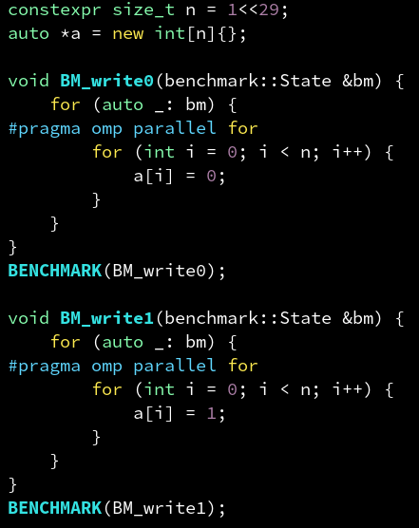

https://www.intel.com/content/www/us/en/docs/intrinsics-guide/index.html
https://www.youtube.com/channel/UCq7dxy_qYNEBcHqQVCbc20w

Slide 6
https://fgiesen.wordpress.com/2009/12/13/decoding-morton-codes/

Slide 7
第1章：内存带宽

Slide 8
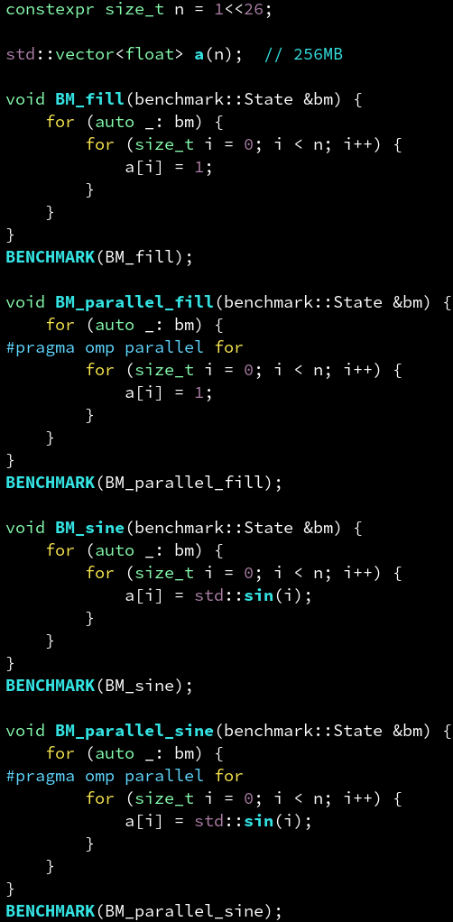
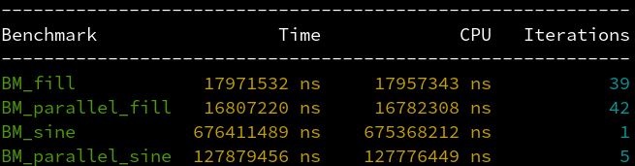
core-bound 与 memory-bound
通常来说，并行只能加速计算的部分，不能加速内存读写的部分。
因此，对 fill 这种没有任何计算量，纯粹只有访存的循环体，并行没有加速效果。称为内存瓶颈（memory-bound）。
而 sine 这种内部需要泰勒展开来计算，每次迭代计算量很大的循环体，并行才有较好的加速效果。称为计算瓶颈（core-bound）。

Slide 9
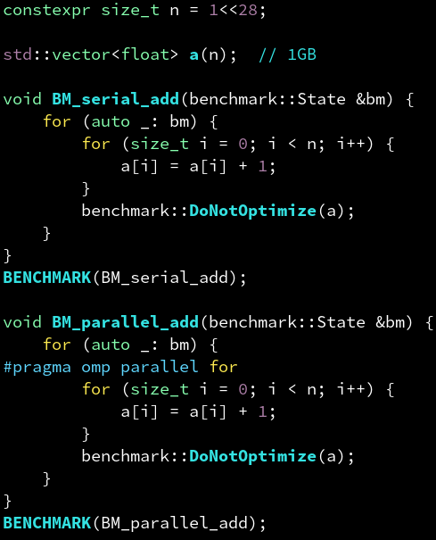
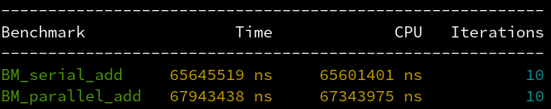
浮点加法的计算量
冷知识：并行地给浮点数组每个元素加 1 反而更慢。
因为一次浮点加法的计算量和访存的超高延迟相比实在太少了。

Slide 10
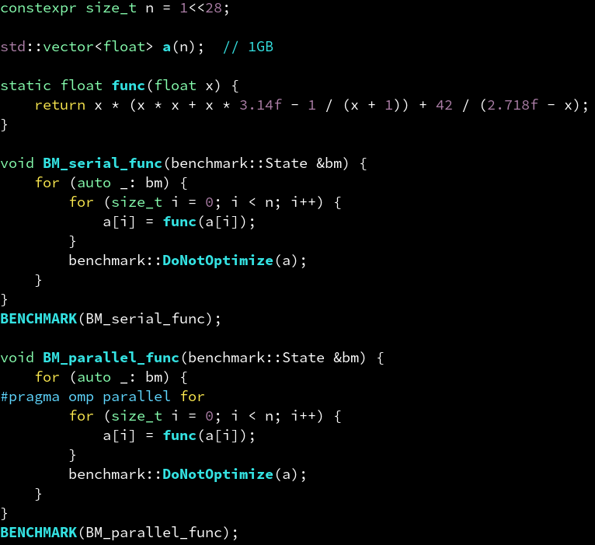
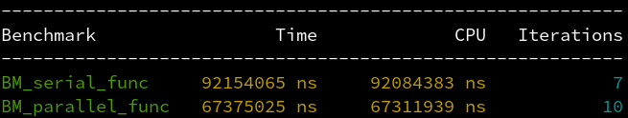
多少计算量才算多？
看右边的 func，够复杂了吧？也只是勉勉强强超过一点内存的延迟了，但在6个物理核心上并行加速后，还是变成mem-bound了。加速比：1.36 倍
达到 6 倍才算 100% 的 core-bound，理想加速比；达到 3 倍则可以认为是 50% core-bound 和 50% mem-bound。

Slide 11


加速曲线
是

