Slide 1


Credit Card Fraud Detection using Machine Learning
ECE 537- Data Mining
Group Members:
Mansi Rajput
Pooja Shrikisan Gurav

Slide 2
Agenda
Group members and responsibilities​
Introduction​
Dataset Description​
Methods and Algorithms
Data Preprocessing and Handling Imbalanced data
Data Analysis
Methodology​
Model Training and Tuning​
Results- Decision Tree, SVM, KNN, Logistic Regression
Conclusion

Slide 3
Group Members and Responsibilities​
Mansi Rajput:
Developed K-Nearest Neighbour (KNN) and Logistic Regression models, performed exploratory data analysis (EDA), dataset preprocessing, and documentation.
Pooja Shrikisan Gurav:
Developed Decision Tree and Support Vector Machine (SVM) models, visualized results using confusion matrices and ROC curves, and contributed to the final report documentation.

Slide 4
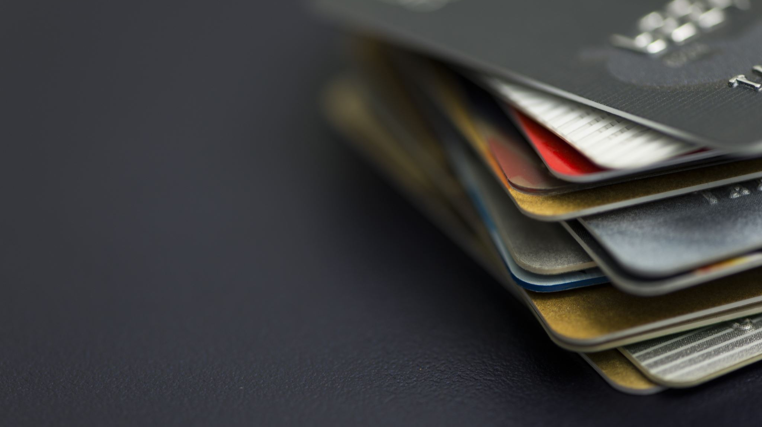
Introduction
Problem statement: The increasing prevalence of credit card fraud in the digital era necessitates the development of robust and efficient fraud detection systems. This project aims to develop a machine-learning model to detect credit card fraud. The model will be trained on a dataset of historical credit card transactions and evaluated on a holdout dataset of unseen transactions.
Challenge: Traditional rule-based systems struggle to detect evolving fraudulent behavior.
Project Goal: The main aim of this project is the detection of fraudulent credit card transactions, as it is essential to figure out the fraudulent transactions so that customers do not get charged for the purchase of products that they did not buy.
Research question: What machine learning model is most suited for detecting fraudulent credit card transactions?

Slide 5

Dataset Description
Data Description: The dataset was retrieved from an open-source website, Kaggle.com. It con- tains data on transactions made in 2013 by European credit card users in two days only. The dataset consists of 31 attributes and 284,808 rows.
Twenty-eight attributes are numeric variables that, due to the confidentiality and privacy of the customers.
Time: which contains the elapsed seconds between the first and other transactions of each Attribute.
Amount : Which is the amount of each transaction
Class : which contains binary variables where 1 is a case of fraudulent transaction, and 0 is not as case of fraudulent transaction.
Dataset : https://www.kaggle.com/datasets/mlg-ulb/creditcardfraud

Slide 6
Methods & Algorithms
Support Vector Machine (SVM)
Type: Margin-based binary classifier
Kernels: Linear & RBF (non-linear mapping)
Tuning: Hyperparameters C and gamma
Strength: Effective in high-dimensional spaces
Limitation: Computationally intensive
K-Nearest Neighbors (KNN)
Type: Non-parametric, instance-based
Distance Metric: Euclidean
Preprocessing: Min-Max Normalization (0–1)
Tuning: Optimal k chosen by evaluating values from 1–39
Limitation: Computational cost & curse of dimensionality
Logistic Regression:
Type: Linear binary classifier using sigmoid function
Preprocessing:
Dropped Time feature
Standardized Amount using z-score
Regularization: L2 with ‘lbfgs’ solver
Strength: Simple, interpretable
Limitation: Struggles with non-linear patterns
Decision Tree Classifier
Type: Tree-structured model using entropy
Features:
No pruning (fixed random_state=0)
Handles imbalance via preprocessing
Visualization: plot_tree() for interpretability

Slide 7
Data Preprocessing and Handling Imbalanced Data
Dataset: Kaggle credit card transaction dataset.
Steps:
Conducted Exploratory Data Analysis (EDA) to examine feature distributions and identify class imbalance.
Removed irrelevant features such as Time.
Normalized Amount feature and dropped the original column.
Applied z-score normalization using standardScaler to standardize features across all models
80/20 train-test split.
Handling Imbalanced Data
No explicit resampling techniques (e.g., SMOTE) or class balancing within model parameters were used.
Class imbalance was identified and analyzed during EDA and model evaluation
Evaluation metrics (e.g., precision, recall, F1-score) were interpreted with imbalance in mind.
Note: While SMOTE is commonly used for oversampling, it was not applied in this implementation. Instead, model evaluation focused on precision/recall to account for class skew.

Slide 8
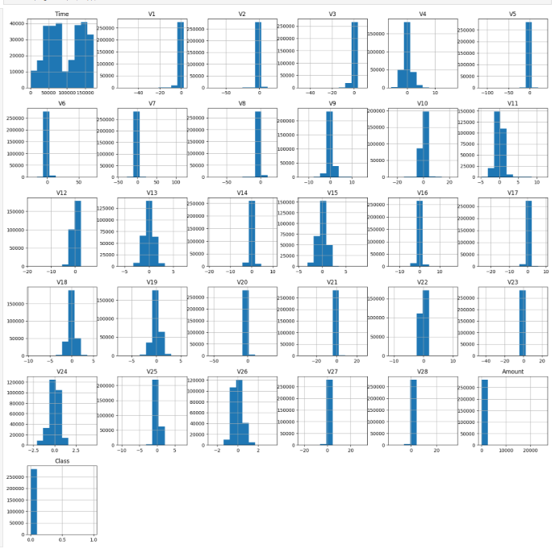
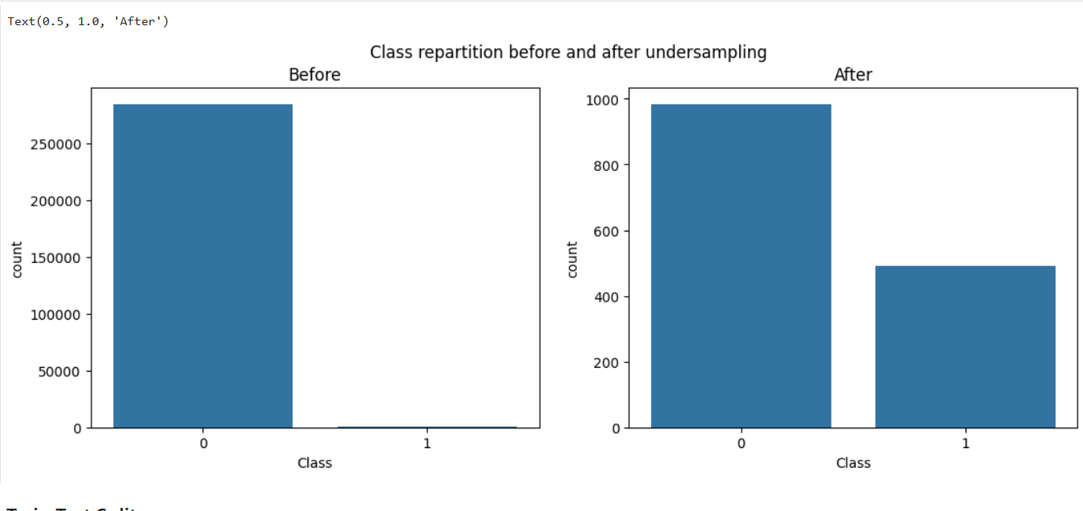
DATA ANALYSIS

Slide 9
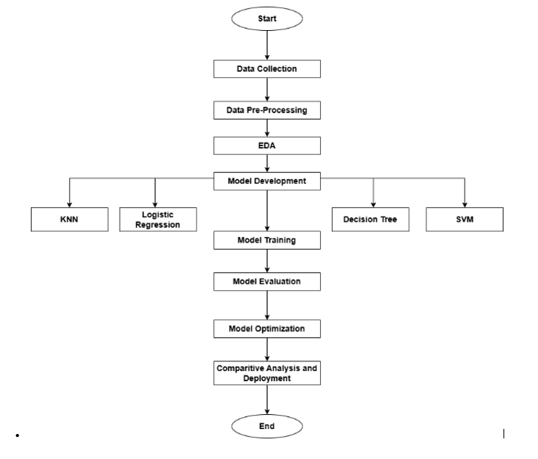
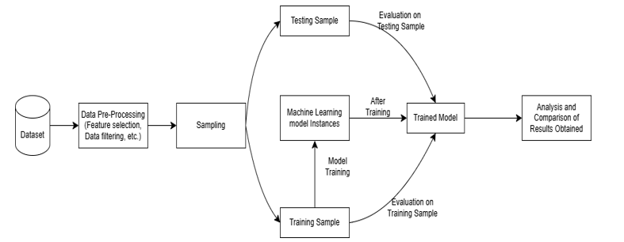
Methodology

Slide 10
Model Training & Tuning
Cross-validation: 5-fold cross-validation.
Hyperparameter tuning: GridSearchCV for KNN, SVM, and Decision Tree.
Model Evaluations: Accuracy, Precision, Recall, F1-Score, ROC-AUC.
Model Evaluation Metrics
Accuracy: Overall model correctness.
Precision: How many predicted fraud cases are actually fraud.
Recall: How many actual fraud cases were detected.
F1-Score: Balance between precision and recall.
ROC-AUC: Model's ability to distinguish between classes.

Slide 11
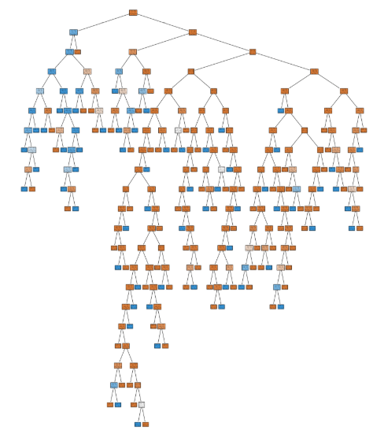
Results – Decision Tree

Slide 12
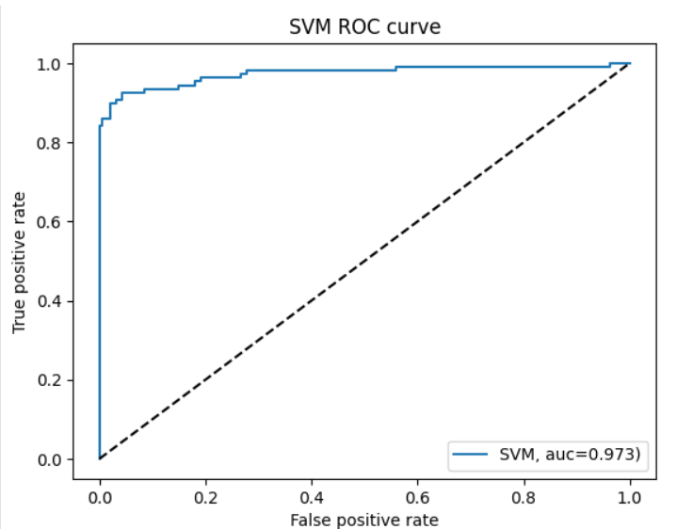
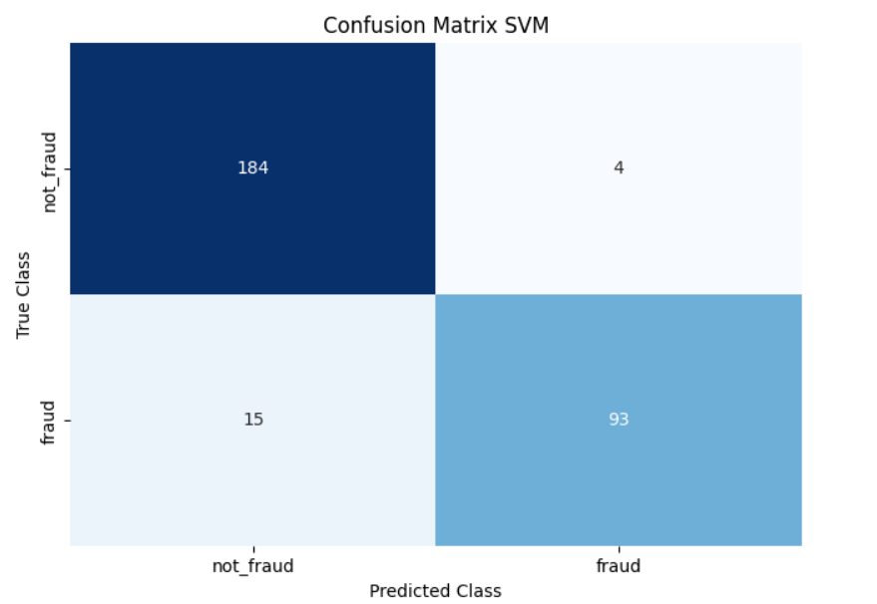
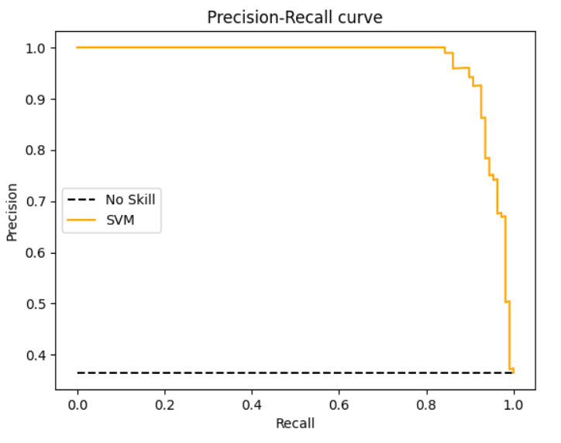
Results – Support Vector Machine

Slide 13
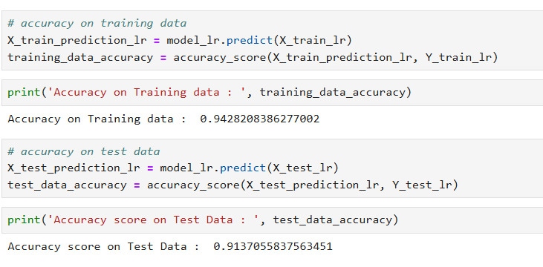
Results – Logistic Regression
Logistic Regression (L.R.): The last model created using Jupiter Notebook is Logistic Regression; the model managed to score an Accuracy on Training data of 94.28%, while it scored an Accuracy score on Test Data of 91.37%, as presented in the below Figure.

Slide 14
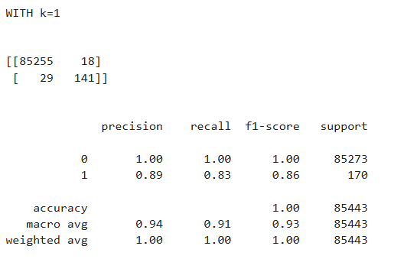
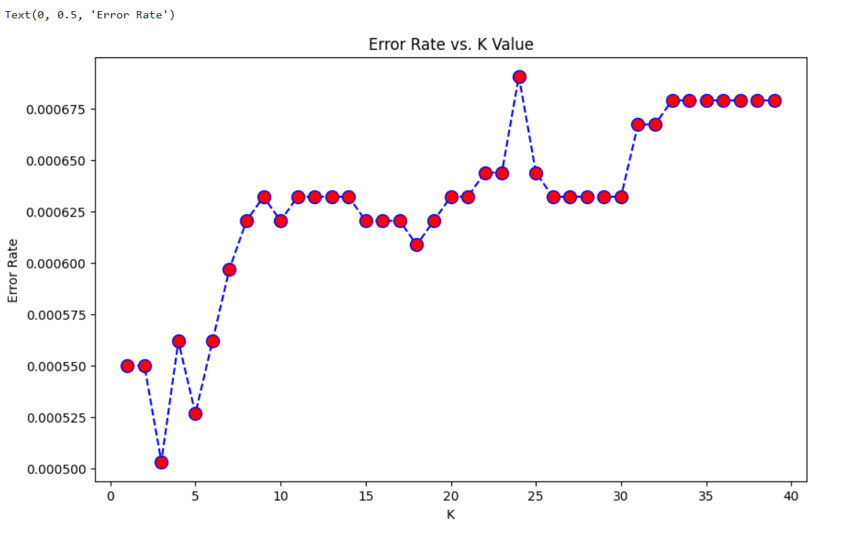
Results – K-Nearest Neighbor (KNN):

Slide 15
Model Training & Tuning
Model | Accuracy | Precision | Recall | F1-Score | ROC-AUC
KNN | 99.94% | 88.67% | 82.94% | 85.71% | 93.5%
Logistic Regression | 91.37% | 93.54% | 88.77% | 91.09% | 95.1%
Decision Tree | 99.91% | 74.28% | 75.91% | 75.09% | 96.8%
SVM (RBF Kernel) | 93.58% | 95.87% | 86.11% | 90.73% | 97.3%
Best Model: SVM (RBF kernel) had the highest precision and strong recall.
Key Findings:
SVM: Best overall performance, perfect precision, and high recall.
Decision Tree: Fast and interpretable, though performance is lower.
KNN: High accuracy but struggles with recall.
Logistic Regression: Reliable baseline with good precision and recall.

Slide 16
Challenges and Model Visualizations
Challenges:
Class Imbalance: Imbalance was analyzed and considered during evaluation, but SMOTE or class weighting was not applied.
Training Time: SVM and KNN were computationally intensive, especially due to kernel computations (SVM) and distance calculations (KNN).
Hyperparameter Tuning: Manual tuning was only performed for KNN by evaluating error rates for multiple values of k.
SVM and Decision Tree were used with default settings due to computational constraints.
Model Visualizations:
Confusion Matrices: Highlight false positive vs false negative trade-offs across all models.
ROC Curves: Visualized for SVM and Decision Tree to demonstrate classifier performance.
Decision Boundaries: Depict how each model separates fraudulent and legitimate transactions, especially helpful for interpreting SVM and Decision Tree behavior.

Slide 17
Conclusion
This project demonstrated the effectiveness of multiple supervised learning models in detecting credit card fraud, with each model offering unique strengths. Standardizing features notably improved model performance, especially for KNN and SVM. Despite challenges like class imbalance and computational costs, the evaluation highlighted critical trade-offs between accuracy, interpretability, and efficiency, guiding informed model selection for fraud detection tasks.

Slide 18
Drive link
All the documents are uploaded in the below mentioned drive link:
https://drive.google.com/drive/folders/10yinkm8xosTdw5_lkjCO78gFx1rFMwfr?usp=drive_link

Slide 19
Thank You

