Slide 1
CASA-Crowd: A Context-Aware Scale Aggregation CNN-Based Crowd Counting Technique
AUTHORS :
NAVEED ILYAS 1
ASHFAQ AHMAD 2 , (Student Member, IEEE),
AND KISEON KIM 1 , (Senior Member, IEEE)
1School of Electrical Engineering and Computer Science, Gwangju Institute of Science and Technology (GIST), Gwangju 61005, South Korea 2School of Electrical Engineering and Computing, The University of Newcastle, Callaghan, NSW 2308, Australia
Published on: 17th December, 2019

Slide 2
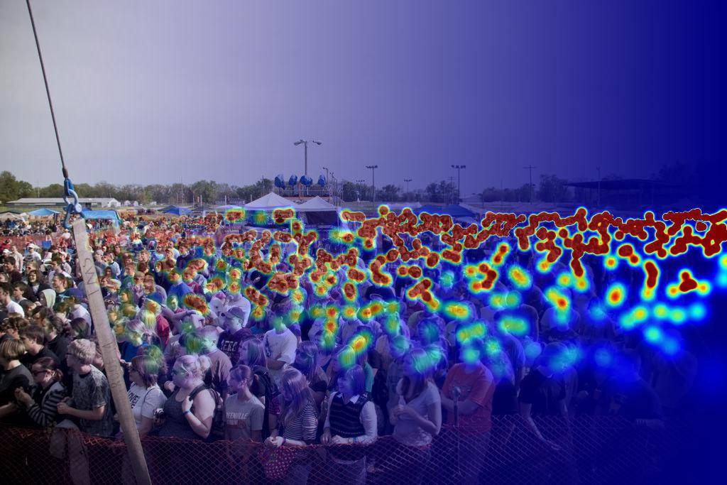
PROBLEM STATEMENT and objective
Detection, tracking and counting in low resolution images
and surveillance videos, where people are represented by
only few pixels tall, are issues that yet demand more investigation.
Nonetheless it is very challenging to accurately
obtain the count due to severe occlusion, clutter,
irregular object distribution and non-uniform object scale ,
it is possible to solve this problem with the boost of
Convolutional Neural Network(CNN).

Slide 3
DATASET DESCRIPTION
THE DATASET CONTAINS TWO PARTS-
SHANGHAITECH PART A- 482 IMAGES: 300 TRAIN IMAGE AND 182 TEST IMAGE.
SHANGHAITECH PART B- 716 IMAGES: 400 TRAIN IMAGE AND 316 TEST IMAGE.
WE HAVE USED SHANGHAITECH PART A DATASET WHILE TRAINING OUR MODEL.
DATASET CONTAINS–
Images: the jpg image file.
ground-truth: .mat format contain annotated head (coordinate x, y).
ground-truth-h5: people density map.
SOURCE – https://www.kaggle.com/tthien/shanghaitech-with-people-density-map

Slide 4
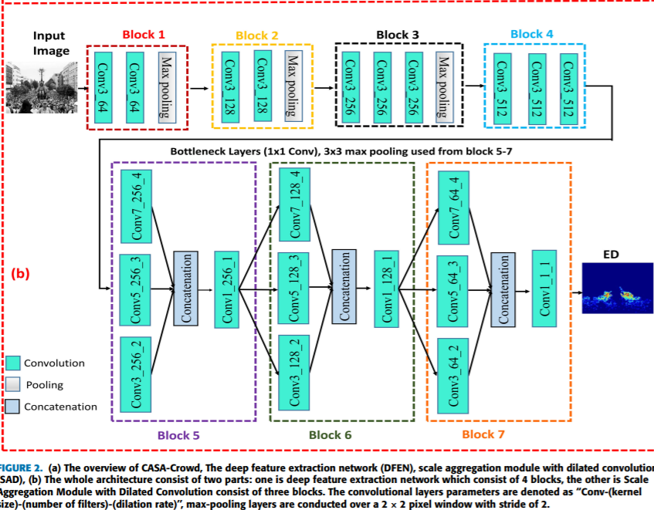
MODEL AND ARCHITECTURE
THE LAYERS SHOWN IN THE PICTURE ARE USED TO MAKE A MODEL.
VGG-16 MODEL IS ALSO DEPLOYED FURTHER TO INCREASE ACCURACY.

Slide 5
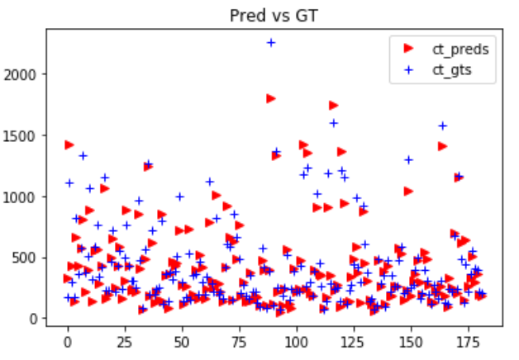
RESULTS OBTAINED
IN THIS IMAGE WE CAN SEE THE GROUND TRUTH AND OUR PREDICTED VALUES OF CROWD COUNTING.

Slide 6
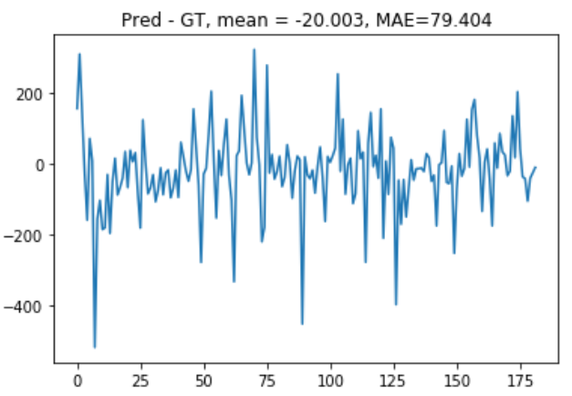
RESULTS OBTAINED
IN THIS IMAGE WE HAVE TRIED TO SHOW THE ACTUAL ERROR BETWEEN GROUND TRUTH AND PREDICTED VALUE WHERE WE CALCULATED THE DIFFERENCE BETWEEN THE GROUND TRUTH AND OUT PREDICTED VALUE OF COUNT AND PLOTTED ON THE GRAPH THAT CAN BE SEEN.

Slide 7
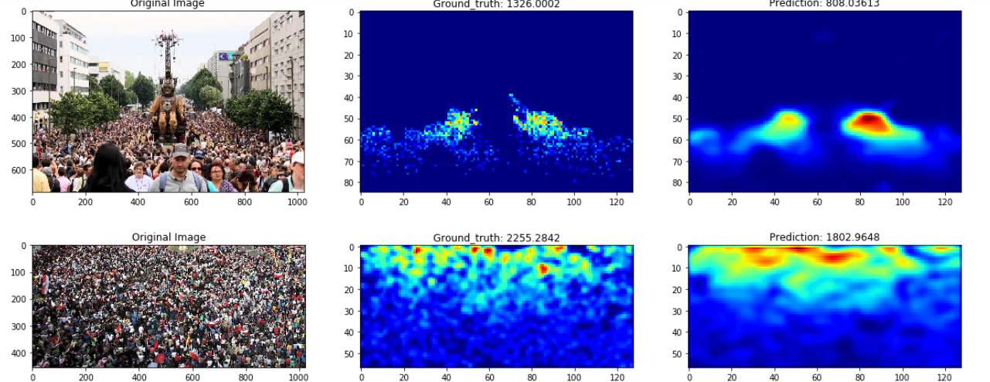
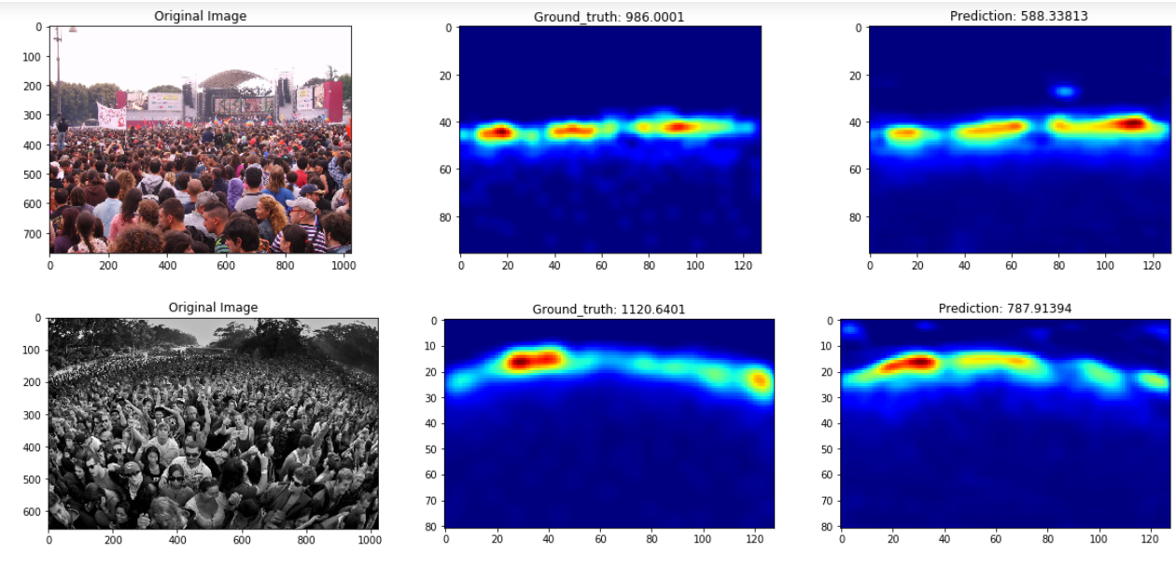
RESULTS OBTAINED
THIS IMAGE IS OF THE FIVE WORST CASE
SAMPLES OUT OF ALL THE IMAGES THAT HAVE
WORKED ON.
OUR PREDICTED VALUES, MAE – 79.4
RMSE – 117.36
THE VALUES IN THE PAPER, MAE – 58.6
RMSE – 97.8

Slide 8
TEAM NAME:g55
DEVANSH JAIN- 1806174
YASH VARGANTWAR- 1806173
ABHISHEK KUMAR- 1806107

