Slide 1
PetsWorld
Submitted TO
Miriam Thomas
Submitted By
Aravind A S
Roll no:16
Notes:
pets

Slide 2
CONTENT
1 . Abstract
2 . Existing System
3 . Proposed System
4 . Objective
5 . Module
6 . Design
7 . Conclusion
8 . Reference

Slide 3
Abstract
“PetsWorld"is a visionary e-commerce platform devoted to meeting the diverse needs of pet owners.
PetsWorld stands out as an all-encompassing destination, offering a vast array of pet products, including food, accessories, and medicines.
Going beyond conventional e-commerce, PetsWorld features a dedicated blog section providing valuable insights into pet care.
With a streamlined mechanism for customer feedback and complaints, PetsWorld ensures an interactive and customer-centric approach.
Additionally, the platform introduces a caretaker service, catering to the needs of pet owners with busy schedules.

Slide 4
Existing System
Disadvantages:
Limited availability of products.
Inconvenient search for specific pet items.
Lack of centralized information and resources for pet care.
Lack of Information
No Caretaker Services
As we acknowledge these limitations, the need for a modern and comprehensive solution becomes evident. Enter PetsWorld, your new and improved pet paradise.
Pet owners typically rely on local brick-and-mortar stores for their pet-related needs.
Limited product selection often results in inconvenience for pet owners seeking specific items.
Information on pet care is scattered, making it challenging for owners to access comprehensive resources.

Slide 5
Proposed System
Advantages
Convenience at your fingertips with 24/7 accessibility.
An extensive product range catering to all your pet's needs.
A centralized information hub through blogs, ensuring well-informed pet care.
PetsWorld is poised to redefine the pet ownership experience, addressing the limitations of the offline system and delivering an unparalleled, holistic solution for all pet-related requirements.
PetsWorld is not just an e-commerce platform; it's a revolutionary solution for pet owners.
Comprehensive e-commerce features covering pet products, food, accessories, and medicine.
A centralized hub offering a seamless shopping experience and a wealth of information for pet care.

Slide 6
Objective
Provide a convenient platform for pet-related purchases.
Offer a wide array of pet products.
Share valuable pet care information through blogs.
Facilitate customer feedback and complaints.
Introduce caretaker services for pet owners.
Secure Transactions
24/7 Availability
Global Accessibility
Comprehensive Information
Convenience and Accessibility

Slide 7
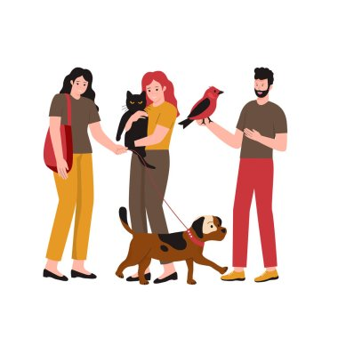
Modules
In this system contain 2 module thats are
User
Admin

Slide 8

User
Register and Login
View product and category list
Add to cart
Manage Address and Payments
Manage Order details
View pets care related videos or blogs
Manage user profile
Manage caretaker service
Send complaints / feedback

Slide 9
Admin
Login
Manage category
Manage product
Manage order
Manage payment
Manage caretaker services
Manage blogs
Manage banners
Manage user feedback / complaints

Slide 10
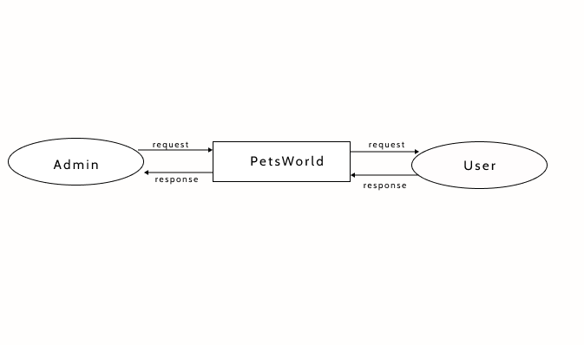
DFD : Context Diagram

Slide 11
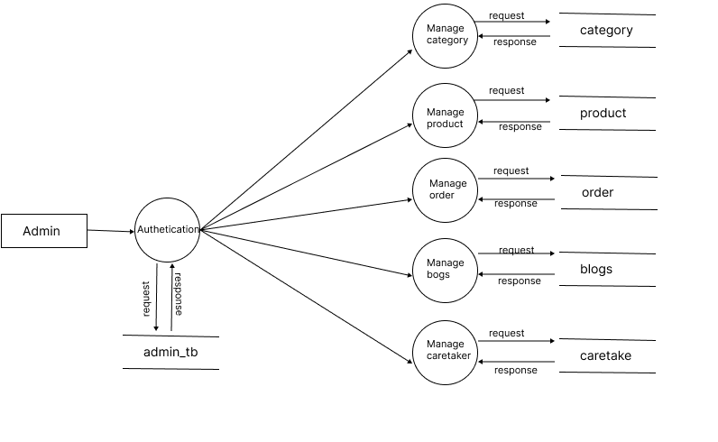
Level - 1

Slide 12
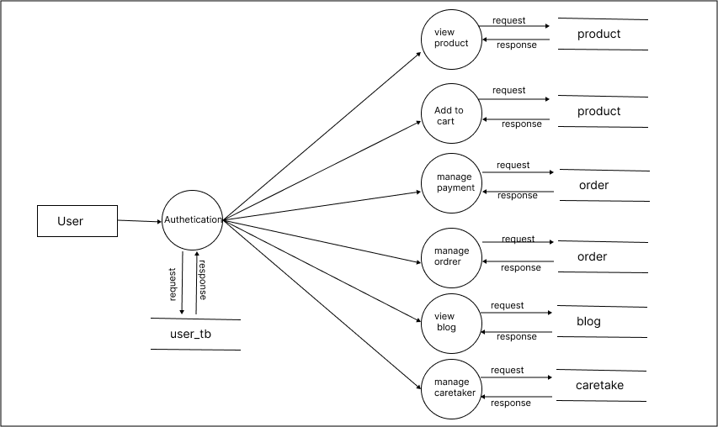
Level - 1.1

Slide 13
Conclusion
In conclusion, PetsWorld is not just an e-commerce platform; it's a commitment to enhancing the pet owner's journey.
By addressing the limitations of the offline system, PetsWorld strives to provide unparalleled convenience, a diverse product range, and a wealth of information in one centralized hub.
As we embark on this journey, we envision PetsWorld becoming the go-to platform for every pet enthusiast, ensuring a seamless and delightful experience for both pets and their owners.
Join us in shaping the future of pet care — where PetsWorld truly becomes Your One-Stop Pet Paradise.

Slide 14
References

