Slide 1
BOOK LIBRARY(Asp.net WEB APPLICATION)

Slide 2
WELCOME

Slide 3
What are we doing in the project?
Design a web application that can handle and manage the activities the CRUD(Create, Read, Update, and Delete) for the administrator to easily handle the library activities in an efficient and reliable way.
Develop a system that can replace a manual library managing system.
Develop a database which contains book details and admin details.
Administrators or Librarians should have logins
Create an attractive, easy to understand, and user-friendly interface.
Reducing time of manual work.
Reducing human error and redundancy in the database

Slide 4
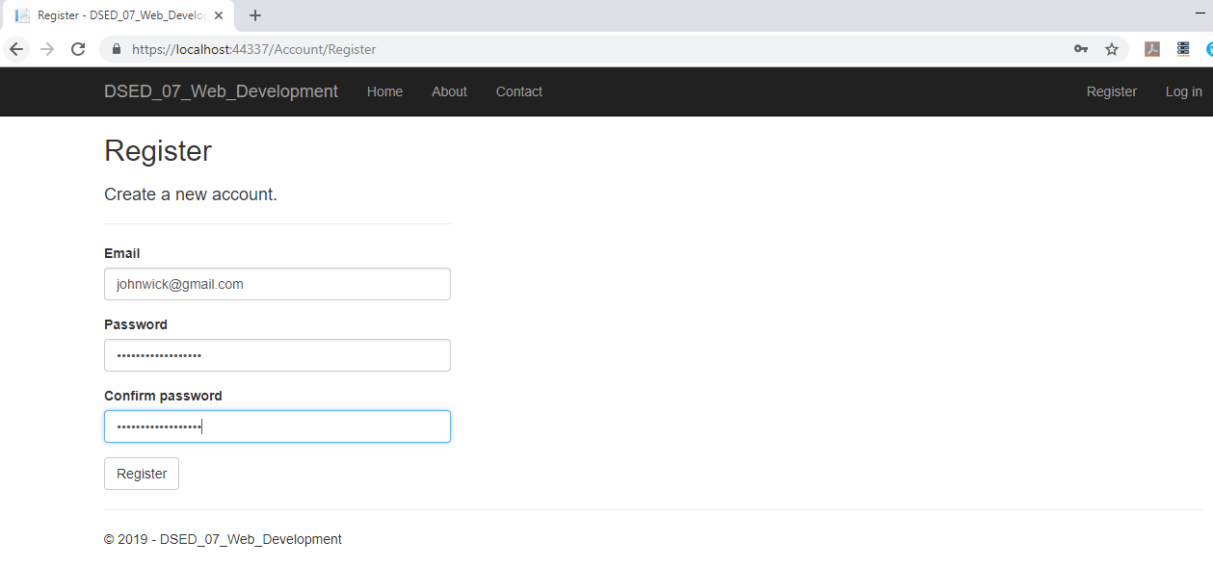
Working of the project through screenshots:-
Admin registration page

Slide 5
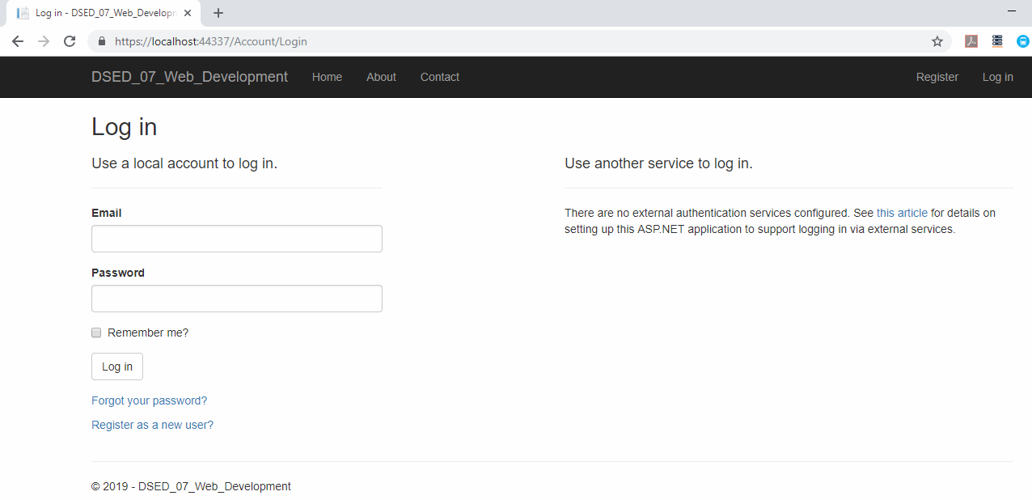
Admin login page

Slide 6
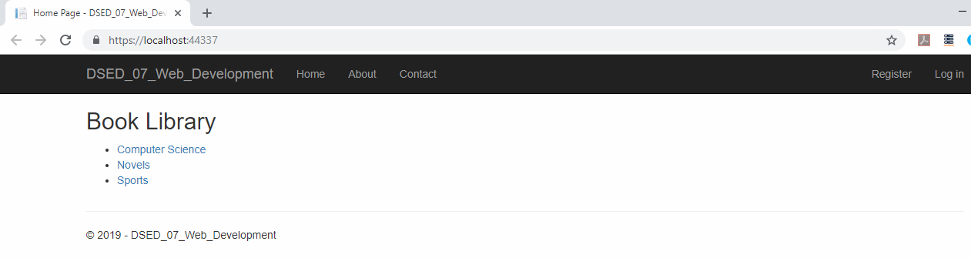
Book library database

Slide 7
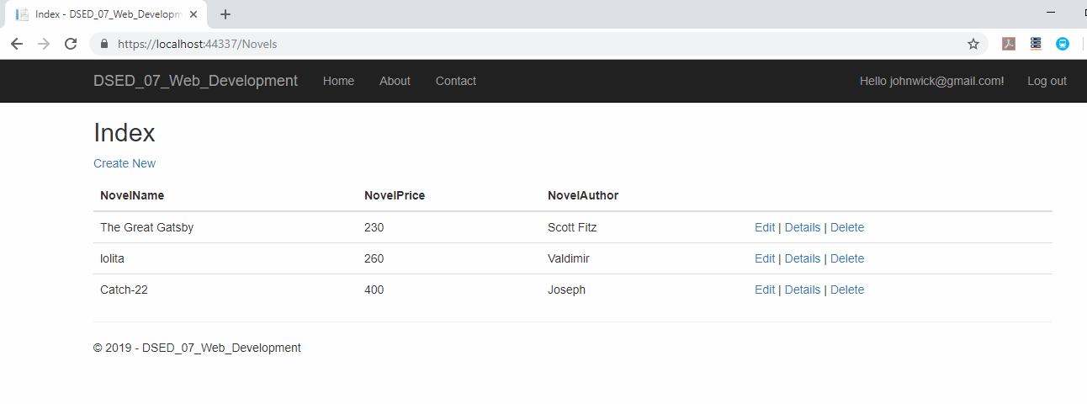
Opening Novel table

Slide 8
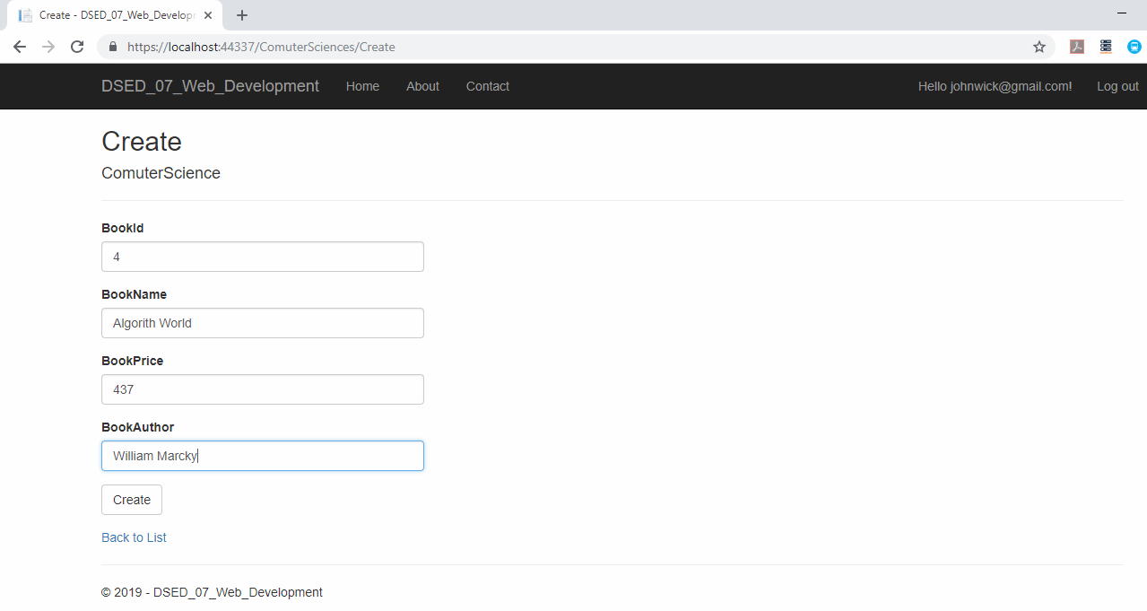
Performing create new action

Slide 9
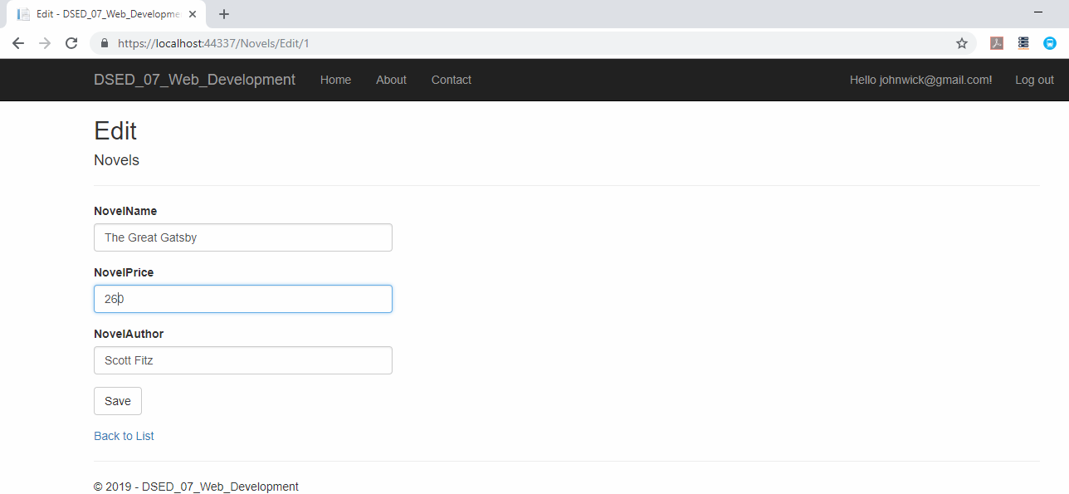
Performing edit action

Slide 10
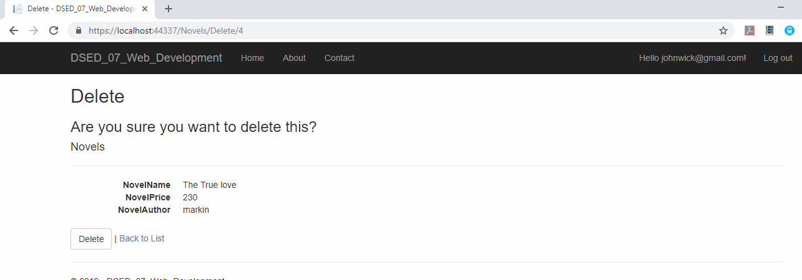
Performing delete action

Slide 11
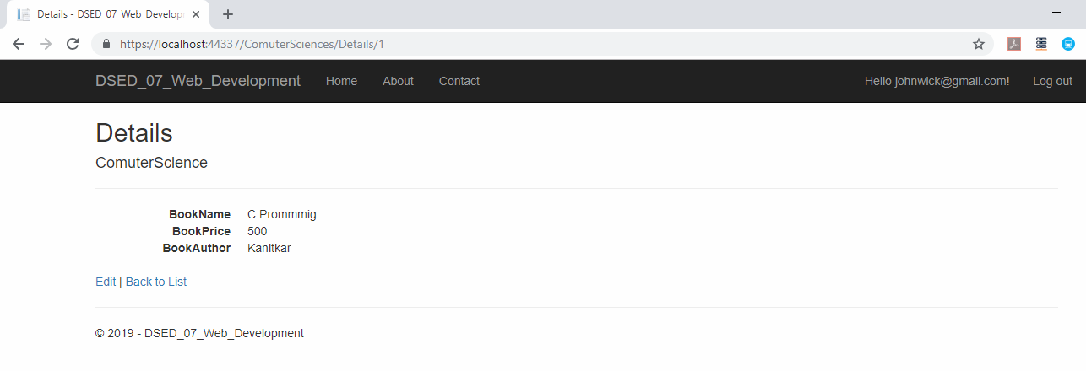
Showing details of book

Slide 12
THANK YOU

