Slide 1

MINOR PROJECT 2022-2023
Project under Supervision of Dr. Ashish Mishra

Slide 2
Dhairya Sachdeva 20103098 Ananya Kapoor 20103104 Sparsh Celly 20103102
Real Time Sign Language Recognition
using
Nvidia Jetson Nano

Slide 3
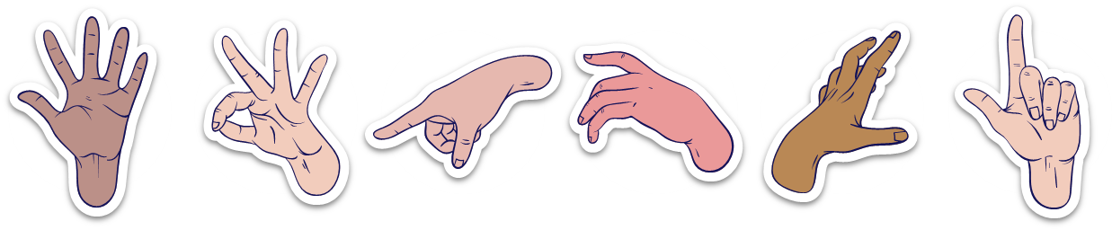
Problem Statement: Many people in India are speech and/or hearing impaired, and they thus use hand gestures to communicate with other people. However, apart from a handful number of people, not everyone is aware of this sign language and they may require an interpreter which can be inconvenient and expensive. A World Health Organization report says around 63 million people in India suffer from either complete or partial deafness, and of these, at least 50 lakh are children.

Slide 4
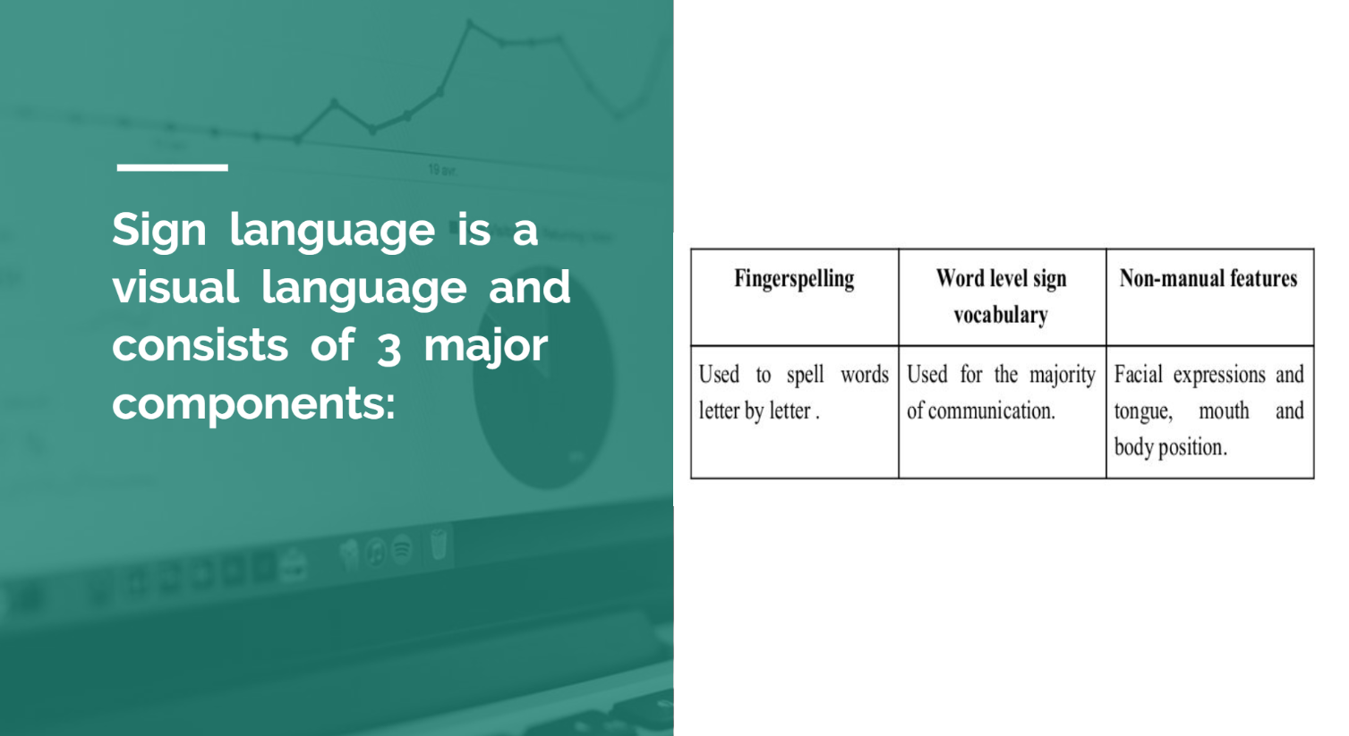

Slide 5
Objectives: 1. To build a product that enables the DEAF and DUMB people to communicate with other people who do not understand Sign Language. 2. To remove the existing communication barrier. 3. To allow fluent communication of the dumb and deaf people in various public services like Railway stations, Airports, etc. 4. To deploy our product in the real world.

Slide 6
Create and train a Machine Learning model
Load the model on the Jetson Nano
Collecting and preprocessing data
Take real time input video through the web camera
Setup and deploy our edge computing device
Pass the video frames as images through our model
Display the real time text output

Slide 7
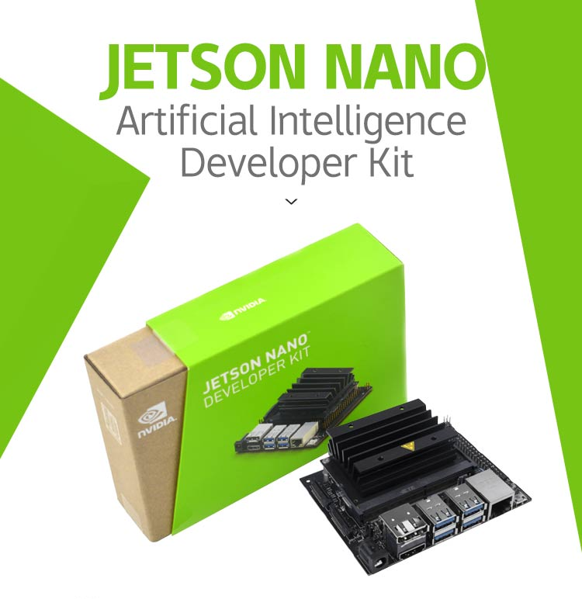
Jetson Nano Kit
NVIDIA® Jetson Nano™ Developer Kit is a small, powerful computer that lets you run multiple neural networks in parallel for applications like image classification, object detection, segmentation, and speech processing. All in an easy-to-use platform that runs in as little as 5 watts. JetPack is compatible with NVIDIA’s world-leading AI platform for training and deploying AI software, reducing complexity and effort for developers.

