Slide 1

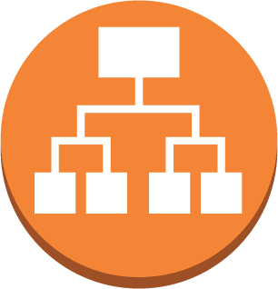

Client application makes a request to the load balancer
Port: 80
Load balancer round-robin distributes requests across all available ports and instances registered in the application’s target group
Application Target Group
Target group is updated by EC2 Container Service to always have an up to date list of all the service containers in the cluster and what port they are accessible on
34763
Each container has a single application process which is bound to port 8080 within its namespace. However in reality all the containers are exposed on a different randomly assigned ports on the host
8080
The architecture is containerized but still monolithic because each container has all the same features of the rest of the containers

Slide 2
Client application makes a request to the load balancer
The application load balancer inspects the client request and based on routing rules directs the request to an instance and port from the target group that matches the rule
Port: 80
Match: /
Match:
/owner/*
Match:
/pet/*
Match:
/visit/*
Match:
/vet/*
Target Group
Target Group
Target Group
Target Group
Target Group
Each class of container has a target group that keeps track of the instances and ports of each container of that class
34763
38777
41312
55621
46213
Each container has a single application process which is bound to port 8080 within its namespace. However in reality all the containers are exposed on a different randomly assigned ports on the host
8080
8080
8080
8080
8080
In this microservice architecture each container only handles a single feature. Different instances can run different combinations of containers with different capabilities, and the load balancer will always direct the right traffic to the right port on the right instance

