Slide 1
r/Place
Community detection
Martin Bakoš
8.1.2024

Slide 2

PRESENTATION STRUCTURE
r/Place
Dataset
  Preprocessing
  Data Exploration
Edge Computation
  Edge
  Color
  Computation Speed
Graph Analysis
Communities
  Results
Summary

Slide 3
WHAT IS
r/Place

Slide 4

r/Place
A Reddit social experiment
Users collaboratively contribute to a pixel art canvas.
Users can place a pixel of their chosen color (32 options) every 5 minutes
Users can influence and react to the evolving canvas
It showcases the online collaboration and creativity of Reddit communities.

Slide 5
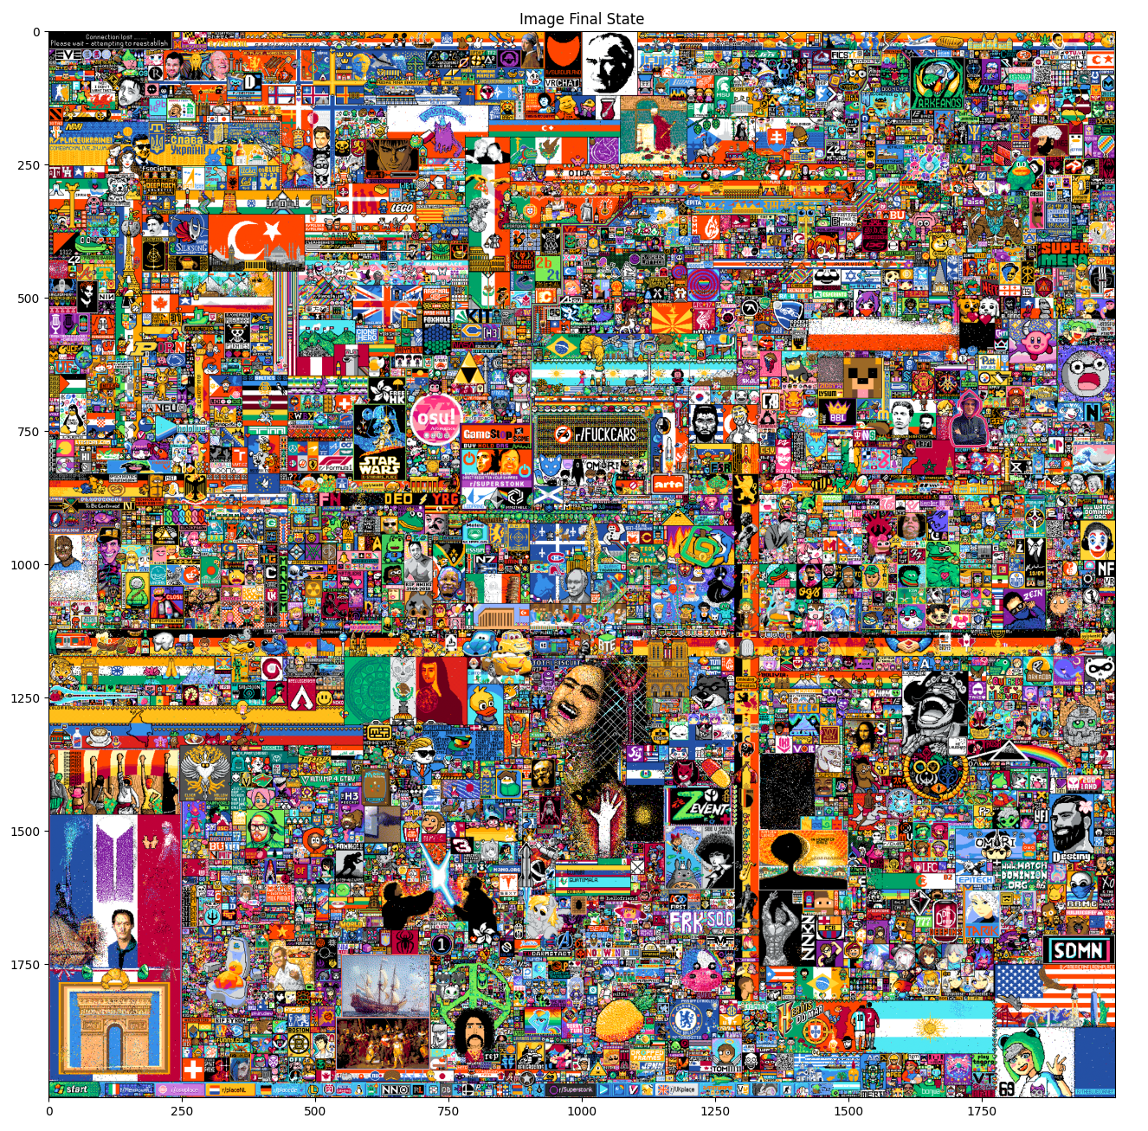

Slide 6
DATASET

Slide 7
DATASET INFO
Timestamp -
  the UTC time of the tile placement
  2022-04-03 17:38:22.252
User_id -
  a hashed identifier for each
  UTC,yTrYCd4LUpBn4rIyNXkkW2+Fac5cQHK2lsDpNghkq0oPu9o//8oPZPlLM4CXQeEIId7l011MbHcAaLyqfhSRoA==
Pixel_color -
  the hex color code of the tile placed
  #FF3881
Coordinate -
  the “x,y” coordinate of the tile placement.
  0,0

Slide 8
DATASET CLEANING
Timestamp -
  UTC time => seconds after referenced time
User_id -
  hashed identifier => map to integers
Pixel_color -
  hex color => map to integers
  save the mapping
Coordinate -
  “x,y” coordinate => separate to X and Y column

Slide 9
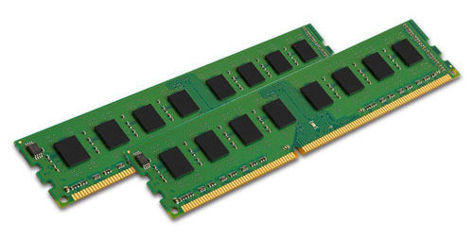
DATASET REQUIREMENTS
The dataset is really big:
ZIPED 12,1 GB
UNZIPED 21,2 GB
CLEANED 5,7 GB
=> Memory heavy
Running on PC with 48GB RAM
Still kind of problematic

Slide 10
DATA EXPLORATION

Slide 11
DATASET STATISTICS
Number of entries: 155925983
Unique colors: 32
Unique users: 10257345
Duration:
  295409.875s = 3d 10h 3m 30.0s
Placement delay:
  mean = 0.00189s
  std = 0.04260s
Placement delay per pixel:
  mean = 2h 36m 2.8s
  std = 3h 24m 0.31s

Slide 12
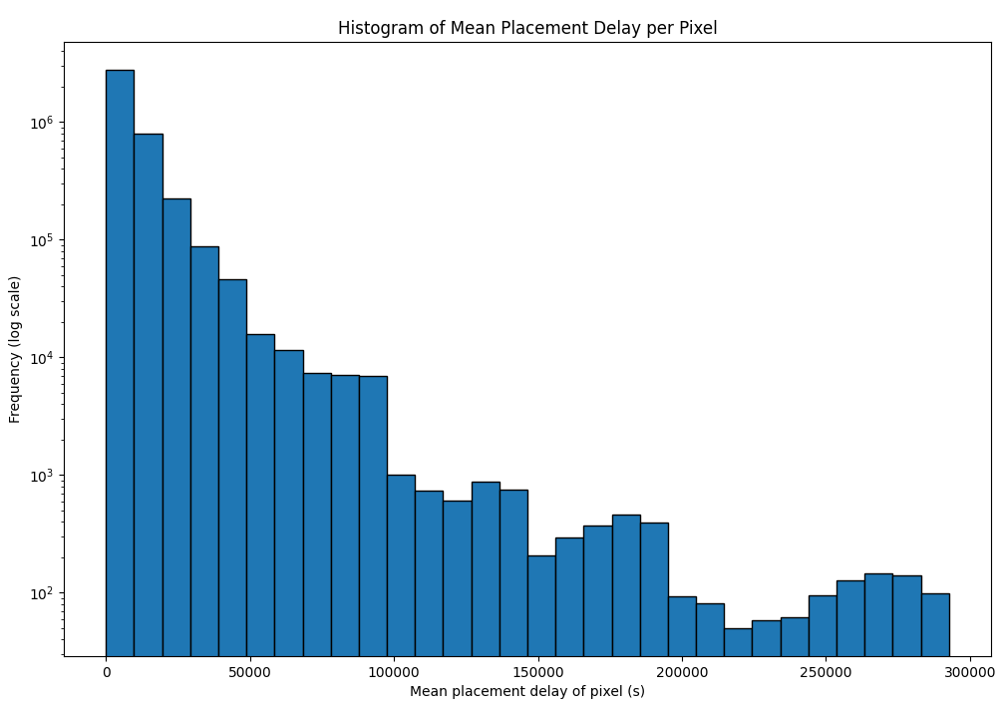

Slide 13
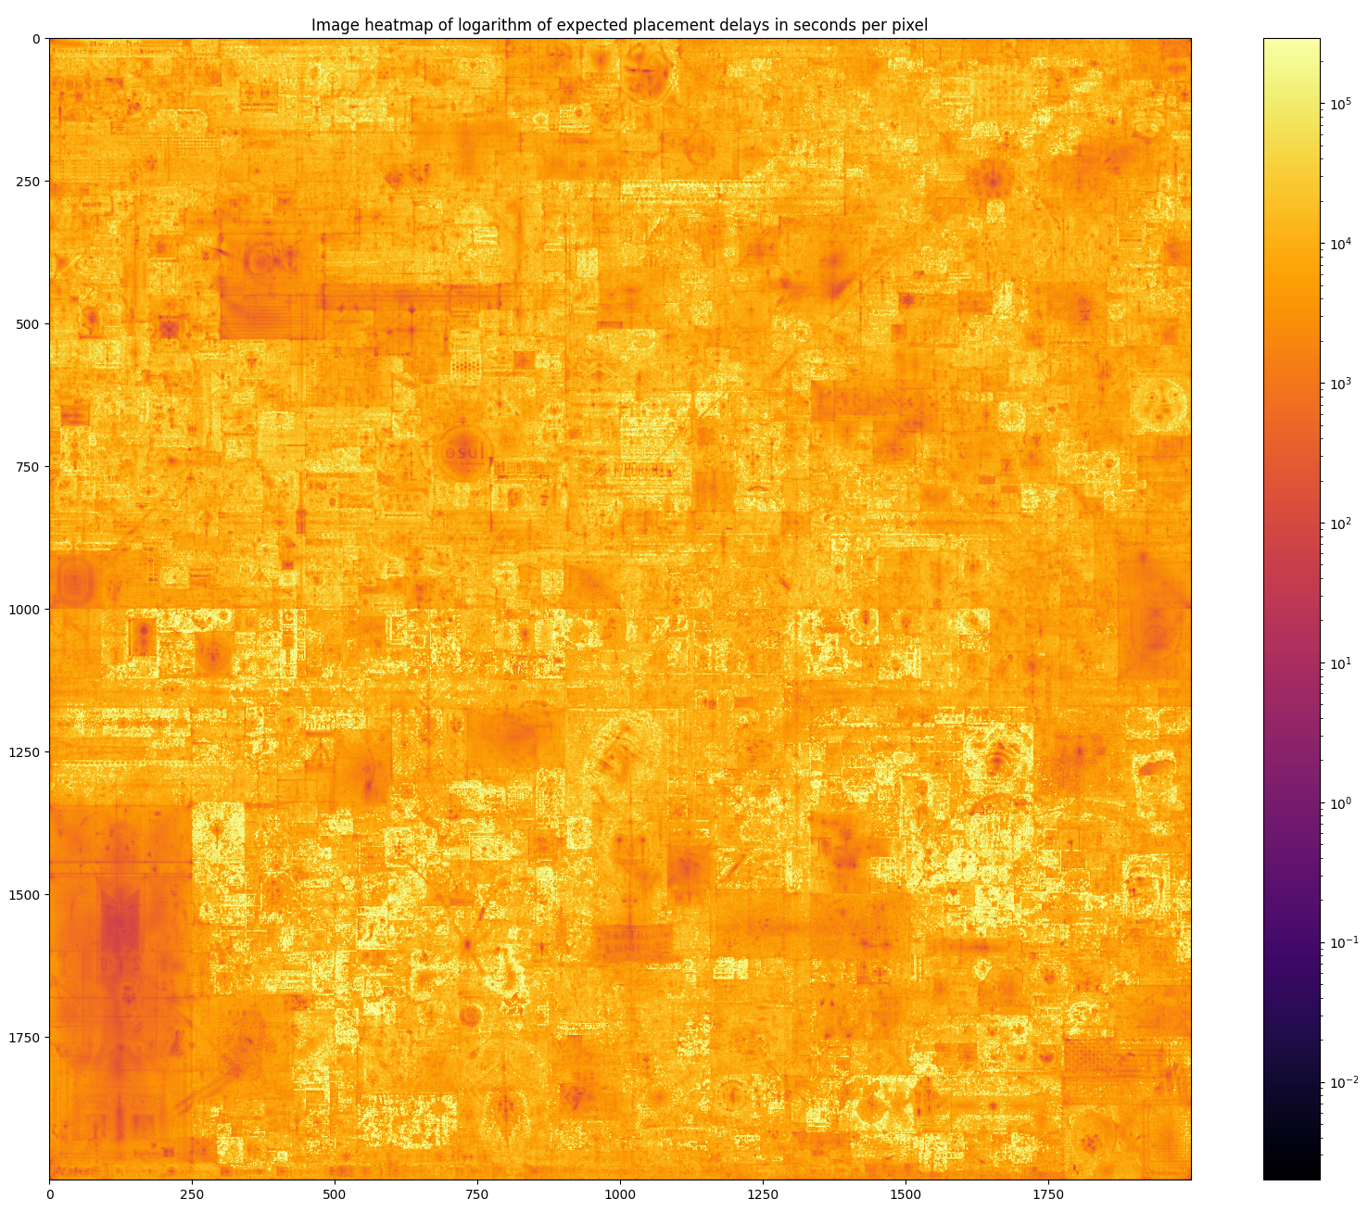

Slide 14
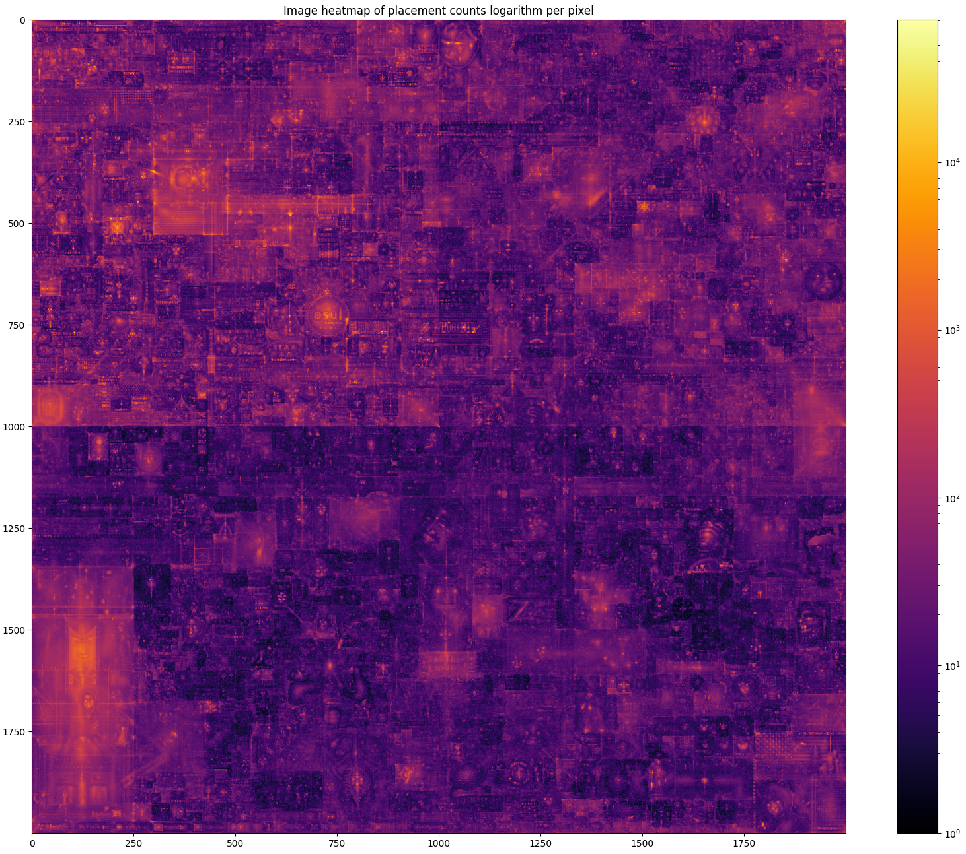

Slide 15
EDGE COMPUTATION

Slide 16
EDGE
When are two user interacting?
If they are
  Placing color on the same pixel
  Placing color on neighbouring pixels
in some time window
When is the interaction positive?
Users are placing similar colors

Slide 17
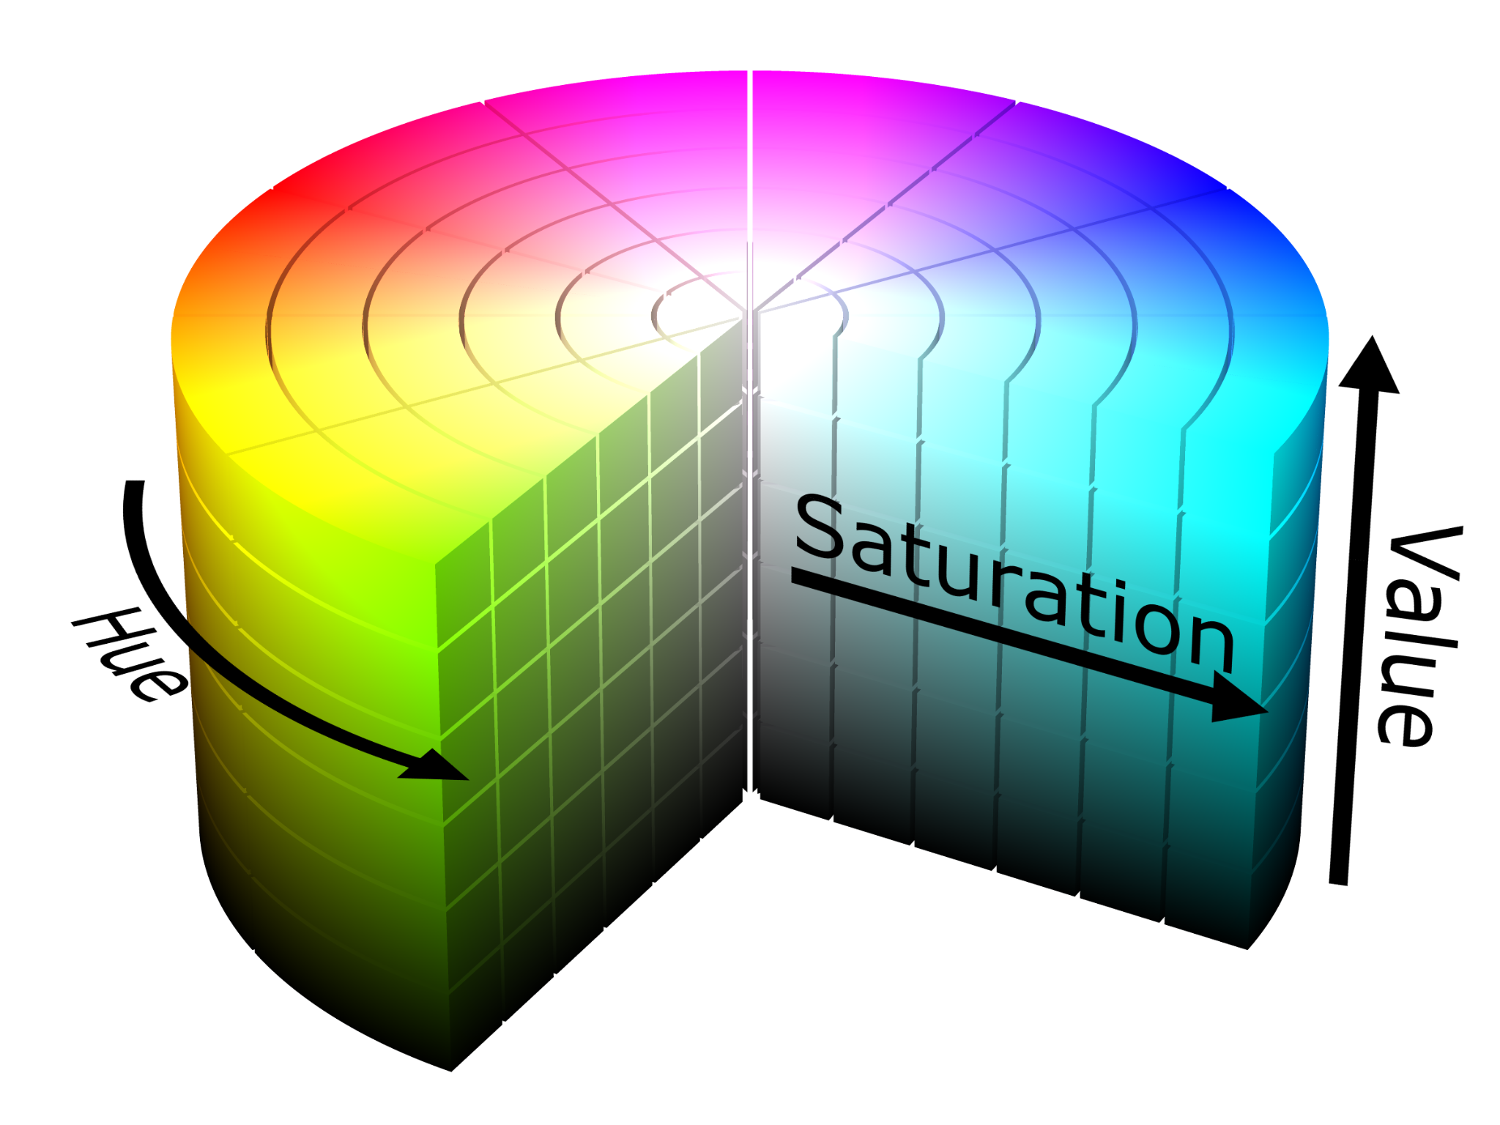
SIMILAR COLORS
What colors are “visualy”similar?
No easy definition, highly subjective
However we can measure a distance in some color space representation
Mesuringing color similarity for representations:
RGB
HSV

Slide 18
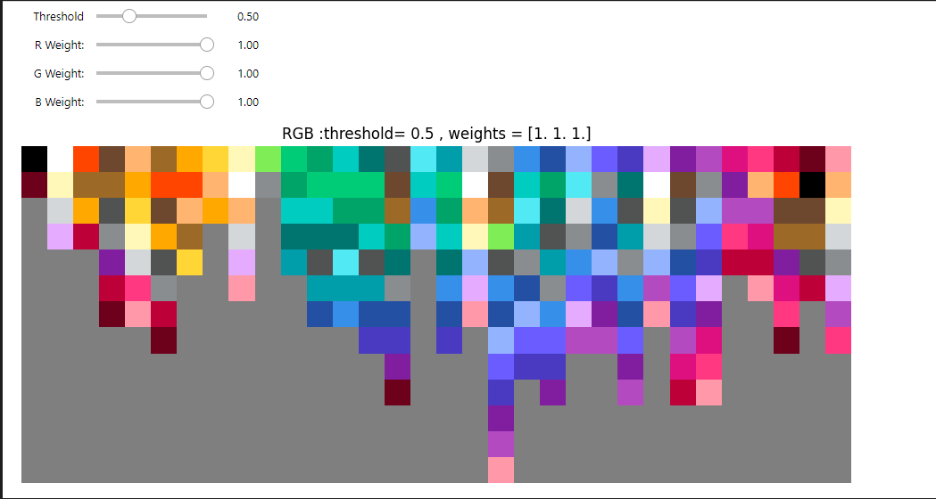
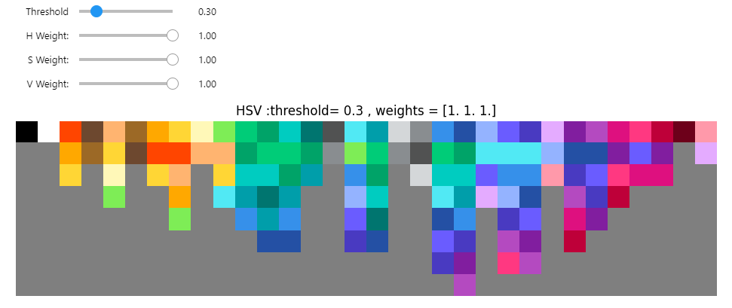
SIMILAR COLORS - TOOL

Slide 19
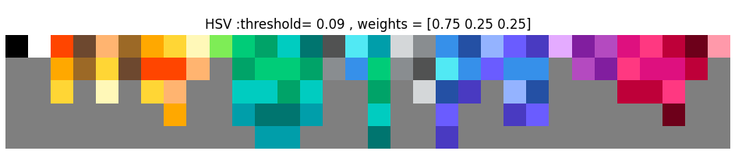
SIMILAR COLORS - RESULT
Based on this we can create matrix of color similarity

Slide 20
GRAPH CREATION ALGORITHM
Idea of edge reaction algorithm:
For each entry:
For each interaction:
On positive interaction between users:
Add an edge with weight one or raise the weight by one.
We can do second pass through to subtract negative interaction and prune the graph.

Slide 21
COMPUTATION
Sorting the data depending on approach by:
X,Y,time
time
Time for 1 000 000 entries:
Python compare ~ (n[['X','Y']]==m[['X','Y']]).all()
  Extremely slow
  ≈ 35min
Python grouped ~ df.groupby(['X','Y'])
  Takes a long time
  ≈2min
C++ Implementation
  Memory efficient and quick
  ≈ 3sec

Slide 22
COMPUTED VARIANTS
Same pixel interacting with previous n users:
3 - good size
5 - on the edge of memory
10 - too large
Neighborhood interacting with n users:
4 - in Plus shape - on the edge of memory
8 - in Square shape - too large

Slide 23
GRAPH
ANALYSIS
Because of Networkx inefficiency for large graphs igraph library was used.

Slide 24
GRAPH PRUNING
Same pixel | 3 users | 5 users
Number of edges in original | 150 324 900 | 251 315 192
Average weight difference per edge | 0.0225 | 0.0262
Average weight difference per edge from edges with difference | 1.207 | 1.240
Count of edges in original that are not in pruned graph | 2 168 981 | 4 049 196
Percentage of edges in original that are not in pruned graph | 1.4429% | 1.6112%

Slide 25
INTERACTION DEFINITION
Same pixel 5 users vs. Neighborhood 4 users | Results
Average weight difference per edge | 0.0545
Average weight difference per edge from edges with difference | 0.0553
Percentage of edges in union that are not in Same pixel graph | 50.899%
Percentage of edges in union that are not in Neighborhood graph | 46.812%
Percentage of edges in union that are in both graphs | 2.289%

Slide 26
SAME PIXEL - GRAPH COMPARISON
Same pixel | 3 users | 5 users | 10 users
Isolated vertices count | 1025945 10% | 825975 8% | 625495 6%
Non-Isolated vertices count | 9231400 90% | 9431370 92% | 9631850 94%
Number of edges | 148 155 919 | 247 265 996 | 459 297 221
Edge density | 2.816e-06 | 4.700e-06 | 8.731e-06

Slide 27
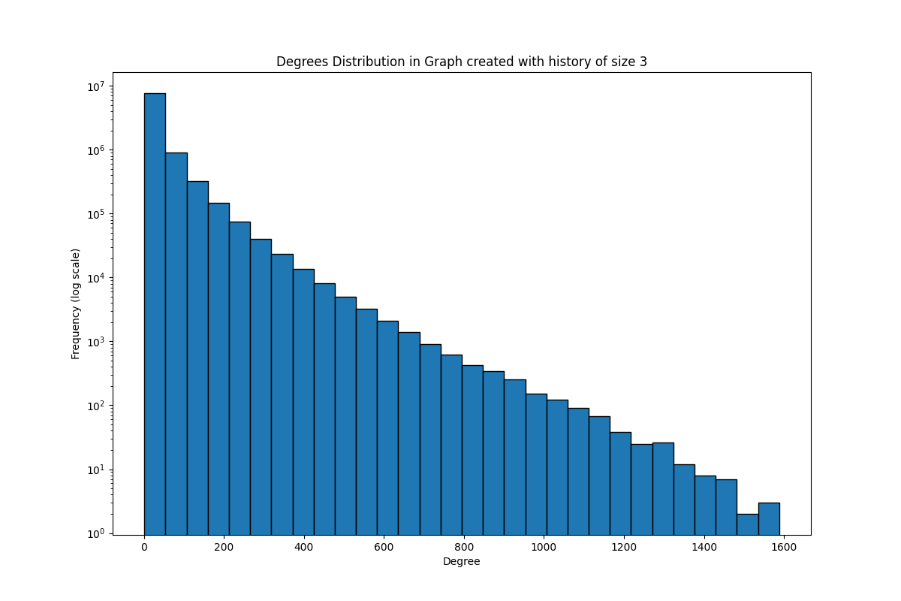
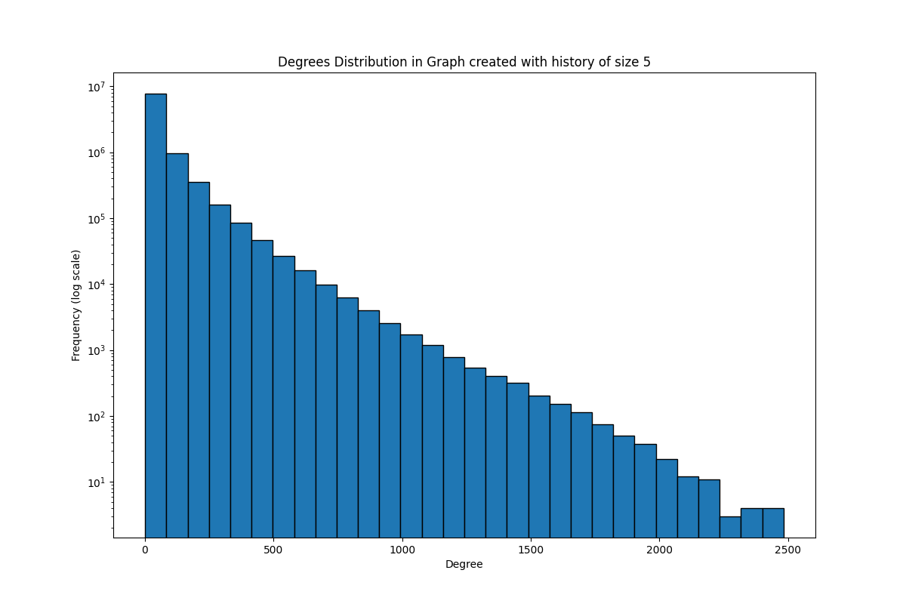

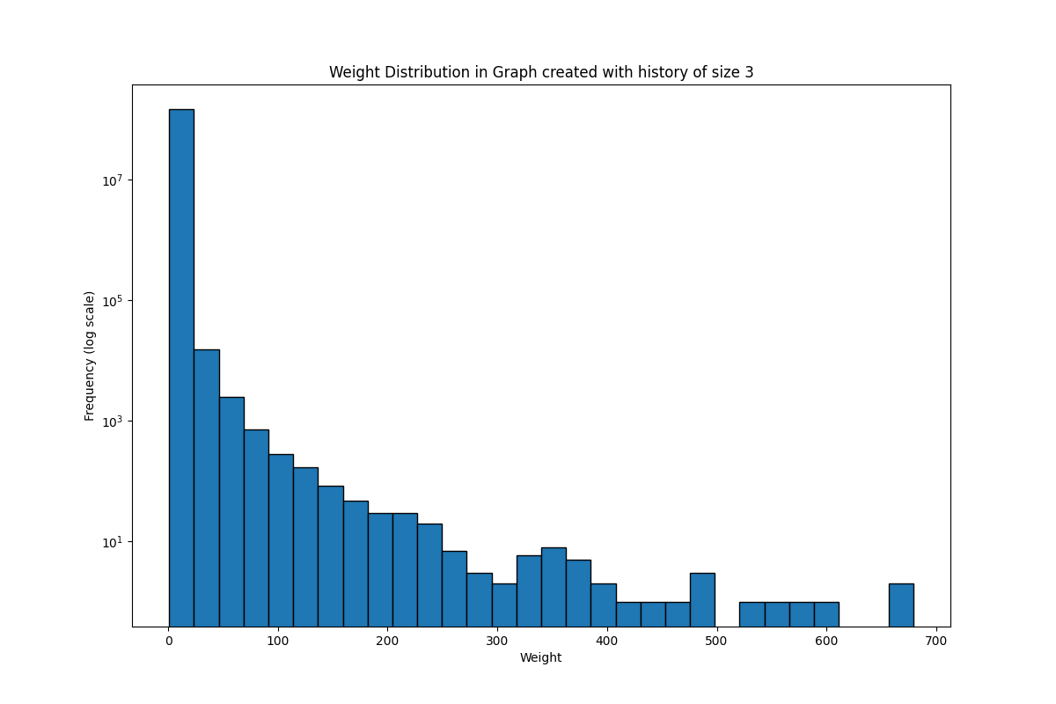
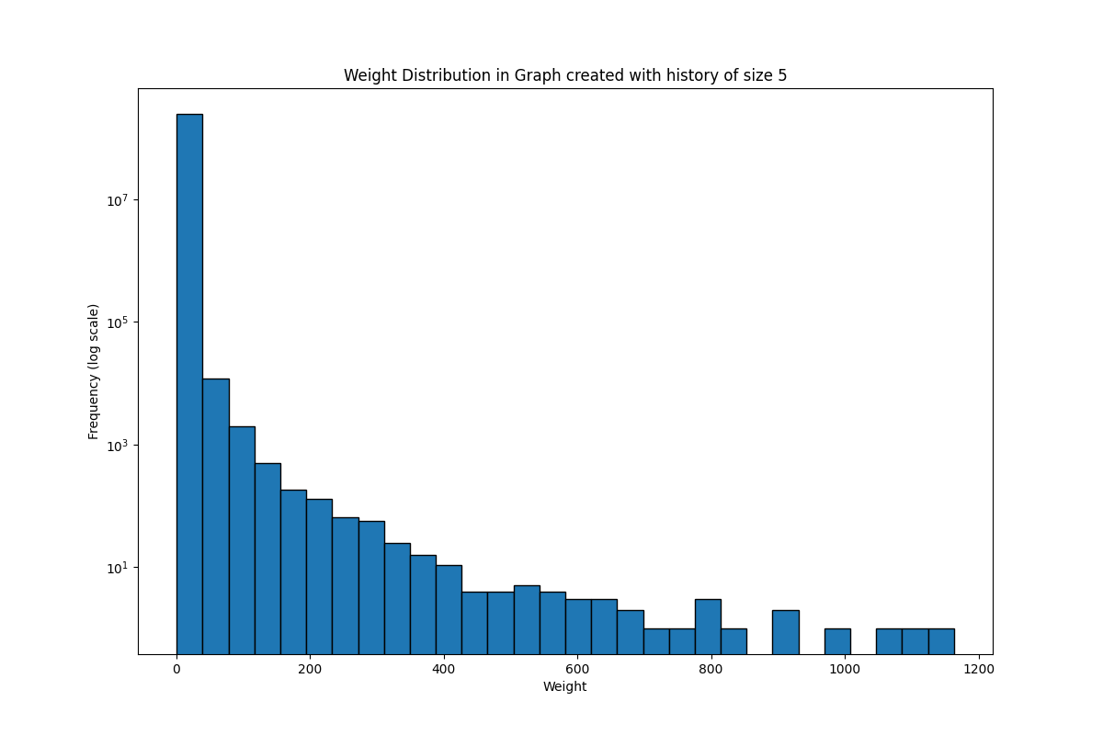
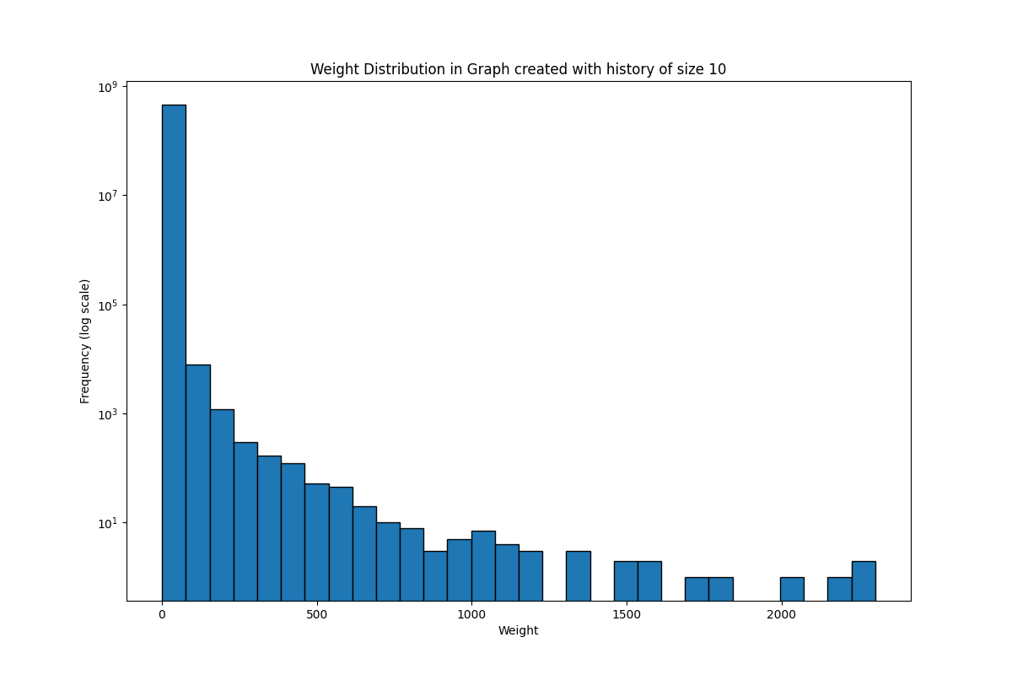
Degrees
Weights

Slide 28
NEIGHBOURHOOD - GRAPH COMPARISON
Neighbourhood | 4 users | 8 users
Isolated vertices count | 1264558 12% | 1130168 11%
Non-Isolated vertices count | 8992787 88% | 9127177 89%
Number of edges | 267 851 035 | 505 284 112
Edge density | 5.092e-06 | 9.605e-06

Slide 29


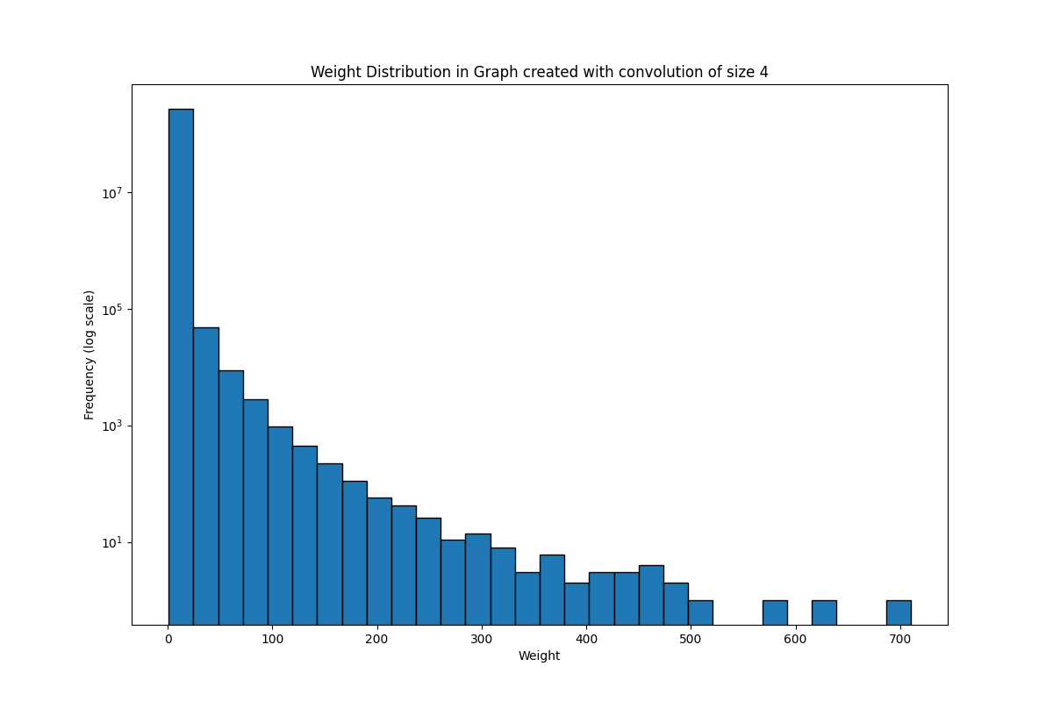
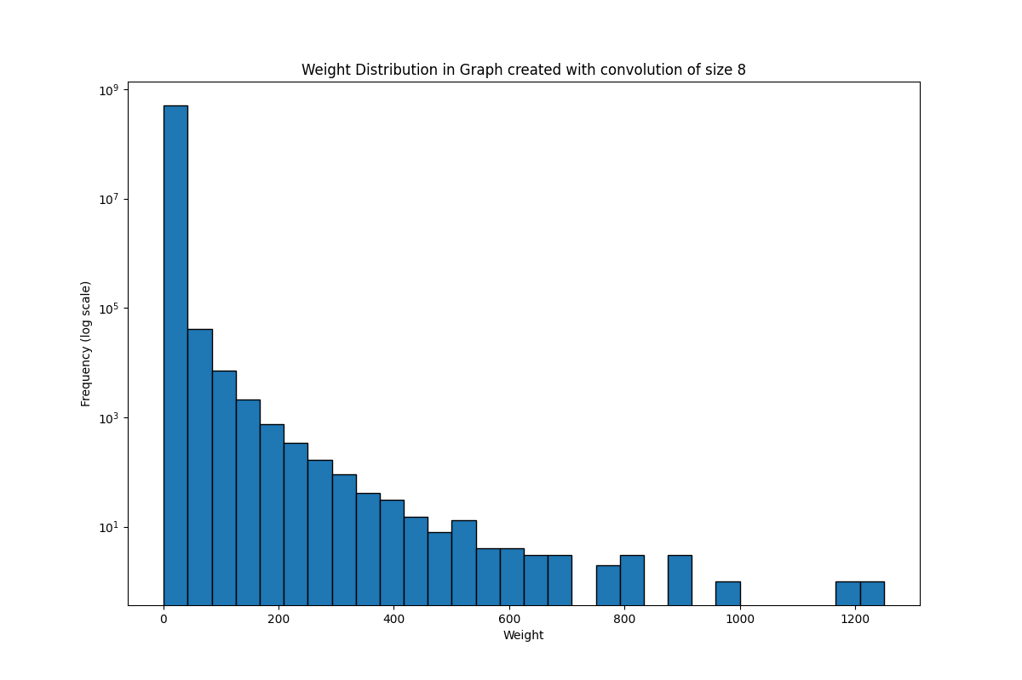

Slide 30
COMMUNITIES

Slide 31
COMMUNITIES
Louvain method for community detection was used
Communities were computed for:
Same pixel interacting with previous 3 users
Same pixel interacting with previous 5 users
Neighborhood interacting with 4 users
Without using the weights

Slide 32
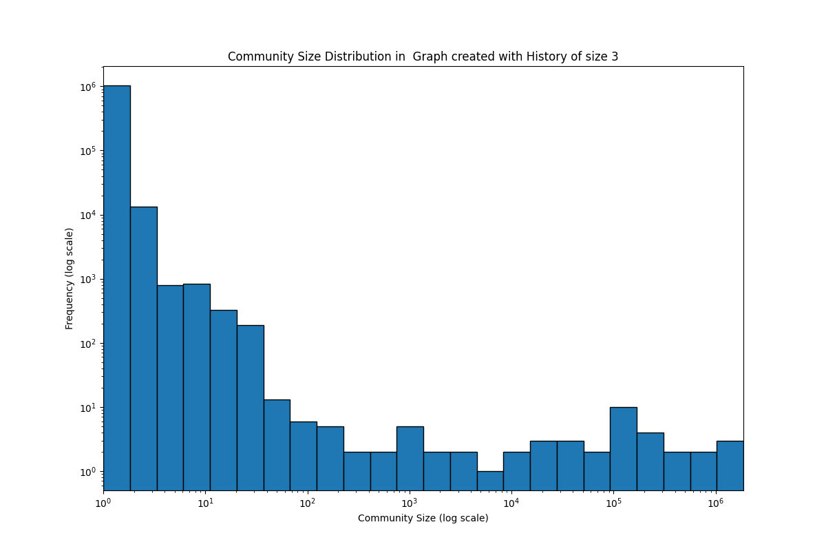

Slide 33
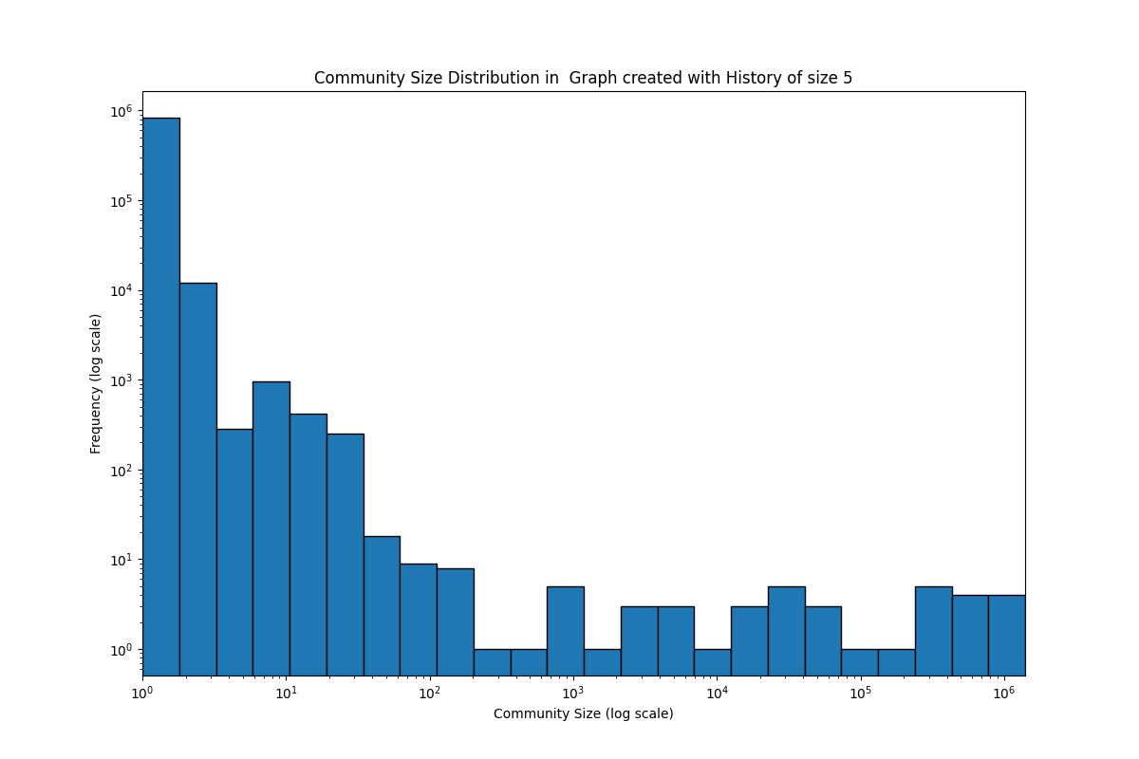

Slide 34
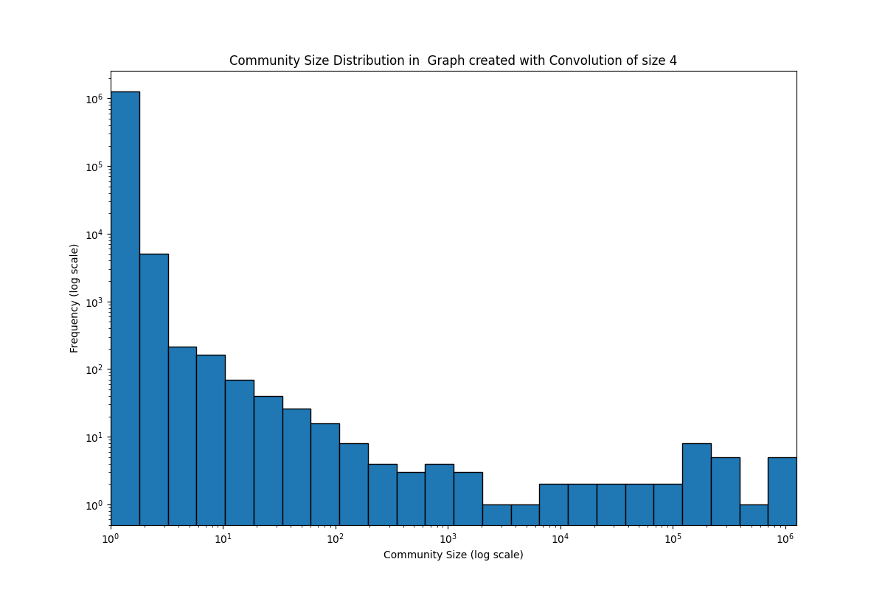

Slide 35
RESULTS

Slide 36
RESULTS OVERVIEW
Despite using different graphs, a lot of communities were not that different. However the are some noticeable differences in the biggest one.
In next slides There will be some community artwork showcases, where:
On the left
Same pixel interacting with previous 5 users
On the right
Neighborhood interacting with 4 users

Slide 37
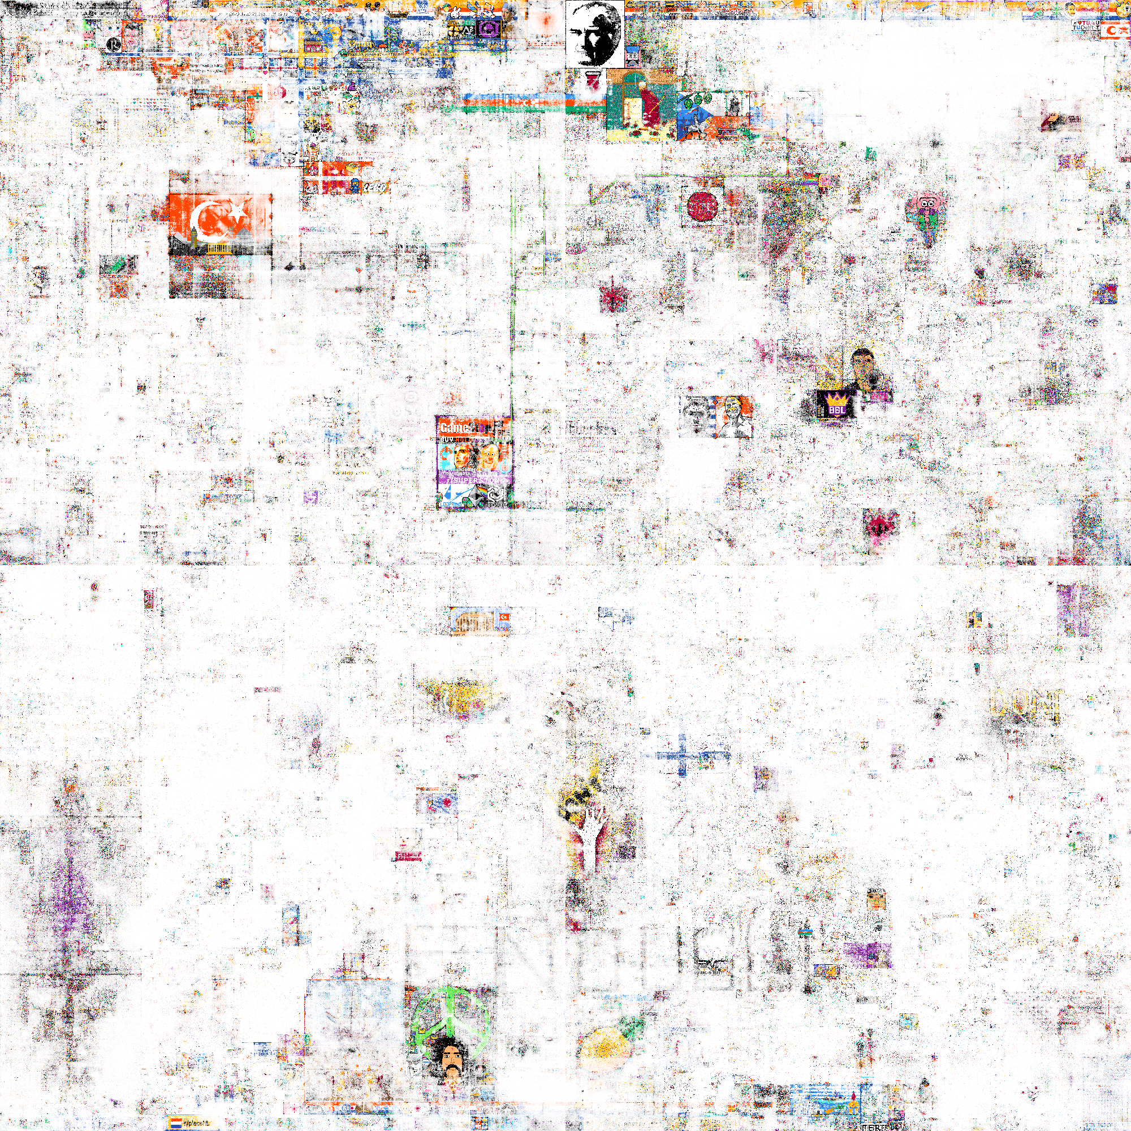
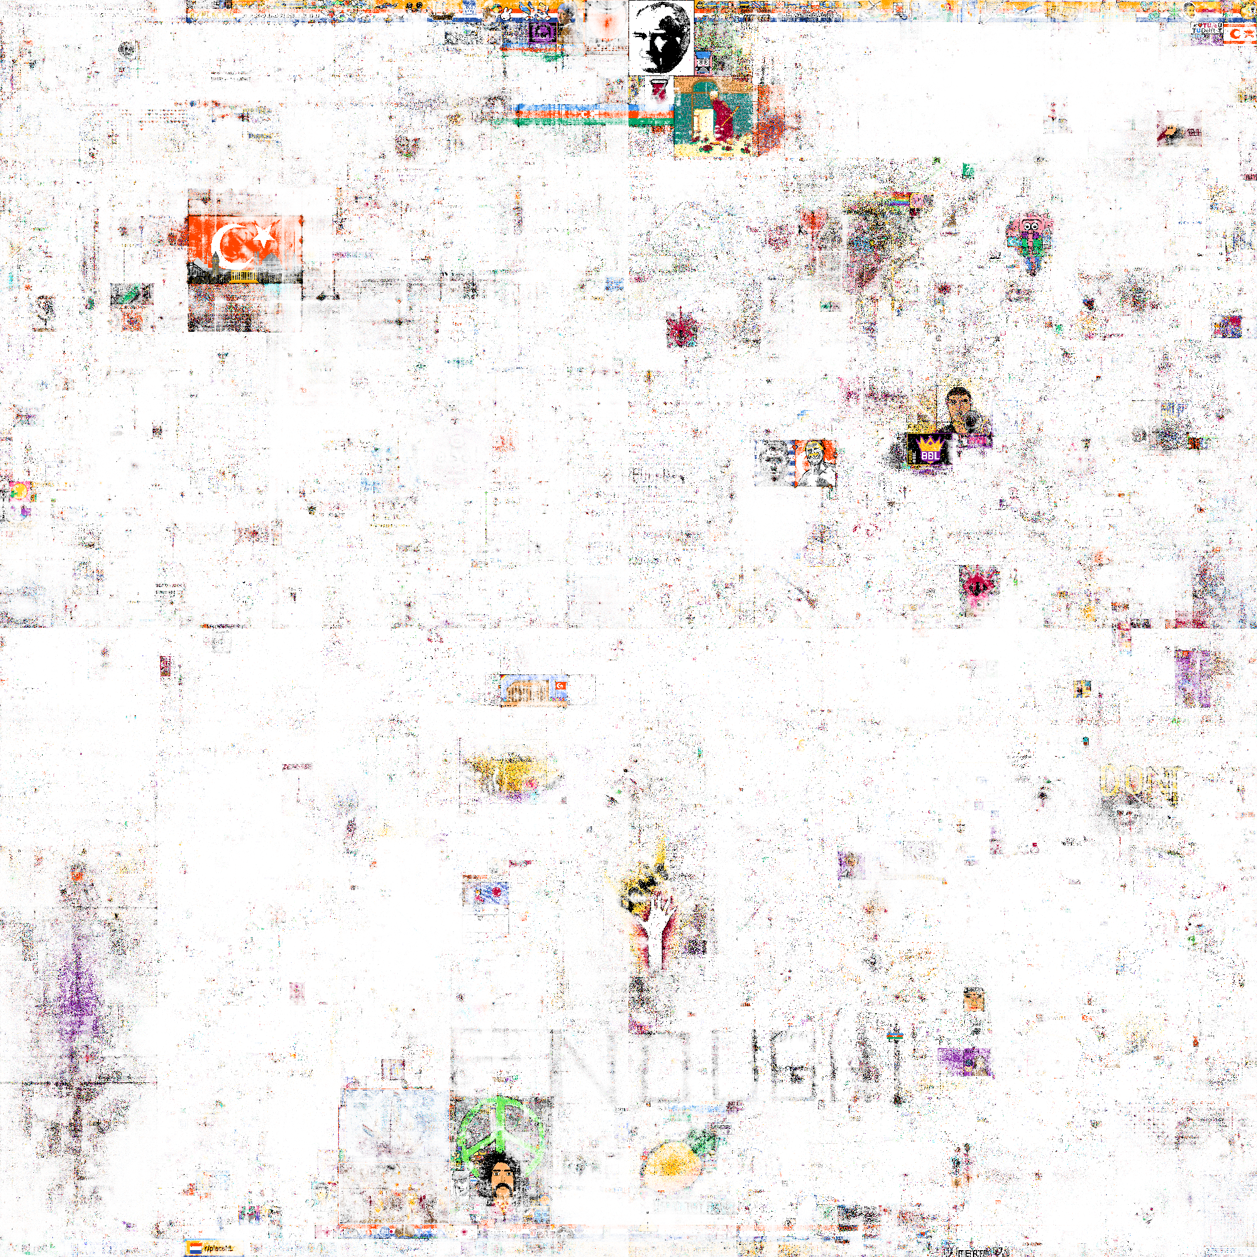
TURKEY (SOME NORTHERN EU?)

Slide 38
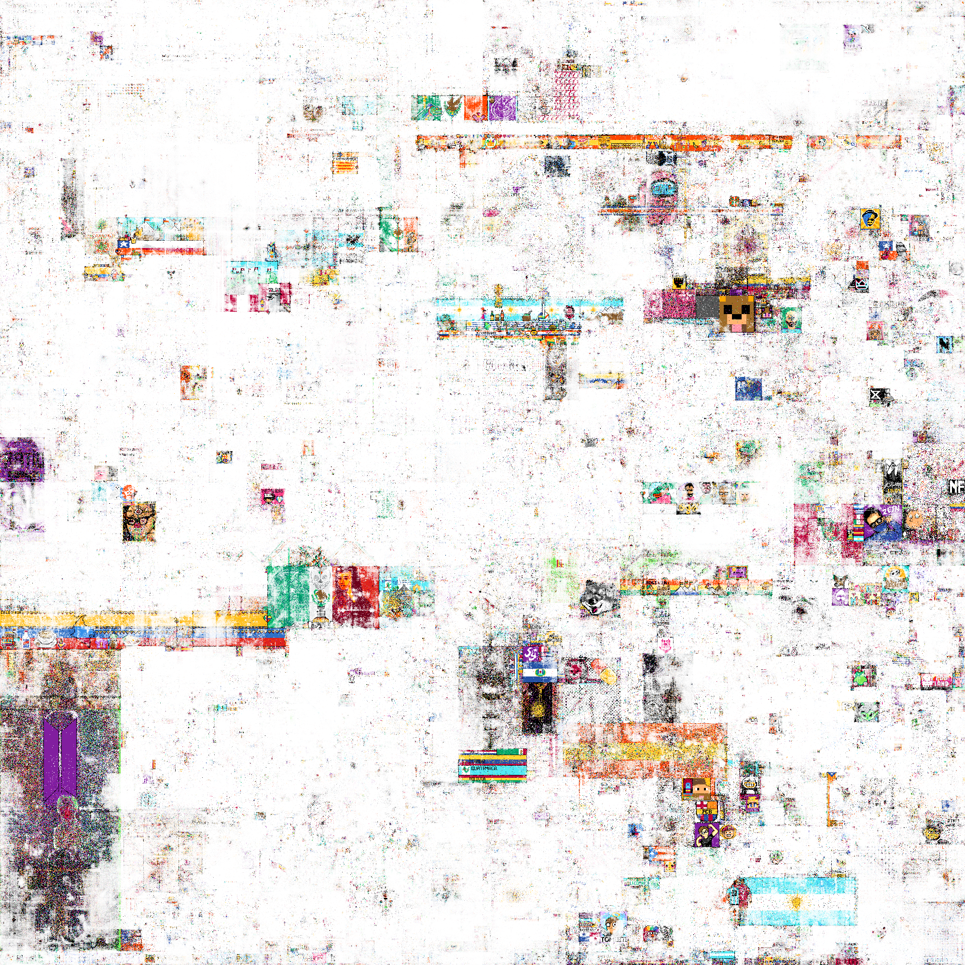
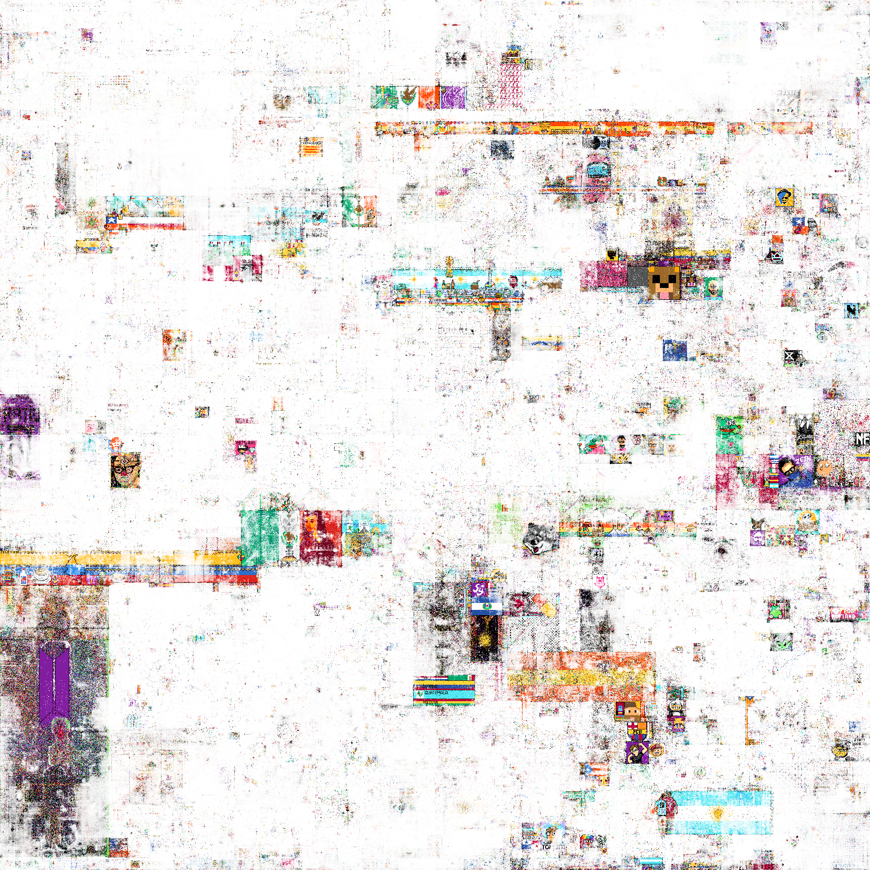
SPANISH SPEAKING

Slide 39
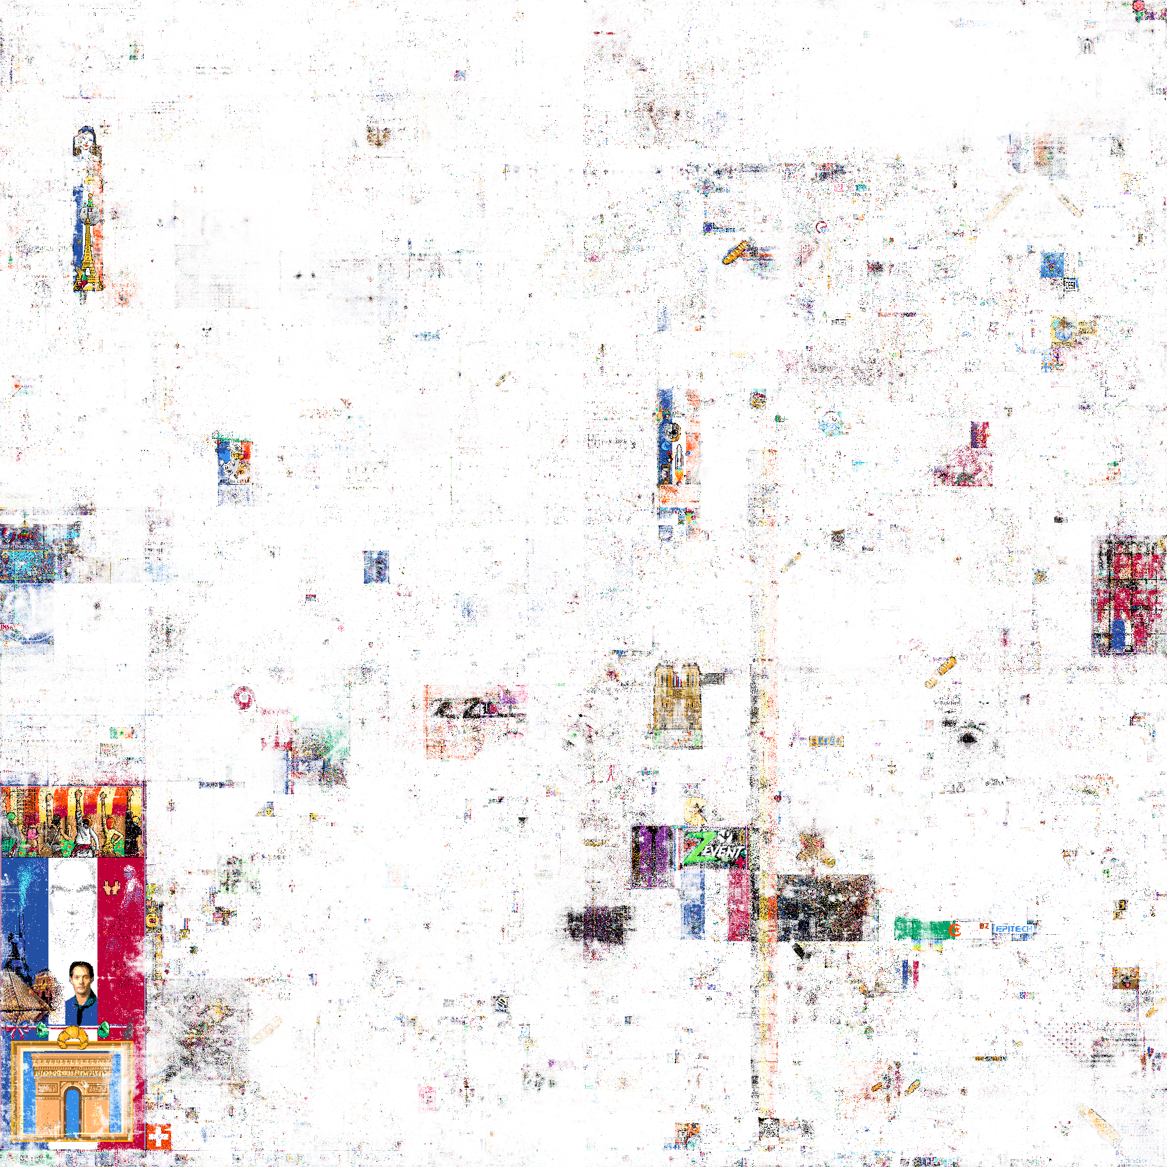
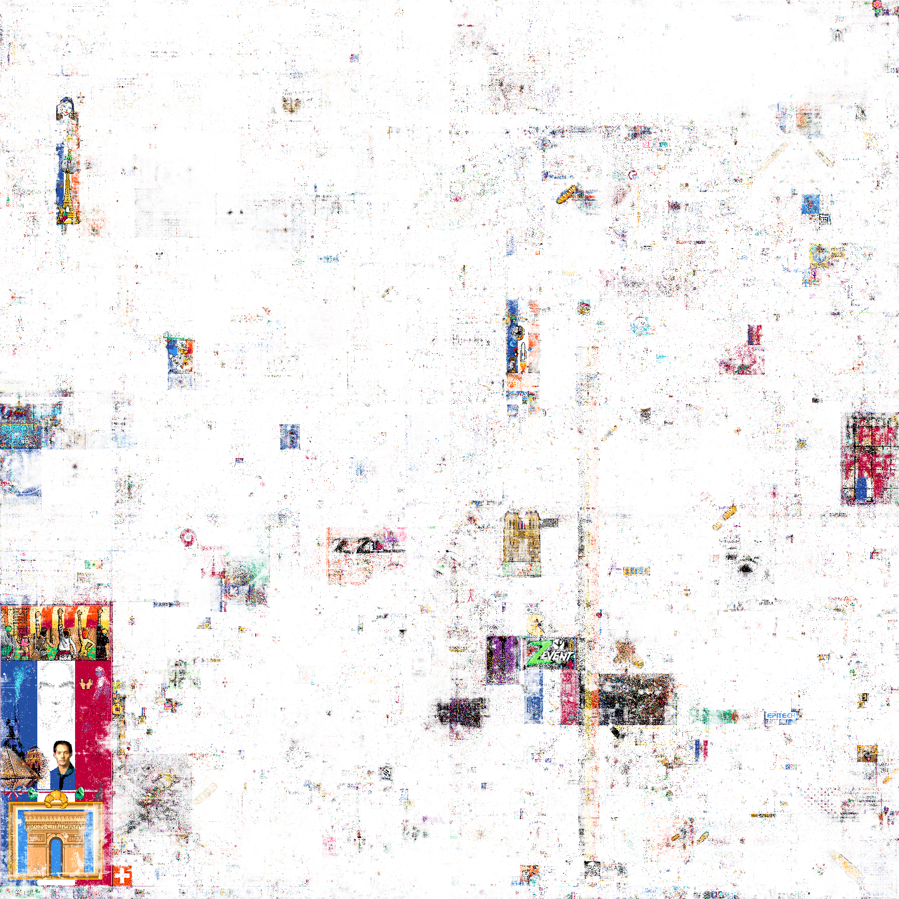
FRENCH

Slide 40
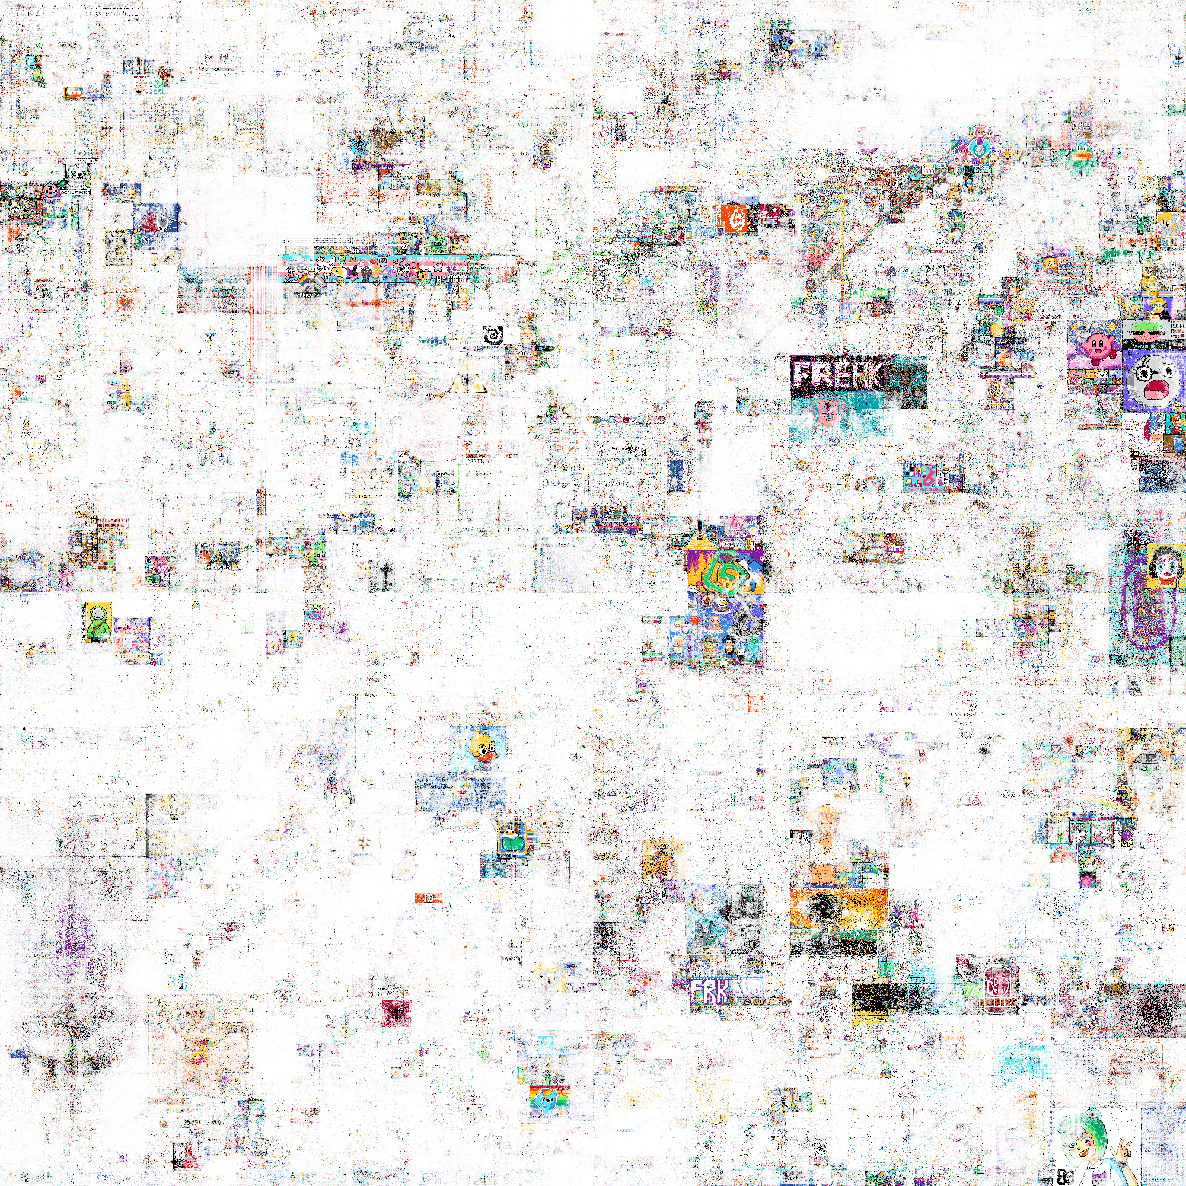
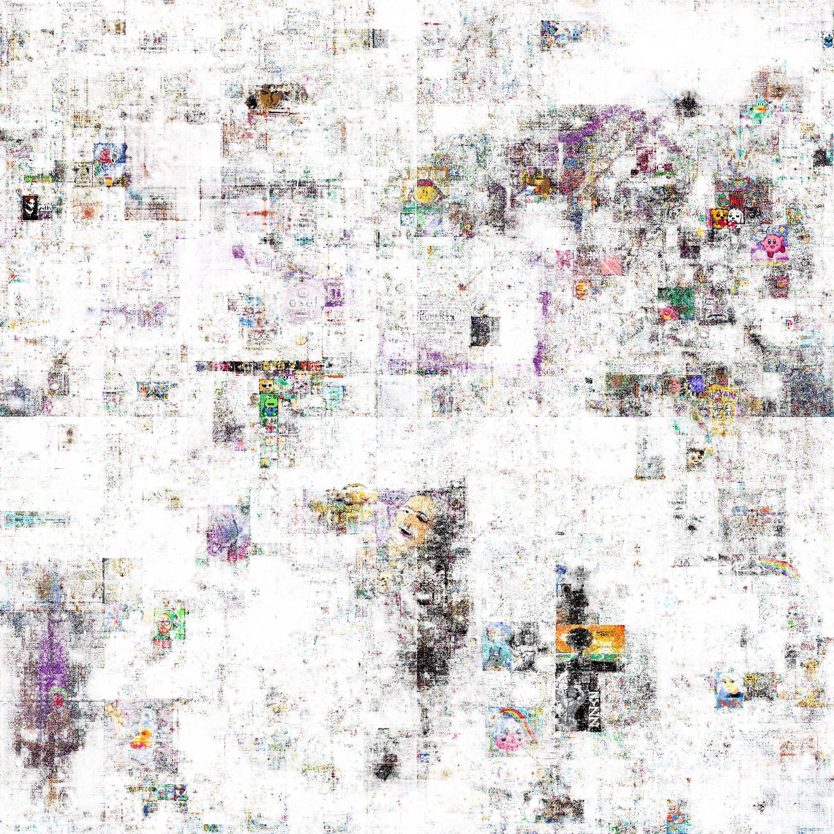
TWITCH STREAMERS

Slide 41


REST (COMMUNITIES WITH SIZE SMALLER THAN 200)

Slide 42
SUMMARY

Slide 43
SUMMARY
During the project we achieved:
Working with large dataset
Finding interesting communities
Compared few different approaches
The are a lot of ways how to further proceed with this project:
Analyze union graph of Neighborhood and Single pixel approaches. (More RAM needed 64GB)
Use project r/Place Atlas to label communities or compute communities of subreddits.
More detailed found Community comparison from different approaches

Slide 44
REFERENCES
https://www.reddit.com/r/place/
https://place-atlas.stefanocoding.me/
https://igraph.org/python/doc/api/igraph.Graph.html
https://networkx.org/documentation/stable/index.html
https://en.wikipedia.org/wiki/Color_difference

Slide 45
THANK YOU FOR ATTENTION

