Slide 1
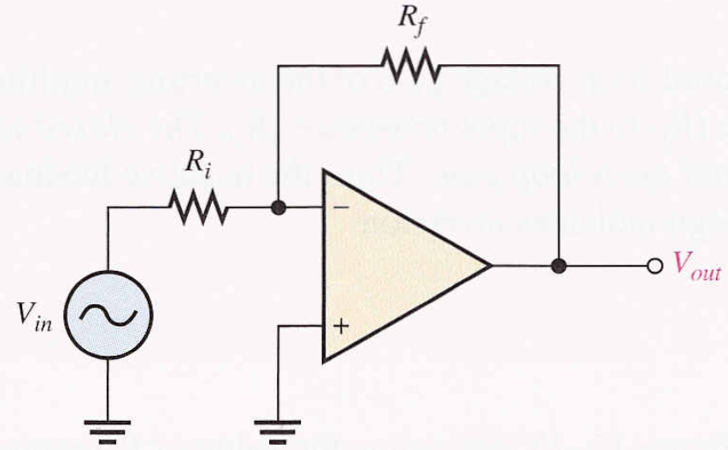
The Operational Amplifier
(op-amp)
Sahariar Reza
Lecturer
Dept. of CSE
Op-amp

Slide 2
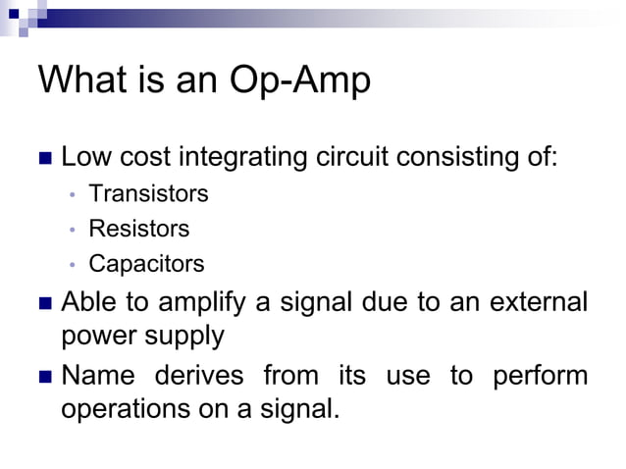

Slide 3
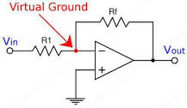
Virtual ground
In opamps the term virtual ground means that the voltage at that particular node is almost equal to ground voltage (0V). It is not physically connected to ground. This concept is very useful in analysis of opamp circuits

Slide 4
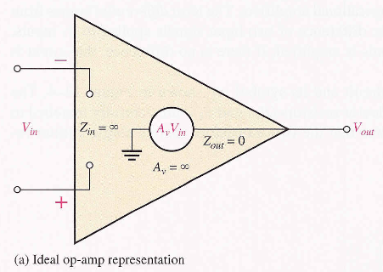
Characteristics of op-amp
Ideal op-amp
Infinite voltage gain
Infinite bandwidth
Infinite input impedance
Zero output impedance

Slide 5
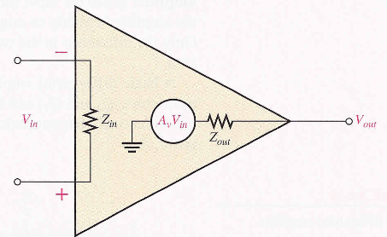
Characteristics of op-amp
Practical op-amp
Very high voltage gain
Wide bandwidth
Very high input impedance
Very low output impedance

Slide 6
Op-amp parameters
1. Common mode input voltage
CMRR
Common mode input voltage range
4. Slew rate

Slide 7
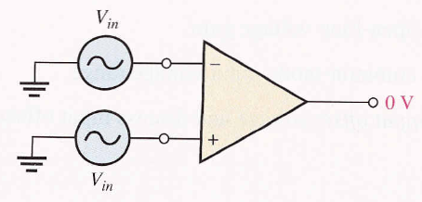
Common mode input voltage
It is the voltage that appears on the both input with same
Amplitude (A)
Frequency (f )
Phase (φ)
When equal input signal are applied to both inputs, they cancel, resulting in a zero output voltage.

Slide 8
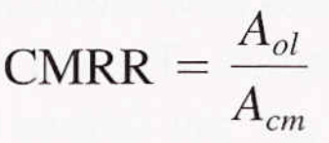
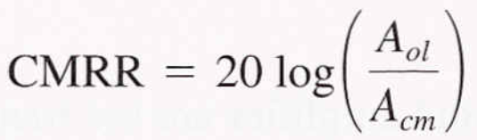
Common Mode Rejection Ratio (CMRR)
It is a measure of ability of an amplifier to reject common mode signals
Practical op-amp exhibits a very small common mode gain (<1).
It measure how much higher Open-loop gain with respect to common mode gain.

Slide 9
Open-Loop Voltage Gain
Ratio of output voltage to input voltage when there is no external component. It is the internal voltage gain. It is set entirely by the internal design.

Slide 10
What does it mean by “CMRR is 100,000”?
We know that:
01. It means that the desired input signal (differential) is amplified 100,000 times more than the unwanted noise (common-mode)
02. If the amplitudes of the differential input signal and the common-mode noise are equal, the desired signal, the desired signal will be appeared on the output 100,000 times larger than common-mode noise.
Thus the noise/interference has been essentially eliminated.

Slide 11
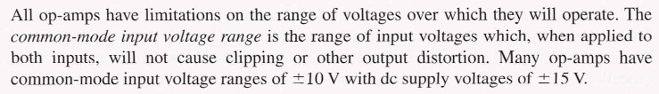
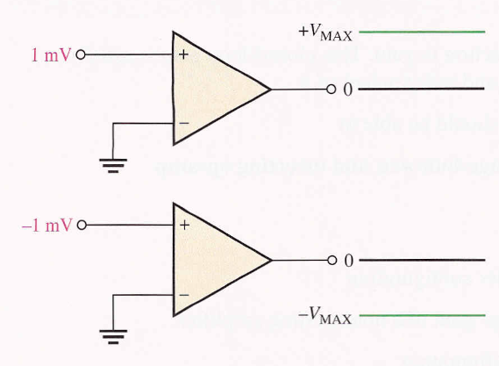
Common mode input voltage range

Slide 12
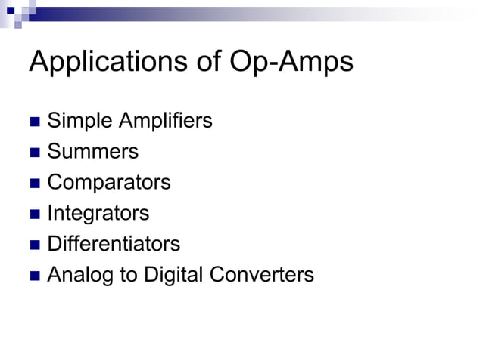

Slide 13
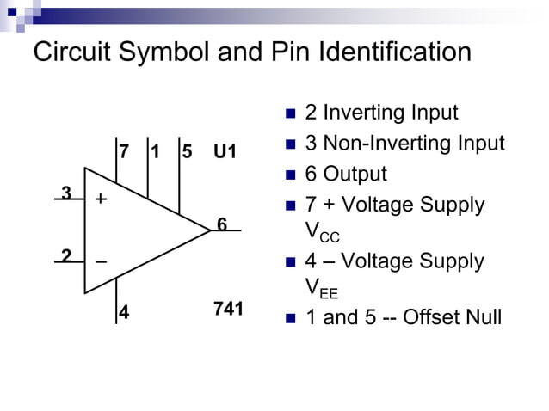

Slide 14
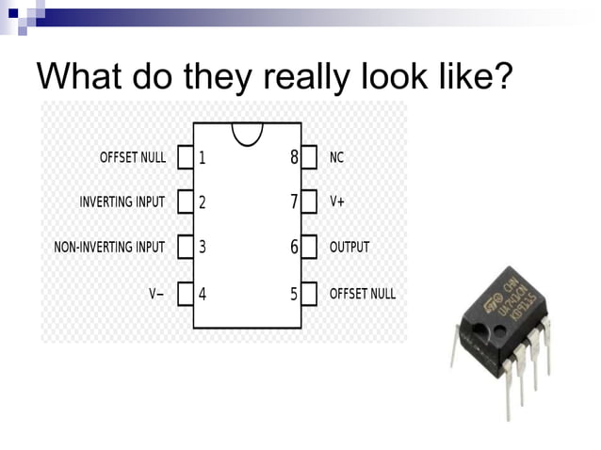

Slide 15
Negative Feedback
system
input
Controller
+
-/+
Feedback

Slide 16
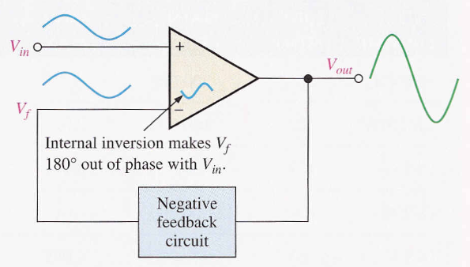
What is negative feedback?

Slide 17
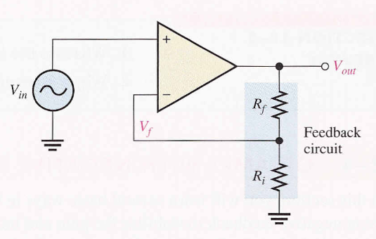

Slide 18
Why use negative feedback?
Gain is reduced and can be controlled so that the
op-amp can function as a linear amplifier
Non-inverting amplifier
Voltage follower
Inverting amplifier
Control of input & output impedances amplifier bandwidth

Slide 19
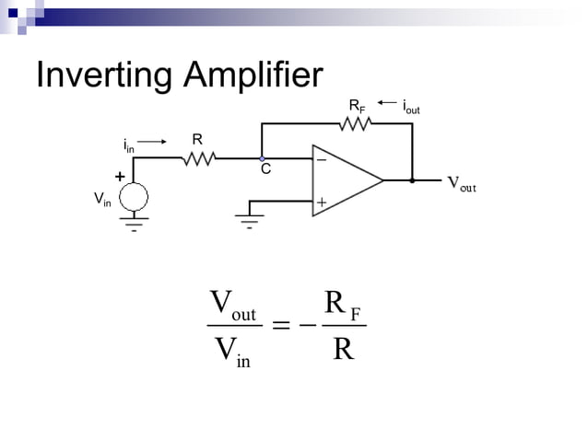

Slide 20
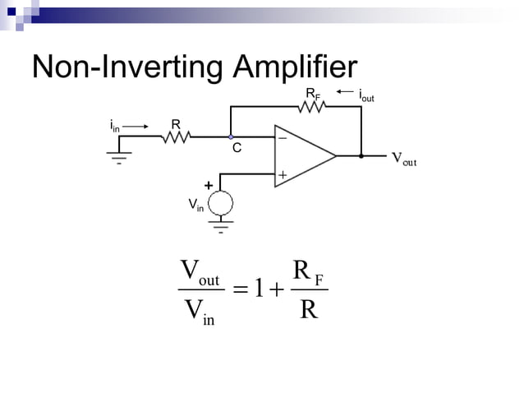

Slide 21
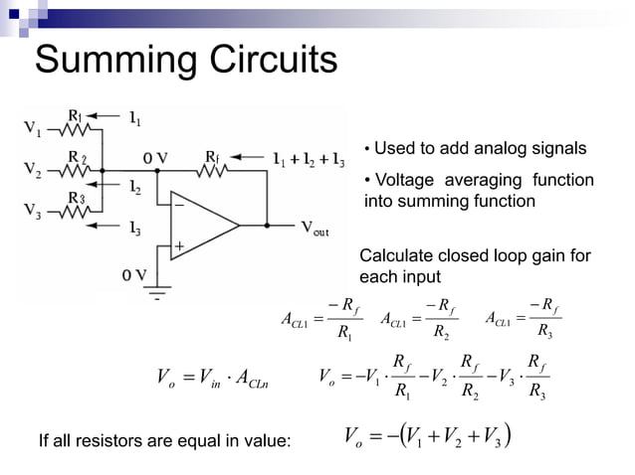

Slide 22
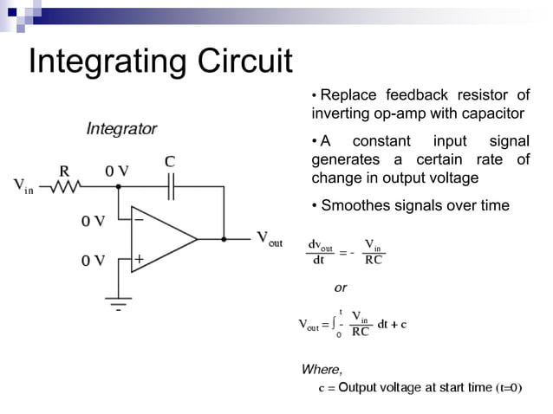

Slide 23
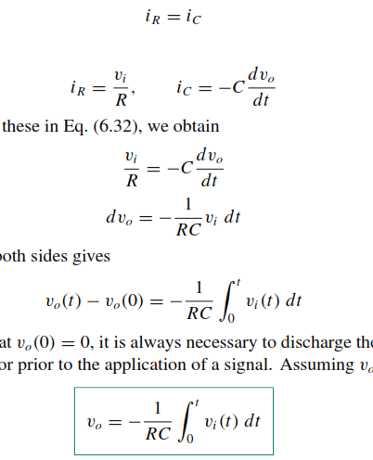
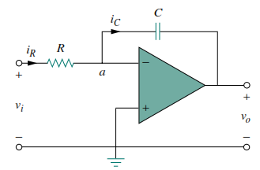
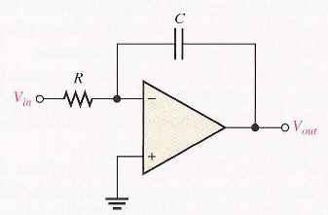
Integrator
Vi – 0 = Vi
0A
0V
0 - Vo = - Vo

Slide 24
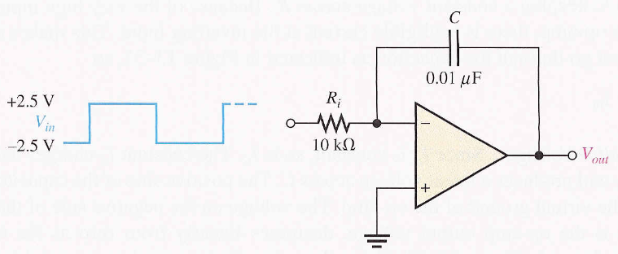
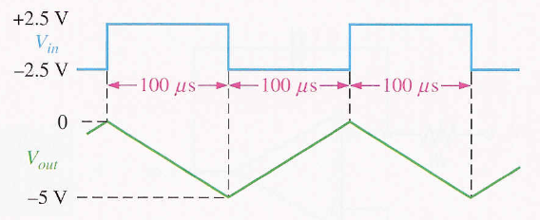

Slide 25
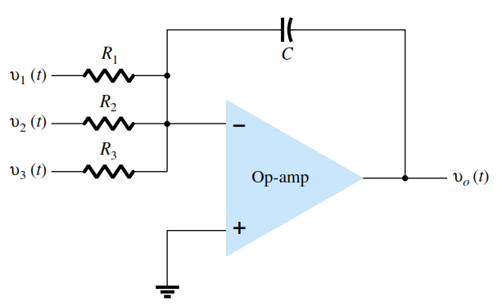


Slide 26
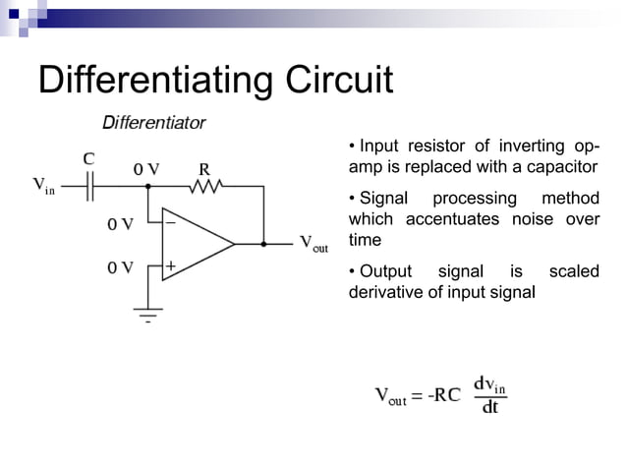

Slide 27
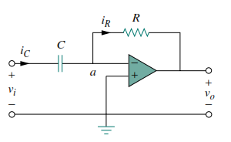
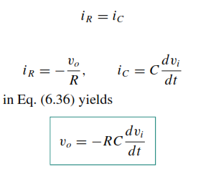
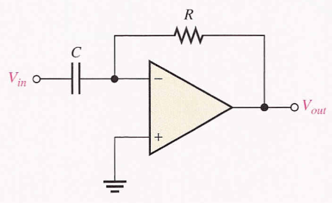
Differentiator

Slide 28
