Slide 1
International Islamic University Chittagong
Department of Computer Science & Engineering
Spring - 2025
Course Code: CSE-2321
Course Title: Data Structures
Mohammed Shamsul Alam
Professor, Dept. of CSE, IIUC

Slide 2
Lecture – 2
Preliminaries

Slide 3
Mathematical Notation and Functions
Floor and Ceiling Functions
∟x⅃, called the floor of x, denotes the greatest integer that does not exceed x.
ℾx⅂, called the ceiling of x, denotes the least integer that is not less than x.
If x is itself an integer, then └ x ┘ = ┌ x ┐; otherwise, ∟ x ⅃ + 1 = ℾ x ⅂.
∟3.14⅃ = 3; ℾ3.14⅂ = 4; ∟-8.5⅃ = -9; ℾ-8.5⅂ = -8; ∟7⅃ = 7; ℾx⅂ = 7.

Slide 4
Mathematical Notation and Functions
Remainder Function
Let k be any integer and let M be a positive integer. Then k (mod M) will denote the integer remainder when k is divided by M.
k (mod M) is the unique integer r such that k = M q + r where 0 ≤ r < M.
25 (mod 7) = 4 25 (mod 5) = 0 3 (mod 8) = 3
Congruence
a ≡ b (mod M) if and only if M divides a – b
22 ≡ 2 (mod 5)

Slide 5
Mathematical Notation and Functions
Integer and Absolute Value Function
Let x be any real number. The integer value of x, written INT(x), converts x into an integer y deleting (truncating) the fractional part of the number.
INT (3.14) = 3 INT (-8.5) = -8 INT (7) = 7
The absolute value of the real number x, written ABS(x) or |x|, is defined as the greater of x and –x.
| -15 | = 15 | 3 | = 3 | -8.5 | = 8.5 | 8.5 | = 8.5
| 0 | = 0

Slide 6
Mathematical Notation and Functions
Factorial Function
n! = 1 . 2 . 3 …. (n-2) . (n-1) . n
4! = 1.2.3.4 = 24 0! = 1
Fibonacci Function
The Fibonacci sequence is as follows: 0, 1, 1, 2, 3, 5, 8, 13, 21, 34, 55, … …
Here, F₀ = 0 and F₁ = 1 and each succeeding term is the sum of two preceding terms.

Slide 7
Mathematical Notation and Functions
Permutation and Combination
^{n} P _{r} = n! / (n-r)!
^{n} C _{r} = n! / r! (n-r)!
Summation
1 + 2 + 3 + ……. + n = n (n +1) / 2

Slide 8
Mathematical Notation and Functions
Exponents and Logarithms
a^{m} = a . a . … . a (m times).
a⁰ = 1
b^{y} = x y = log _{b} x
log ₂ 8 = 3 log ₁₀ 100 = 2
Common logarithm (base 10), Natural logarithm (base e), Binary logarithm (base 2)
The term log x shall mean log ₂ x unless otherwise specified

Slide 9
Algorithmic Notation
An algorithm is a finite step‑by‑step list of well‑defined instructions for solving a particular problem.
The format for the formal presentation of an algorithm consists of two parts. The first part is a paragraph which tells the purpose of the algorithm, identifies the variables which occur in the algorithm and lists the input data. The second part of the algorithm consists of the list of steps that is to be executed.
Algorithm 2.1: (Largest Element in Array) A nonempty array DATA with N numerical values is given. This algorithm finds the location LOC and the value MAX of the largest element of DATA. The variable K is used as a counter.
  Step 1. [Initialize] Set K:= 1, LOC:= 1 and MAX: = DATA[1].
  Step 2. [Increment counter] Set K:= K + 1.
  Step 3. [Test counter] If K > N, then:
  Write: LOC, MAX, and Exit.
  Step 4. [Compare and update] If MAX < DATA[K], then:
  Set LOC:= K and MAX:= DATA [K].
  Step 5. [Repeat loop] Go to Step 2.

Slide 10
Algorithmic Notation
The following summarizes certain conventions that we will use in presenting our algorithms.
Steps, Control, Exit: The steps of the algorithm are executed one after the other, beginning with Step 1, unless indicated otherwise. Control may be transferred to Step n of the algorithm by the statement “Go to Step n”. If several statements appear in the same step, then they are executed from left to right. The algorithm is completed when the statement Exit is encountered.
Comments: Each step may contain a comment in brackets which indicates the main purpose of the step.
Variable Name: Variable names will use capital letters. Single-letter [both uppercase and lowercase] names of variables used as counters or subscripts.
Assignment statement: Dots-equal notation : = is used as assignment operation. Some texts use backward arrow ← or the equal sign = for this operation.
Input and Output: For input Read: variables names is used. For writing, Write: Messages and/or variable names.

Slide 11
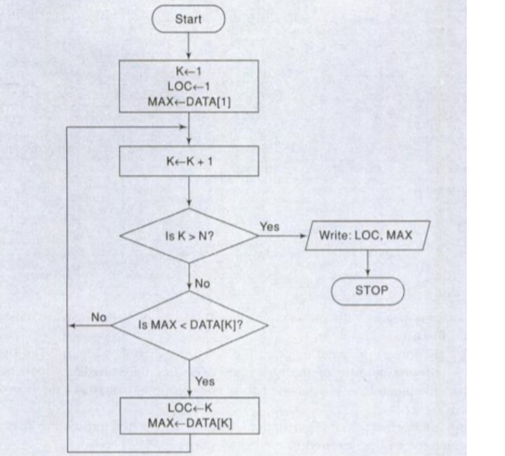
Flowchart
The graphical representation of an algorithm is called a flowchart. For the flowchart of the above algorithm see the following flowchart:

Slide 12
CONTROL STRUCTURES
There are three types of logic, or flow of control, called
a. Sequence logic or sequential flow
b. Selection logic or conditional flow
c. Iteration logic or repetitive flow

Slide 13
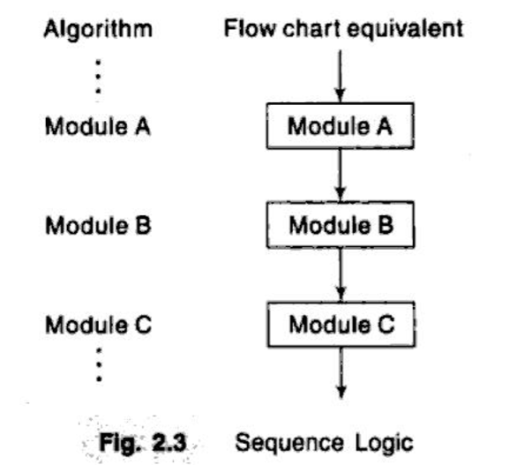
Sequence Logic (Sequential Flow)
Unless instructions are given to the contrary, the modules are executed in the obvious sequence. The sequence may be presented explicitly, by means of numbered steps, or implicitly, by the order in which the modules arc written. Most processing, even of complex problems, will generally follow this elementary flow pattern.

Slide 14
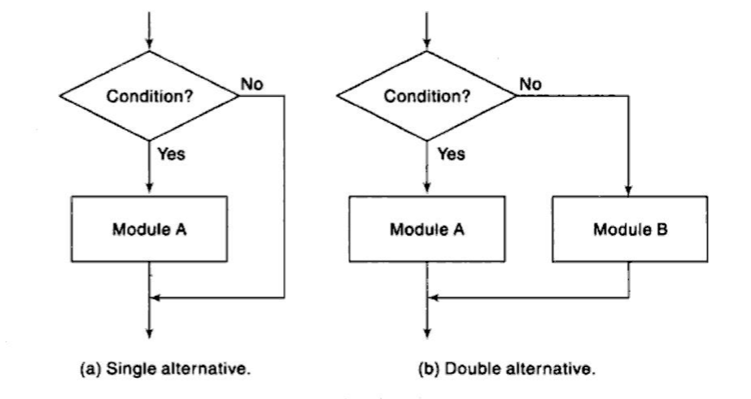
Selection Logic (Conditional Flow)
Selection logic employs a number of conditions which lead to a selection of one out of several alternative modules. The structures which implement this logic are called conditional structures or If structures. These conditional structures fall into three types, which are discussed below.
i) Single alternative: This structure has the form
If condition, then:
[Module A]
[End of If structure]
Here, if the condition is TRUE, then Module A is executed, otherwise, Module A is skipped and control transfers to the next step of the algorithm.

Slide 15
Selection Logic (Conditional Flow)
ii) Double alternative: This structure has the form
If condition, then:
[Module A]
Else:
[Module B]
[End of If structure]
In this logic, if the condition is TRUE, then Module A is executed; if it is FALSE then Module B is executed.
iii) Multiple alternatives: This structure has the form:
If condition (1) then:
[Module A₁]
Else if condition (2) then:
[Module A₂]
........
Else if Condition (M) then:
[Module A_{M}]
Else:
[Module B]
[End of If structure]
The logic of this structure allows only one of the modules to be executed. If the condition (1) is TRUE then Module A₁ is executed, if it is false then condition (2) is checked and if it is TRUE, then Module A₂ is executed, and so on. If all the conditions are FALSE then Module B is executed.

Slide 16
Quadratic Equation
Algorithm: (Quadratic Equation) This algorithm inputs the coefficients A, B, C of a quadratic equation and outputs the real solutions, if any.
Step 1. Read: A, B, C.
Step 2. Set D:= B² ‑ 4AC.
Step 3. If D > 0, then:
(a) Set X1 := (‑B + √D)/2A and X2:= (‑B ‑√D)/2A.
(b) Write: X1, X2.
Else if D = 0, then:
(a) Set X:= ‑B/2A.
(b) Write: 'UNIQUE SOLUTION', X.
Else:
Write: ' NO REAL SOLUTIONS'
[End of If structure]
Step 4. Exit.
Home task: Draw the flowchart for the above algorithm.

Slide 17
Iteration Logic (Repetitive Flow)
There are two types of iteration logic. Each type begins with a Repeat statement and is followed by a module, called the body of the loop.
i) The repeat-for loop:
Repeat for K = R to S by T:
[Module]
[End of loop]
Here, R is called the initial value, S is the end value and T is the increment. K is called control variable.
ii) The repeat-while loop:
Repeat while condition:
[Module]
[End of loop]
Here the loop is executed until the condition is FALSE.

Slide 18
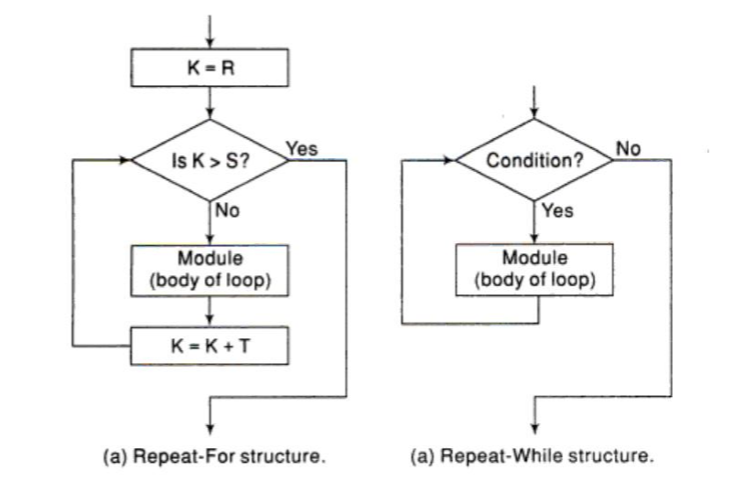
Iteration Logic (Repetitive Flow)

Slide 19
Largest Element in Array
Algorithm 2.3: (Largest Element in Array) given a nonempty array DATA with N numerical values, this algorithm finds the location LOC and the value MAX of the largest element of DATA.
1. [Initialize] Set K:=1, LOC:=1 and MAX:= DATA[1].
2. Repeat Steps 3 and 4 while K <= N:
3. If MAX < DATA [K], then:
Set LOC: = K and MAX: = DATA [K].
4. Set K: = K+1.
[End of Step 2 loop.]
5. Write: LOC, MAX.
6. Exit.
Home task: Draw the flowchart for the above algorithm.

Slide 20
SUBALGORITHMS
A subalgorithm is a complete and independently defined algorithmic module which is used (or invoked or called) by some main algorithm or by some other subalgorithm. A subalgorithm receives values, called arguments, from an originating (calling) algorithm; performs computations; and then sends back the result to the calling algorithm. The subalgorithm is defined independently so that it may be called by many different algorithms or called at different times in the same algorithm. The relationship between an algorithm and a subalgorithm is similar to the relationship between a main program and a subprogram in a programming language.
The main difference between the format of a subalgorithm and that of an algorithm is that the subalgorithm will usually have a heading of the form NAME (PAR₁, PAR₂, … , PAR_{K}).
Another difference is that the subalgorithm will have a Return statement rather than an Exit statement.

Slide 21
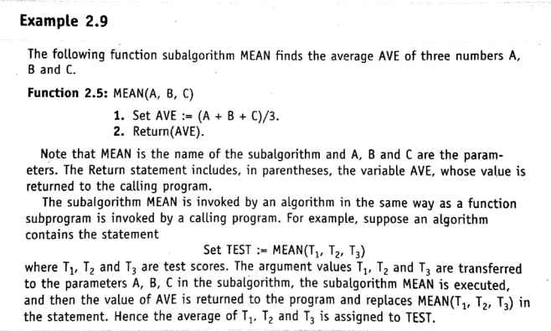
SUBALGORITHMS

Slide 22
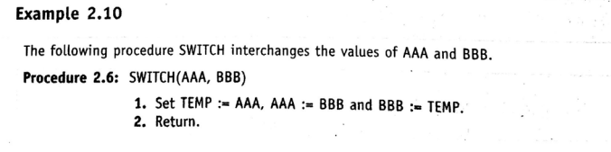
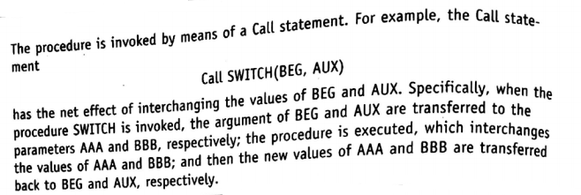
SUBALGORITHMS

Slide 23
Home Task
Problem:
Write a program to calculate the roots of the quadratic equation ax² + bx + c = 0 where a, b and c are known.
Write a program to find the largest number from a given list of integers.

