Slide 1
International Islamic University Chittagong
Department of Computer Science & Engineering
Spring - 2025
Course Code: CSE-2321
Course Title: Data Structures
Mohammed Shamsul Alam
Professor, Dept. of CSE, IIUC

Slide 2
Lecture – 3
Arrays

Slide 3
Linear Arrays
A linear array is a list of a finite number n of homogeneous data elements (i.e., data elements of the same type) such that:
The elements of the array are referenced respectively by an index set consisting of n consecutive numbers.
The elements of the array are stored respectively in successive memory locations.
The number n of elements is called the length or size of the array. If not explicitly stated, we will assume the index set consists of the integers 1, 2, …. N. In general the length or the number of data elements can be obtained from the index set by the formula
Length = UB – LB + 1
Where UB is the largest index, called the upper bound and LB is the smallest index, called the lower bound of the array.
The elements of an array may be denoted by the bracket notation (used in Pascal and C/C++)
A[1], A[2] , A[3], ……… , A[n]
The number K in A[K] is called a subscript or an index and A[K] is called a subscripted variable.

Slide 4
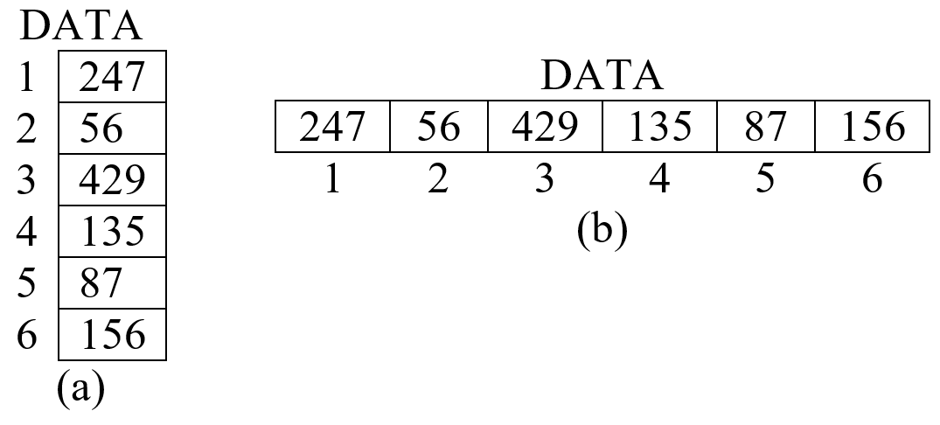
Linear Arrays
Example 4.1: Let DATA be a 6-element array of integers such that
DATA[1] = 247 DATA[2] = 56 DATA[3] = 429 DATA[4] = 135 DATA[5] = 87 DATA[6] = 156
  The array DATA is frequently pictured as in

Slide 5
Representation of Linear Arrays in Memory
Let LA be a linear array in the memory of the computer. We know, the memory of the computer is simply a sequence of addressed locations. Let us use the notation:
LOC (LA[K]) = address of the element LA[K] of the array LA
As previously noted, the elements of LA are stored in successive memory cells. Accordingly, the computer does not need to keep track of the address of every elements of LA, but needs to keep track only of the address of the first element of LA, denoted by BASE (LA) and called the based address of LA. Using this address BASE (LA), the computer calculates the address of any element of LA by the following formula:
LOC (LA[K]) = BASE(LA) + w ( K − LB)
Where w is the number of words per memory cell for the array LA.
  Note that the time to calculate LOC (LA[K)) is essentially the same for any value of K. Furthermore, given any subscript K, one can locate and access the content of LA[K] without scanning any other element of LA.

Slide 6
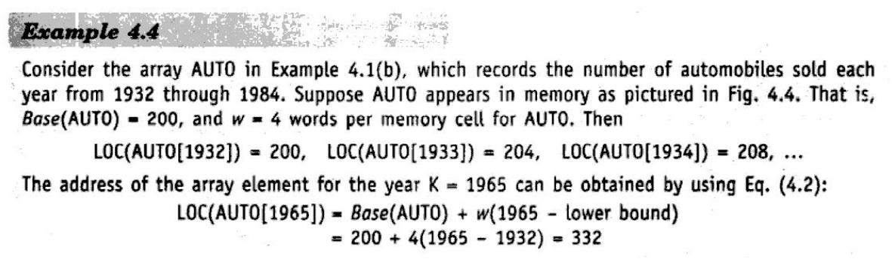
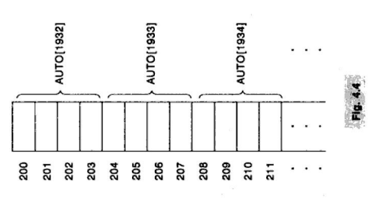
Representation of Linear Arrays in Memory

Slide 7
Traversing Linear Arrays
Let A be a collection of data elements stored in the memory of the computer. Suppose we want to print the contents of each element of A or suppose we want to count the number of elements of A with the given property. This can be accomplished by traversing A, by accessing and processing (frequently called visiting) each element of A exactly once.
(Traversing a Linear array) Here LA is a linear array with lower bound LB and upper bound UB. This algorithm traverses LA applying an operation PROCESS to each element of LA.
1. Set K := LB
2. Repeat Steps 3 and 4 while K<= UB
Apply PROCESS to LA[K]
3. Set K := K+1
[End of Step 2 Loop]
4. Exit.
  We also state an alternative form of the algorithm which uses a repeat-for loop instead of the repeat-while loop.
(Traversing a Linear array) This algorithm traverses linear array LA with lower bound LB and upper bound UB.
1. Repeat for K = LB to UB
Apply PROCESS to LA[K]
2. Exit.

Slide 8
Traversing Linear Arrays
  Caution: the operation PROCESS in the traversal algorithm may use certain variables which must be initialized before PROCESS is applied to any of the elements in the array. Accordingly the algorithm may need to be processed by such an initialized step.
  Example: Consider the array AUTO, which records the number of automobiles sold each year from 2000 through 2019. Each of the following modules, which carry out the given operation, involves traversing AUTO.
a. Find the number NUM of years during which more than 300 automobiles were sold.
1. Set NUM:=0.
2. Repeat for K =2000 to 2019:
If AUTO[K] > 300, then: Set NUM:‑NUM+1.
3. Return.
b. Print each year and the number of automobiles sold in that year.
1. Repeat for K=2000 to 2019:
Write: K, AUTO[K].
2. Return.
Sessional: Write a program to create an array of n elements and then separately write the odd and even elements of the list.

Slide 9
Inserting into a Linear Array
Let A be a collection of data elements in the memory of the computer. “Inserting” refers to the operation of adding another element to the collection A.
Inserting an element at the “end” of a linear array can be easily done provided the memory space allocated for the array is large enough to accommodate the additional element. On the other hand, suppose we need to insert an element in the middle of the array. Then, on the average, half of the elements must be moved downward to new locations to accommodate the new element and keep the order of the other elements.
(Inserting into a Linear Array) INSERT (LA, N, K, ITEM)
Here LA is a linear array with N elements and K is a positive integer such that K ≤ N. This algorithm inserts an element ITEM into the Kth position in LA.
1. Set J := N
2. Repeat Steps 3 and 4 while J ≥ K
3. Set LA [J+1] := LA [J]
4. Set J := J ‑ 1
5. Set LA [K] := ITEM
6. Set N := N + 1
7. Exit.

Slide 10
Deleting from a Linear Array
Let A be a collection of data elements in the memory of the computer. “Deleting” refers to the operation of removing one of the elements from A.
Deleting an element at the "end" of an array presents no difficulties, but deleting an element somewhere in the middle of the array would require that each subsequent element be moved one location upward in order to "fill up" the array.
(Deleting from a Linear Array) DELETE (LA, N, K. ITEM)
Here LA is a linear array with N elements and K is a positive integer such that K ≤ N. This algorithm deletes the Kth clement from LA.
I. Set ITEM := LA [K]
2. Repeat for J = K to N ‑ 1:
Set LA[J] := LA[J + 1]
3. Set N := N ‑ 1.
4. Exit.
Sessional:
Write a program to create an array of n elements and then insert an element to the list.
Write a program to create an array of n elements and then delete an element from the list.

Slide 11
Sorting: Bubble Sort
Let A be a list of n numbers. Sorting A refers to the operation of rearranging the elements of A so they are in increasing order, i.e., so that
A[1] < A[2] < A[3] < . . . < A[N]
For example, suppose A originally is the list
8, 4, 19, 2, 7, 13, 5, 16
After sorting, A is the list
2, 4, 5, 7, 3, 13, 16, 19.
(Bubble Sort) BUBBLE (DATA, N)
Here DATA is an array with N elements. This algorithm sorts the elements in DATA.
1. Repeat Steps 2 and 3 for K = 1 to N ‑ 1
2. Set PTR := 1
3. Repeat while PTR <= N ‑ K:
(a) If DATA[PTR] > DATA[PTR+1], then:
Interchange DATA[PTR] and DATA[PTR+1]
(b) Set PTR := PTR+1
4. Exit.

Slide 12
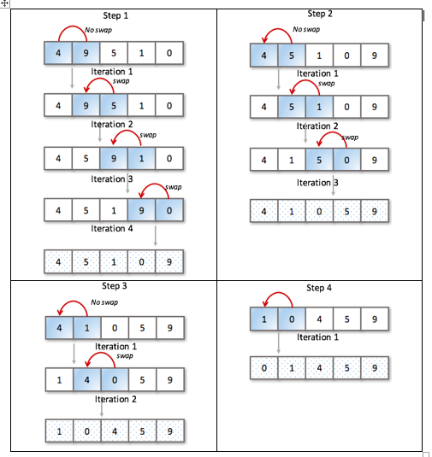
Example of Bubble Sort

Slide 13
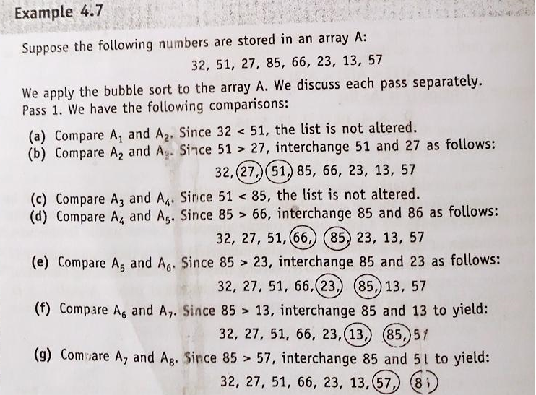
Sorting: Bubble Sort

Slide 14
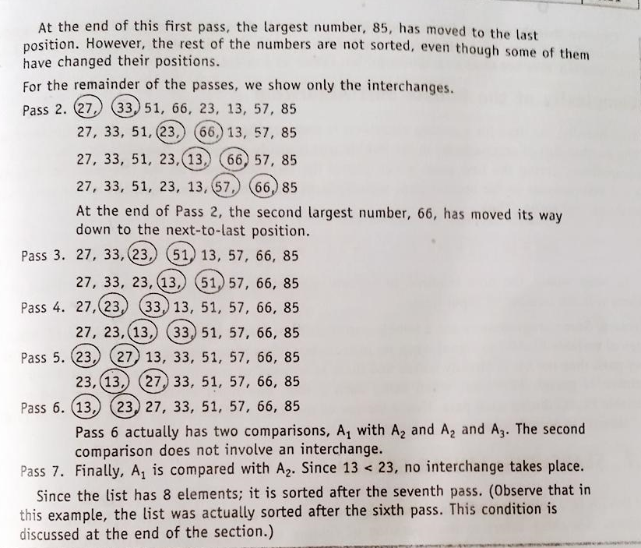
Bubble Sort

Slide 15
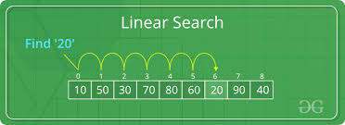
Searching
Let DATA be a collection of data elements in memory, and suppose a specific ITEM of information is given. Searching refers to the operation of finding the location LOC of ITEM in DATA, or printing some message that ITEM does not appear there. The search is said to be successful if ITEM does appear in DATA and unsuccessful otherwise.
There are many different searching algorithms. The algorithm that one chooses generally depends on the way the information in DATA is organized. Here we will discus two algorithms called linear search and binary search.
Linear Search
Suppose DATA is a linear array with n elements. Given no other information about DATA, the most intuitive way to search for a given ITEM in DATA is to compare ITEM with each element of DATA one by one. That is, first we test whether DATA[1] = ITEM, and then we test whether DATA[2] = ITEM, and so on. This method, which traverses DATA sequentially to locate ITEM, is called linear search or sequential search.

Slide 16
Linear Search
(Linear Search) A linear array DATA with N elements and a specific ITEM of information are given. This algorithm finds the location LOC of ITEM in the array DATA or sets LOC=0.
I. Set K := 1 and LOC := 0
2. Repeat Steps 3 arid 4 while LOC = 0 and K <= N
3. If ITEM = DATA [K], then: Set LOC := K
4. Set K := K + 1
5. If LOC = 0, then:
Write: ITEM is not in the array DATA
Else:
Write: LOC is the location of ITEM
6. Exit.

Slide 17
Linear Search
The following algorithm is suitable when one want to add the element ITEM to DATA after an unsuccessful search for ITEM in DATA.
(Linear Search) LINEAR (DATA, N. ITEM, LOC)
Here DATA is a linear array with N elements, and ITEM is a given item of information. This algorithm finds the location LOC of ITEM in DATA or sets LOC = 0 if the search is unsuccessful.
1. [Insert ITEM at the end of DATA] Set DATA [N + 1] := ITEM
2. Set LOC :=1
3. Repeat while DATA [LOC] ≠ ITEM:
Set LOC:= LOC + 1.
4. [Successful?] If LOC=N+ 1, then: Set LOC := 0
5. Exit.
Remark: Here, Step-1 guarantees that the loop in step 3 must terminate.

Slide 18
Binary Search
Suppose DATA is an array which is sorted in increasing numerical order or, equivalently, alphabetically. Then there is an extremely efficient searching algorithm, called binary search, which can be used to find the location LOC of a given ITEM of information in DATA.
(Binary Search) BINARY (DATA, LB, UB, ITEM, LOC)
Here DATA is a sorted array with lower bound LB and upper bound UB and ITEM is a given item of information. The variables BEG, END and MID denote, respectively, the beginning, end and middle locations of a segment of elements of DATA. This algorithm finds the location LOC of ITEM in DATA or sets LOC=NULL.
1. Set BEG := LB, END := UB and MID := INT((BEG+END)/2)
2. Repeat Steps 3 and 4 while BEG ≤ END and DATA [MID] ≠ ITEM
3. If ITEM < DATA [MID], then:
Set END := MID‑1
Else:
Set BEG := MID+1
4. Set MID := INT((BEG+END)/2)
5. If DATA [MID] = ITEM, then:
Set LOC := MID
Else:
Set LOC := NULL
6. Exit.

Slide 19
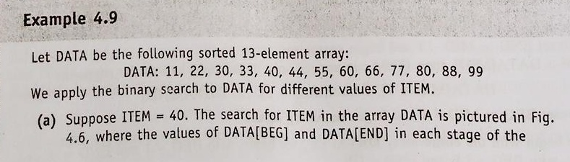
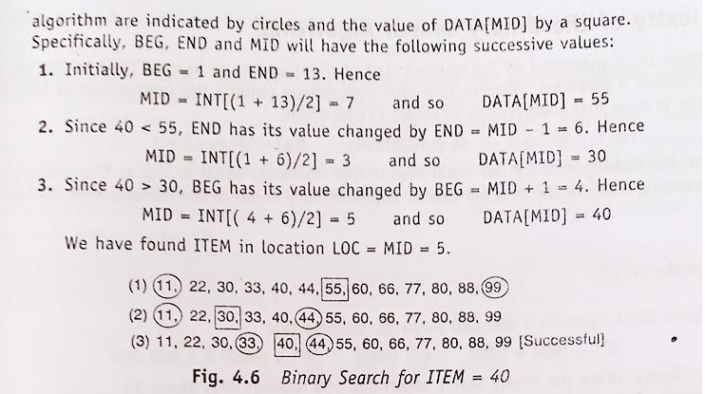
Binary Search

Slide 20
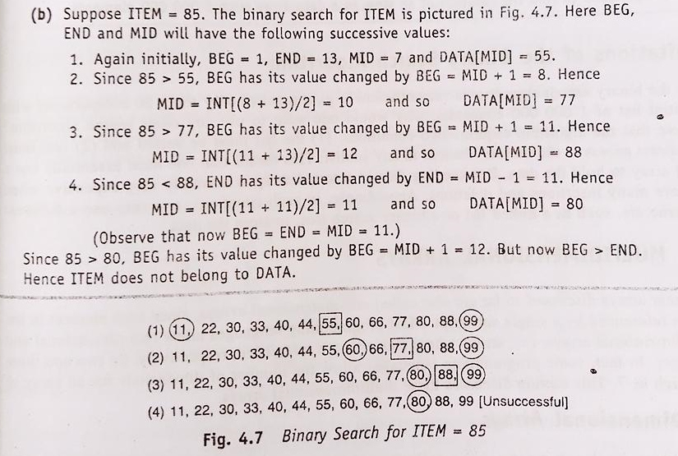
Binary Search
Remark: Whenever ITEM does not appear in DATA, the algorithm eventually arrives at the stage that BEG = END = MID. Then the next step yields END < BEG, and control transfers to Step 5 of the algorithm.
Remark: Whenever ITEM does not appear in DATA, the algorithm eventually arrives at the stage that BEG = END = MID. Then the next step yields END < BEG, and control transfers to Step 5 of the algorithm.

Slide 21
Binary Search
Limitations of the Binary Search Algorithm
a. The list must be sorted and
b. One must have direct access to the middle element to any sublist.
This means that one must essentially use a sorted array to hold the data. But keeping data in a sorted array is normally very expensive when there are many insertions and deletions. Accordingly, in such situations, one may use a different data structure, such as a linked list or a binary search tree, to store the data.
Sessional:
1. Write a program to sort n numbers using Bubble Sort algorithm.
2. Write a program to search an element from a list of n numbers using Linear Search algorithm.
3. Write a program to search an element from a list of n numbers using Binary Search algorithm.

