Slide 1
International Islamic University Chittagong
Department of Computer Science & Engineering
Spring - 2025
Course Code: CSE-2321
Course Title: Data Structures
Mohammed Shamsul Alam
Professor, Dept. of CSE, IIUC

Slide 2
Lecture – 5
Multidimensional Arrays

Slide 3
Multidimensional Arrays
A multi-dimensional array is an array of arrays.
2-dimensional arrays are the most commonly used. They are used to store data in a tabular manner.
Most programming languages allow two‑dimensional and three‑dimensional arrays, i.e., arrays where elements are referenced, respectively by two and three subscripts.
In fact some programming languages allow the number of dimensions for an array to be as high as 7.
In C programming an array can have two, three, or even ten or more dimensions. The maximum dimensions a C program can have depends on which compiler is being used.

Slide 4
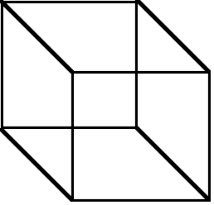
Higher-Dimensional Arrays
An array can be declared with multiple dimensions.
2 Dimensional 3 Dimensional
Multiple dimensions get difficult to visualize graphically.
•

Slide 5
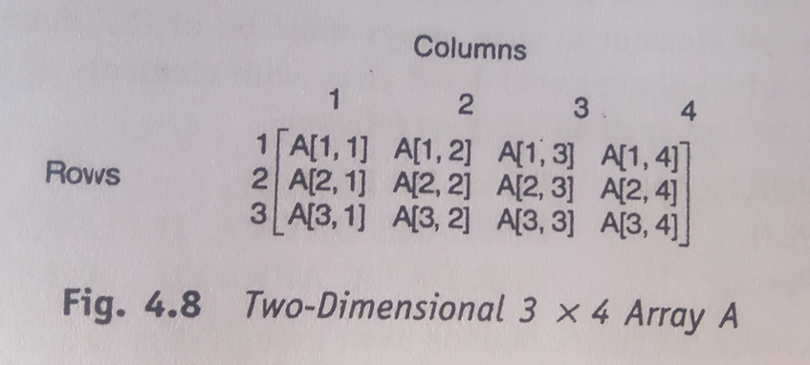
Two-Dimensional Arrays
A two-dimensional m x n array A is a collection of m . n data elements such that each element is specified by a pair of integers (such as j , k), called subscripts, with the property that
1 ≤ j ≤ m and 1 ≤ k ≤ n.
The element of A with first subscript j and second subscript k will be denoted by
A _{j, k} or A [j, k] or A [ j ] [ k ]
Two-dimensional arrays are called matrices in mathematics and tables in business applications; hence two-dimensional arrays are sometimes called matrix arrays.
A standard way of drawing a two-dimensional m x n array A where the elements of A form a rectangular array with m rows and n columns and where the element A [j, k] appears in row j and column k. Fig- 4.8 [page-4.19] shows a 3 x 4 array.

Slide 6
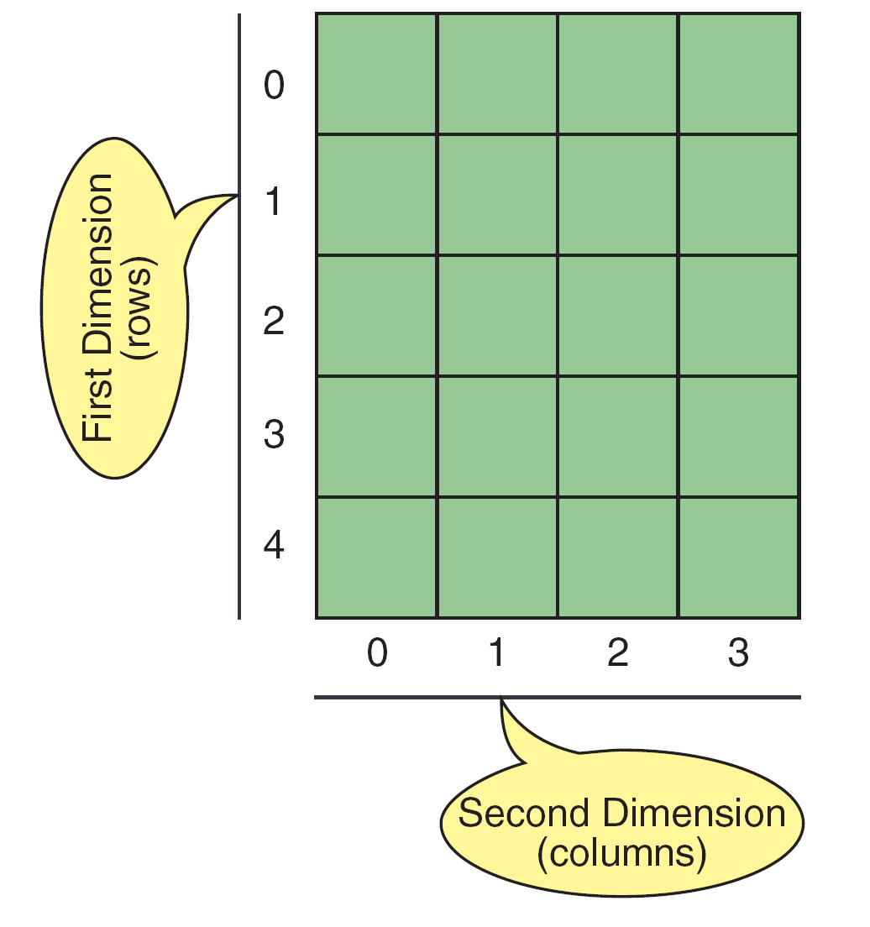
FIGURE 8-34 A Two-dimensional Array (5 x 4)

Slide 7
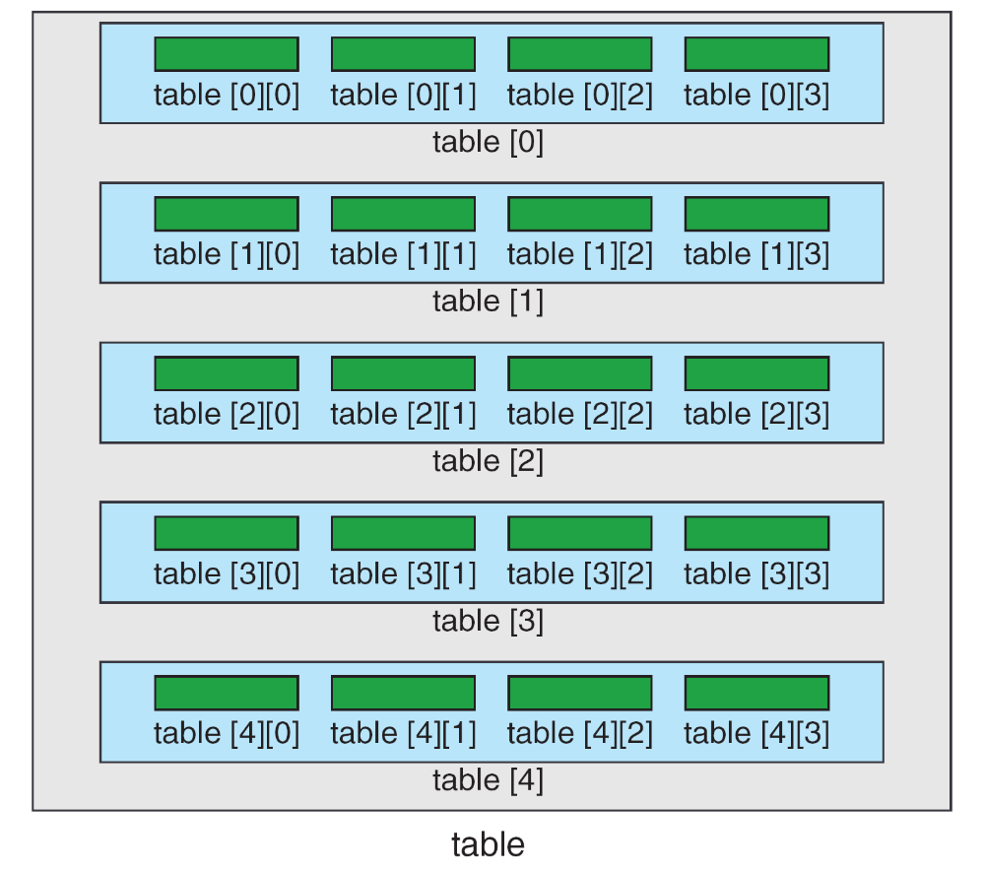
FIGURE C View of Two-dimensional Array

Slide 8
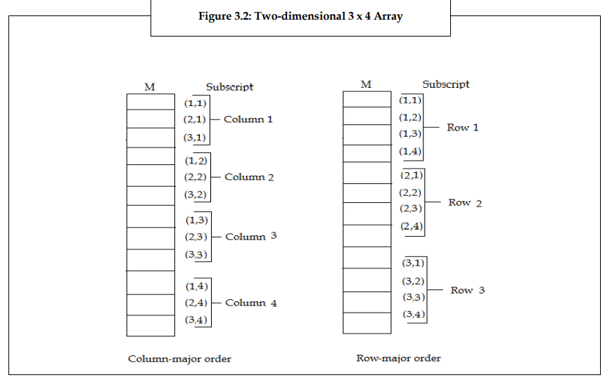
Representation of Two‑Dimensional Arrays in Memory
Let A be a two‑dimensional m x n array. Although A is pictured as a rectangular array of elements with m rows and n columns, the array will be represented in memory by a block of m . n sequential memory locations.
Specifically, the programming language will store the array A either
a) column by column, is what is called column‑major order, or
b) row by row, in row‑major order.
Row-major order is used in C,PL/I; column-major order is used in Fortran, MATLAB.
The following figure shows these two ways when A is a two‑dimensional 3 x 4 array.

Slide 9
Representation of Two‑Dimensional Arrays in Memory
To compute the address LOC (A [J, K]) of A [J, K] we can use the following two formulas:
(Column‑major order): LOC (A [J, K]) = Base (A) + w [M (K ‑ 1) + (J ‑ I)]
(Row‑major order): LOC (A [J, K]) = Base (A) + w [N (J ‑ 1) + (K ‑ 1)]
Here Base (A) is the address of the first element A[1,1] of A.
Example: Consider that 25 students are given 4 tests. The students are numbered from 1-25 and the test score is assigned in a 25 x 4 matrix array - MARKS. Suppose Base (MARKS) = 100 and w = 4 bytes, and the program stores two dimensional arrays using row-major order.
The address of MARKS[10,2], that is the marks scored by the tenth student in the second test are as per the formula:
LOC (MARKS[J,K]) = Base(MARKS) + w [N(J-1) + (K-1)]
LOC (MARKS[10,2]) = 100 + 4 [4(10-1) + (2-1)]
= 100 + 4 [36+1] = 248
If MARKS is stored using column-major order then what is the address of MARKS[10,2]?

Slide 10
2D Array Implementation in C
Write a program to read the elements of a 2D array and then display the elements of the array.
#include<stdio.h>
int main()
{
int r, c, i, j, m[10][10];
printf("How many rows and columns: ");
scanf("%d%d",&r, &c);
for(i=1 ; i<=r ; i++)
for(j=1 ; j<=c ; j++)
scanf("%d",&m[i][j]);
printf("\nOutput:\n");
for(i=1 ; i<=r ; i++)
{
for(j=1 ; j<=c ; j++)
printf("%d\t",m[i][j]);
printf("\n");
}
return 0;
}

Slide 11
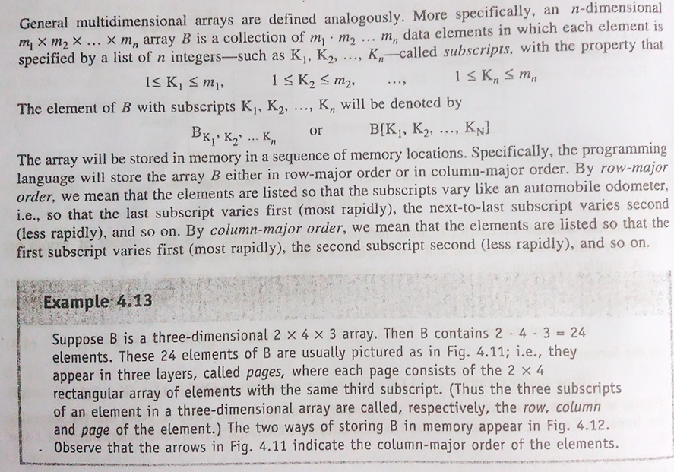
General Multidimensional Arrays

Slide 12
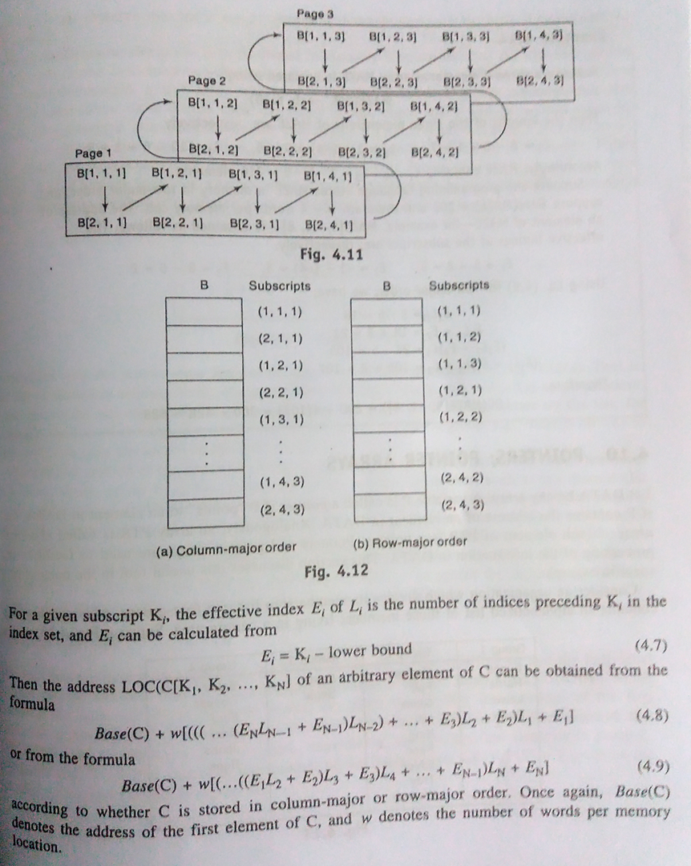
General Multidimensional Arrays

Slide 13
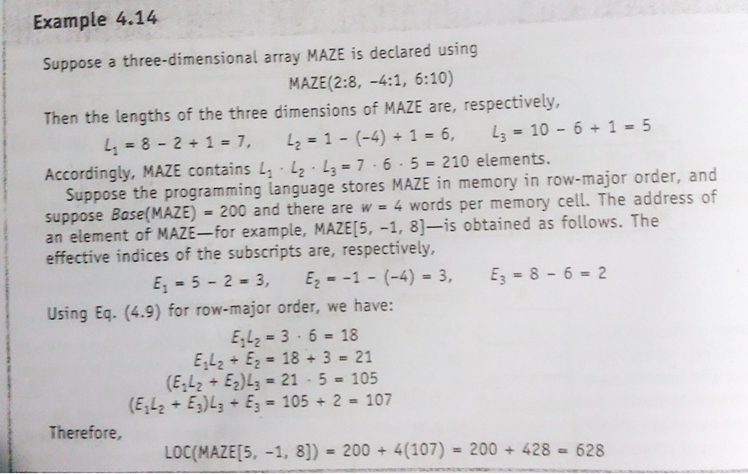
General Multidimensional Arrays

Slide 14
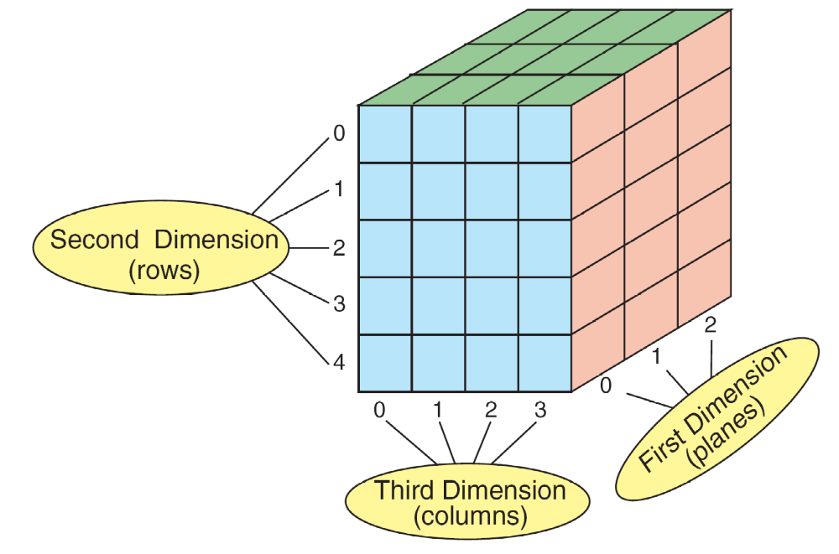
FIGURE 8-40 A Three-dimensional Array (3 x 5 x 4)

Slide 15
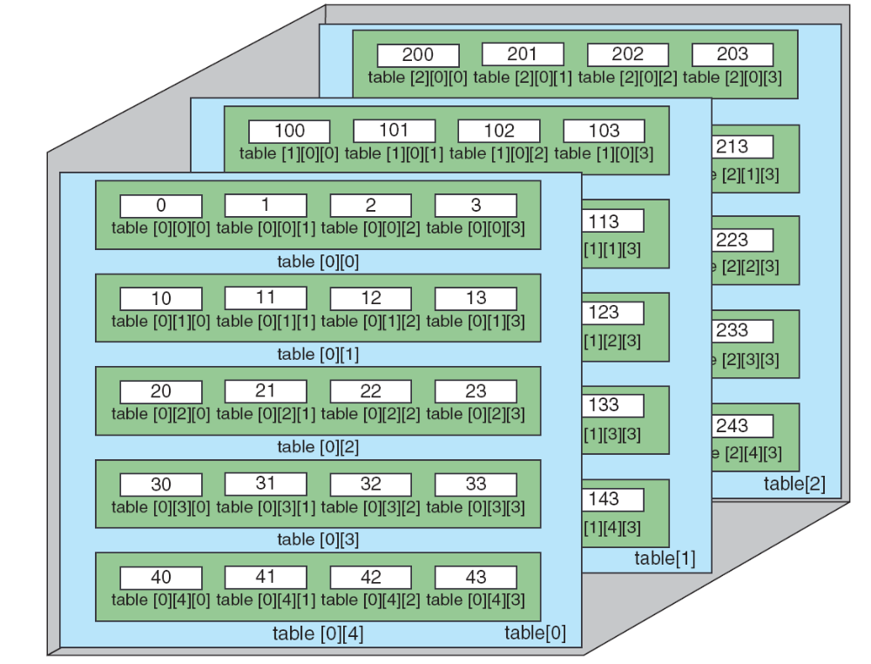
FIGURE 8-41 C View of Three-dimensional Array

Slide 16
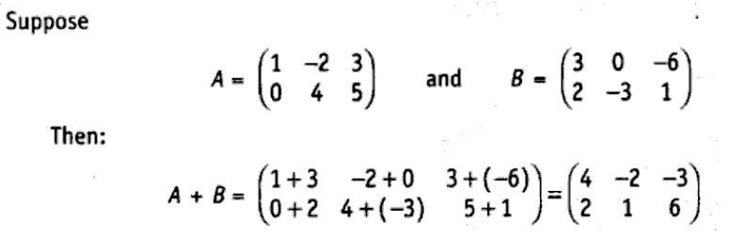
Matrices
An m x n matrix A is an array of m . n numbers arranged in m rows and n columns as follows:
A₁₁ A₁₂ A₁₃ . . . A_{1n}
A₂₁ A₂₂ A₂₃ . . . A_{2n}
A = . . . . . . . . . . . . . . . . . . . .
A_{m1} A_{m2} A_{m3} . . . A_{mn}
The transpose of a matrix is simply a flipped version of the original matrix. The result of transposing an m x n matrix is an n x m matrix with property:
    M^{T}(j,i) = M(i,j), 1 <= i <= m, 1 <= j <= n.
The sum of matrices is only defined for matrices that have the same dimensions. Suppose A and B are m x n matrices. The sum of A and B, written A + B, is the m x n matrix obtained by adding corresponding elements from A and B;

Slide 17
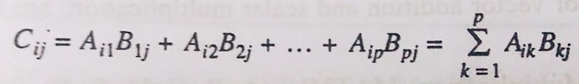
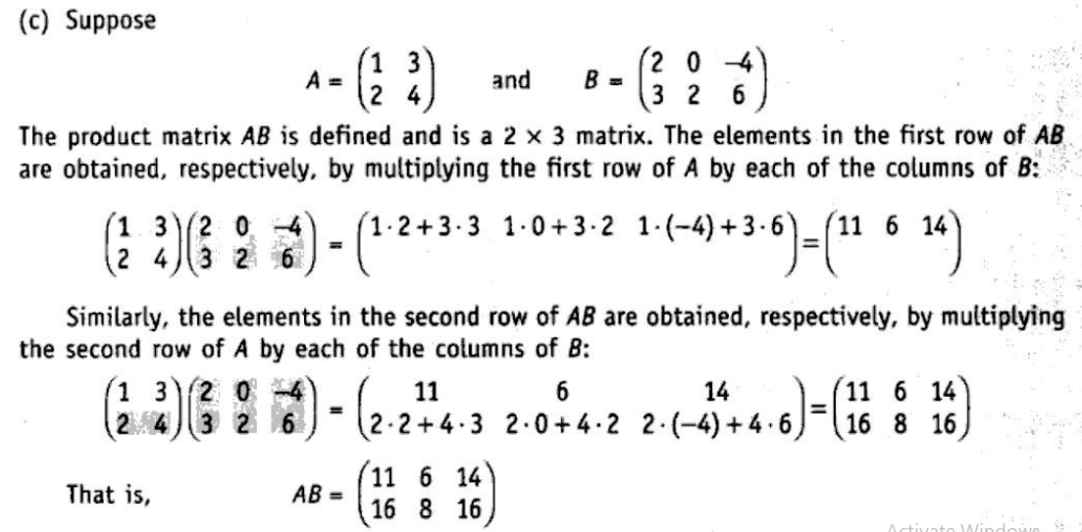
Matrix Multiplication
  The product of matrices A and B is only defined when the number of columns in A is equal to the number of rows in B.
  Suppose A is an m x p and suppose B is a p x n matrix. The product of A and B, written AB, is the m x n matrix C whose ij th element C_{ij} is given by

Slide 18
Matrix Multiplication
(Matrix Multiplication) MATMUL (A, B, C, M, P, N)
Let A be an M x P matrix array, and let B be a P x N matrix array. This algorithm stores the product of A and B in an M x N matrix array C.
1. Repeat Steps 2 to 4 for I = 1 to M:
2. Repeat Steps 3 and 4 for J = 1 to N:
3. Set C [I, J] := 0
4. Repeat for K= 1 to P:
C [I, J] := C [I, J] + A [I, K] * B [K, J]
Exit.
Sessional:
1. Write a program to interchange the row and column of a matrix.
2. Write a program to add two matrices.
3. Write a program to calculate the multiplication of two matrices.

Slide 19
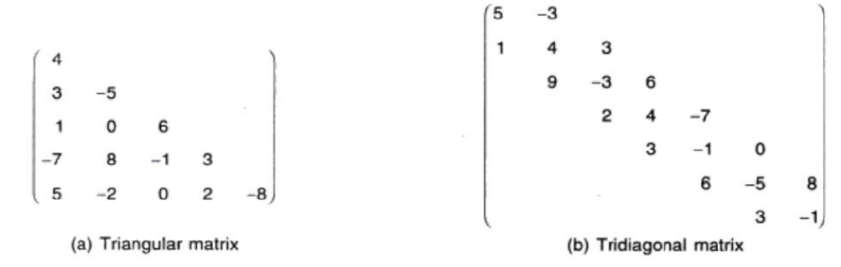
Sparse Matrices
Matrices with a relatively high proportion of zero entries are called sparse matrices. If the number of zeros in a matrix exceeds (n*m)/2, where n, m is the dimension of the matrix, then the matrix is called sparse matrix.
Two general types of n-square sparse matrices are there which occur in various applications are mention in figure below(It is sometimes customary to omit blocks of zeros in a matrix as shown in figure below)
Triangular matrix This is the matrix where all the entries above the main diagonal are zero or equivalently where non-zero entries can only occur on or below the main diagonal is called a (lower)Triangular matrix.
Tridiagonal matrix This is the matrix where non-zero entries can only occur on the diagonal or on elements immediately above or below the diagonal is called a Tridiagonal matrix.
The natural method of representing matrices in memory as two-dimensional arrays may not be suitable for sparse matrices i.e. one may save space by storing only those entries which may be non-zero

Slide 20
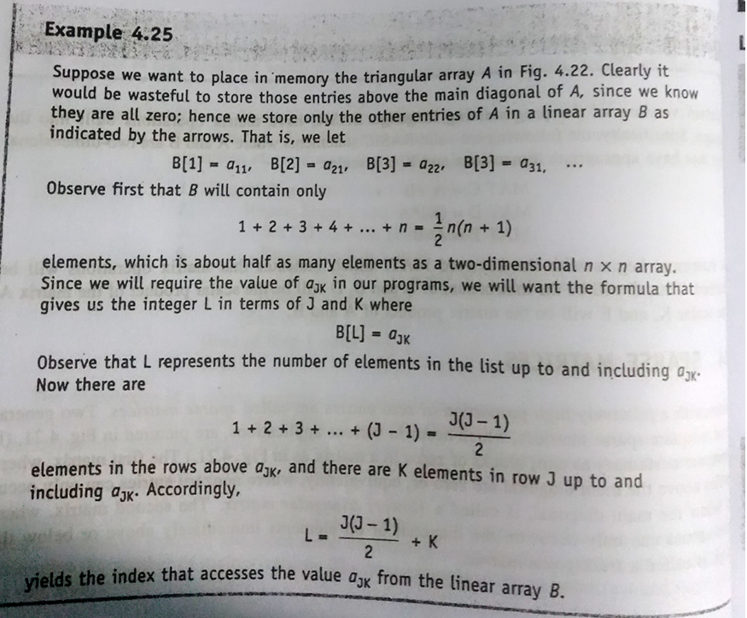
Sparse Matrices

Slide 21
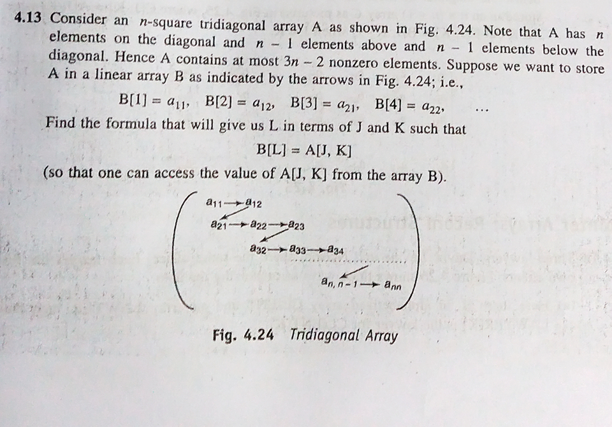
Sparse Matrices
Home Task:

