Slide 1
International Islamic University Chittagong
Department of Computer Science & Engineering
Spring - 2025
Course Code: CSE-2321
Course Title: Data Structures
Mohammed Shamsul Alam
Professor, Dept. of CSE, IIUC

Slide 2
Lecture – 6
String

Slide 3
String
A finite sequence S of zero or more characters is called a String.
The string with zero character is called the empty string or null string.
The number of characters in a string is called its length.
Specific string will be denoted by enclosing their character in single quotation mark. For example:
‘THE END’ ‘TO BE OR NOT TO BE’ ‘’ ‘123‘
are strings with lengths 7, 18, 0 and 3.
Let S1 and S2 be the strings. The string consisting of the character of S1 followed by the characters of S2 is called the concatenation of S1 and S2 . It will be denoted by S1 || S2 . For example,
S1 = ‘THE’ S2 = ‘END then
S1 || S2 = ‘THEEND’
S1 || ‘□‘ || S2 = ‘THE END’ Here ‘□‘ means blank space
The length of S1 || S2 is equal to the sum of lengths of the strings S1 and S2.

Slide 4
String
A string Y is called a substring of a string S if there exits strings X and Z such that S = X || Y || Z.
If X is an empty string, then Y is called initial substring of S, and if Z is an empty string then Y is called terminal substring of S.
For example
‘BE OR NOT’ is a substring of ‘TO BE OR NOT TO BE’
‘THE’ is an initial substring of ‘THE END’
‘END’ is a terminal substring of ‘THE END’
If Y is a substring of S then the length of Y cannot exceed the length of S.

Slide 5
String Operations
Length
The number of characters in a string is called its length. We will write LENGTH (string)
for the length of a given string. For example,
LENGTH (‘Computer’) = 8
LENGTH (‘0’) = 1
Concatenation
Let S1 and S2 be strings. The concatenation of S1 and S2 is denoted by S1 || S2 , is the string consisting of the characters of S1 followed by the characters of S2 . For example,
Suppose S1 = ‘Kazi‘ and S2 = ‘Nazrul’ then
S1 || S2 = ‘KaziNazrul’
S1 || ‘□‘ || S2 = ‘Kazi Nazrul’

Slide 6
String Operations
Substring
Accessing a substring from a given string requires 3 pieces of information.
i) The name of the string or the string itself
ii) The position of the first character of the substring in the given string
iii) The length of the substring or position of the last character of the substring
We call this operation SUBSTRING. Specifically, we write
SUBSTRING (String, initial, length)
to denote the substring of a string S beginning in a position K and having a length L or SUBSTRING (S, K, L).
For example,
SUBSTRING (‘TO BE OR NOT TO BE‘, 4, 7) = ‘BE OR N’
SUBSTRING (‘THE END’, 4, 4) = ‘□END’

Slide 7
String Operations
Indexing
Indexing also called pattern matching, refers to finding the position where a string pattern P first appears in a given string text T.
We call this operation INDEX and write as
INDEX (text, pattern)
If the pattern P does not appear in text T then INDEX is assigned the value 0.
The arguments text and pattern can be either string constants or string variables.
For example,
T = ‘HIS FATHER IS THE PROFESSOR‘
Then
INDEX (T, ‘THE‘) = 7
INDEX (T,’THEN‘) = 0
INDEX (T, ‘□THE‘) = 14

Slide 8
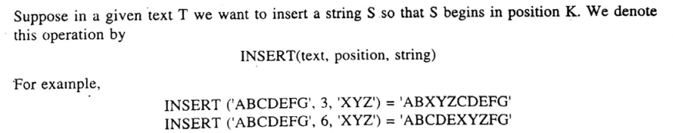
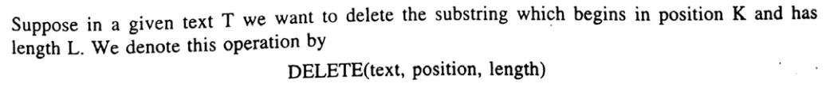
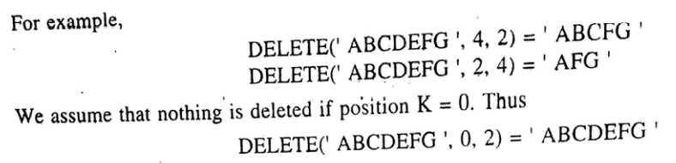
Word Processing
Insertion
Deletion

Slide 9
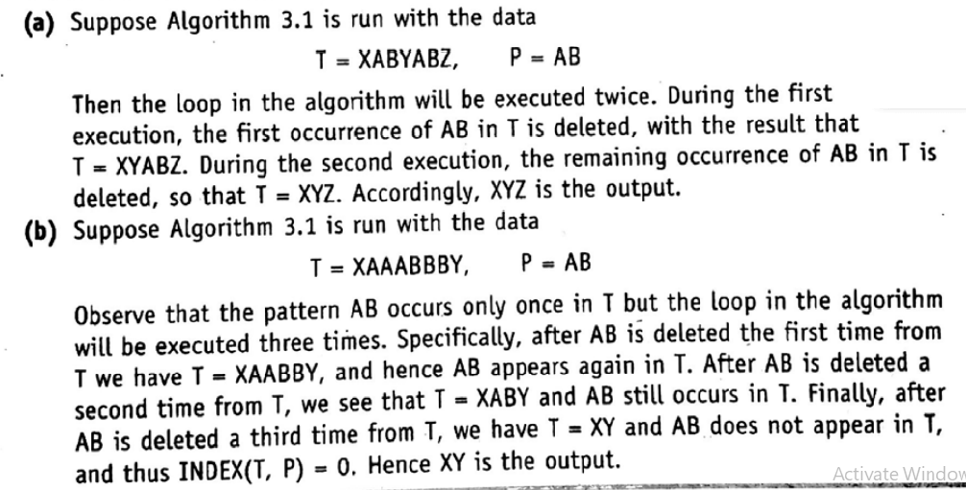
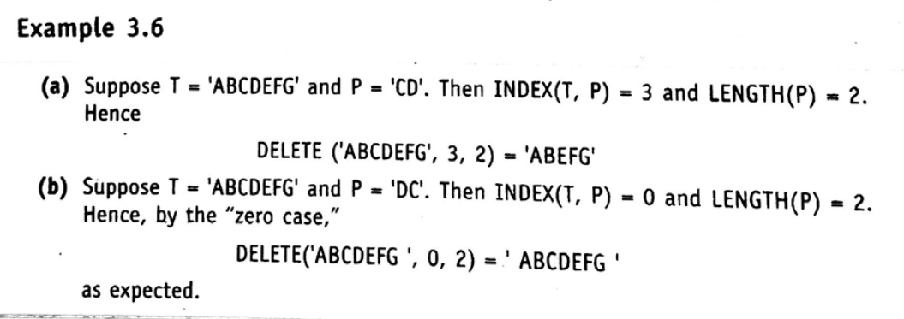
Word Processing
Deletion [First occurrence of the pattern P in T]
Deletion [Every occurrence of the pattern P in T]

Slide 10
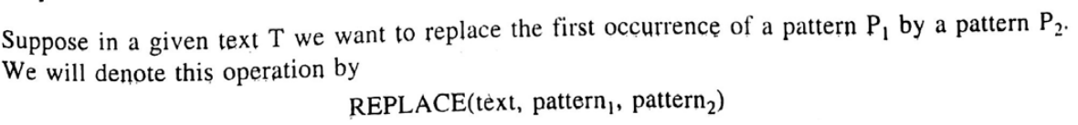
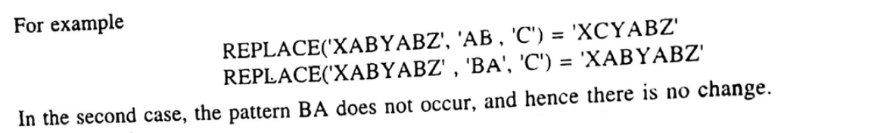
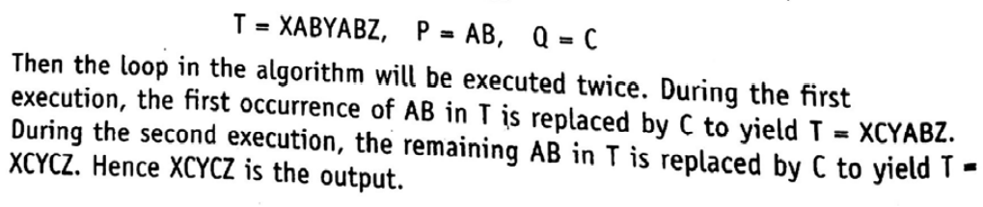
Word Processing
Replacement
Replacement [Every occurrence of the pattern P in T by Q]

Slide 11
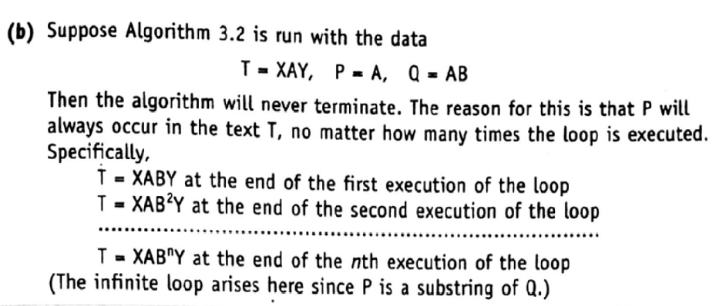
Word Processing
Replacement [Every occurrence of the pattern P in T by Q]
NB:

Slide 12
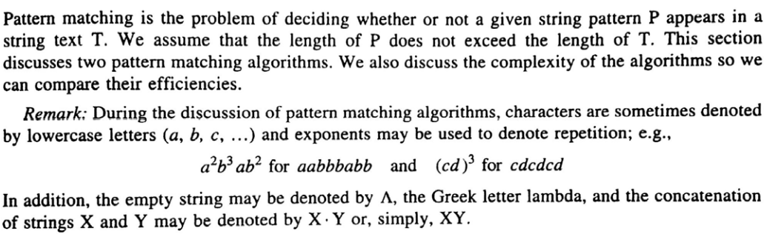
Pattern Matching Algorithm

Slide 13
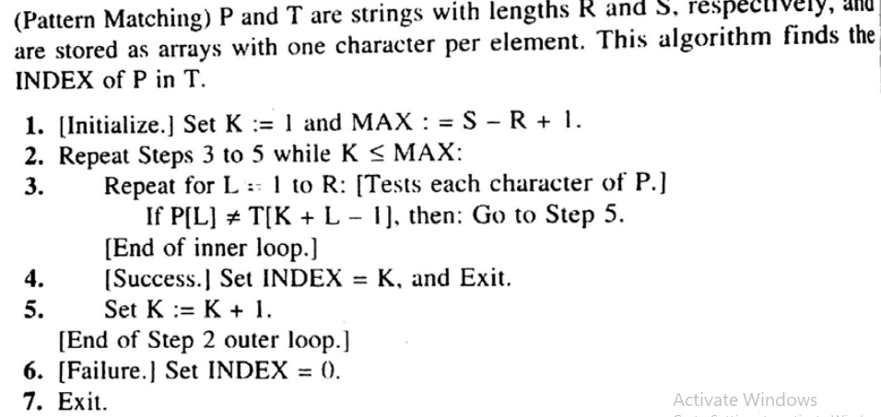
Pattern Matching Algorithm

Slide 14
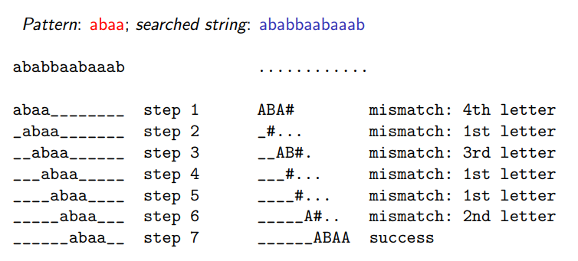
Pattern Matching Algorithm

Slide 15
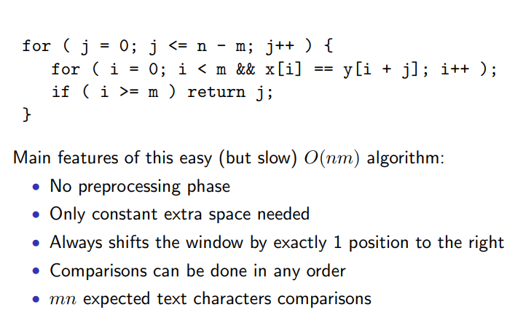
Pattern Matching Algorithm

Slide 16
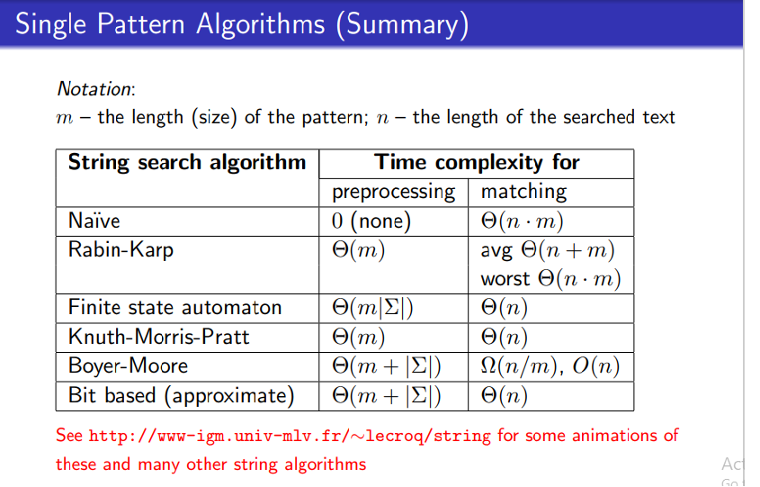
Pattern Matching Algorithm

