Slide 1
International Islamic University Chittagong
Department of Computer Science & Engineering
Spring - 2025
Course Code: CSE-2321
Course Title: Data Structures
Mohammed Shamsul Alam
Professor, Dept. of CSE, IIUC

Slide 2
Lecture – 7
Linked List

Slide 3
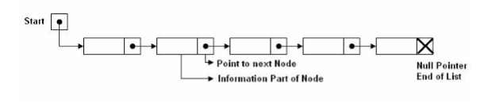
Linked list
A linked list, or one-way list, is a linear collection of data elements, called nodes, where the linear order is maintained by means of links or pointers.
In linked list, each node is divided into two parts: the first part contains the information of the element, and the second part, called the link field or next pointer field, contains the address of the next node in the list.
The pointer of the last node contains a special value, called null pointer, which is any invalid address. The null pointer, denoted by x in the diagram, signals the end of the list.
There is a special pointer START - which contains the address of first node in the list.
START = NULL means list has no nodes. Such a list is called the null list or empty list.
The following Fig shows a schematic diagram of a linked list with five nodes.

Slide 4
Linked list
Linked lists were developed in the year 1955-56 by Allen Newell, Cliff Shaw, and Herbert Simon at RAND Corporation as a primary data structure. It was developed for their Information Processing Language (IPL). IPL was used by the authors to develop several early artificial intelligent programs, including Logic Theory Machine, the General Problem Solver, and a computer chess program.
The drawbacks of using arrays are:
1. Once the elements are stored, it becomes difficult to insert or delete an element at any position in a list.
2. Arrays have fixed size. Hence, if the memory allocated is too large than the actual data, unused portion of the memory is wasted. If the allocated memory is less, it will result in loss of data due to inadequate memory.
The advantage of using linked list is its ability to dynamically shrink and expand in size. This allows you to insert or delete elements efficiently at any position in the list.

Slide 5
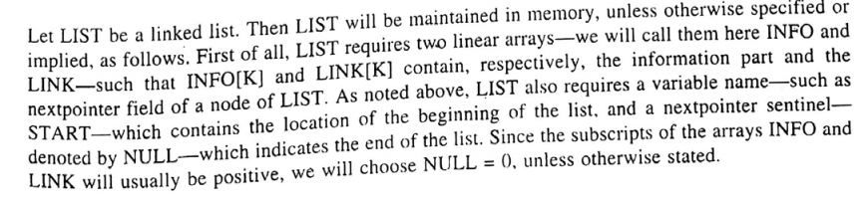
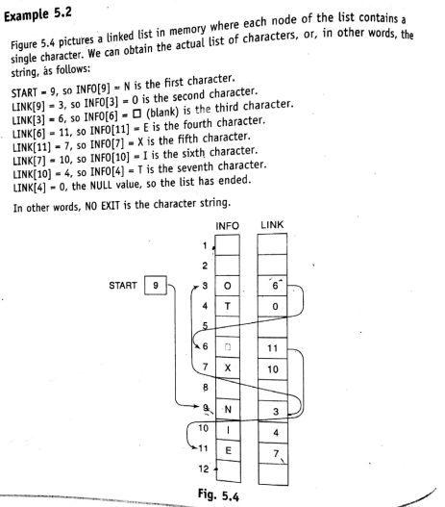
Representation of the linked list in memory
M..

Slide 6
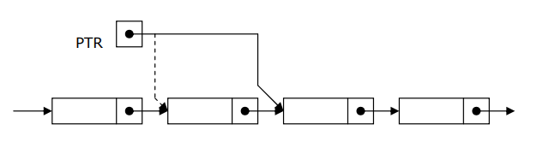
Traversing a Linked List
Algorithm: (Traversing a Linked List) Let LIST be a linked list in memory. This algorithm traverses LIST, applying an operation PROCESS to each element of list. The variable PTR point to the node currently being processed.
1. Set PTR=START. [Initializes pointer PTR.]
2. Repeat Steps 3 and 4 while PTR!=NULL.
3. Apply PROCESS to INFO[PTR]. // PTR-> INFO
4. Set PTR = LINK [PTR] [PTR now points to the next node.]
// PTR= PTR-> NEXT
[End of Step 2 loop.]
5. Exit.

Slide 7
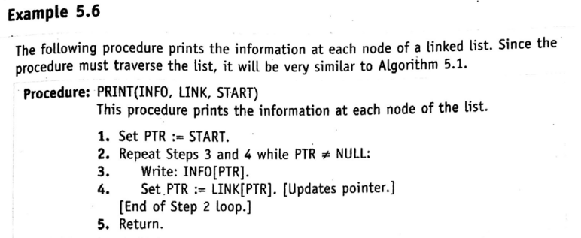
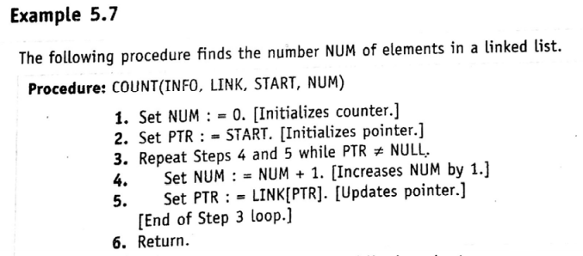
Traversing a Linked List

Slide 8
Searching a Linked List
Algorithm: SEARCH(INFO, NEXT, HEAD, ITEM, PREV, CURR, SCAN) LIST is a linked list in the memory. This algorithm finds the location LOC of the node where ITEM first appear in LIST, otherwise sets LOC=NULL.
1. Set PTR=START.
2. Repeat Step 3 and 4 while PTR≠NULL:
3. if ITEM = INFO [PTR] then: // ITEM = PTR->INFO
Set LOC=PTR, and Exit. [Search is successful.]
Else:
Set PTR=LNK [PTR] // PTR = PTR->NEXT
[End of Step 2 loop.]
4. Set LOC=NULL [Search is unsuccessful.]
5. Exit.

Slide 9
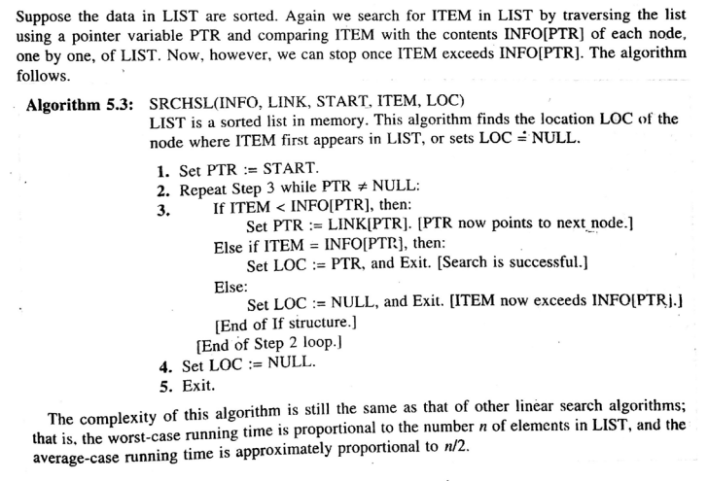
Searching a Sorted Linked List
Binary search algorithm can not be applied to a sorted linked list, since there is no way of indexing the middle element in the list.

Slide 10
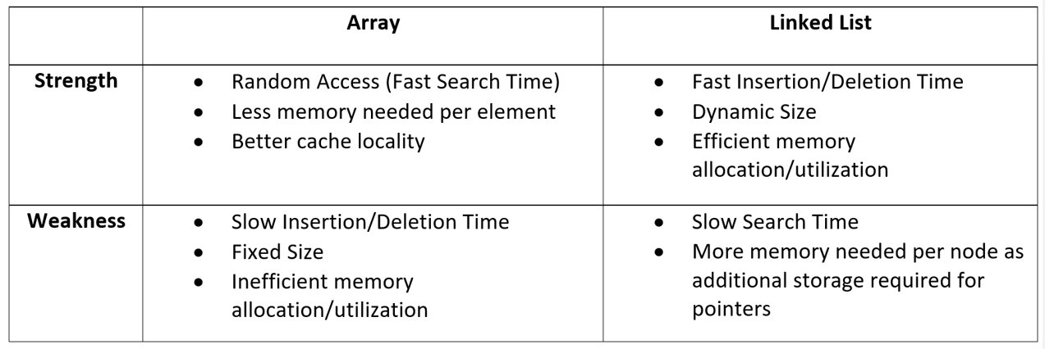
Array vs Linked list
.

