Slide 1
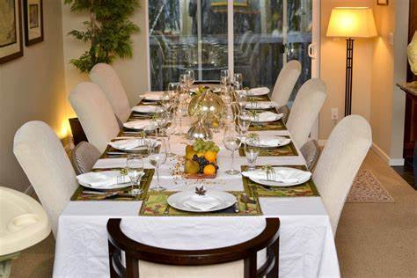
PRESENTED BY: Vijayalakshmi.R 422521104042
RESTAURANT RESERVATION CHATBOT

Slide 2
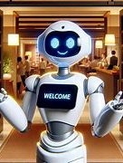
TITLE:
RESTAURANT RESERVATION CHATBOT

Slide 3
AGENDA:
1) Problem statement 2)Project Overview 3)Who are the end users 4)My solution and its value proposition 5)The wow in my solution 6)Modelling 7)Result 8)Conclusion

Slide 4
PROBLEM STATEMENT:
1)Traditional restaurant reservation expect. systems lack the immediacy and personalization that modern consumers.
2)Customers often face delays in confirming bookings, limited access to real-time availability, and minimal assistance in navigating menu options or special requests.
3)This leads to frustration, missed opportunities, and ultimately, a decline in customer satisfaction and loyalty.

Slide 5
PROJECT OVERVIEW:
The restaurant reservation chatbot project aims to revolutionize the way customers interact with the reservation process. Leveraging artificial intelligence and natural language processing technologies, the chatbot serves as an intelligent virtual assistant, guiding customers through the booking journey with ease and efficiency.
KEY FEATURES:
1) Seamless Booking
2) Real-time Availability
3) Personalized Assistance
4) Menu Exploration
5) Integration
6) Continuous Improvement

Slide 6
End Users:
Customers
Restaurant Staff
Individuals looking to make reservations at restaurants for dining purposes. They seek convenience, efficiency, and personalized assistance in the booking process.
Hosts, managers, and other staff members responsible for managing reservations and seating arrangements. They benefit from the chatbot by automating booking tasks, reducing workload, and improving operational efficiency.
Restaurant Owners
Marketing Teams
Business owners and managers who oversee the restaurant's operations and seek to optimize resource utilization, enhance customer satisfaction, and increase revenue through improved reservation management.
Professionals responsible for promoting the restaurant and attracting customers. They utilize the chatbot's data insights to understand customer preferences, tailor marketing campaigns, and drive customer engagement.

Slide 7
MY INNOVATIVE SOLUTIONS:
Introduce a modernized reservation system featuring online booking, real-time availability updates, and personalized customer interactions. Emphasize the value proposition of streamlined operations, improved customer satisfaction, and increased revenue.
VALUABLE PROPOSITION:
The valuable proposition of the restaurant reservations chatbot lies in its ability to enhance the booking experience for customers, streamline operations for restaurant staff, and drive business growth through personalized assistance, real-time updates, and seamless integration.

Slide 8

WOW IN MY SOLUTION :
01
Instantaneous Assistance: Our chatbot offers immediate responses to customer inquiries, providing real-time availability updates and personalized recommendations within seconds, creating a wow-worthy experience of efficiency and responsiveness.
Predictive Intelligence: Through advanced algorithms, our chatbot anticipates customer needs and preferences, offering tailored suggestions for seating arrangements, menu options, and special requests, leaving customers pleasantly surprised by its intuitive understanding.
24/7 Accessibility: Unlike traditional reservation methods, our chatbot is available round-the-clock, allowing customers to make bookings anytime, anywhere, enhancing convenience and flexibility, and setting a new standard for accessibility in the industry.
02
03

Slide 9
MODELLING:
Natural Language Understanding:
NLU
Use NLU techniques to extract key information from user messages, such as date, time, party size, and special requests.
RMSI
Reservation management System Integration:
Connect the chatbot to the restaurant's reservation system to check availability and make bookings in real-time.
IR
Intent Recognition:
Train the chatbot to understand user intents like making, modifying, or canceling reservations.

Slide 10
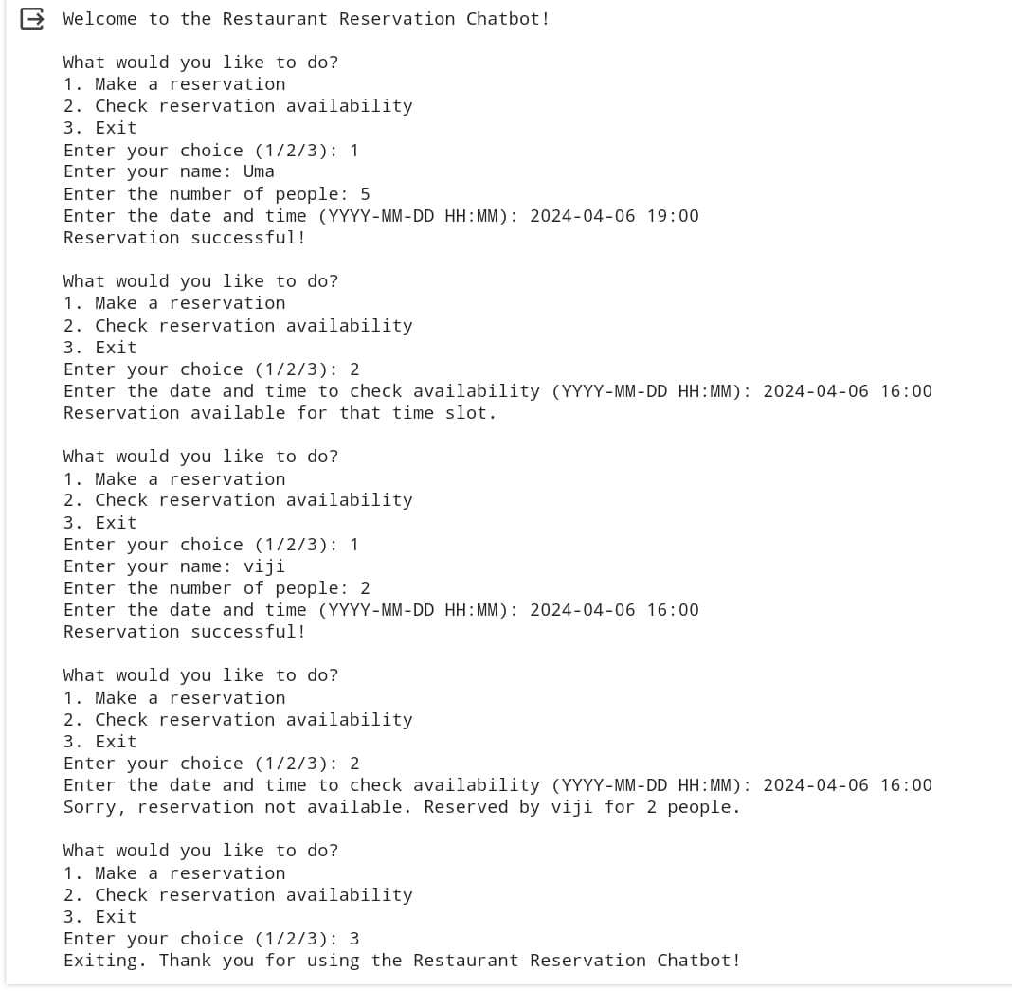
RESULT:

Slide 11
CONCLUSION:
In conclusion, the restaurant reservations chatbot provides a seamless and efficient way for customers to book tables, inquire about availability, and receive instant confirmations. Its user-friendly interface, quick responses, and round-the-clock availability enhance customer satisfaction and streamline restaurant operations.
With its ability to handle reservations, inquiries, and even provide recommendations, the chatbot serves as a valuable tool in enhancing the dining experience for both customers and restaurant staff.
“SEAMLESS RESERVATIONS,UNFORGETTABLE DINING.”

Slide 12
REFERENCES:
https://pandas.pydata.org/
https://scikit-learn.org/stable/index.html
https://chat.openai.com/

