Slide 1
Bird Species Classification using Transfer Learning with Multistage Training
Presented by:
Hizar Sajjad (20021519-068)
Hassan Tahir (20021519-083)

Slide 2
Bird Species Classification
01
Problem Statement
02
Proposed Technique
03
Dataset
04
Result

Slide 3
Problem Statement
Bird species classification poses a challenge in computer vision due to discriminative region localization and fine-grained feature learning difficulties. This paper addresses these challenges using a transfer learning-based approach with multistage training, aiming to achieve accurate species recognition from high-resolution photographs, considering issues like intensity variation, various poses, and class imbalance.

Slide 4
Proposed Technique
Architecture
Diagrams
Methodology

Slide 5
Proposed Technique
Architecture:
The architecture of the proposed bird species classification system involves a Transfer Learning-based approach with a Multistage Training strategy. It leverages pretrained Mask-RCNN for bird region localization and an ensemble model incorporating Inception Nets (Inceptionv3 net & InceptionResnetv2). The architecture aims to extract both micro and macro-level features from bird regions of interest (ROIs) for accurate classification.

Slide 6
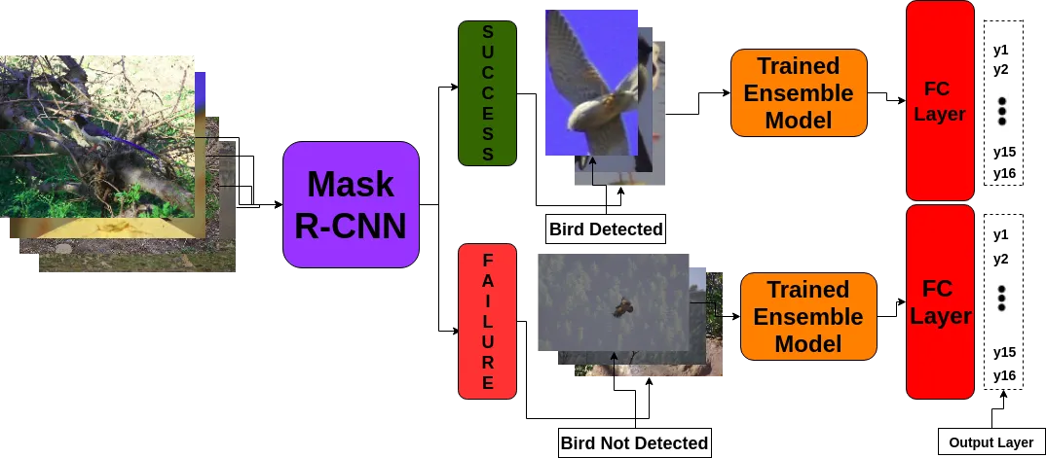
Proposed Technique
Diagram

Slide 7
Proposed Technique
Methodology
Data Augmentation
01
Bird ROI Detection
Transfer Learning
02
03
Utilized Mask R-CNN for localizing birds in images.
Pretrained on COCO dataset for accurate bird localization.
Techniques applied: Gaussian Noise, Gaussian Blur, Flip, Contrast, Hue, Add, Multiply, Sharp, Affine Transform.
Increased training dataset from 150 to 1330 images to address overfitting.
Used ImageNet pretrained weights for initialization.
Improved fine-grained and global features learning for accurate classification.

Slide 8
Proposed Technique
Methodology
Ensemble Model
04
Multi-Stage Training
05
Incorporated InceptionResNetV2 and InceptionV3 architectures.
Prediction vectors compared for each class during testing.
Initial training on InceptionV3 and InceptionResNetV2 on data-augmented original images.
Subsequent training on cropped images generated from Mask R-CNN.
Enhanced accuracy by 2-3%, emphasizing the importance of fine-grained features.

Slide 9
Dataset
01 | Source of Dataset
 | Utilized the CVIP 2018 Bird Species Challenge dataset.
02 | Training Dataset
 | Comprised 150 high-resolution images. Covered 16 different bird species.
03 | Testing Dataset
 | Consisted of 158 images for evaluation
04 | Image Characteristics
 | Varied resolutions, ranging from 800 × 600 to 4000 × 6000. Dataset exhibited class imbalance, with 5 images in one species to 20 images in others.

Slide 10
Results
01
Evaluation Metrics
02
Multi-Stage Training Impact
Precision, Recall, and F1-score used for comprehensive evaluation.
Metrics calculated from confusion matrix.
Inception ResNet V2 model, trained on both original and Mask R-CNN cropped images, showed the best results.
Improved accuracy by 2-3% after training on cropped images
04
Ensemble Model
03
Performance Across Architectures
InceptionV3 model achieved 41.66% accuracy on the test dataset.
InceptionResNetV2 model achieved 49.09% accuracy.
Mask R-CNN combined with InceptionV3 achieved an F1-score of 47.09%.
Mask R-CNN combined with InceptionResnetV2 achieved an F1-score of 51.05%.
Ensemble model, combining both, achieved the highest F1-score of 55.67%.

Slide 11
Thank You

