Slide 1
The effects of regularization on RNN models
Notes:
62759249-615a-433a-878f-5ccff6d67f3d

Slide 2
Hizar Sajjad
Presented by:
Hassan Tahir
20021519-068
20021519-083
Presented To:
Dr Zafar Mehmood Khattak

Slide 3
CONTENTS
Problem Statement
Proposed Technique
Dataset
Result
Notes:
72eb133f-e959-4c09-a4cb-c16a5aff074b

Slide 4
Problem Statement
01
Notes:
53ea509b-6c50-4bc6-9755-f76878922f7f

Slide 5

Problem Statement
The research addresses the challenge of enhancing the performance of Recurrent Neural Networks (RNNs) on small COVID-19 time series datasets. The primary goal is to identify effective regularization methods to improve the flexibility and effectiveness of the model in predicting the course of the pandemic.
Notes:
04e31f47-4772-46db-9e6e-494759801dfe

Slide 6
Proposed Technique
02
Architecture
Diagrams
Equations
Methodology
Notes:
5405b9f5-6dc1-4dc3-8735-abe051f287fc

Slide 7
Architecture
Multi-output encoder-decoder architecture.
Input: Location ID and multivariate time series for each country.
Components:
RNN encoder for time series processing.
Linear layer for handling location ID.
Three branches of fully connected nodes for confirmed, deceased, and recovered cases.
Outputs are concatenated into a context.
Context is processed by three specialized branches.
Notes:
1ab779b4-57c8-442b-9de0-d39d15124021

Slide 8
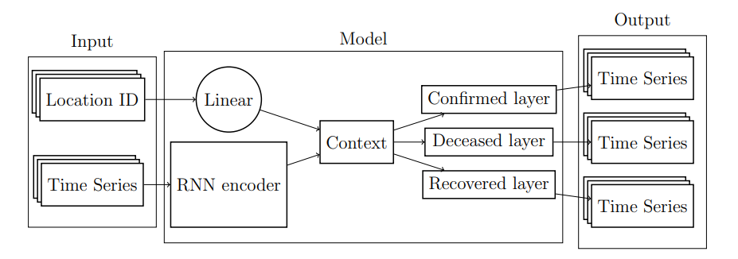
Diagram
Equations
Mathematical representation: yt+1:t+n​=M(x1:t​,ID,θ)
x1:t​: Time series data, ID: Location's unique identifier, θ: Model parameters.
Loss functions for L1 and L2 regularization with penalty factor λ for weights.
Notes:
84b1bff3-db27-442b-9b92-e9a043717259

Slide 9
Methodology
Training: 300 epochs with Adam optimizer, learning rate of 0.001, MSE as the loss function.
Regularization methods: L1, L2, and Dropout to prevent overfitting.
Cross-validation using forward chaining, forecast horizon of 28 days.
Training data size ranges from 28 to 392 days.
Evaluation based on RMSE.
Impact analysis of regularization on different data types (smooth, outlier, step, flat).
Best-performing model: GRU with 20% Dropout rate.
Notes:
091078b3-39ca-4738-9389-6b079057d39b

Slide 10
Dataset
03
Notes:
6b3f9804-a7b2-4385-a9f2-89164ce7f33d

Slide 11
Dataset
Source: Johns Hopkins University GitHub repository [2].
Number of Locations: The dataset includes information for a total of 187 different locations, mostly countries, and some cruise ships.
Multivariate Time Series: The data provides multiple time series for each location, capturing various aspects related to the COVID-19 pandemic, such as confirmed cases, deceased cases, and recovered cases.
Temporal Coverage: The time series data spans a significant period, starting from 04/02/2020 to 27/04/2021.
Preprocessing: To address issues related to data scale, the original data is standardized before being used in the neural network models.

Slide 12
Result
04
Notes:
9c39b2b7-48be-4371-a1d8-bb6b5793a745

Slide 13
Results
The results of the experiments outlined in the research paper provide insights into the performance of the proposed model and the impact of regularization methods. Here are key findings from the results:
Model Comparison: The study compares different models, particularly focusing on the Generalized Recurrent Unit (GRU) with various regularization techniques (L1, L2, and Dropout).
Regularization Impact: The results demonstrate that applying regularization methods, particularly a 20% Dropout, significantly improves model performance, as indicated by the reduction in Root Mean Squared Error (RMSE) scores.
Dataset Size Influence: Models trained on smaller datasets (e.g., 28 days of data) benefit more from regularization, with a notable 23% reduction in RMSE when using Dropout on a GRU model trained on only 28 days of data.
Performance Variability: The impact of regularization varies across different validation folds, indicating that the effectiveness of regularization methods depends on the specific characteristics of the data for each time period.

Slide 14
Thank you
Notes:
9c39b2b7-48be-4371-a1d8-bb6b5793a745

