Slide 1
Welcome
CS771: Introduction to Machine Learning
Purushottam Kar

Slide 2
Add-Drop
Add requests will be processed according to pre-declared policy http://tinyurl.com/ml19-20wfaq
All queries, requests, clarifications regarding add-drop will be handled only over email
Please do not approach me in person after class/in my office without prior appointment – I will not be able to respond to you in person

Slide 3
Course Details
Name: CS771 Introduction to Machine Learning
Lectures: Mon, Wed, Fri, 6:30-7:30 PM RM101
Course Team: wait for next slide
Course Website: https://tinyurl.com/ml19-20ww
Piazza Website: https://tinyurl.com/ml19-20wp (Enroll yourself!)
Office hours: uploaded on Piazza https://piazza.com/iitk.ac.in/secondsemester2020/cs771/staff

Slide 4
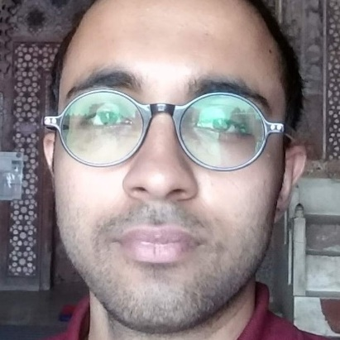

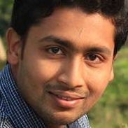

Course Team
Soumya Banerjee (soumyab)
Incremental Learning, Computer Vision, Machine Learning
Amit Chandak (amitch)
Decremental Learning, Bayesian Optimization, Representational Learning on Graphs
Debojyoti Dey (debojyot)
Optimization, Bayesian machine learning, Markov Chains, Dynamical systems
Nitish Mangesh Kalan (nitismk)
Reinforcement Learning, Computer Vision

Slide 5

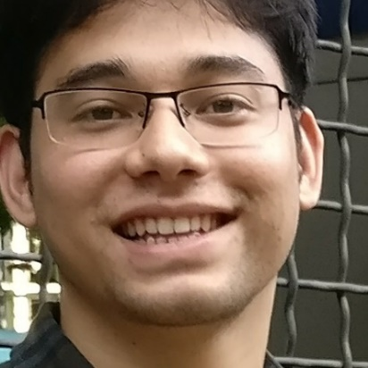
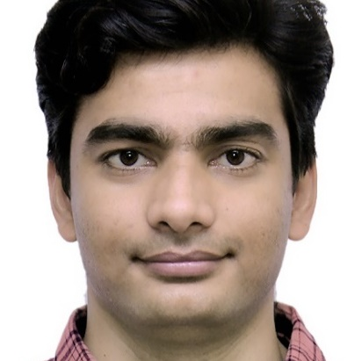

Course Team
Jimmy Kumar (jimmy)
Extreme Classification, Recommendation Systems, Bayesian Inference
Neeraj Matiyali (neermat)
Computer Vision
Bhaskar Pratim Mukhoty (bhaskarm)
Robust Learning, Security in ML, Time-series forecasting
Shailesh Vishweshwar Nandkule (nandkule)
Recommendation Systems, Reinforcement Learning

Slide 6



Course Team
Avijit Roy (avijit)
Deep Learning, Computer Vision
Saiteja Utpala (sait)
Probabilistic ML
Purushottam “Puru” Kar (purushot)
ML in Education, Extreme Classification, Robust Learning

Slide 7
Auditors
Please enrol yourself on Piazza (there is no separate mailing list)
Auditors will have access to several aspects of the course
Lectures and lecture material
Discussion forum activities
Assignment, quiz and examination questions and solutions
We regret our inability to extend the following services
Submit assignments and receive graded submissions
Appear for quizzes, examinations and receive graded answer scripts

Slide 8
Grading Scheme
Quizzes – 20%
Mini-projects – 30%
Mid-semester Exam – 20%
End-semester Exam – 30%

Slide 9
Quizzes – 20%
Two (2) quizzes to be conducted – each worth 10%
Jan 22 (Wed), Mar 25 (Wed)
Quizzes will be held in a separate lecture hall (L20) – details later
Only registered students will be allowed to appear for quizzes
Syllabus for each quiz will cover roughly 8-10 lectures – short quiz
If you are regular with lectures, practice problems, then you should not have to prepare excessively for these quizzes

Slide 10
Mini-projects (assignments) – 30%
Three (3) mini projects to be done (weightages to be decided)
Replaces the single monolith project in previous offerings of CS771
Mini-projects to be done in groups of five (5) students each
Start forming your group today
Will ask you to submit group details once add-drop is over
Groups can only contain registered students (no auditors)
Will have 1-2 weeks to finish each mini-project
Submission will include code + report
Code should be in Python – start learning Python today
Report must be in LaTeX – start learning LaTeX today

Slide 11
Reference Material
No single textbook for the course
Lecture slides, course notes will be uploaded onto course website
Reference material is already up on course material
Locally cached copies for some textbooks also available
Python Resources: several available – choose your favourite
www.geeksforgeeks.org/python-programming-language/
LaTeX resources: several available – choose your favourite
www.sharelatex.com/blog/latex-guides/beginners-tutorial.html
www.overleaf.com/learn/latex/Tutorials

Slide 12
Course Website
Detailed syllabus for this course
Course calendar : schedule for holidays, exams, quizzes
Course policies: assessment, course drop, make-up
Use of unfair means
Course etiquettes

Slide 13
To Do for You
Registered Students
Register yourself on Piazza
Start forming groups of five (5) students – do not wait long
Auditors
Register yourself on Piazza
Everybody
Refresh your calculus, probability theory, linear algebra basics
Start learning Python and LaTeX

Slide 14



What is Machine Learning
Why is it needed?
Hi, I am Ms. M and I will accompany you as you learn about ML
How is it done?
What is it?

Slide 15









Machine Learning
“
“
The art and science of designing adaptive algorithms
A Non-adaptive Algorithm
Sorting: given $n$ numbers, sort them in decreasing order of their value
An Adaptive Algorithm
Recommendation: given a person John and$n$ items, sort items in decreasing order of how much John likes them
4
9
5
5
1
7
-6
4
5
5
4
1
9
4
-3
0
I can help you learn patterns that allow you to sort the same set of items differently for each person according to their taste
3
3
-2
-2
7
2
1
-3
2
1
0
-6

Slide 16
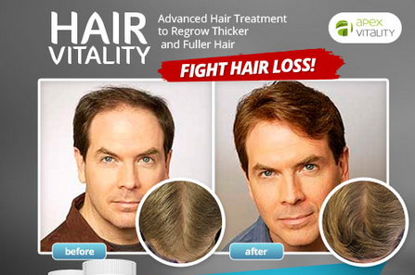
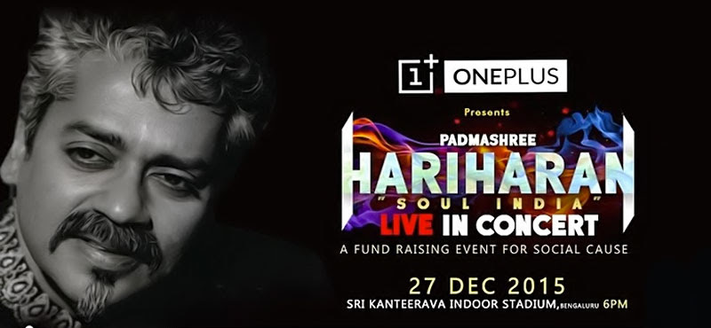
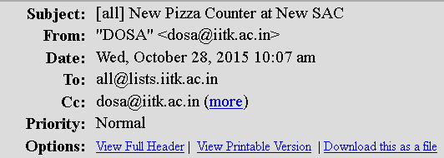
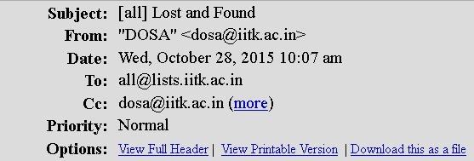
Machine Learning
“
“
The art and science of designing adaptive algorithms

Slide 17
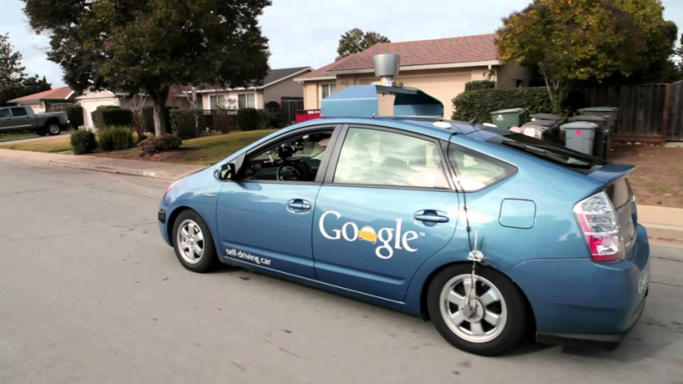
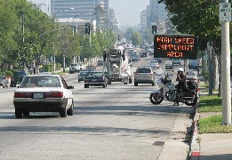
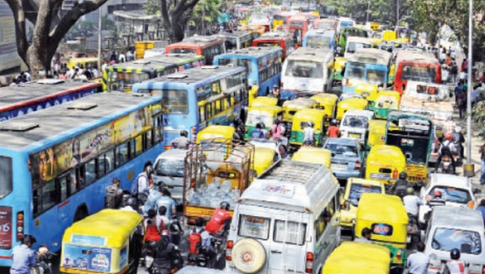
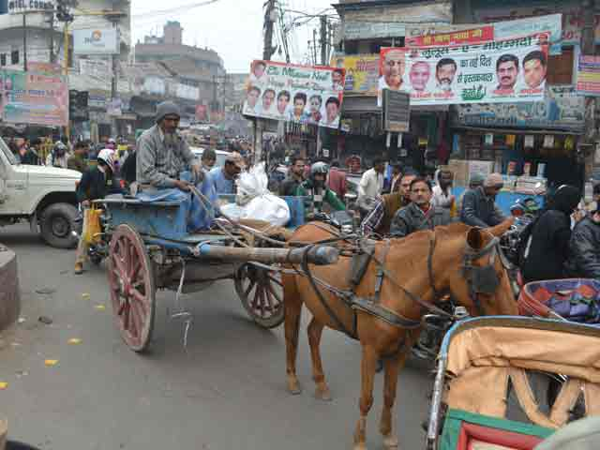
Machine Learning
“
“
The art and science of designing adaptive algorithms

Slide 18










When to apply ML
Complexity: no “closed form” solutions
Humans cannot specify simple rules to get solution
Detecting spelling mistakes not a good ML problem
A simple dictionary lookup (binary search) is enough
Presence of immense variety
Too many variants to be solved independently
Correcting spelling mistakes a very good ML problem
Need for automation
Scalability and speed are main criterion
Do we need to automate medicine, driving?
macine
macine
machine

Slide 19
A few cool applications of ML
ML + Programming Languages
ML + Logic/Cognition
ML + Image Processing
ML + Video Processing
ML + Earth Sciences

Slide 20
Program Correction with ML
IITK offers a C programming course to ~1000 students each year
#include <stdio.h>
int main(){
int a;
scanf("%d", a);
printf("ans=%d",a+10);
return 0;
}
#include <stdio.h>
int main(){
int a;
scanf("%d", &a);
printf("ans=%d",a+10);
return 0;
}
Line-4, Column-9: warning: format ‘%d’ expects argument of type ‘int *’, but argument 2 has type ‘int’

Slide 21
Program Correction with ML
IITK offers a C programming course to ~1000 students each year
#include <stdio.h>
int main(){
int x, x1 ,d;
d=(x-x1)(x-x1);
return d;
}
#include <stdio.h>
int main(){
int x, x1 ,d;
d=(x-x1)*(x-x1);
return d;
}
Line-4, Column-11: error: called object type ‘int’ is not a function or function pointer

Slide 22
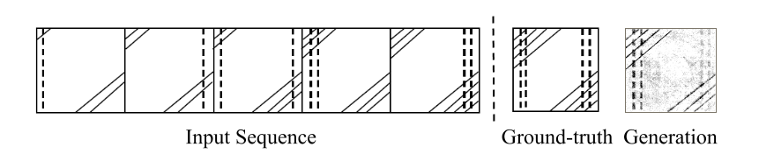



Abstract Reasoning with ML

Slide 23
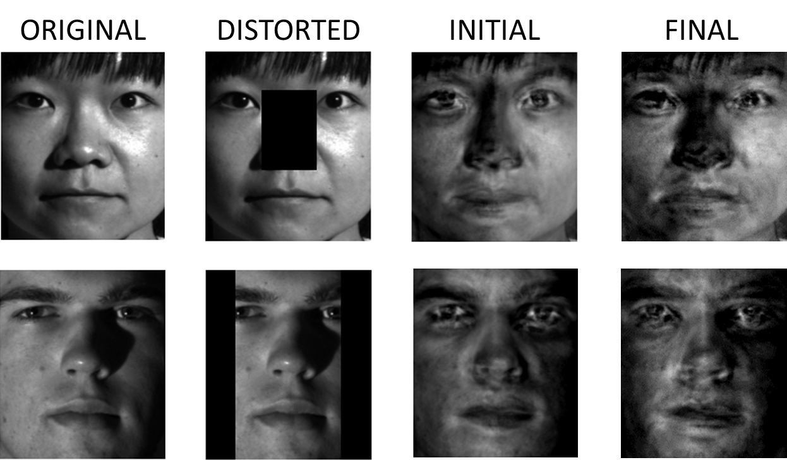
Image Reconstruction with ML

Slide 24
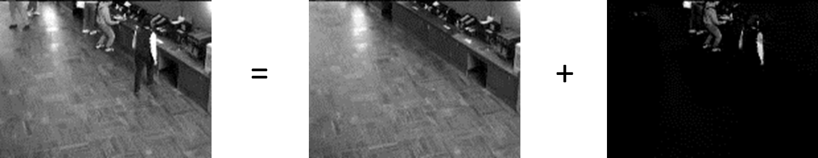

Video Surveillance with ML

Slide 25
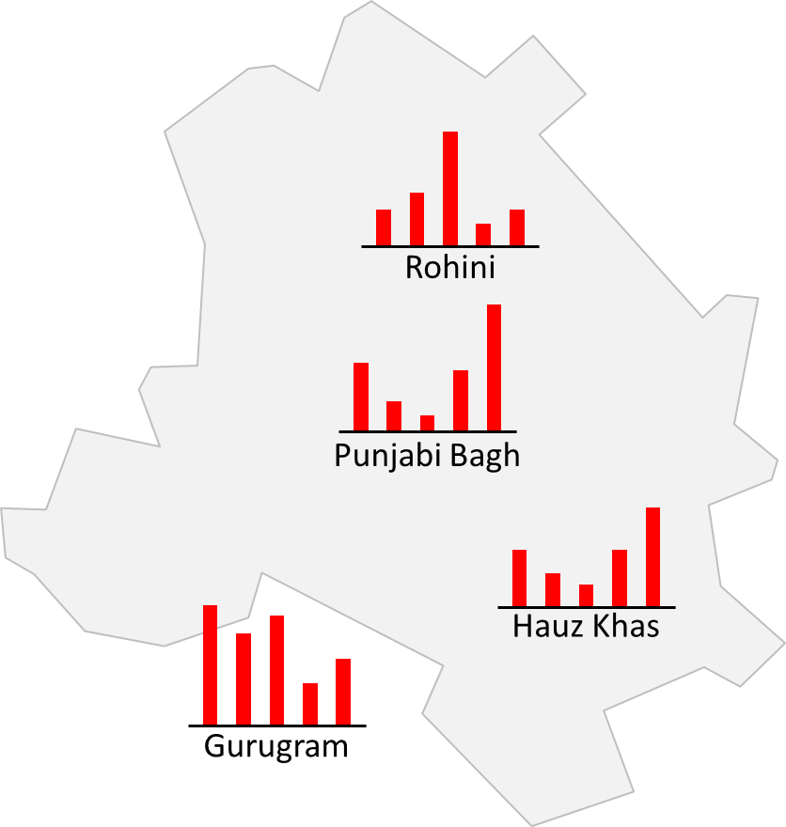
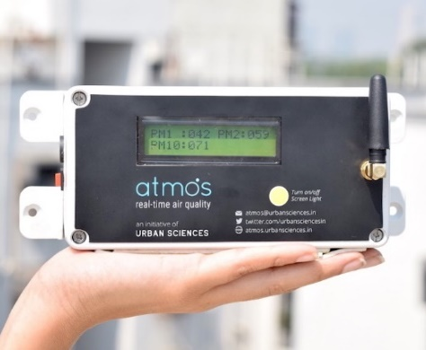

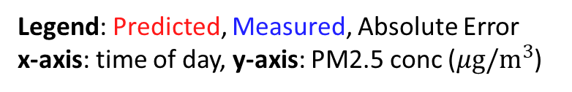

AQ Prediction with ML
Legend: Predicted, Measured, Absolute Error
x-axis: time of day, y-axis: PM2.5 conc ($μg/m^{3}$)
Gurugram S30
400
200
0
400
PM2.5 conc ($μg/m^{3}$)
200
0
400
200
0
2019-2-27
19:00:00
2019-3-03
14:00:00
2019-3-07
03:00:00
2019-3-10
23:00:00
2019-3-14
12:00:00
2019-3-18
01:00:00
2019-3-21
13:00:00
2019-3-25
02:00:00
IITD2
100
0
100
PM2.5 conc ($μg/m^{3}$)
0
100
50
0
50
2019-2-27
19:00:00
2019-3-03
14:00:00
2019-3-07
03:00:00
2019-3-10
23:00:00
2019-3-14
12:00:00
2019-3-18
01:00:00
2019-3-21
13:00:00
2019-3-25
02:00:00

