Slide 1
Introduction to JavaScript
Team 2

Slide 2
JavaScript is primarily used in front-end web development to create interactive elements, handle form validation, and perform client-side data processing. It can also be used in back-end development with frameworks like Node.js.

Slide 3
Advantages and Disadvantages
Advantages of JavaScript
Easy to learn and understand for beginners.
Can be used for both front-end and back-end development, making it versatile.
Has a large community support, providing resources and assistance.
Disadvantages of JavaScript
Security vulnerabilities can expose websites to potential attacks.
Browser compatibility issues may arise, requiring additional testing and adjustments.
Potential performance issues can occur, especially with large-scale applications.

Slide 4
Introduction to JavaScript
JavaScript is a programming language used to make web pages interactive and dynamic. It allows developers to add functionality, animations, and user interaction to websites.
JavaScript is supported by all modern web browsers, making it a reliable choice for web development.
It allows for the creation of dynamic and interactive web pages, enhancing the user experience.
JavaScript has a large and active community, providing developers with resources, libraries, and frameworks.

Slide 5
Key Features of JavaScript
➡️ Arrow Functions
Arrow functions are a concise way to write functions in JavaScript. They provide a shorter syntax compared to traditional function expressions.
⏳️ Asynchronous Programming
Asynchronous programming allows JavaScript to handle tasks that may take some time to complete, such as fetching data from a server or performing calculations.
📄 DOM Documents
DOM documents represent the structure of an HTML or XML document. JavaScript can manipulate the DOM to dynamically update the content and behavior of a web page.

Slide 6
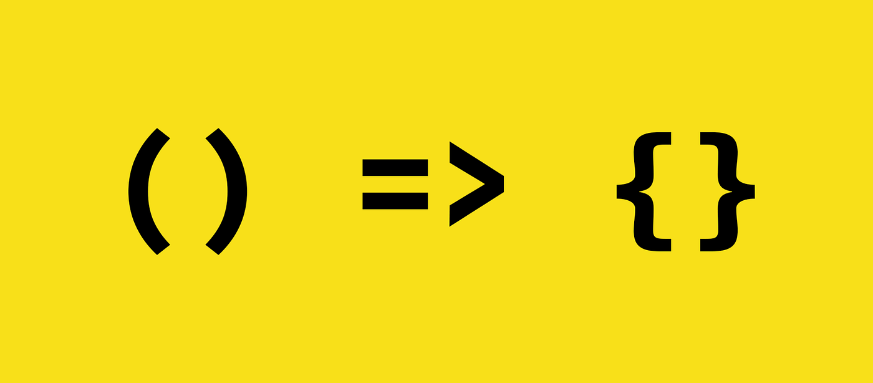
Introduction to Arrow Functions
Arrow functions are a type of function expression in JavaScript that allow for more concise and efficient code. They are defined using the arrow symbol (→) and can be used to simplify code and reduce the amount of code needed to accomplish a task.

Slide 7
Examples of Arrow Functions
Arrow functions can be used to simplify code by eliminating the need for a return statement. For example:
const result = (x, y) => x + y;
Arrow functions can be used to create anonymous functions. For example:
const add = (x, y) => x + y;
Arrow functions can be used to create higher-order functions. For example:
const double = (x) => x * 2;

Slide 8
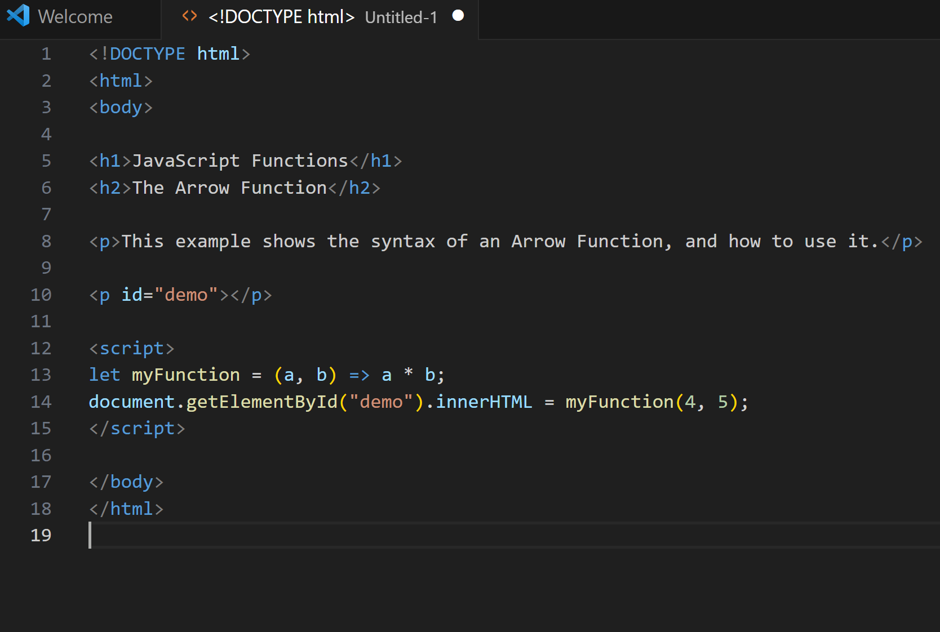
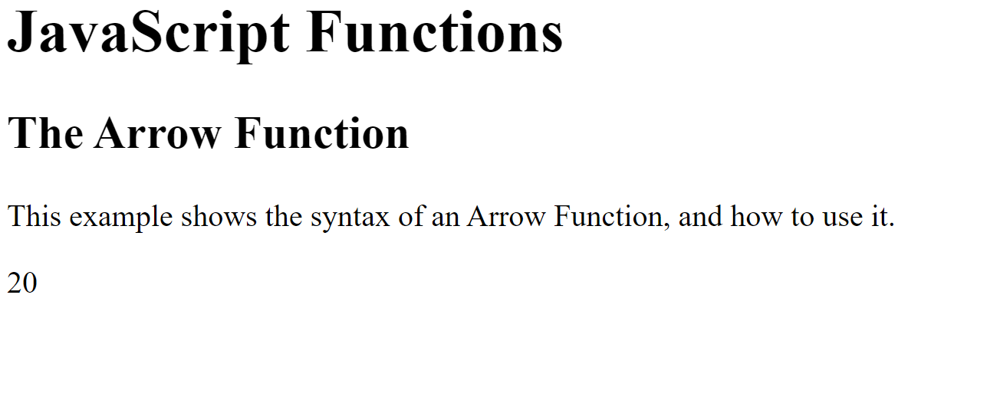
Basic Example

Slide 9
Basic Example
Put Output Here
Put Input Here
// Example 1: Basic arrow function
const greet = () => {
console.log("Hello, there!");
};
greet(); // Output: Hello, there!
// Example 2: Arrow function with parameters
const multiply = (a, b) => {
return a * b;
};
console.log(multiply(5, 3)); // Output: 15
// Example 3: Arrow function with implicit return
const square = (num) => num * num;
console.log(square(4)); // Output: 16
// Example 4: Arrow function in array methods (e.g., map)
const numbers = [1, 2, 3, 4, 5];
const squaredNumbers = numbers.map((num) => num * num);
console.log(squaredNumbers); // Output: [1, 4, 9, 16, 25]
The output for each example when executed in a JavaScript environment would be as described in the comments:
Example 1: Output: Hello, there!
Example 2: Output: 15
Example 3: Output: 16
Example 4: Output: [1, 4, 9, 16, 25]

Slide 10
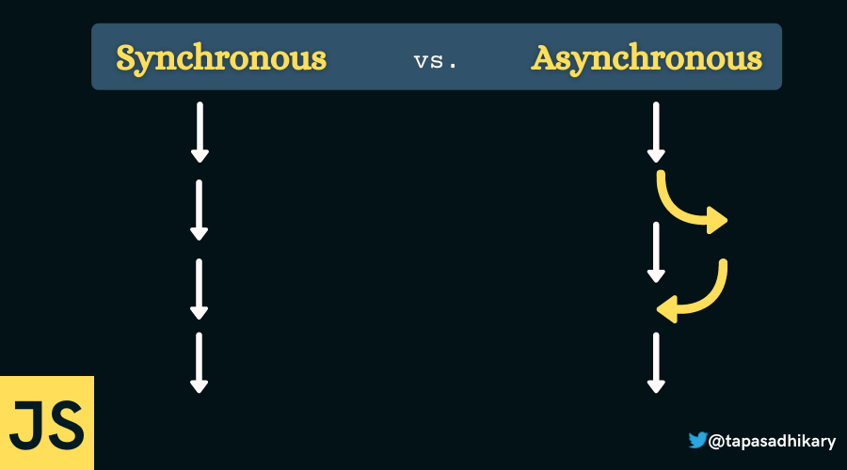
Asynchronous in JavaScript
Asynchronous programming is a technique used in JavaScript to handle multiple tasks simultaneously without blocking the main thread of execution. It allows for non-blocking I/O operations, such as reading from a file or making an HTTP request, to be performed without waiting for the operation to complete.

Slide 11
Why Use Asynchronous Programming?
Asynchronous programming is useful for improving the performance and responsiveness of web applications, as it allows for non-blocking I/O operations to be performed without blocking the main thread of execution. It also allows for more efficient use of system resources, as it can prevent the CPU from being tied up waiting for I/O operations to complete.

Slide 12
Benefits of Asynchronous
Improved performance: Asynchronous programming allows code to run concurrently, reducing the time it takes to complete tasks and improving overall performance.
Reduced risk of errors: Asynchronous programming allows code to continue executing even if an API request or event is taking longer than expected, reducing the risk of errors and improving reliability.
Improved user experience: Asynchronous programming allows for smoother and more responsive user interactions, improving the overall user experience.

Slide 13
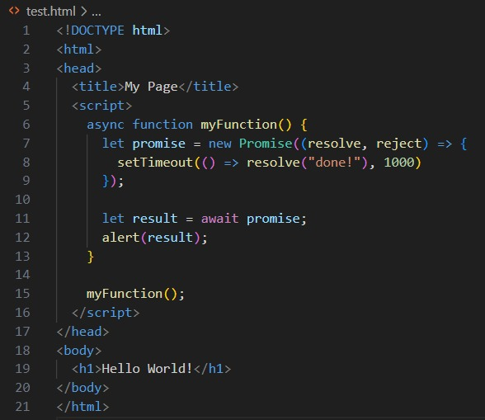
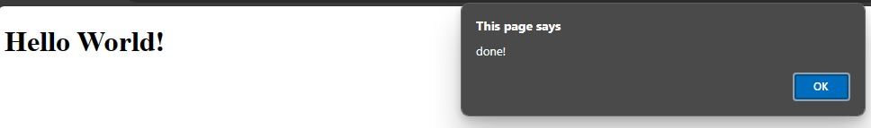
Basic Example 1

Slide 14
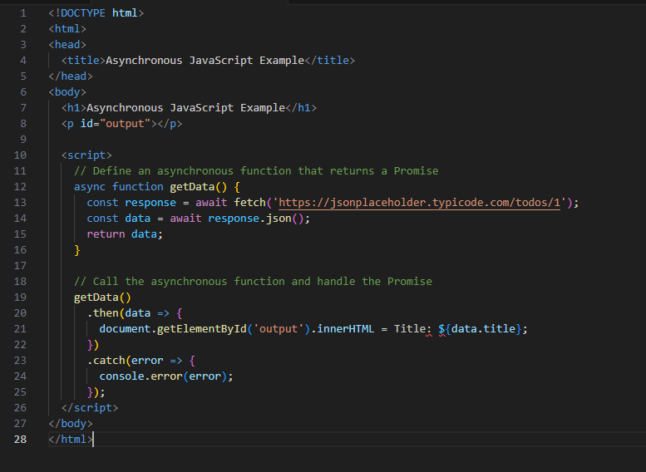

Basic Example 2

Slide 15
DOM Documents in JavaScript
The Document Object Model (DOM) is a programming interface for HTML and XML documents. It allows you to interact with the structure and content of a document, and is used extensively in web development.
One of the key benefits of the DOM is that it allows you to manipulate the content of a document using JavaScript. This can be useful for a variety of purposes, such as creating dynamic web pages, updating content in real-time, and adding interactivity to web applications.

Slide 16
Basic Example 1
To add a button to a web page using JavaScript and the DOM, you can follow these steps:
Get a reference to the HTML element that you want to add the button to.
Create a new HTML element using the document.createElement() method, and set its attributes as desired.
Add the new element to the parent element using the parentNode.appendChild() method.
Add event listeners to the button using the addEventListener() method, such as onclick to trigger an action when the button is clicked.

Slide 17
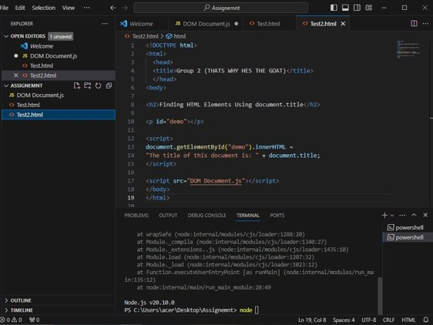
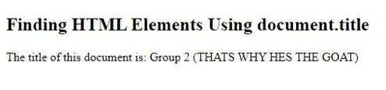
Basic Example 2

Slide 18
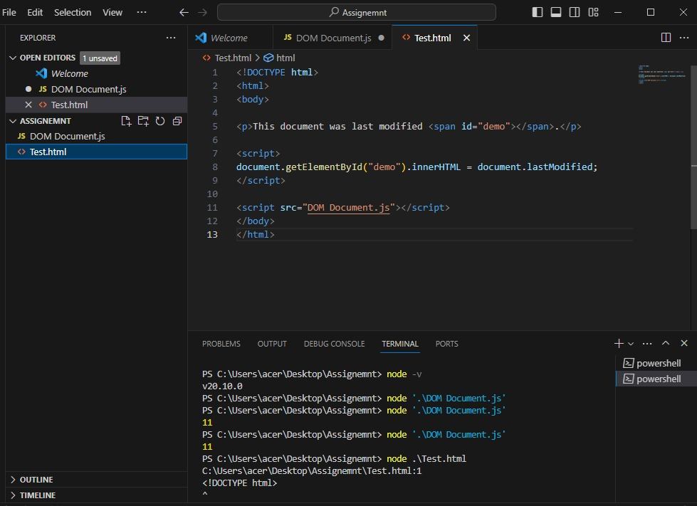

Basic Example 3

