Slide 1


Gas Protection
Team 5: Brianna, Austin, Joshua, Alec (BAJA)

Slide 2

Background
Benzene, carbon monoxide, and many other harmful pollutants commonly leak from household gas stoves, other gas appliances, and even cars.
The Center of Disease Control (CDC) states that short time exposures can lead to mild irritation of the skin, eyes, and respiratory tract.
Long term exposure may cause anemia, alterations to the immune system, and central nervous system depression.

Slide 3

Goal
Create an integrated system that senses and responds to current levels of indoor air pollution and reports the information to a user.
This device would use sensors to monitor and manage the dispersion of indoor pollutants by activating a nearby ventilation system and notifying the user once measured pollutant levels reach a certain threshold.

Slide 4
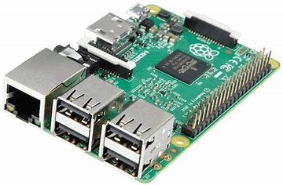
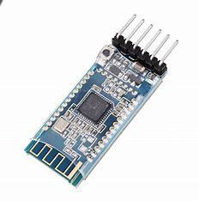
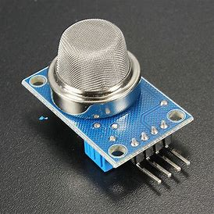

Components
Air quality sensor
Bluetooth chip
Arduino and/or Ras pi
User device

Slide 5

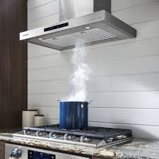

System Diagram
NOx
Sensor
Arduino/ Raspberry Pi
SQL Database
CO
Sensor
Particulate Matter
Sensor

Slide 6

Considerations
Studies have found gas stoves emit significant levels of nitrogen dioxide, carbon monoxide and fine particulate matter – which without proper ventilation can raise the levels of indoor concentration levels to unsafe levels as deemed by the Environmental Protection Agency (EPA).
Power, Using batteries will require a notification that the battery life is low
Testing?

Slide 7

Questions/Concerns?

