Slide 1
Fast Image Encryption algorithm
Based on Parallel Computing System
Xingyuan Wang, Le Feng, Hongyu Zhao
Publisher: Elsevier
https://doi.org/10.1016/j.ins.2019.02.049

Slide 2
Introduction

Slide 3
Two Stages
Permutation - shuffles and exchanges pixel positions - To remove the strong correlations between adjacent pixels.
Diffusion - conducts pixel values replacement and performs mutual diffusion among different pixels.

Slide 4
Stage 1 : Permutation : Changing Pixel Positions
Sort based
Permutation effect
Cost of permutation
Cyclic Shift Based
Computation Time and Memory Costs
Permutation effect
So here, sort-based permutation between the different rows and columns of an image
and perform cyclic shift permutation within each row and column is used.

Slide 5
Stage 2 : Diffusion : Changing Pixel Values
The plain image is first converted into its corresponding pixel stream; then, each unit is successively diffused from left to right, thus combining previous units.
Resistant to Chosen Plain attacks.
A method of parallel diffusion that operates under distributed or parallel computing conditions called TIDBD diffusion is proposed.

Slide 6
Key Generation
Coupled Map Logistic lattices (CML) is used as the key generator of permutation and diffusion.

Slide 7
Key Generation

Slide 8
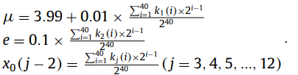
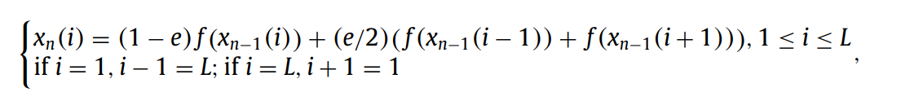
Input : 480 bit secret key K Output: Set of Keys M, N, A, B, D, E
Divide K into 12 sub keys.
Use these keys to find the coefficients and initial values of every CML lattice.
The loop is ran for a certain number of iterations and the values of CML lattice in each iteration is calculated as follows.
The some of these values are then used to compute keys M, N, A, B, D, E.
5) M, N -> Permutation, A, B, D, E -> TIDBD

Slide 9
Encryption

Slide 10
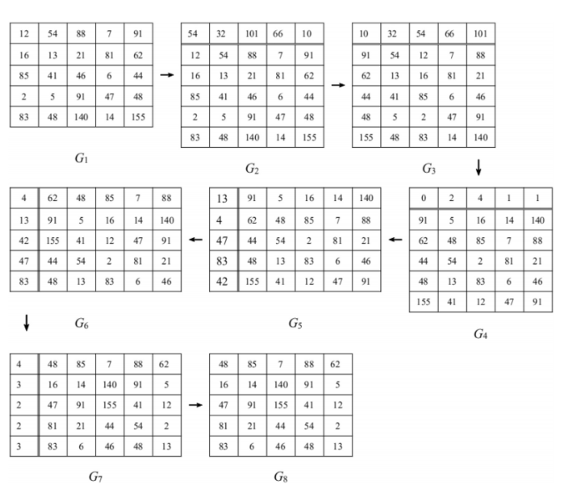
Permutation
Sort columns based on N
Cyclic Shift Down by N mod m.
Sort rows based on M
Cyclic Shift Right by M mod n.

Slide 11
TIDBD Diffusion
Segment the permuted image into p groups, where p is the number of processors.
The first independent diffusion of each group is performed under the condition of parallelism.
Exchange the first two pixels with the last two pixels within each group.
Bidirectional diffusion of the first two pixels taken from all groups is performed.
The second independent diffusion of each group is performed under the condition of parallelism.
Combine all the groups into the diffused image
Twice Independent Diffusion ( || ^{el})
Bidirectional diffusion

Slide 12
Decryption
The Decryption is simply the inversion process of Encryption

Slide 13
Encryption performance analysis
Adjacent pixel correlation
Pixel distribution Histogram

Slide 14
Improvement :
A parallel version of the permutation algorithm should be implemented to ensure the permutation performance and to achieve the full advantages of parallel processing.

