Slide 1


Machine Learning on Loan Default Prediction
Super Rookie
Rongxuan Wang
Yan Dong
Yinjue Yi
Zhihan Zhou
Jiatong Zhang
IEOR E4523 Data Analytics
Notes:
1

Slide 2
Overview of Dataset
Data Source: LendingClub
Data Description: Accepted loans between 2007 to 2018Q4.
Columns: 150
Rows: 2 million+
Objective:
Predict whether the loan will be fully paid on time or default
Explore important features for loan default to improve future loan decisions

Slide 3
Agenda
Model Training & Evaluation
Linear Regressions
Logistic Regressions
Random Forest
Neural Network
SVM
Conclusion
Model Results
Conclusion
Future Improvement
Data Preprocessing
Feature Selection
Data Cleaning & Feature Engineering
Data Visualization
Variable Correlation
Distribution on Grade
Distribution on Term
Distribution on Verification Status

Slide 4

Data Preprocessing
4 | Jiatong Zhang

Slide 5
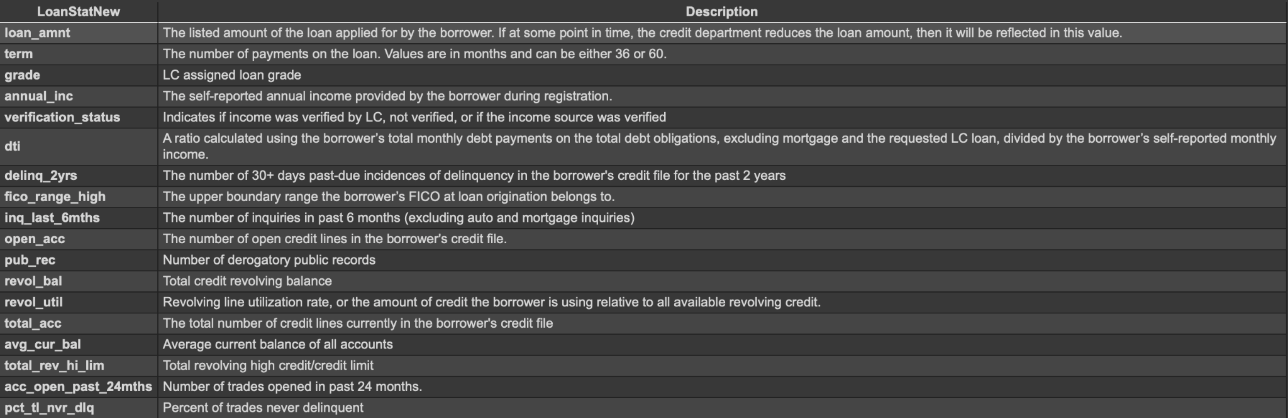
Feature Selection
Select features by their descriptions and correlations
149 -> 18 features.

Slide 6
Data Cleaning & Feature Engineering
Null data
Use dropna() to drop all rows with nan value -> 1m rows
Loan Status (Predicting Variable)
Original loan status: ‘Fully Paid’, ‘Current’, ‘Charged Off’, ‘In Grace Period’, ‘Late (31-120 days)’, ‘Late (16-30 days)’, ‘Default’
Drop ‘Current’ and ‘In Grace Period’
Set ‘Fully Paid’ as 1, others as 0
Category data
Use pandas.Series.cat.codes to change 3 category features into numerical type

Slide 7
Data Visualization
7 | Zhihan Zhou

Slide 8
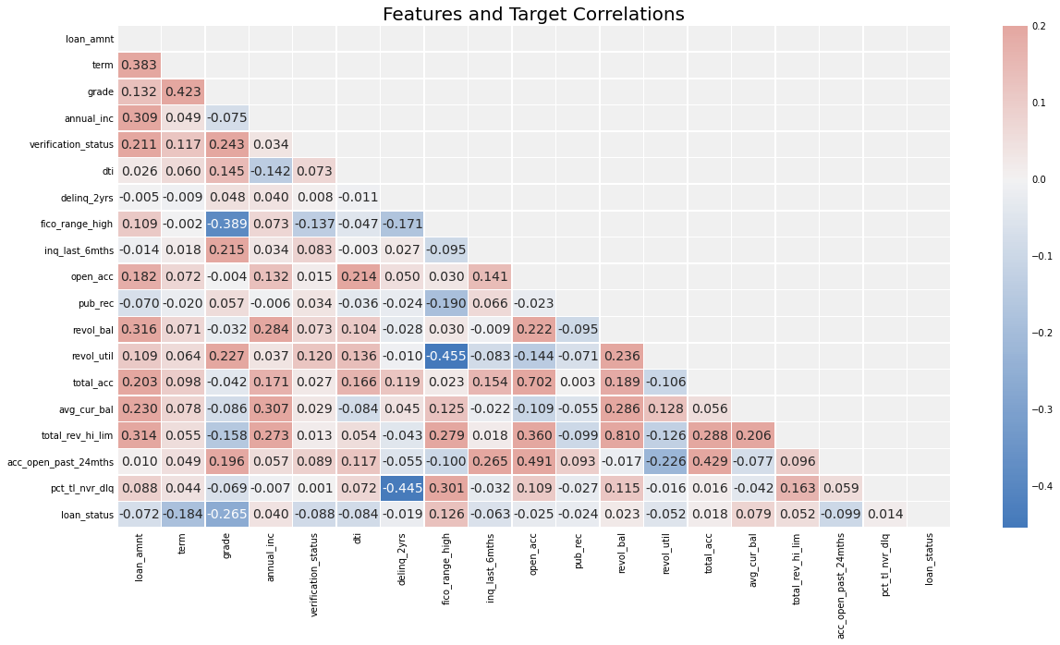
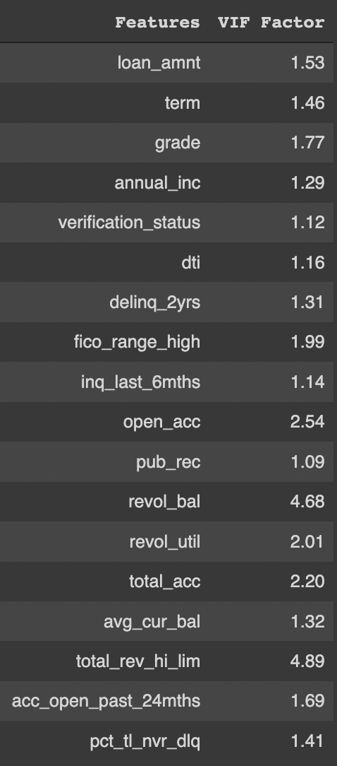
Variable Correlation

Slide 9
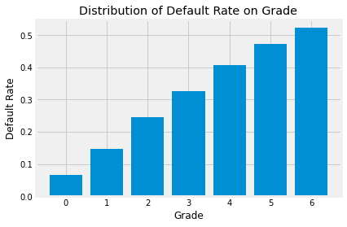
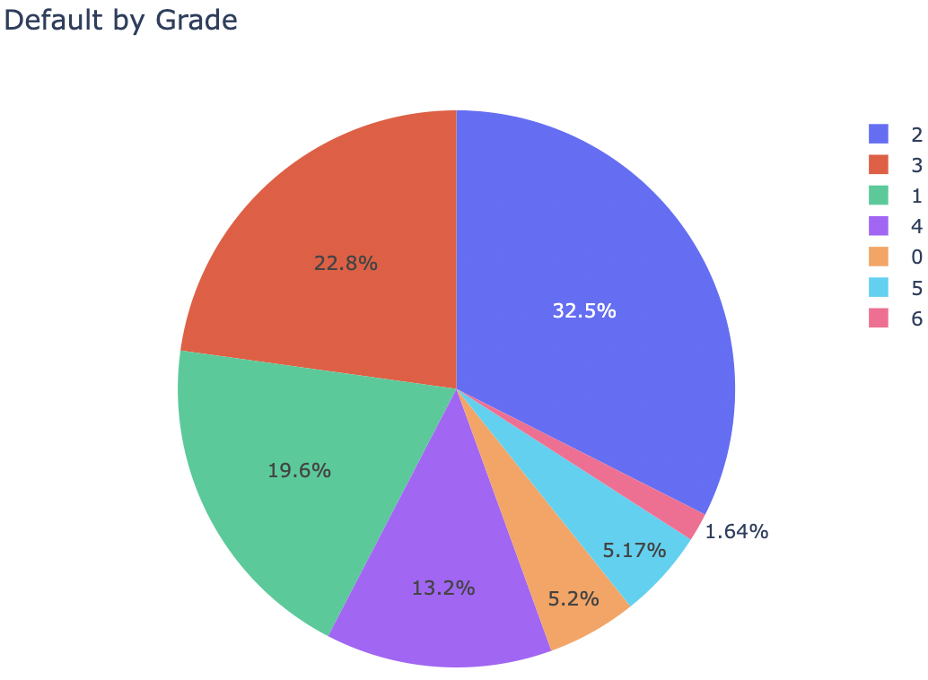
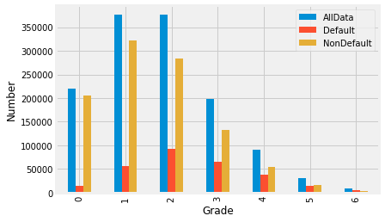
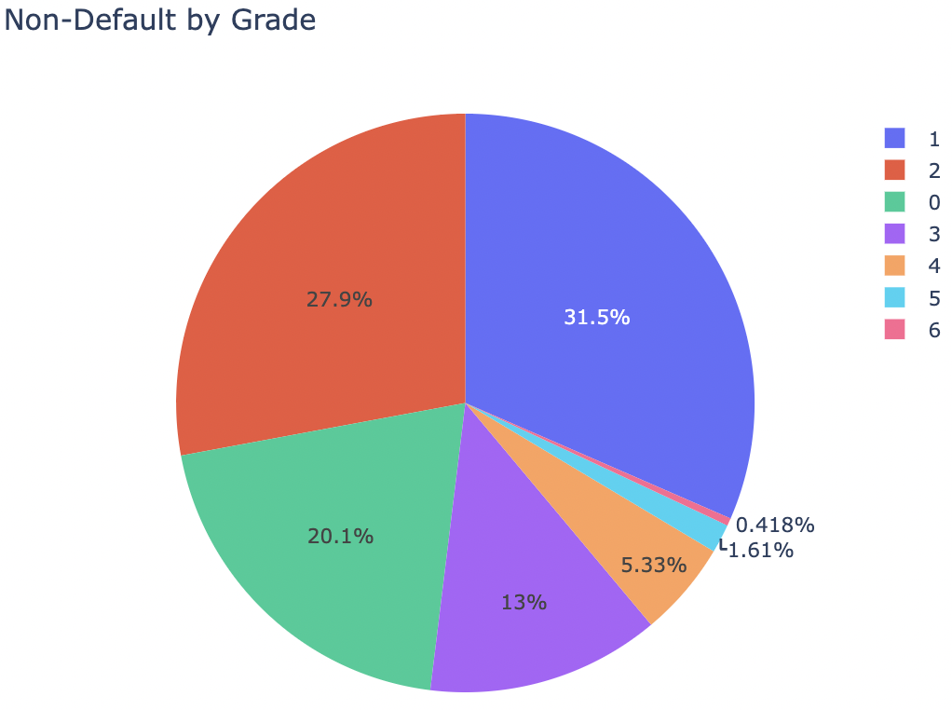
Distribution on Grade

Slide 10
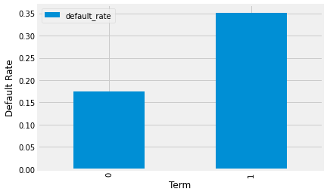
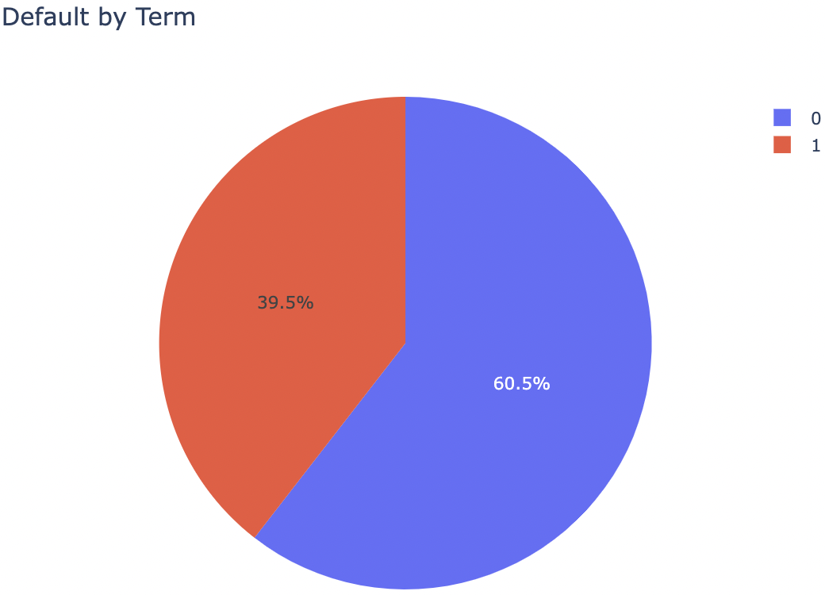
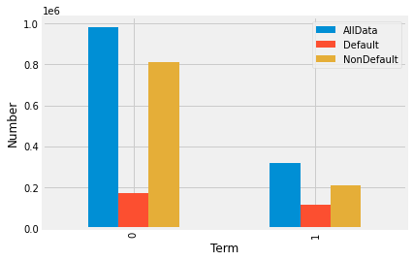
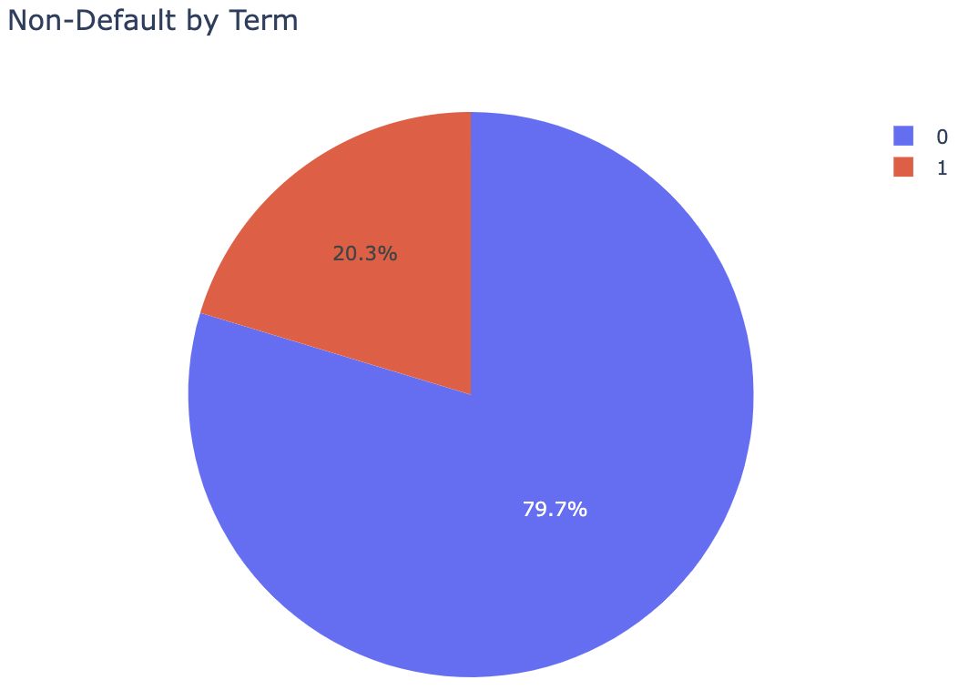
Distribution on Term

Slide 11
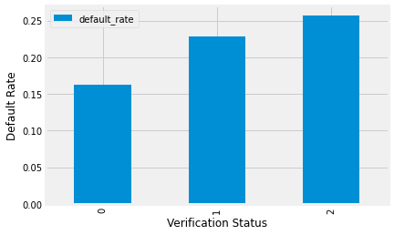
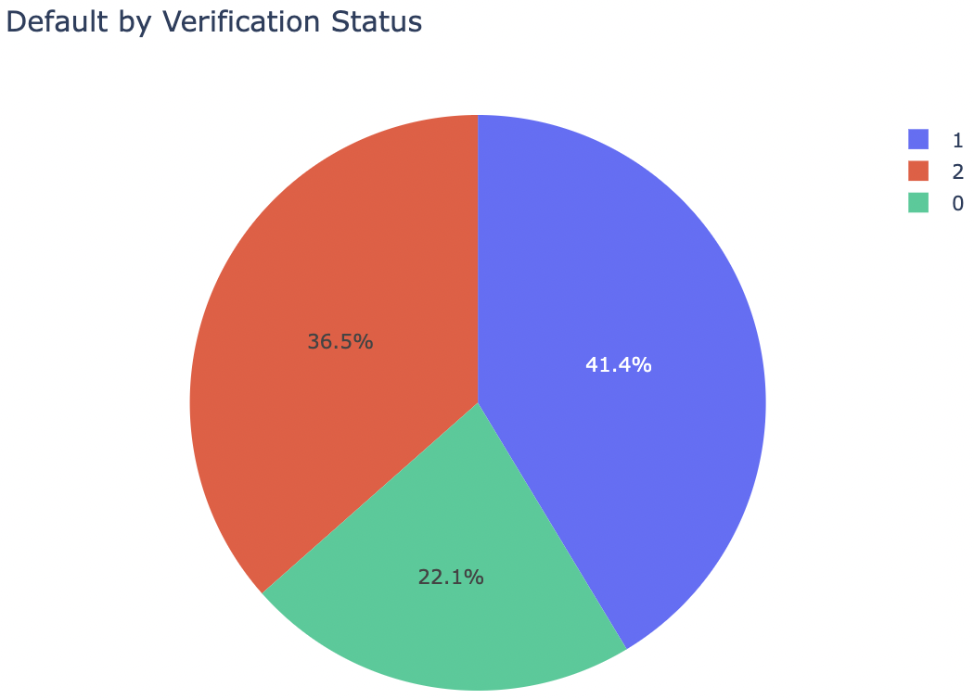
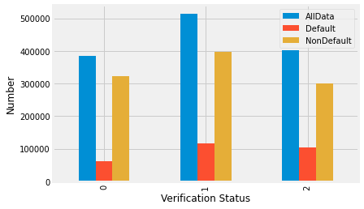
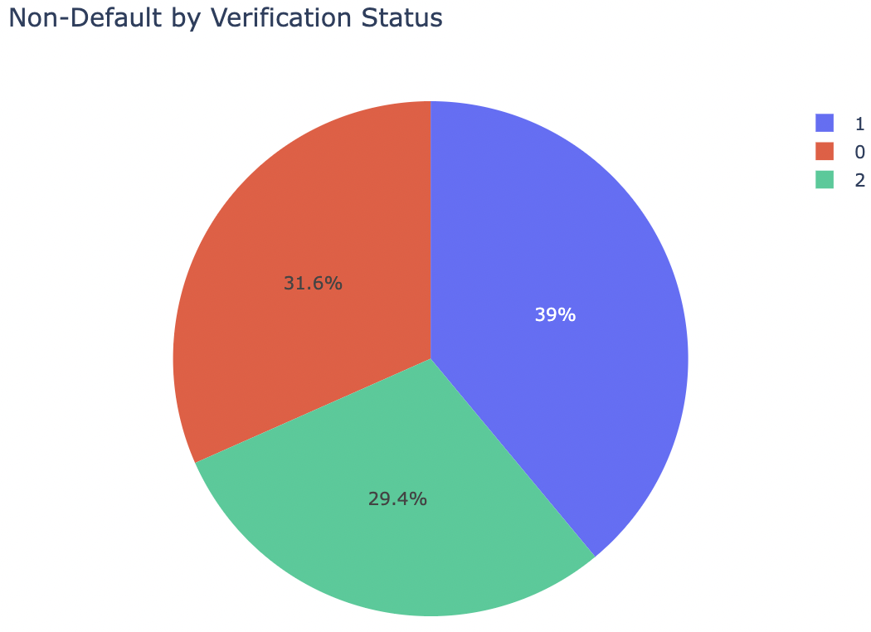
Distribution on Verification Status

Slide 12
Model Training & Evaluation
12 | Presentation Title Presentation Title

Slide 13
Model Selection and Data Rebalance
Model Selection: Linear Regression, Logistic Regression, Decision Tree, Random Forest, Neural Network and SVM.
Data Rebalance: Since the data set is imbalanced on the Loan Status (Predicting Variable) , we use RandomUnderSampler().fit_resample() to balance our data so as to improve the prediction performance.
Train and test: We split the total data set into a train set (70%) and a test set (30%).

Slide 14
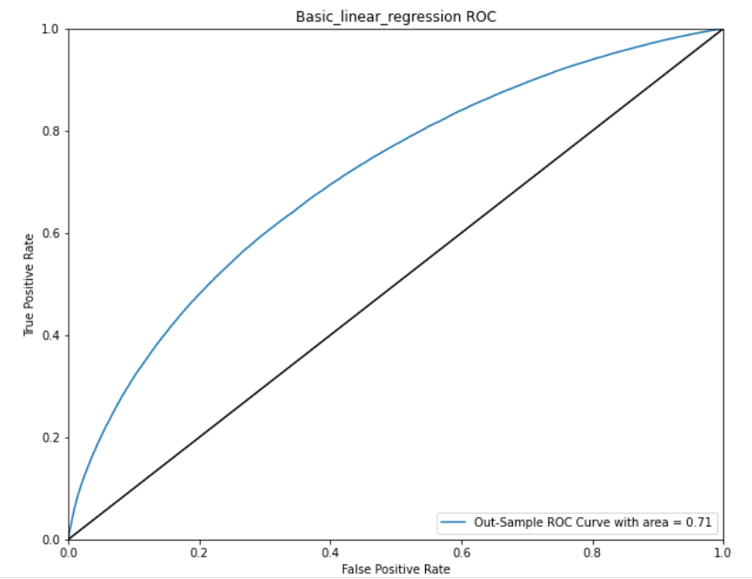
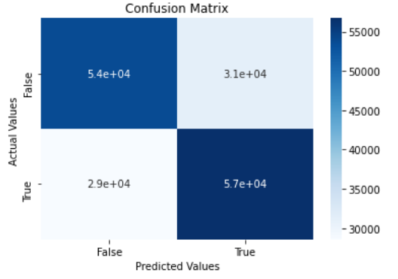
Basic Linear Regression
Accuracy: 64.90%
Precision: 64.51%
Recall: 66.50%

Slide 15
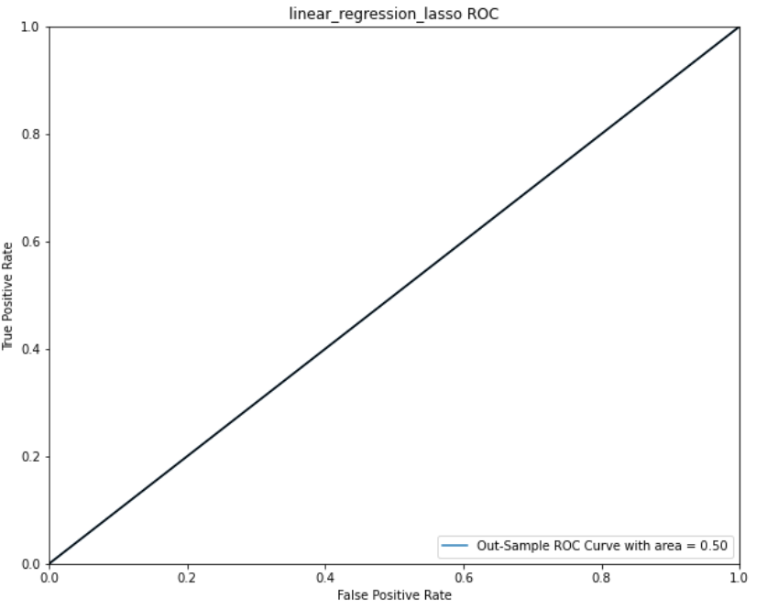
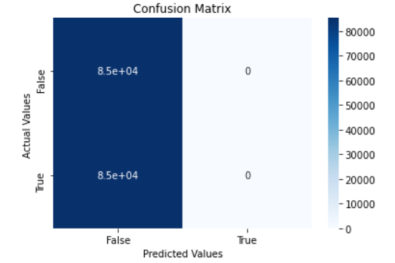
Linear regression with Lasso
In our dataset, all coefficients are shrunk to 0 when applying Lasso regression, so it is not appropriate to use Lasso for prediction here.

Slide 16
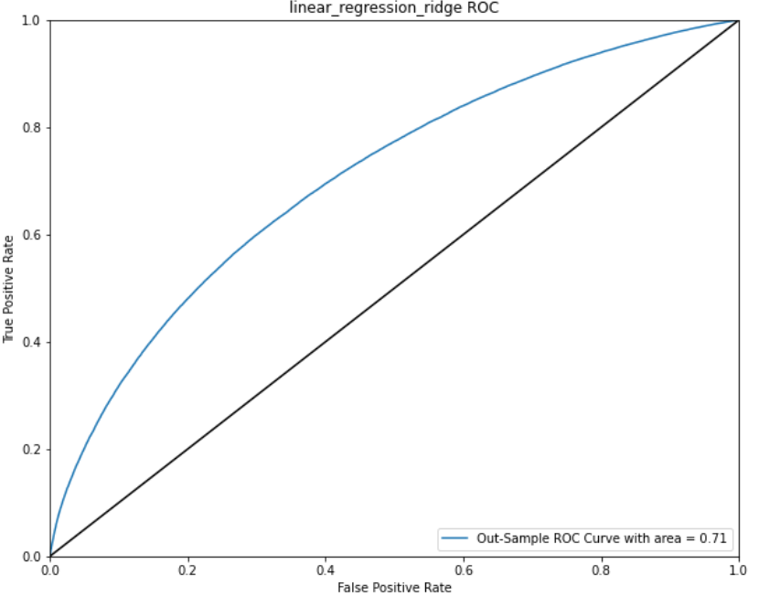
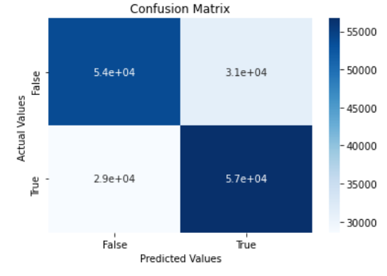
Linear regression with Ridge
Accuracy: 64.90%
Precision: 64.51%
Recall: 66.50%

Slide 17
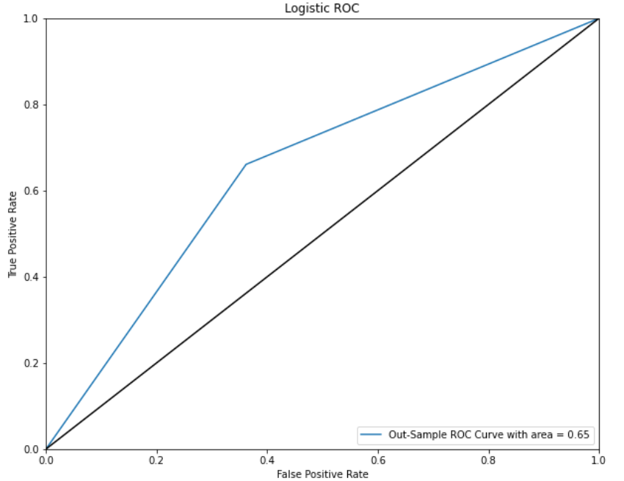
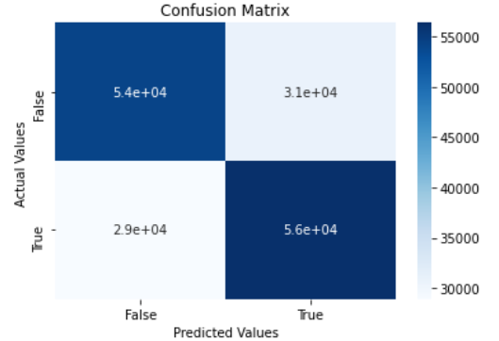
Logistic Regression
Accuracy: 64.96%
Precision: 64.97%
Recall: 66.09%

Slide 18
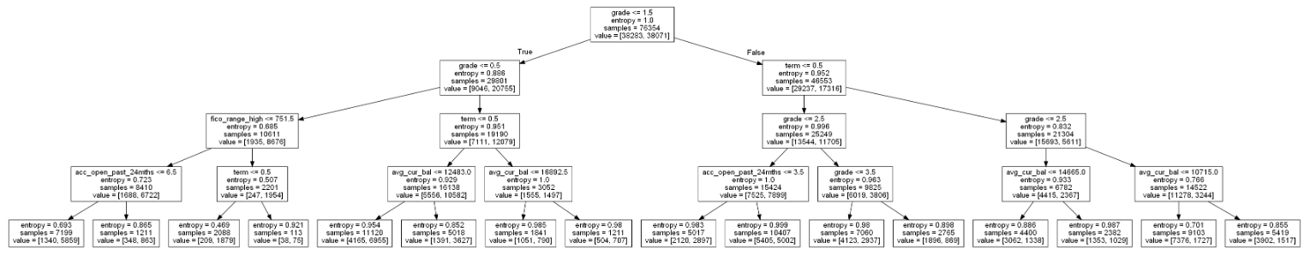
Decision Tree
max_depth = 4
criterion='entropy'

Slide 19
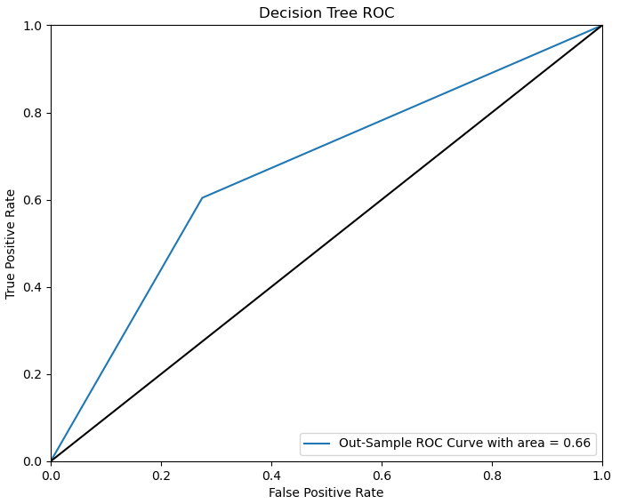
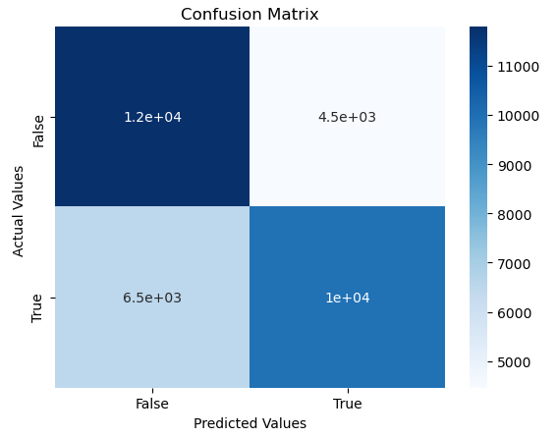
Decision Tree

Slide 20
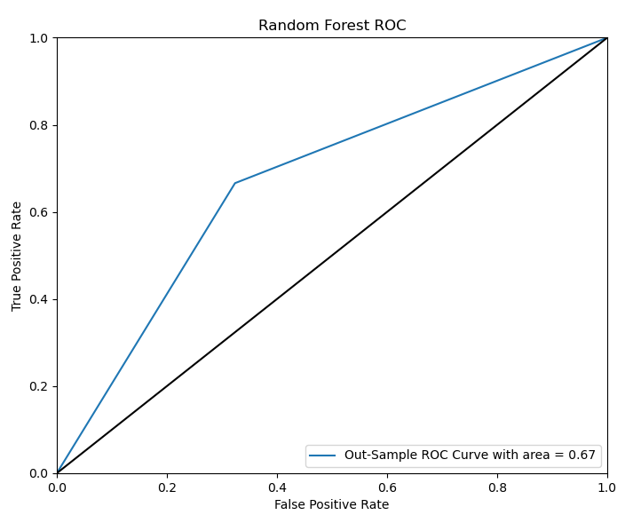
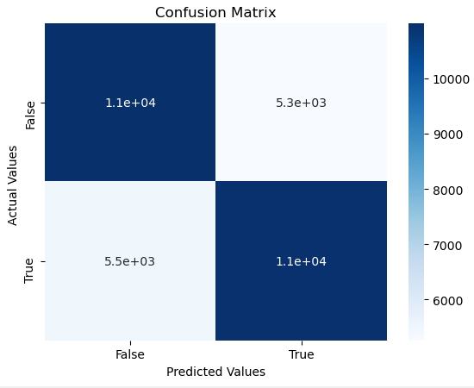
Random Forest

Slide 21
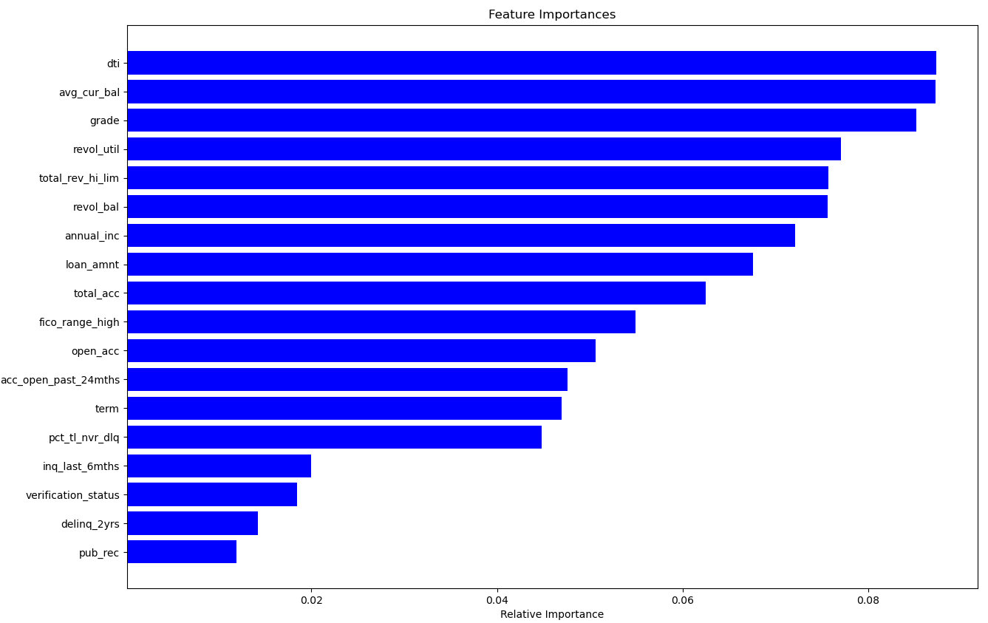
Feature Importance (Random Forest)

Slide 22
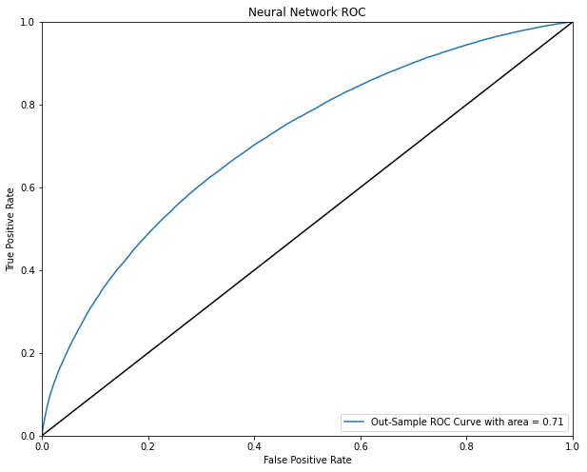
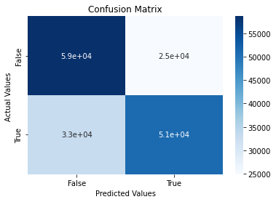
Neural Network

Slide 23
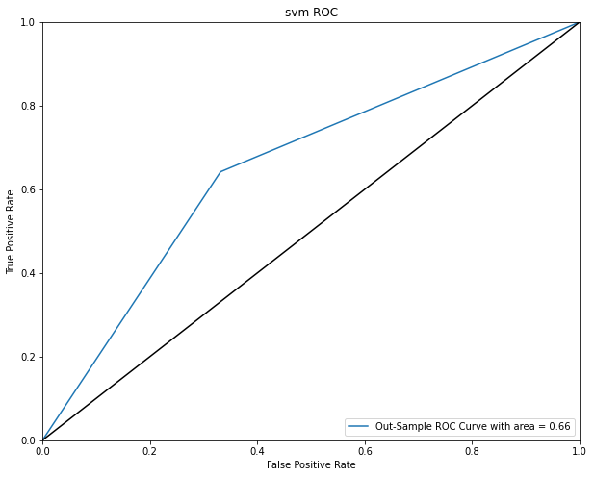
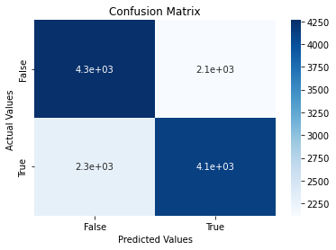
SVM

Slide 24
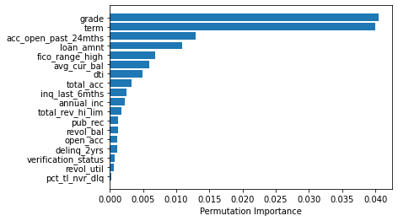
Feature Importance (SVM)

Slide 25
Conclusions
25 | Presentation Title Presentation Title

Slide 26
Model Results
Modeling | Accuracy | Precision | Recall | AUC
Basic linear regression | 64.90% | 64.51% | 66.50% | 0.7061
Linear regressions with Ridge | 64.90% | 64.51% | 66.50% | 0.7061
Logistic regression | 64.96% | 64.97% | 66.09% | 0.6495
Logistic-Ridge Penalty | 64.95% | 64.69% | 66.09% | 0.6495
Logistic-Lasso Penalty | 63.94% | 62.90% | 68.24% | 0.6393

Slide 27
Model Results (continue)
Modeling | Accuracy | Precision | Recall | AUC
Decision Tree | 66.43% | 69.01% | 60.42% | 0.6647
Random Forest | 67.28% | 67.74% | 66.77% | 0.6728
Neural Network | 65.36% | 67.17% | 60.56% | 0.7124
SVM | 65.52% | 66.14% | 64.21% | 0.6552

Slide 28
Conclusion
Based on our analysis, we find that the random forest model is the best model considering the four test scores and confusion matrix.
According to the feature importance analysis, we find grade and dti (the ratio of total monthly debt payments to the borrower’s income) appears to be the most significant features to predict whether the loan will be fully paid on time or default.

Slide 29
Future Improvement
Models
Consider some other classifiers like XGBoost and KNN.
Data Sources
Introduce macroeconomic data or local environmental data, which are closely related to borrowers' willingness to repay. Use Principal Component Analysis to check their effects and select dimensions.

Slide 30
Thank you !
30 | Presentation Title Presentation Title

