Slide 1
Chat App Design
Team Houston
Jonathan Wang, Manu Maheshwari, Yanjun Yang, Tianqi Ma, Youyi Wei, Jiang Lin, Chengyin Liu

Slide 2
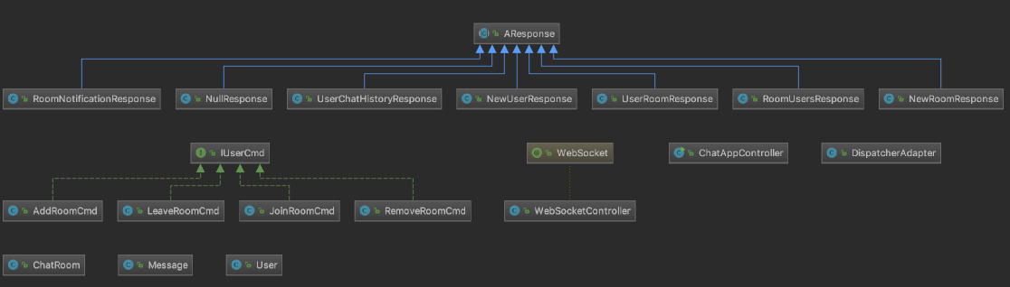
UML Diagram
Notes:
(More detailed needs to be added to satisfy the requirements)

Slide 3
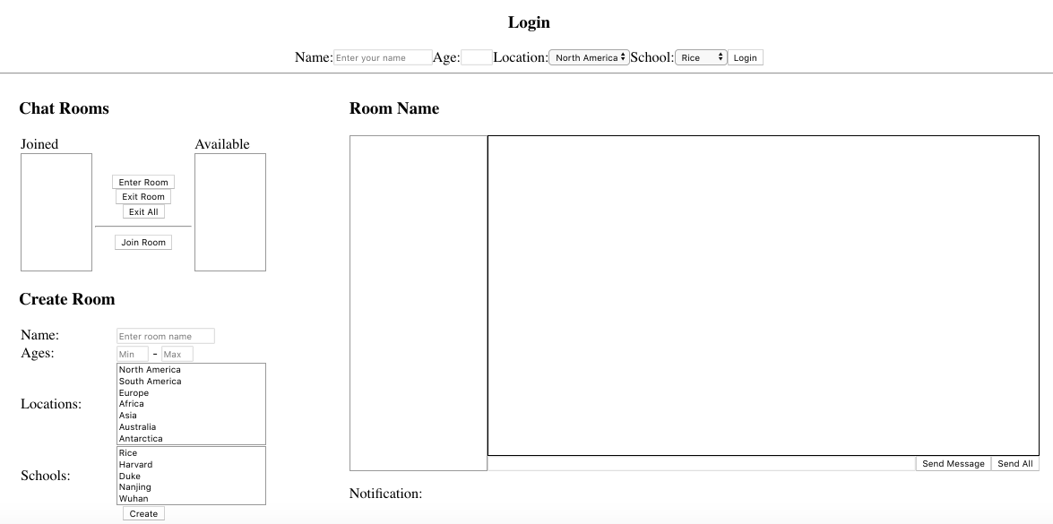
Use Cases

Slide 4
Use Cases and Implementations

Slide 5
User Login
Front end -> WSC
DA: loadUser
newSession
nextUserId++
Get the info
Create and map the user object
Check ChatRoom Availability
Available chatRoom shown
Add to the observables
newUserResponce
userRoomResponce

Slide 6
Create ChatRoom
Front end -> WSC
DA: loadRoom
Check owner eligibility
Get restrictions
Create and map chatRoom object
addRoomCmd
Add room to eligible users
Update lists of eligible users
Owner automatically joins the room
Notes:
Restrictions, create and map room obj, check owner -> if not stop -> otherwise -> send the addRoomCmd -> notify everyone of room, add room to eligible users, update lists of eligible users, owner auto join/enter the room.

Slide 7
Join/leave chatRoom
Front end -> WSC
DA: joinRoom / LeaveRoom
JoinRoomCmd
LeaveRoomCmd
Get the user and chatRoom
info
Notify observers
If owner leave the room
-> destroy the room
roomNotification
roomUserNotificationResponce
userRoomNotificationResponce
Notes:
(need some modification for this slides)

Slide 8
Send Message
Front end -> WSC
DA: sendMessage
Filter message
Get
sender/receiver/room info
and the message
If hate
If not hate
Check owner
-> If sender is owner
-> can send to all users
Kick the user out from all rooms
NotifyClient

Slide 9
Load Message
Front end -> WSC
DA: query
Update message in the front end
Load user chat history
DA: ackMessage
Change the message status -> isReceived
Load Message
Notify sender

Slide 10
Design Decisions
Show latest notification regardless of room
Received messages are shown in green
Only show eligible rooms
Can’t modify room restriction, no empty restrictions
Delete room when owner leaves

Slide 11
Demo and Questions

