Slide 1
Chat App API Design
Team Houston
Jonathan Wang, Manu Maheshwari, Yanjun Yang, Tianqi Ma, Youyi Wei, Jiang Lin, Chengyin Liu

Slide 2
Use Cases
Create user
Create chat room
Join/leave chat room
Send message
See chat rooms user is in/can join, users in chat room
Notes:
(Presenter 1) Several high level use cases – requests that need to be supported by backend

Slide 3
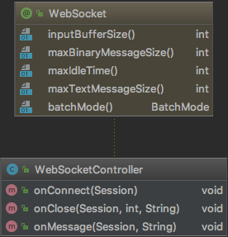
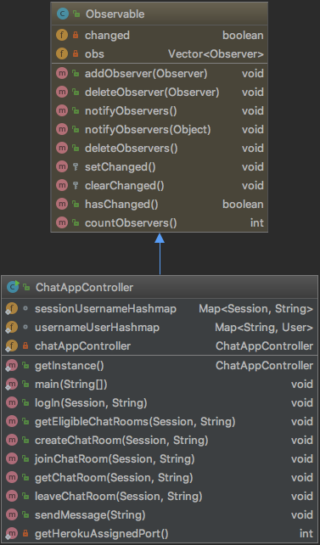
Controllers
Notes:
(Presenter 1) CAC is an observable observed by chat rooms and also a singleton, so that we can access notifyObservers. Session->username->user object hash maps. WSC receives front end requests. CAC stores data and processes requests.

Slide 4
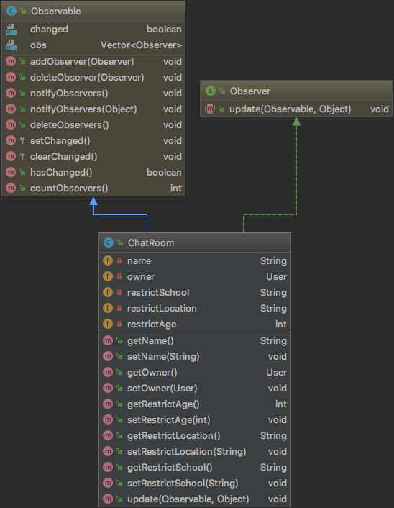
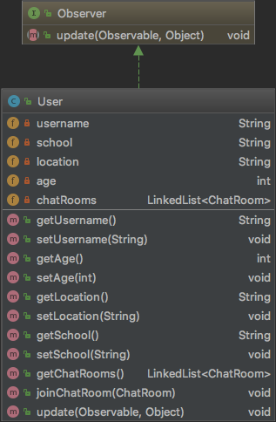
Objects
Notes:
(Presenter 1) ChatRoom observes CAC. Users observe ChatRoom.

Slide 5
Request Handling
HTML
Click button
View
Send request as JSON
WebSocket Controller
onMessage
Parse request
ChatApp Controller
Call appropriate method (notifyObservers) and send response to session as JSON
View
onMessage
Update chat app view
Notes:
(Presenter 2) (THIS IS A VERY IMPORTANT SLIDE) All requests from view go to WSC via websocket send interface. CAC handles backend action and sends response back to view as a message. This allows us to use Session as the single identifier from the view.
CAC uses command to update chat rooms. Composite users and composite chat rooms to send messages to all or exit all chat rooms.

Slide 6

Commands
ChatAppController -> ChatRooms
Send message to chat room
Join/leave room
ChatRoom -> Users
Send message to users
Notes:
(Presenter 2) Two levels of commands. CAC->ChatRoom and ChatRoom->User. Used for all observable-observer interactions such as sending messages and joining/leaving rooms.

Slide 7
Chat Room Design
Select menu containing users in chat room
Message history for this user contains all messages involving user (sent/received)
Message
Send
Notes:
(Presenter 3) (THIS SLIDE IS PRETTY IMPORTANT TOO) Introduce main assumption of message sending. The rest of design is based off this assumption, not like chat apps we use.
Regular messages go to a single other user in the chat room. Owners can send a message to all other users.
Users can receive messages even when they are not on the chat room page.

Slide 8
Sending Messages
WebSocketController
onMessage(user, message)
Message is a JSON string containing request from view
ChatRoom
notifyObservers(command)
If message is in chat room then notify observer users using another command
ChatAppController
notifyObservers(command)
Send request body to observer chat rooms using a command
User/CompositeUser
broadcastMessage(msg)
If user is involved in message, broadcast message to user view.
Notes:
(Presenter 3) Walk through flow of sending message. Observer-observable, command design pattern, composite design pattern

Slide 9
API Summary
WebSocketController receives all view requests
ChatAppController -> ChatRooms -> Users
ChatAppController is a singleton to access notifyObservers
Communicate to observers using commands
Send response to view using websocket session
Notes:
(Presenter 4) Summarize the API aspects of design.

Slide 10
Demo and Questions
Notes:
(Presenter 4) Walk through the different flows in the app. Lists start out empty on page load. Lists load when user logs in and chat room loads when user enters room. What happens when each button is pressed.

