Slide 1
Pacman Game API Design
Team Houston
Jonathan Wang, Manu Maheshwari, Yanjun Yang, Tianqi Ma, Youyi Wei, Jiang Lin

Slide 2
Use Cases
Game
Display all game objects
Spawn fruit periodically
End game on win/lose condition
Track score, lives, timers, etc.

Slide 3
Use Cases
Pacman
Move in all direction based on user input
Does not go through walls
Warp through exit
Eat food – destroy food, update score, update ghost strategy
Eaten by ghosts – lose life
Eat afraid ghosts – send to jail, update score

Slide 4
Use Cases
Ghosts
Move based on strategy
Does not go through walls
Warp through exit
Exit jail after some time

Slide 5
API Breakdown
Model – Cmds, Strategies, GameObjects
Interfaces and abstract classes
DispatchAdapter, Controller
Manage game, process requests
View.js, Index.html
Display game objects, make requests
Notes:
Overview of how each piece connects to use cases

Slide 6
Model – Commands, Strategies
Commands
IGameObjectCmd
Strategies
IUpdateStrategy – move Pacman and ghosts
IInteractStrategy – one-directional interactions
Notes:
Talk about how interfaces satisfy use cases. Interact strategy example: ghost handles all pacman-ghost interactions, and pacman does not worry about it.

Slide 7
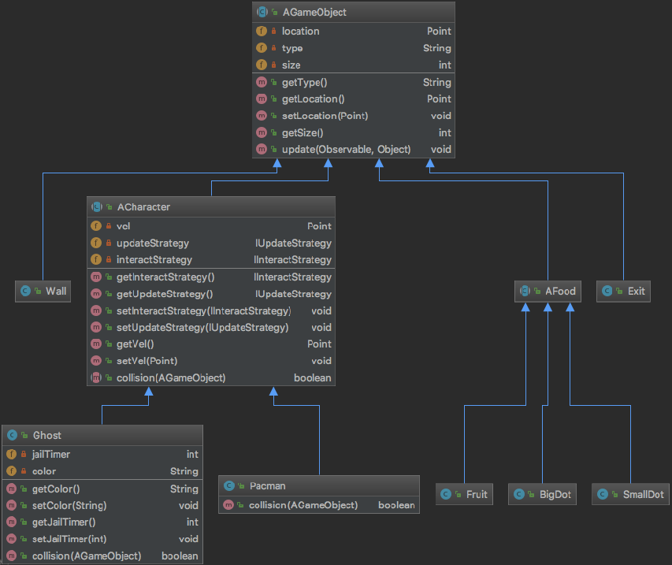
Model – GameObjects
Notes:
All AGameObjects implement Observer. Talk about inheritance structure and functions.
Separate concrete classes for easy object creation and extensibility.

Slide 8
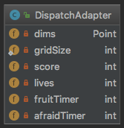
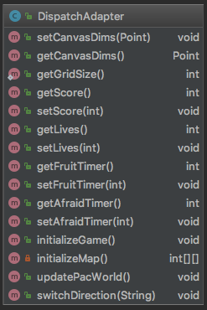
DispatchAdapter
Notes:
Talk about timers and values. Grid size is static for easy access in concrete classes.

Slide 9
Controller
Supported requests
resetGame – get canvas dims and reset game objects
updateGame – update game object states
switchDirection – switch Pacman direction
Notes:
What each request does

Slide 10
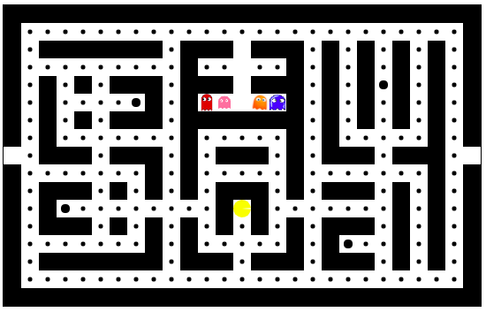
View
http://pacman-team-houston.herokuapp.com/
Notes:
Design decisions – flashing ghosts, blinking dots, pacman animation do not affect game so are handled only in view. Talk about how we are drawing different game objects. When to call each request

Slide 11
Questions?

