Slide 1
Pacman Final Game Design
Team Houston
Jonathan Wang, Manu Maheshwari, Yanjun Yang, Tianqi Ma, Youyi Wei, Jiang Lin

Slide 2
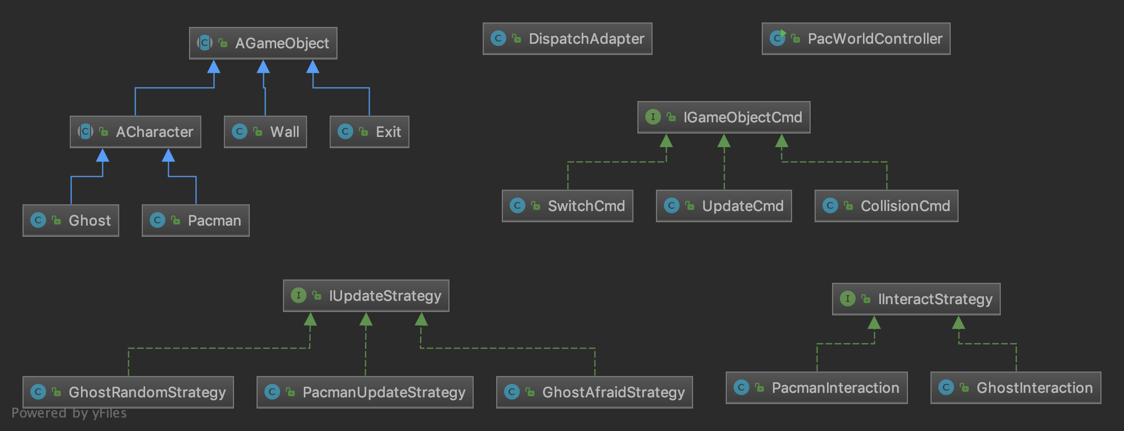
API Overview
Model – Cmds, Strategies, GameObjects
Interfaces and abstract classes
DispatchAdapter, Controller
Manage game, process requests
View.js, Index.html
Display game objects, make requests

Slide 3
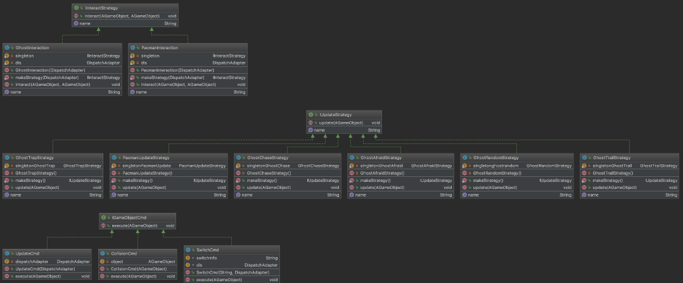
Model—Commands, Strategies

Slide 4
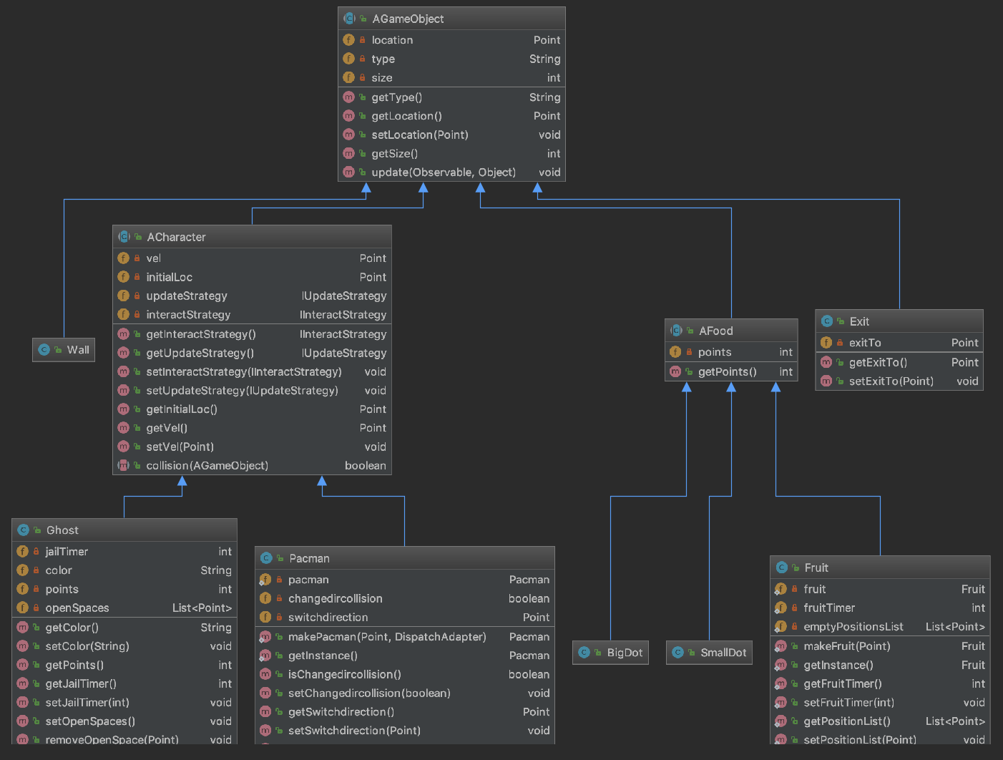
Model – GameObjects
Notes:
All AGameObjects implement Observer. Talk about inheritance structure and functions.
Separate concrete classes for easy object creation and extensibility.

Slide 5
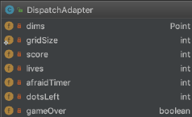
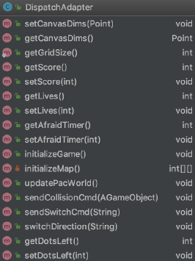
DispatchAdapter
Notes:
Talk about timers and values. Grid size is static for easy access in concrete classes.

Slide 6
Use Cases and Implementations
Notes:
We broke down the game into 6 primary use cases that will explain how the api satisfies the game requirements

Slide 7
Moving Pacman
updatePacWorld()
Update Command
Pacman Update Strategy
Collision Command
Pacman Interaction Strategy
If PacmanCollision
Notes:
Explain flow – update command -> collision command -> interaction strategy -> update strategy. Emphasize basics of update and collision commands. Update doesn’t do any of the velocity checking, it just sets the new location

Slide 8
Collisions and Interactions
Pacman Interactions
Wall
velocity (0, 0)
Exit
location (exitTo)
Food
update all values
Notes:
Discuss how collision works. Talk about Pacman’s various interactions, especially all the food values

Slide 9
Switch Direction/Queue Turn
POST SwitchDirection
switchDirection() (in DA)
Switch Command
-> switch velocity
Collision Command
check PacmanCollision
on switch velocity
Notes:
Highlight that this feature builds off existing update/collision flow. Discuss all the extra features in those commands and the additional fields added to track the state

Slide 10
Moving Ghost
updatePacWorld()
Ghost checks open spaces
Update Command
Ghost Update Strategy
Collision Command
Interaction Strategy
If Collision
Notes:
Ghost movement flow is exactly like Pacman except for interaction and update strategies. All pacman-ghost interactions are handled by ghost. Ghost checks for open spaces to decide where to move.

Slide 11
Remaining Objects/DispatchAdapter
Fruit
fruitTimer
Exit
exitTo
emptyPosList
DA updatePacWorld()
Check for game end:
lives/dotsLeft
Check and update afraidTimer
Check and update fruitTimer
Notes:
Talk about how fruit tracks empty positions. Exit know where to go to. Go over all the checks in updatePacWorld besides update notification

Slide 12
View
Draws all objects
Update Game
Draws the Pacman with correct facing direction
Score, lives
FrameCount
Pacman animation
flashing ghost
Blinding dots
Notes:
Go over all visual features – pacman direction, animation, flashing, blinking, etc. Demo app and show features.

Slide 13
Questions?

