Slide 1
Pacman Game API Design
Jonathan Wang, Manu Maheshwari, Yanjun Yang, Tianqi Ma, Youyi Wei, Jiang Lin

Slide 2
Use Cases
Game
Display all game objects
Spawn fruit periodically
End game on win/lose condition
Track score, lives, timers, etc.

Slide 3
Use Cases
Pacman
Move in all direction based on user input
Does not go through walls
Warp through exit
Eat food – destroy food, update score, update ghost strategy
Eaten by ghosts – lose life
Eat afraid ghosts – send to jail, update score

Slide 4
Use Cases
Ghosts
Move based on strategy
Does not go through walls
Warp through exit
Exit jail after some time

Slide 5
API Breakdown
Model – Cmds, Strategies, GameObjects
Interfaces and abstract classes
DispatchAdapter, Controller
Manage game, process requests
View.js, Index.html
Display game objects, make requests

Slide 6
Model – Commands, Strategies
Commands
IGameObjectCmd
Strategies
IUpdateStrategy – move Pacman and ghosts
IInteractStrategy – one-directional interactions
Notes:
Interact strategy example: ghost handles all pacman-ghost interactions, and pacman does not worry about it.

Slide 7
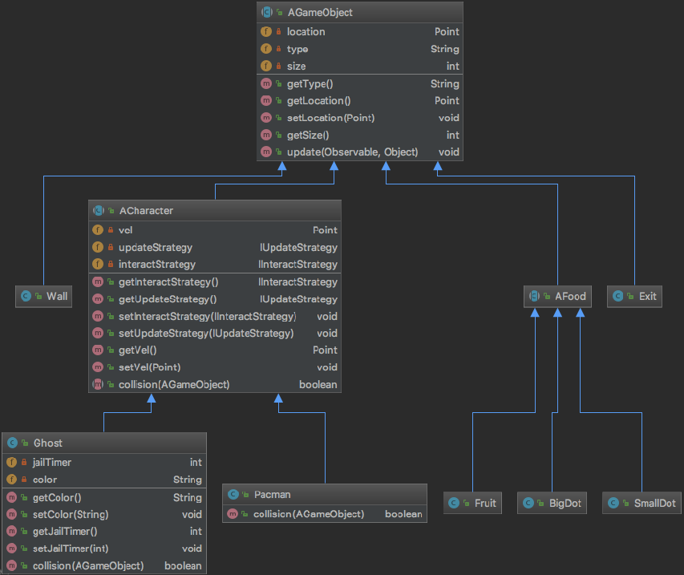
Model – GameObjects
Notes:
All AGameObjects implement Observer. Talk about inheritance structure and functions.
Separate concrete classes for easy object creation and extensibility.

Slide 8
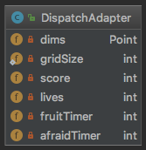
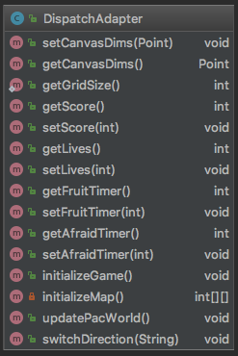
DispatchAdapter
Notes:
Talk about timers and values. Grid size is static for easy access in concrete classes.

Slide 9
Controller
Supported requests
resetGame – get canvas dims and reset game objects
updateGame – update game object states
switchDirection – switch Pacman direction
Notes:
What each request does

Slide 10
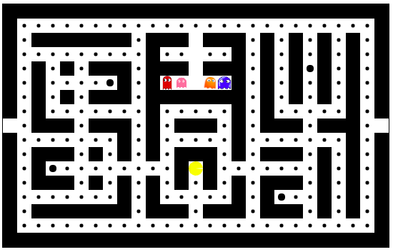
View
http://pacman-team-houston.herokuapp.com/
Notes:
Talk about how we are drawing different game objects, link to heroku

Slide 11
Questions?

