Slide 1
Pacman Final Game Design
Team Houston
Jonathan Wang, Manu Maheshwari, Yanjun Yang, Tianqi Ma, Youyi Wei, Jiang Lin

Slide 2
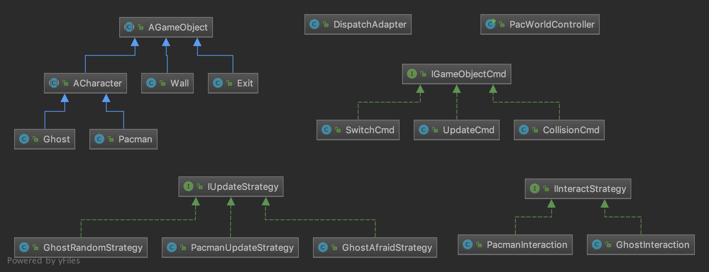
API Overview
Model – Cmds, Strategies, GameObjects
Interfaces and abstract classes
DispatchAdapter, Controller
Manage game, process requests
View.js, Index.html
Display game objects, make requests

Slide 3
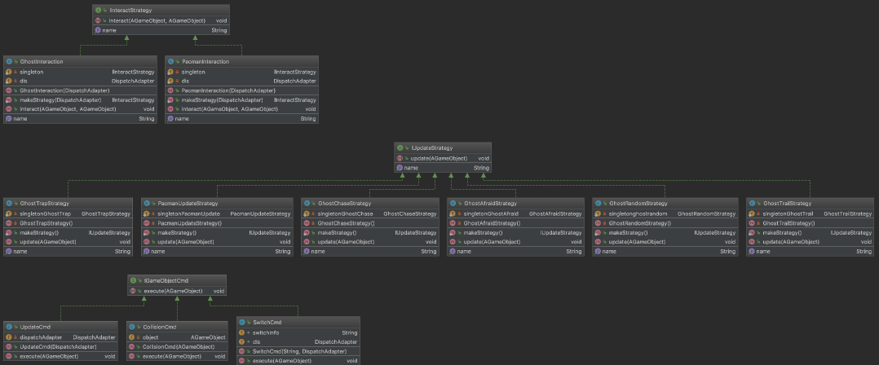
Model—Commands, Strategies

Slide 4
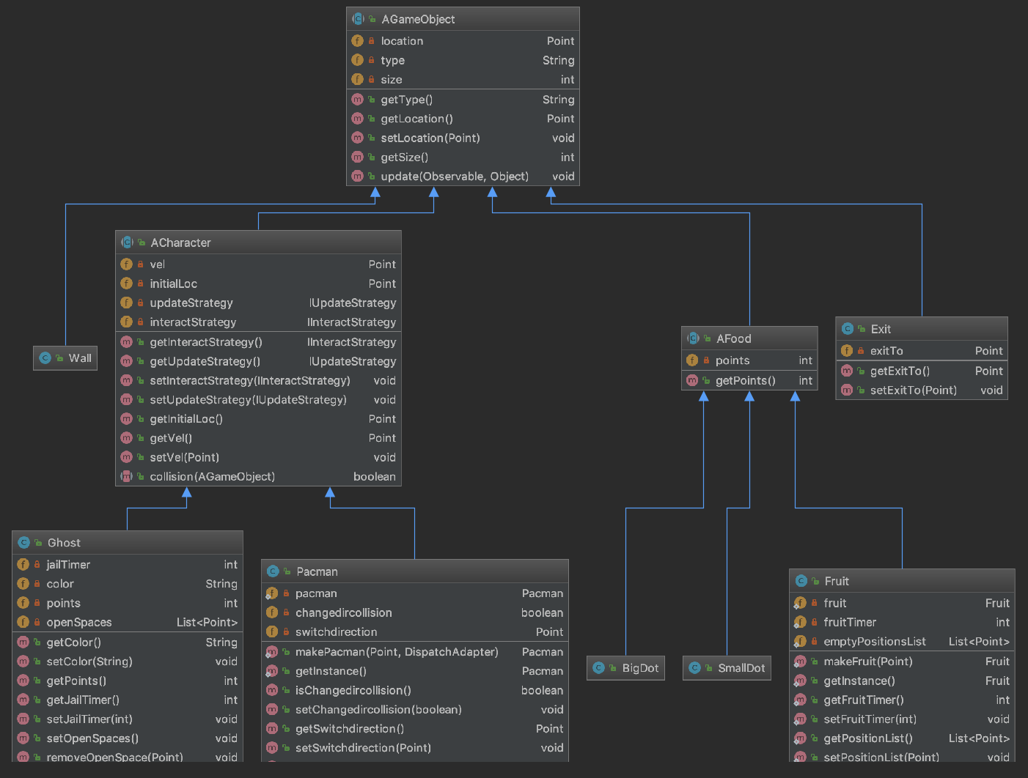
Model – GameObjects
Notes:
All AGameObjects implement Observer. Talk about inheritance structure and functions.
Separate concrete classes for easy object creation and extensibility.

Slide 5
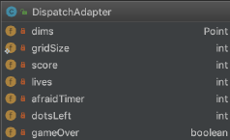
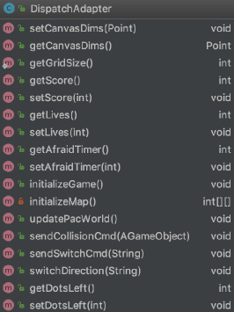
DispatchAdapter
Notes:
Talk about timers and values. Grid size is static for easy access in concrete classes.

Slide 6
Moving Pacman
updatePacWorld
updateCmd
Pacman Update
collisionCmd
Pacman Interaction
If PacmanCollision

Slide 7
Collisions and Interactions
Pacman Interactions
Wall
Velocity (0, 0)
Exit
location (exitTo)
Food
update all values

Slide 8
Switch Dir/ Queue Turn
POST SwitchDirection
SwitchDirection() (in DA)
SwitchCmd
-> switch velocity
collisionCmd
check PacmanCollision
on switch velocity

Slide 9
Moving Ghost
updatePacWorld
Ghost checks open spaces
updateCmd
Ghost Update
collisionCmd
Interaction Strategy
If Collision

Slide 10
Remaining Objects/DispatchAdapter
Fruit
fruitTimer
Exit
exitTo
emptyPosList
DA updatePacWorld()
Check for game end:
Lives/dotsLeft
afraidTimer
fruitTimer

Slide 11
View
Draws all objects
Update Game
Draws the Pacman with correct facing direction
Score, lives
FrameCount
Pacman animation
flashing ghost
Blinding dots

Slide 12
Questions?

Slide 14
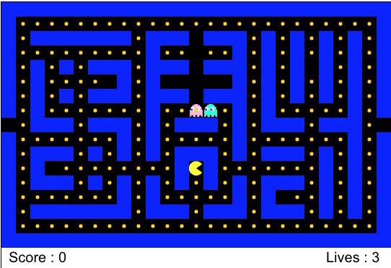
View
http://pacman-team-houston.herokuapp.com/
Notes:
Design decisions – flashing ghosts, blinking dots, pacman animation do not affect game so are handled only in view. Talk about how we are drawing different game objects. When to call each request

Slide 15
Controller
Supported requests
resetGame – get canvas dims and reset game objects
updateGame – update game object states
switchDirection – switch Pacman direction
Notes:
What each request does

Slide 16
Use Cases
Pacman
Pacman can move in all directions - can change direction with user input
Pacman does not go through walls
Pacman can teleport through exits
Pacman eats food - food is destroyed, update score, ghost strategy
Pacman eats afraid ghosts

Slide 17
Use Cases
Ghosts
Ghost starts in jail
Ghost can move based on strategy
Ghost does not go through walls
Ghost can teleport through exit
Eating large dot makes ghosts afraid
Ghost goes to jail when eaten

Slide 18
Use Cases
Game
Spawn fruit periodically
End game on win/lose condition

Slide 19
API Breakdown
Model – Cmds, Strategies, GameObjects
Interfaces and abstract classes
DispatchAdapter, Controller
Manage game, process requests
View.js, Index.html
Display game objects, make requests
Notes:
Overview of how each piece connects to use cases

Slide 20
Model – Commands, Strategies
Commands
IGameObjectCmd
Strategies
IUpdateStrategy – move Pacman and ghosts
IInteractStrategy – one-directional interactions
Notes:
Talk about how interfaces satisfy use cases. Interact strategy example: ghost handles all pacman-ghost interactions, and pacman does not worry about it.

Slide 21
Design Overview
Command design pattern
For the overall game design
Singleton design pattern
For the pacman
For concrete strategies and commands

