Slide 1
State of US Economy

Slide 2
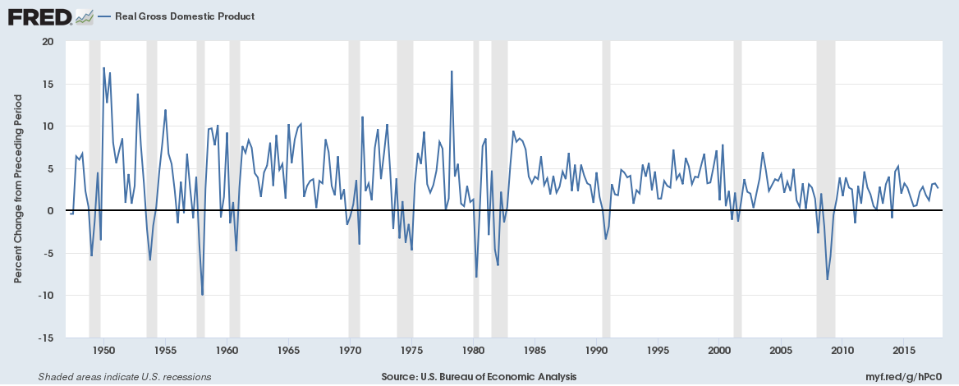
Slow Growth
Real GDP has increased more slowly since the 2008 recession.
Growth increase has been in an overall decline, as seen in the chart below.
However, recent reports suggest that new economic policies could increase GDP growth in 2018

Slide 3
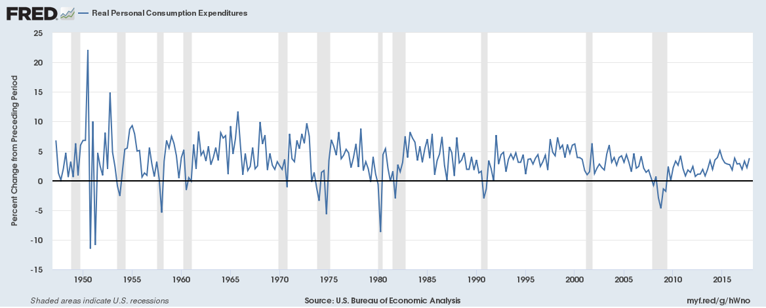
Consumer Spending Increase
Consumer spending has been increasing and has approached early 2000s growth levels
However, like real GDP it is in a long term decline

Slide 4
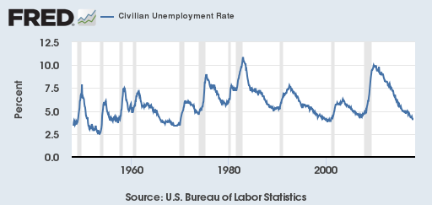
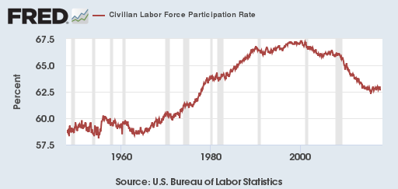
Unemployment is low, but so is participtation
Unemployment is at the lowest point in 18 years
However, Labor Force Participation is at lowest level since about 1977
So while most people looking for jobs are finding them, many seem to have given up

Slide 5
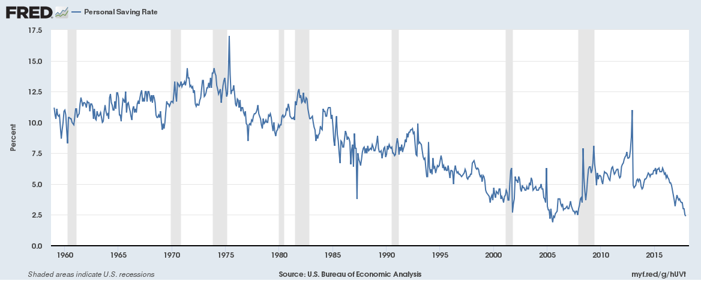
Lower Savings
The Personal Savings Rate is at the lowest level since the recession
This could be good, as it means people are feeling secure about economic growth continuing in the future
Too little savings though could leave people vulnerable when the next recession happens

Slide 6
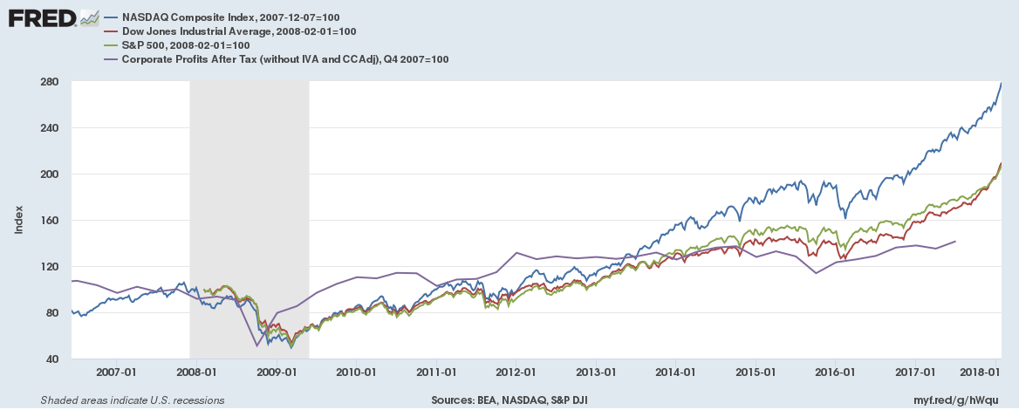
Strong Stock Performance
Stock market indices have shown strong growth, with all major indices hitting new highs
Although corporate profits are strong, stock indices have out-paced them
I believe low returns of other financial instruments (Savings, Bonds, etc) and government promises of lower taxes and regulations have contributed to this.

