Slide 1
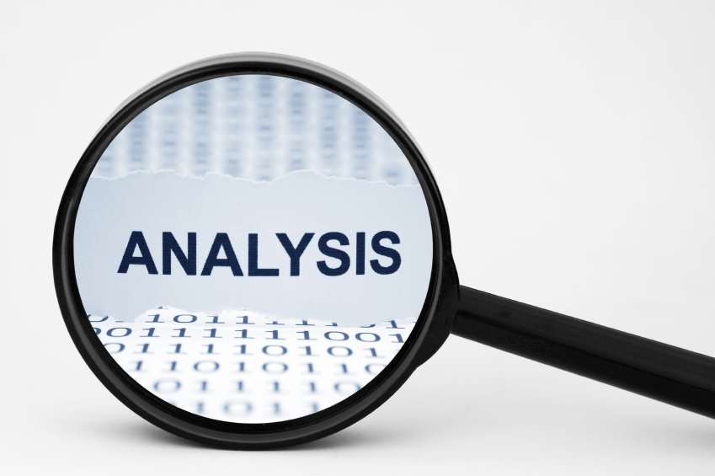

Slide 2

Problem statement
How to store data about events, members and lecturers?

Slide 3

Problem statement
How to find proper lecturers for events ?

Slide 4

Problem statement
How to make the system easy to extend and provide new functionalities?

Slide 5




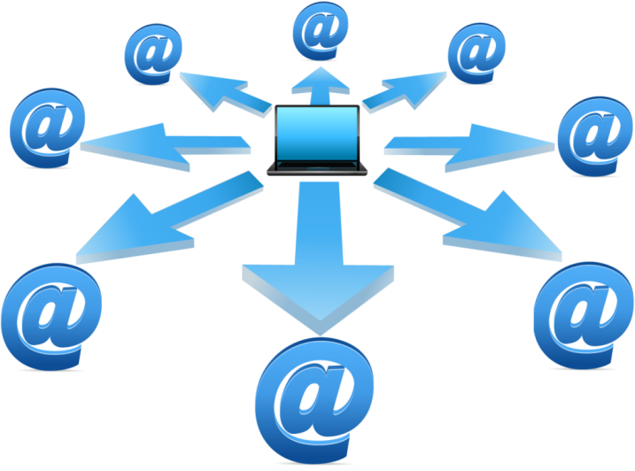

Delimitations
FEEDBACK

Slide 6
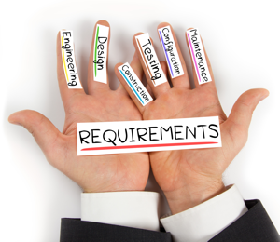

Slide 7


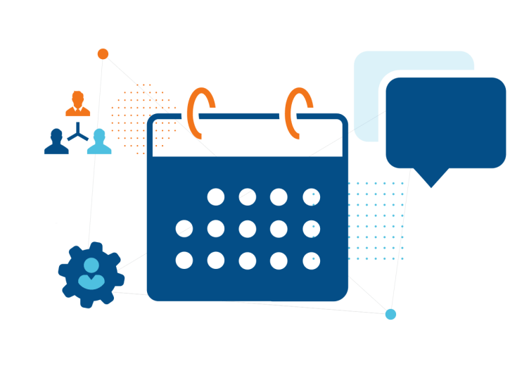

Functional requirements
Members/Participants
Lecturer
Event
Newsletter

Slide 8
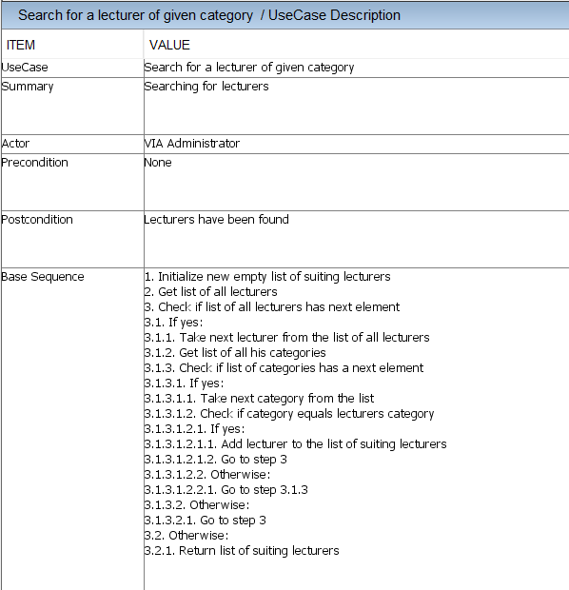

Slide 9



Non-functional requirements
The system must be implemented in Java
Secondary storage needs to be done with files
The parts of the system must be accessible among them

Slide 10
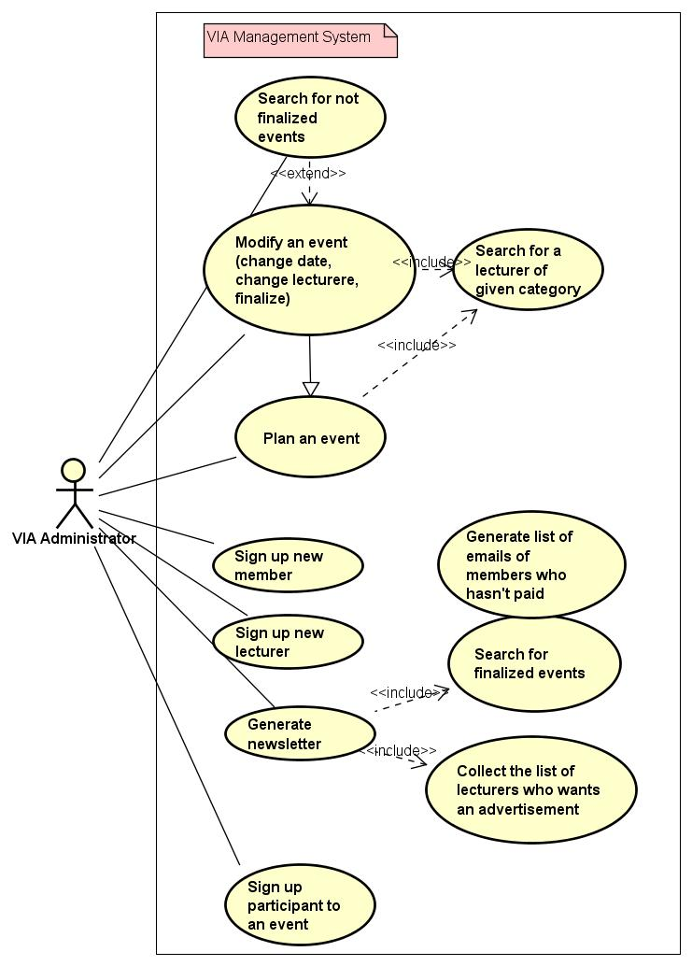
USE CASE DIAGRAM

Slide 11
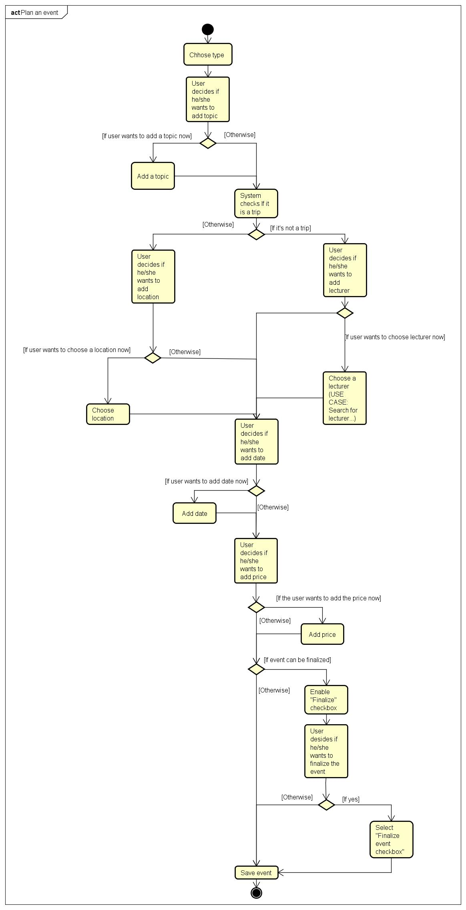
ACTIVITY DIAGRAM Plan an event

