Slide 1
VIAPASSANA
Daniela Koch
Matej Michalek
Michaela Golhova
Michal Karol Pompa
Remedios Pastor Molines

Slide 2

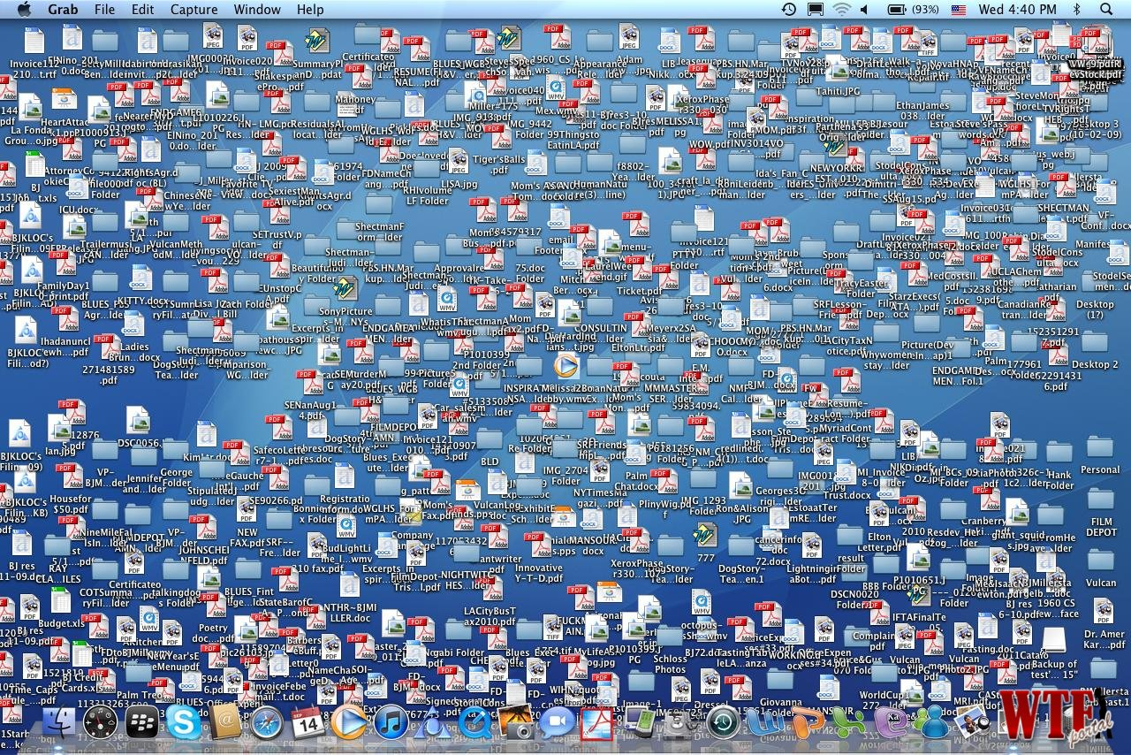

Problem Statement

Slide 3


Slide 4
Analysis
List of requirements
Explanation requirements
Design
IMPLEMENTATION
PROCESS
COnclusion

Slide 5
The organization is in a need of keeping track
of events, members, lecturers in an easy way. It needs a system that would store data and
provide an easy access to them (to take an example to simplify sending emails to the
members). Moreover, a computer-based system would solve the complication of searching for
proper lecturers. What is more, the system should be maintainable, what would enable
Vipassana to easily add new functionalities. Even though similar systems already exist they do
not meet the needs of our client. That is due to the fact that VIA expects a simple server and
the existing ones are complicated.

Slide 6
Store data
Computer-based system
Maintainable
simple

Slide 7
Conclusion
Lack of time
One more member in group
Part of the members went home
System difficult
Grammar mistakes

Slide 8
Conclusion project report
Requirements→Use cases DONE
System contruct based in the design and analysis ANALYSIS←→DEDIGN→Implementation
We use manual tester

Slide 9
Conclusion Process rep
Good group→good relationship between us
BUT:
Divide and organise
Time
More discussion
Mofify group contract (meeting hour)
Stay in Denmark
Difficult system
New member

Slide 10
future
Data bases

