Slide 1


Slide 2

Problem statement
How to store data about events, members and lecturers?

Slide 3

Problem statement
How to find proper lecturers for events ?

Slide 4

Problem statement
How to make the system easy to extend and provide new functionalities?

Slide 5
Delimitations
The system will not use database to store data.
Data will be provided by files, not from real users.
The system will not be storing feedback.
The system will not be sending emails automatically to users.
The system will not look for events between a specific time period.

Slide 6




Slide 8



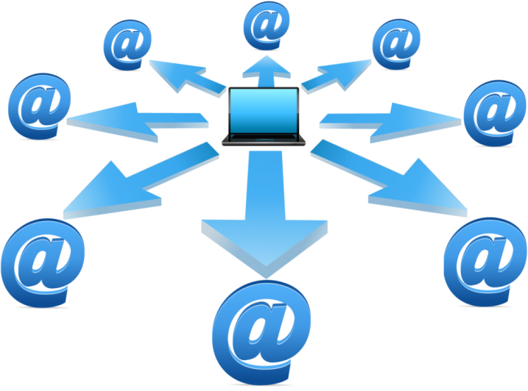

Delimitations
FEEDBACK

Slide 9
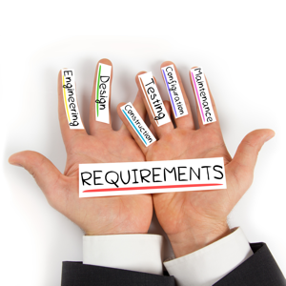
Requirements
Functional
Non-functional

Slide 10
Functional requirements
Regarding:
Member/Participant
Lecturer
Event
Newsletter

Slide 11




Functional requirements

Slide 12
Member/Participant
Store info about new member
Generate list of emails of members who have not paid
Count the price for members, having considered the discount for events
Sign up member/participant to an event

Slide 13
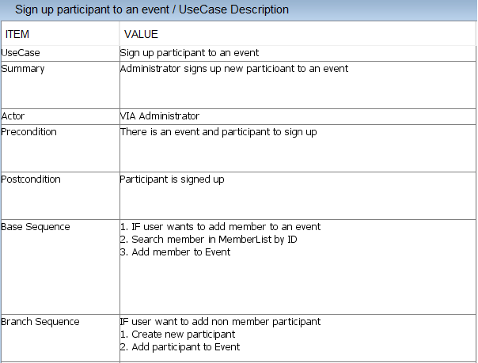

Slide 14
Lecturer
Store info about new lecturer
Search for lecturers of given category

Slide 15
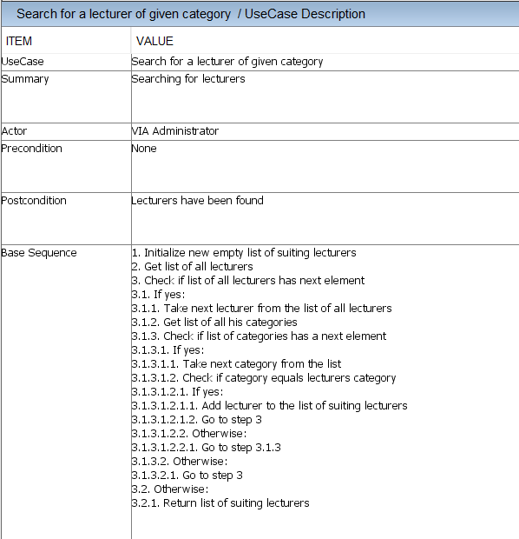

Slide 16
Event
Plan and modify event
Search for not finalized events
Return the amount of available places for every event

Slide 17
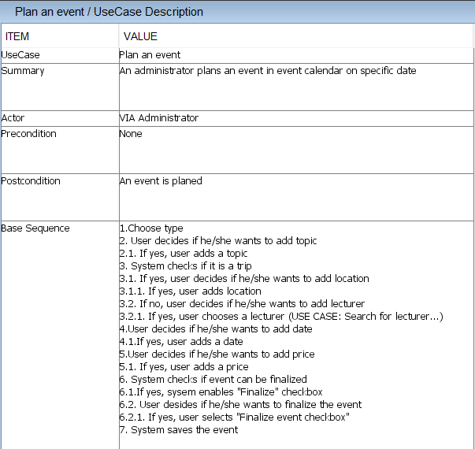

Slide 18
Newsletter
Collect list of lecturers who want a fee or advertisement
Collect list of finalized events
Generate newsletter

Slide 19
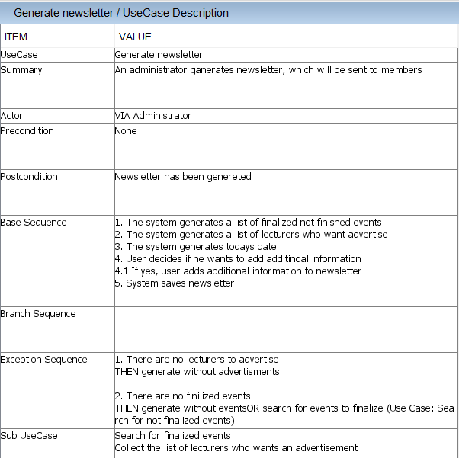

Slide 20



Non-functional requirements
The system must be implemented in Java
Secondary storage needs to be done with files (Event/Lecturer/Memberlists, newsletter)
The parts of the system must be accessible among them (feedback with events/sponsors/event calendar).

Slide 21
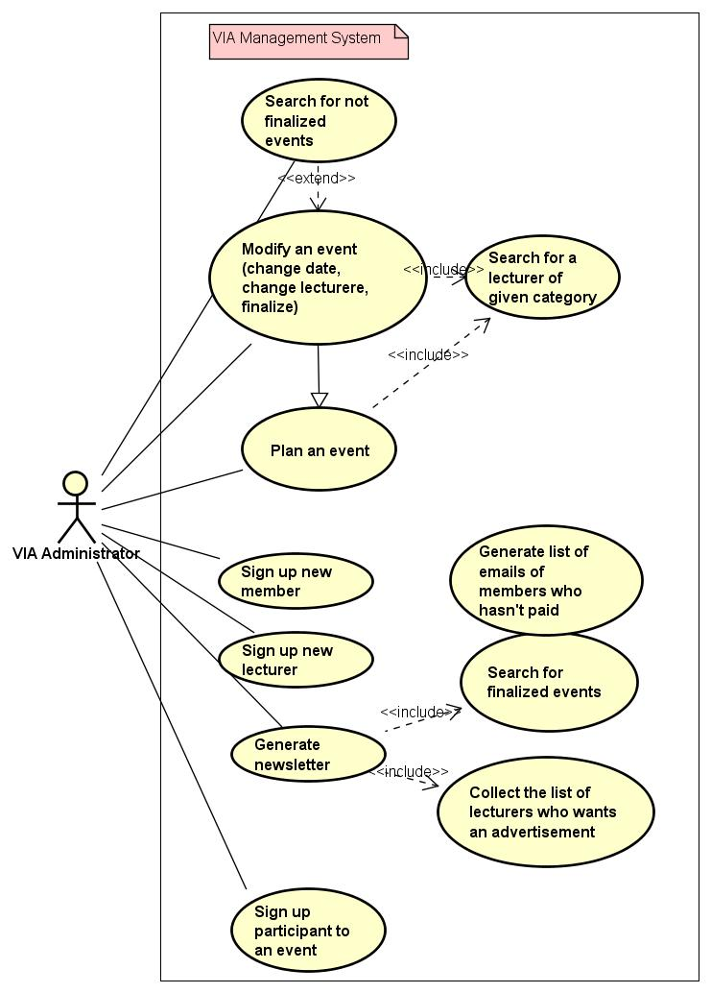
USE CASE DIAGRAM

Slide 22
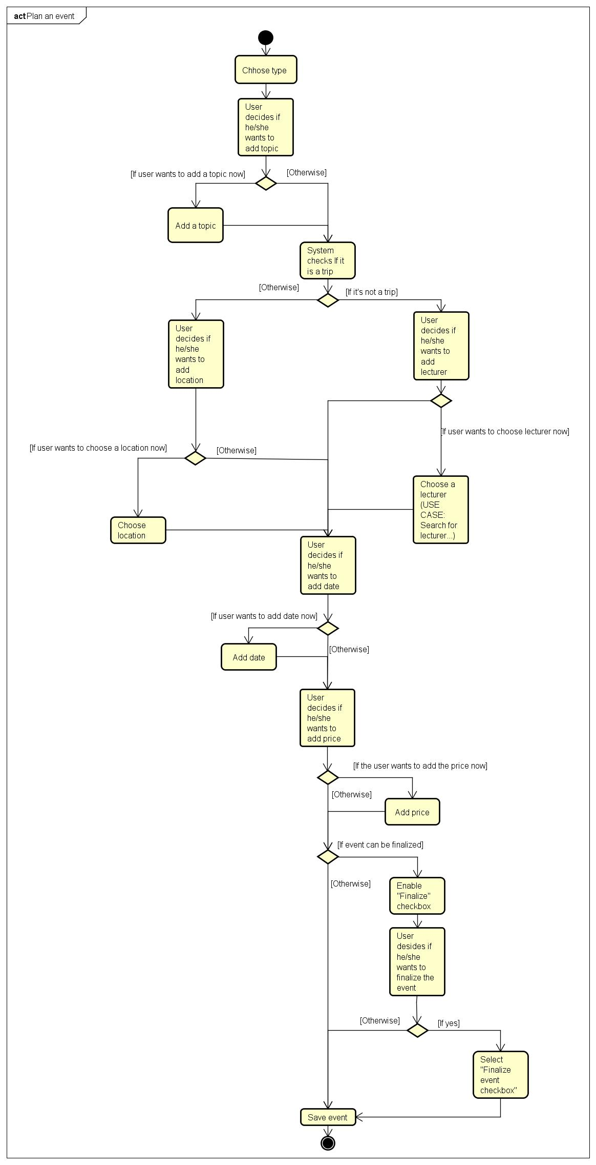
ACTIVITY DIAGRAM – Create event

Slide 23
ACTIVITY DIAGRAM Create event

