Slide 1


Slide 2

Problem statement
How to store data about events, members and lecturers?

Slide 3

Problem statement
How to find proper lecturers for events ?

Slide 4

Problem statement
How to make the system easy to extend and provide new functionalities?

Slide 5




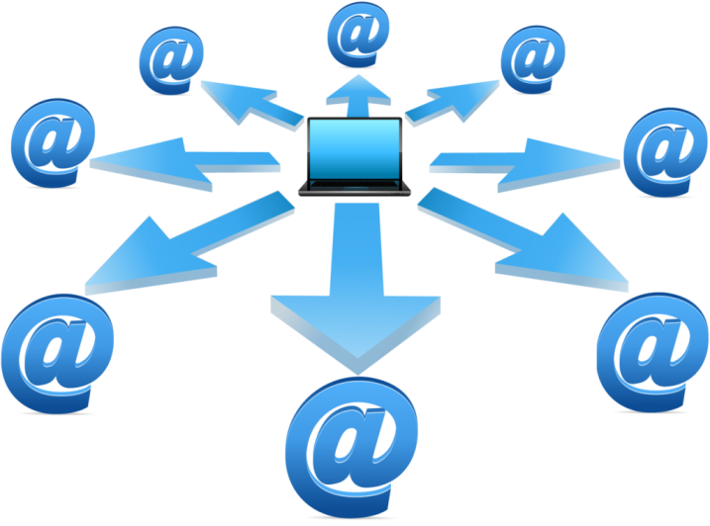

Delimitations
FEEDBACK

Slide 6
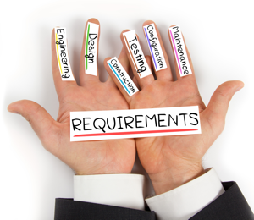

Slide 7




Functional requirements
Members/Participants
Lecturer
Event
Newsletter

Slide 8
Member/Participant
Store info about new member
Generate list of emails of members who have not paid
Count the price for members, having considered the discount for events
Sign up member/participant to an event

Slide 9
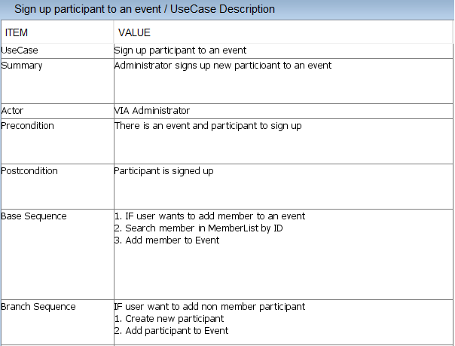

Slide 10
Lecturer
Store info about new lecturer
Search for lecturers of given category

Slide 11
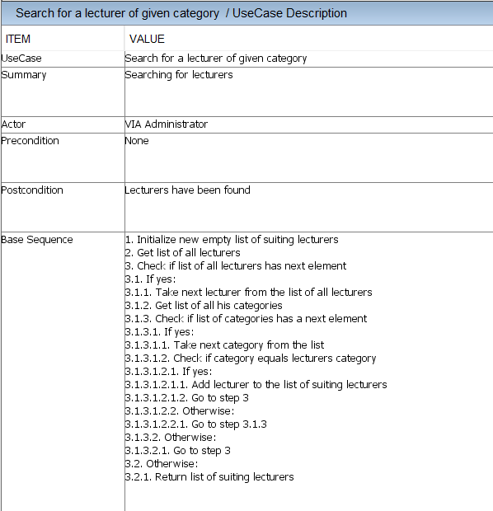

Slide 12
Event
Plan and modify event
Search for not finalized events
Return the amount of available places for every event

Slide 13
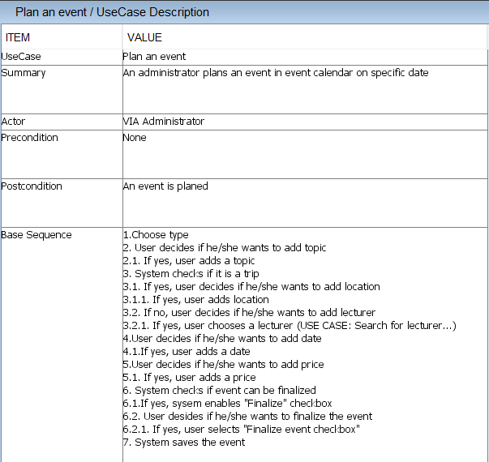

Slide 14
Newsletter
Collect list of lecturers who want a fee or advertisement
Collect list of finalized events
Generate newsletter

Slide 15
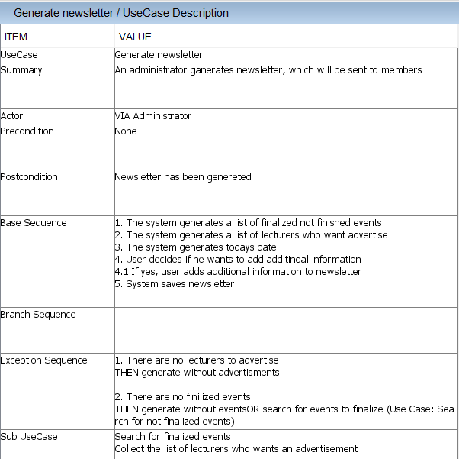

Slide 16



Non-functional requirements
The system must be implemented in Java
Secondary storage needs to be done with files (Event/Lecturer/Memberlists, newsletter)
The parts of the system must be accessible among them

Slide 17
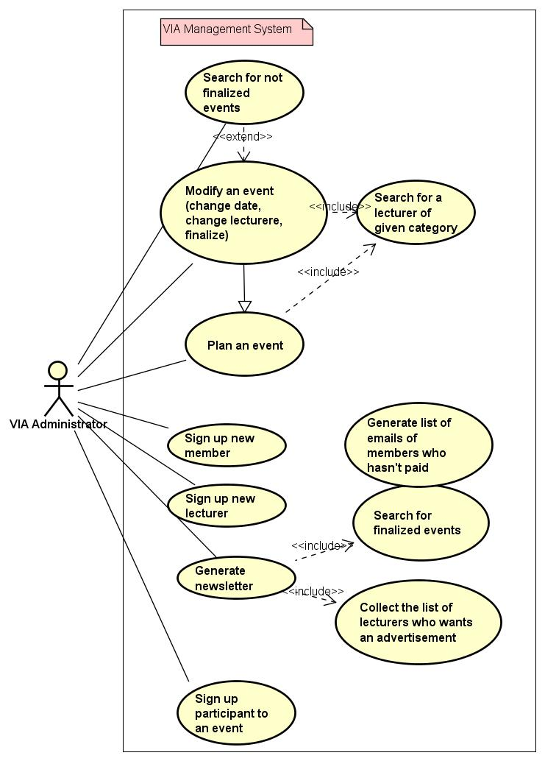
USE CASE DIAGRAM

Slide 18
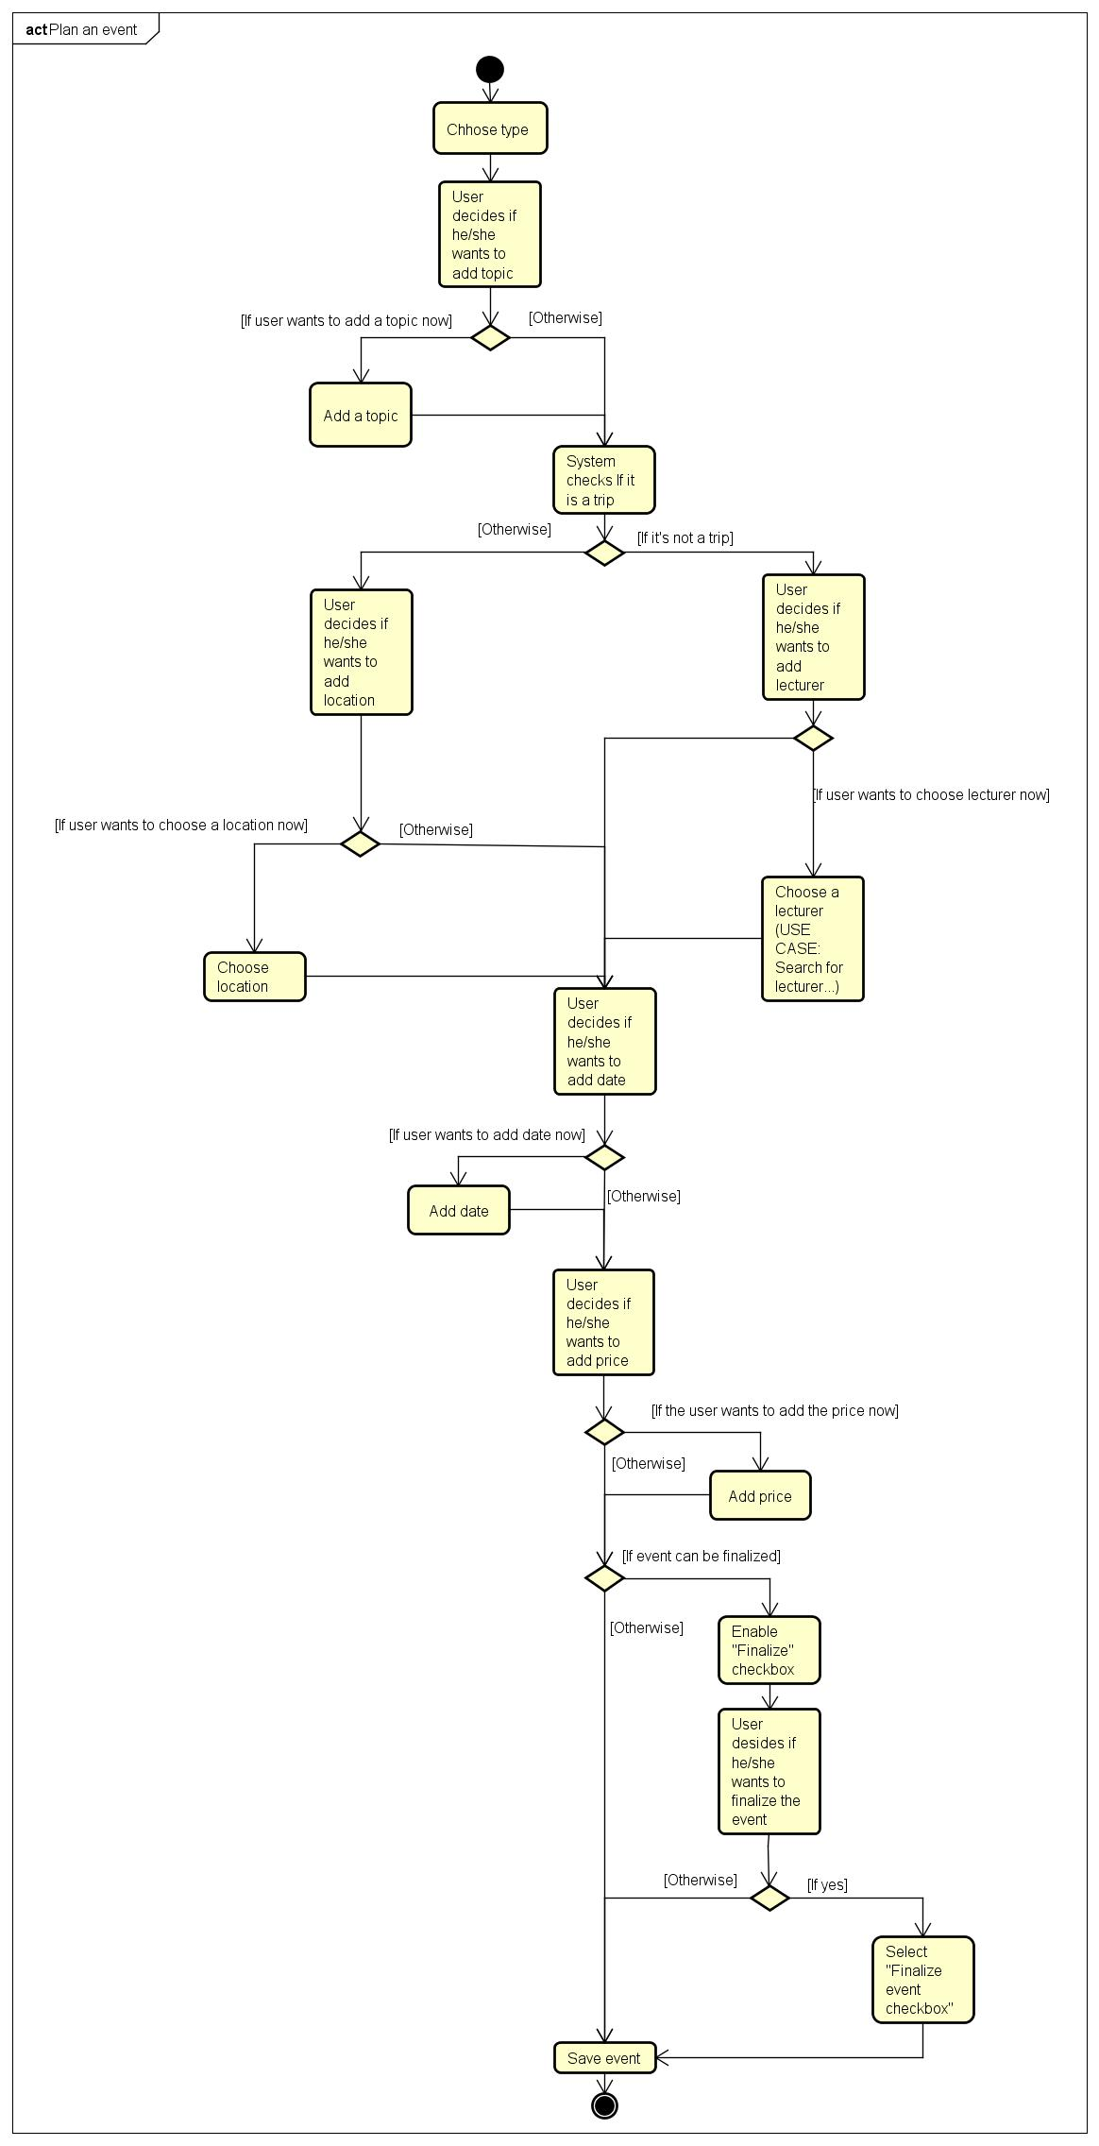
ACTIVITY DIAGRAM Create event

