Slide 1


Under the guidance of Aishwarya Saxena
By Priyanka Singh
Based on Machine Learning in Python
Sentimental Analysis

Slide 2
Contents:
Introduction
Objective
Background
Hardware and Software requirement
Future scope
Conclusion
References and Bibliography

Slide 3
Introduction
Sentiment analysis is a powerful tool that allows computers to understand the underlying subjective tone of a piece of writing.
This is something that humans have difficulty with, and as you might imagine, it isn’t always so easy for computers, either.
But with the right tools and Python, you can use sentiment analysis to better understand the sentiment of a piece of writing.

Slide 4
Objective
Objective Sentiment classification is a way to analyze the subjective information in the text and then mine the opinion.
Sentiment analysis is the procedure by which information is extracted from the opinions, appraisals and emotions of people in regards to entities, events and their attributes.
To implement an algorithm for automatic classification of text into positive, negative or neural.
Sentiment Analysis to determine the attitude of the mass is positive, negative or neural towards the subject of interest.
Graphical representation of the sentiment in form of Bar -Chart.

Slide 5
background
Sentiment analysis is a term that refers to the use of natural language processing, text analysis, and computational linguistics in order to ascertain the attitude of a speaker or writer toward a specific topic.
Basically, it helps to determine whether a text is expressing sentiments that are positive, negative, or neutral.
Sentiment analysis is an excellent way to discover how people, particularly consumers, feel about a particular topic, product, or idea.

Slide 6
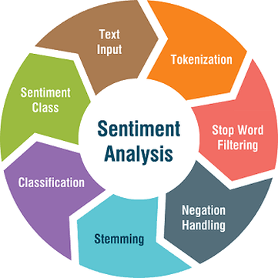

Slide 7
Hardware and software requirement
Hardware requirements:-
Sr No | Hardware tools | Minimum requirements
1. | Processor | i5 or above
2. | Hardware | 10GB
3. | Ram | 8GB
4. | Mouse | Optimal
5. | Monitor | 17'''coloured
6. | Keyboard | 122 key

Slide 8
Hardware and software requirement
Software requirements:-
Sr no | Software tools | Minimum Requirement
1. | Platform | Windows, Linux or MacOS
2. | Operating system | Windows, Linux or MacOS
3. | Scripting language | Python
4. | Technology | Python with machine learning
5. | IDE | Python

Slide 9
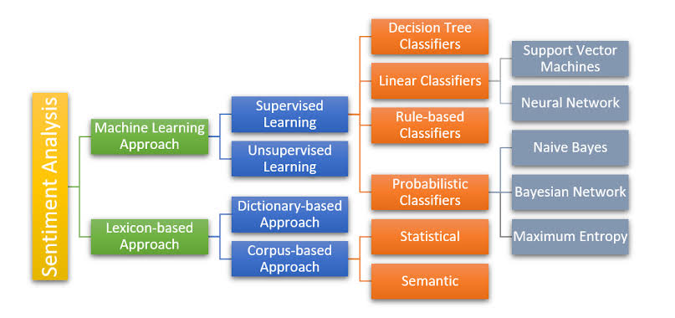
Block diagram

Slide 10
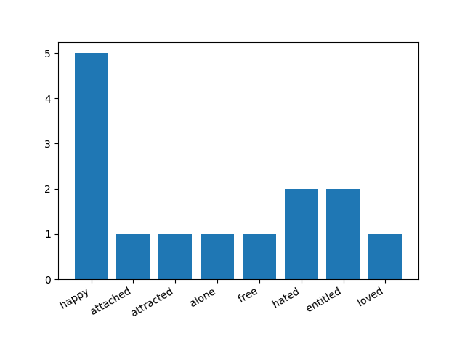
graph

Slide 11
Future scope
The future of sentiment analysis is going to continue to dig deeper, far past the surface of the number of likes, comments and shares, and aim to reach, and truly understand, the significance of social media interactions and what they tell us about the consumers behind the screens.
This forecast also predicts broader applications for sentiment analysis – brands will continue to leverage this tool, but so will individuals in the public eye, governments, nonprofits, education centers and many other organizations.
Data Pre-Processing using more parameters to get best sentiments. Updating Dictionary for new Synonym and Antonyms of already existing words.
Context Sentimental Analysis may be implemented in future for accuracy purposes.

Slide 12
conclusion
Sentiment analysis or opinion mining is a field of study that analyzes people's sentiments, attitudes, or emotions towards certain entities.
This paper tackles a fundamental problem of sentiment analysis, sentiment polarity categorization.
We proposed a new approach for automatically extracting Patterns from the contextual Sentiment similarities of words in tweets.
SS- Patterns consistently outperformed the syntactic and semantic type of features for entity and tweet level sentiment analysis.
Conducted quantitative analysis on a sample of our extracted SS-Patterns and show that our patterns are strongly consistent with the sentiment of the words within them.

Slide 13
References and bibliography
Introduction:-(https://www.linkedin.com/pulse/future-sentiment-analysis-shahbaz-anwar)
Future scope:-(https://www.kdnuggets.com/2015/12/sentiment-analysis-101.html)
Wikipedia:-(https://en.wikipedia.org/wiki/Sentiment_analysis)
Install Python:-(https://www.python.org/downloads/, and select the latest version for windows.
Install Matplotlib:-( pip install matplotlibm )
Install GetOldTweets3:-( pip install GetOldTweets3 )
Install nltk:-( pip install nltk)

