Slide 1

SAP System Impact Simulation
SAP BC / Middleware / SAP Operations Guide
Network Science based Shock Propagation Simulation
2026.03

Slide 2
Contents
01
SAP Entity Mapping
9 SAP system nodes and their correlations
02
Correlation Settings
How to set and interpret system correlations
03
System Topology View
Network graph with centrality metrics
04
Governance & Impact View
Heatmap, impact bars, and radar charts
05
Operations Time Series View
Shock propagation over time
06
Scenario Examples
RFC timeout, DB lock, kernel patch failure
07
Quick Start Guide
Step-by-step usage tutorial

Slide 3

01 SAP Entity Mapping
Node ID | Label | Description | Issue Examples
sap_basis | SAP Basis | Server/Instance/Kernel/Patch mgmt | Patch fail, Memory shortage
sap_abap | SAP ABAP | Custom dev/Reports/Enhancement | Dump, Performance issues
fi_co | FI/CO | Financial/Management accounting | Posting error, Close delay
mm_sd | MM/SD | Purchasing/Sales/Logistics | PO error, Delivery delay
middleware | Middleware | RFC/PI/PO/API interface | RFC timeout, Msg loss
auth_mgmt | Auth Mgmt | Role/Authorization/Audit | Auth missing, SoD violation
external | External | 3rd Party/Legacy interface | Interface fail, Format mismatch
db_hana | DB/HANA | Database management/Tuning | Table lock, Query delay
infra_os | Infra/OS | Server/Network/Storage | Disk full, Network outage
Edit config/constants.py NODES list to change entity names and labels

Slide 4

02 Correlation Settings
+0.7 ~ +1.0
Strong positive
config/defaults.py
Major impact propagation (Basis-HANA: 0.90)
("sap_basis", "db_hana"): 0.90
("sap_basis", "middleware"): 0.80
("sap_abap", "fi_co"): 0.65
("middleware", "external"): 0.75
("sap_abap", "infra_os"): -0.20
+0.3 ~ +0.7
Moderate positive
Partial impact (ABAP-FI/CO: 0.65)
0.0 ~ +0.3
Weak correlation
Nearly independent (Auth-Infra: 0.15)
-1.0 ~ 0.0
Negative correlation
Inverse relationship (ABAP-Infra: -0.20)
Sidebar sliders let you adjust
correlations in real-time

Slide 5
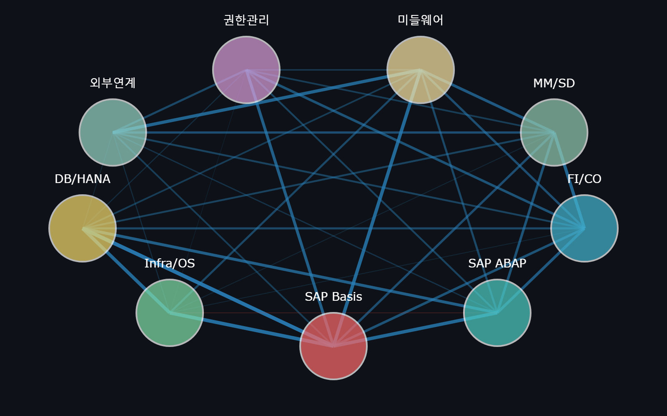




03 System Topology View
Node = SAP System
Size reflects centrality (importance)
Edge = Correlation
Thickness shows connection strength
Centrality Metrics
Degree / Betweenness / Eigenvector
Time Step Slider
Animate shock propagation step-by-step
Nodes: 9 | Edges: 36 | Density: 1.000 | Avg Path: 1.00

Slide 6
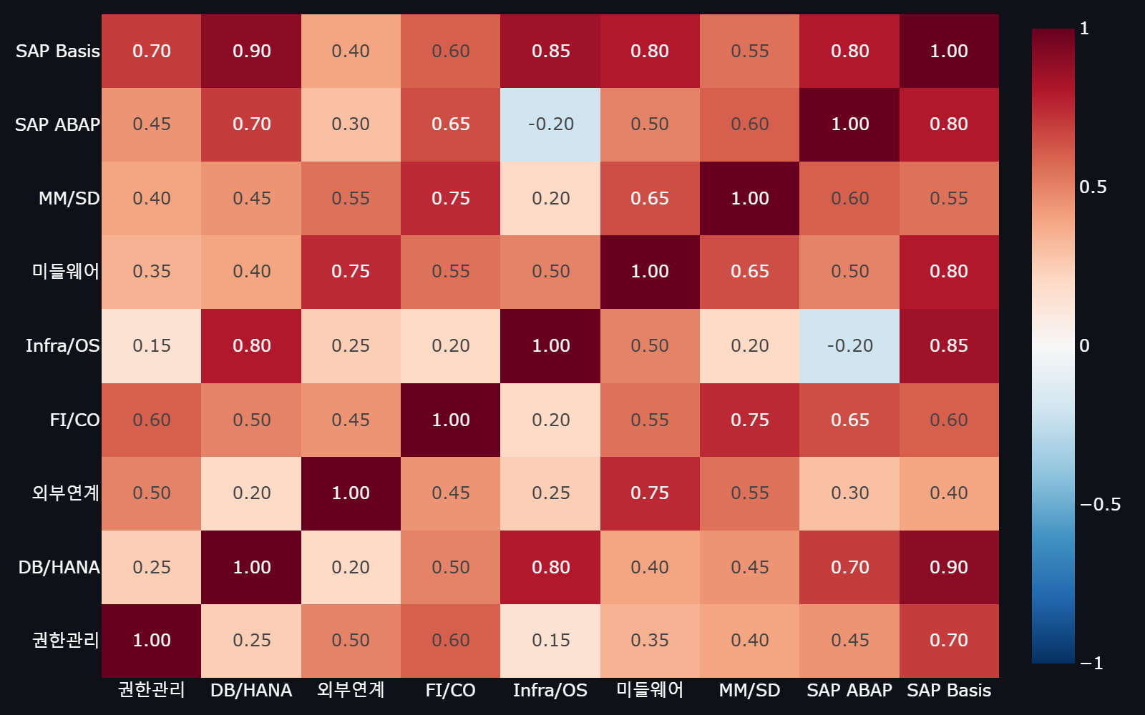
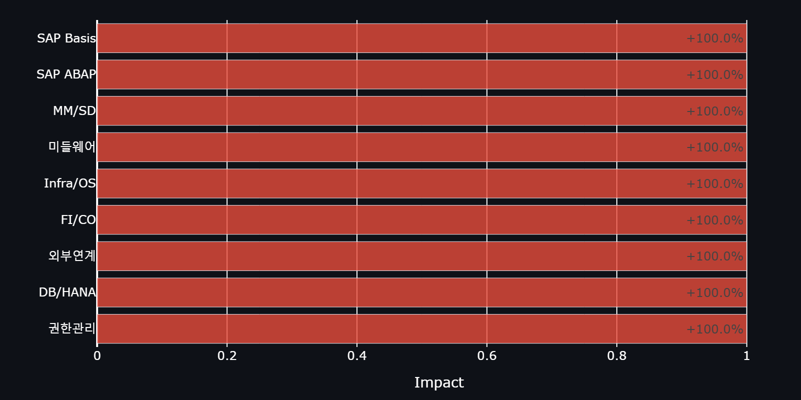
04 Governance & Impact View
Shock Impact by Node
Key Insights:
Red = strong positive correlation
Blue = negative correlation
Radar: SAP Basis vs DB/HANA reach
System Correlation Matrix

Slide 7
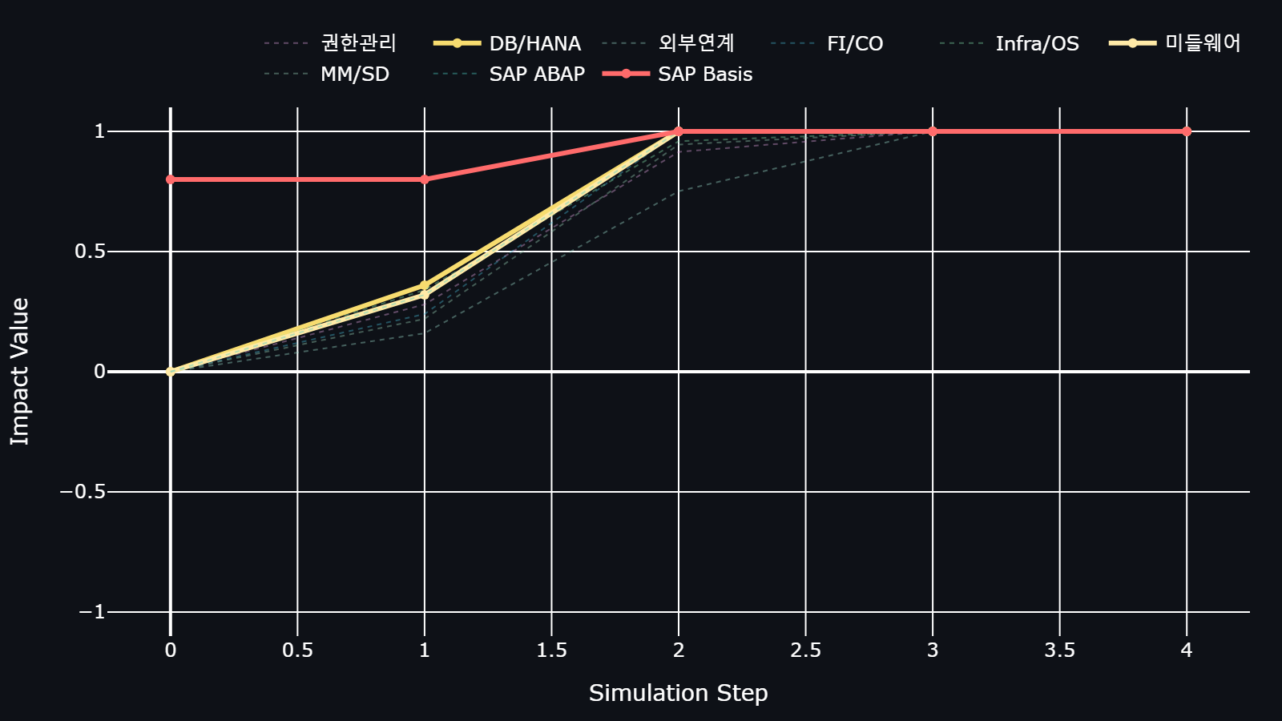
05 Operations Time Series View
Reading the Chart
Solid lines = Core Ops
(SAP Basis, DB/HANA, Middleware)
Dotted lines = Other systems
(FI/CO, MM/SD, Auth, etc.)
X-axis = Simulation steps
Y-axis = Impact value (-1 to +1)
Convergence = system stabilizes
when impact stops changing

Slide 8
06 Scenario Examples
RFC Timeout
Propagation:
Middleware > Basis(0.80) > HANA(0.90)
> FI/CO posting delay > MM/SD shipment stop
Response
Origin: Middleware node: -0.8 shock
PI/PO channel monitoring
+ RFC parameter check
HANA DB Lock
Propagation:
HANA > Basis(0.90) > ABAP dump surge
> FI/CO close delay > Reporting halt
Response
Origin: DB/HANA node: -0.7 shock
M_LOCK_WAITS_CURRENT
+ Transaction rollback
Kernel Patch Failure
Propagation:
Basis > All connected nodes propagate
> Login failure > Enterprise-wide outage
Response
Origin: SAP Basis node: -0.6 shock
Patch rollback
+ Pre-test simulation required

Slide 9



07 Quick Start Guide
1. Open App
2. Check Nodes
3. Set Shock
Go to
network-science-simulation
.streamlit.app
Sidebar shows 9 system
nodes with correlation
sliders
Pick target node and
intensity (-1.0 ~ +1.0)
Set simulation steps
4. Topology Tab
5. Impact Tab
6. Time Series Tab
Node size = centrality
Edge width = correlation
Time step animation
Heatmap + bar chart
+ radar for multi-angle
impact analysis
Shock propagation over
time. Check convergence
and stabilization point

Slide 10



Try the Simulation Now
https://network-science-simulation.streamlit.app
GitHub: github.com/11pyo/network-science-simulation
Impact Prediction
Data-driven Ops
Customizable
Predict shock propagation
across SAP systems
Objective decisions from
correlation analysis
Freely modify nodes
and correlations

